Slide 1
Predicting bacteria species based on repeated lossy measurements of DNA snippets
Solution to the Kaggle's Tabular Playground Series (Feb 2022) competition
Presented by Giulio Vaccari 03/2022

Slide 2
Intro: k-MER SEQUENCES
In bioinformatics, k-mers are substrings of length k contained within a biological sequence
Primarily used within the context of computational genomics and sequence analysis, in which k-mers are composed of nucleotides (i.e. A, T, G, and C)
An example of 10-mer is the following DNA segment: ATATGGCCTT
In this task we will work with data from a genomic analysis technique that has some data compression and data loss
In this technique, 10-mer snippets of DNA from bacteria are sampled and analyzed to give the histogram of base count
In other words, the DNA segment ATATGGCCTT becomes A₂T₄G₂C₂

Slide 3
The task
The task is to classify 10 different bacteria species using data extracted from their DNA
Each bacterium sample will be described by the normalized spectrum of 286 histograms generated from its DNA
In order to generate this spectrum, several 10-mers were sampled from the bacterium DNA and it has been counted how many times each of the 286 histogram possibilities (e.g., A₀T₀G₀C₁₀ to A₁₀T₀G₀C₀) occurred
Every species has its own characteristic spectrum, and we must predict the bacterium’s name from the spectrum of the sample

Slide 4
The dataset
Large dataset with 200000 rows
Each row of data contains the spectrum of histograms generated by repeated measurements of a bacterium sample, each row containing the output of all 286 histogram possibilities, which then has a bias spectrum (of totally random ATGC) subtracted from the results
The data (both train and test) also contains simulated measurement errors (of varying rates) for many of the samples, which makes the problem more challenging
Possible problem: Curse of dimensionality

Slide 5
Proposed solution

Slide 6
Dimensionality reduction
Principal Component Analysis (PCA) to project each data point onto only the first few principal components to obtain lower-dimensional data while preserving as much of the data's variation as possible
Feature standardization before PCA in order to remove the mean and scaling to unit variance

Slide 7
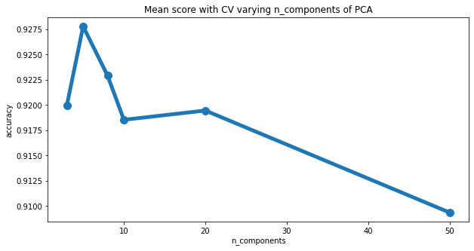
Grid search on pca
Grid-search with cross validation to find the best number of output dimensions from the PCA transformation
Decision Tree Classifier used to produce reference scores
The best transformation found reduced the number of features from 286 to less than 10

Slide 8
Model selection
Four different machine learning models have been considered:
Decision Tree
Random Forest
Extremely Randomized Trees
Deep Neural Network
The first three non-deep models were tested using grid search with cross validation to perform hyper-parameters tuning
The deep neural network were trained and validated using a more classical train-validation dataset split

Slide 9
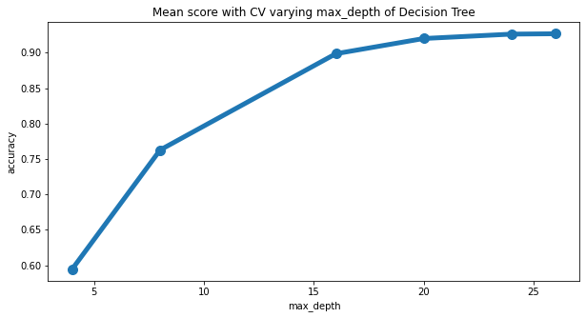
Decision tree
The decision tree was tested varying its max depth in order to obtain a good variance-bias trade-off

Slide 10
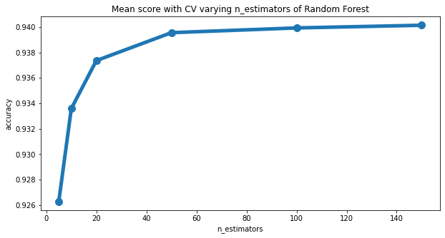
Random forest
In random forests each tree in the ensemble is built from a sample drawn with replacement from the training set
Furthermore, when splitting each node during the construction of a tree, the best split is found from a random subset of the input features
It has been tested varying the number of trees to use in the ensemble

Slide 11
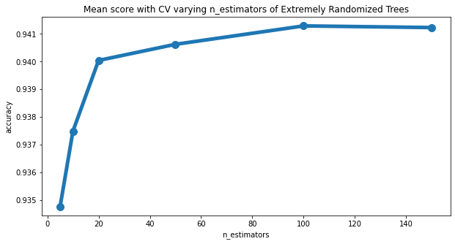
Extremely randomized trees
In extremely randomized trees, randomness goes one step further compared to random forest in the way splits are computed
As in random forests, a random subset of candidate features is used, but instead of looking for the most discriminative thresholds, thresholds are drawn at random for each candidate feature and the best of these randomly-generated thresholds is picked as the splitting rule

Slide 12
Deep neural network
Deep network with 6 layers and a final softmax activation function
It produces a probability distribution over the target classes given the input features
After 10 epochs of training with minibatches of 64 samples, it achieved an accuracy of 0.83 on the validation set
Worse performances compared to tree-based models

Slide 13
Final pipeline
Standardization
PCA
Random Forest Classifier

Slide 14
Final model evaluation

Slide 15
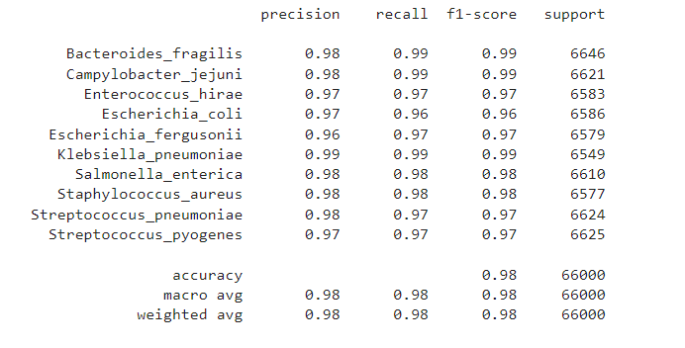
Results on test set

Slide 16
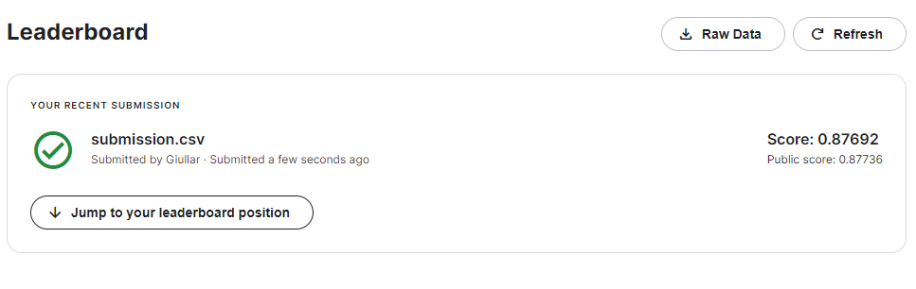
Kaggle submission results

Slide 17
References
Kaggle competition:
https://www.kaggle.com/c/tabular-playground-series-feb-2022/overview
What is a K-mer:
https://en.wikipedia.org/wiki/K-mer
The idea for this competition came from the following paper:
Wood et al., 2020, "Analysis of Identification Method for Bacterial Species and Antibiotic Resistance Genes Using Optical Data From DNA Oligomers", Frontiers in Microbiology, https://www.frontiersin.org/article/10.3389/fmicb.2020.00257

