Slide 1
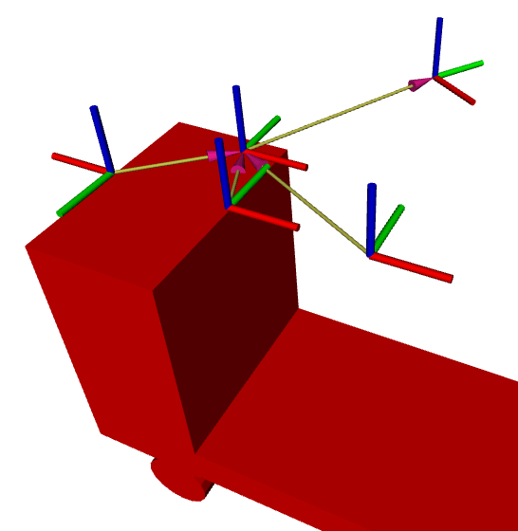
base_link
odom
laser
map
cam_back
base_frame
cam_front

