Slide 1
Set Cover problem

Slide 2
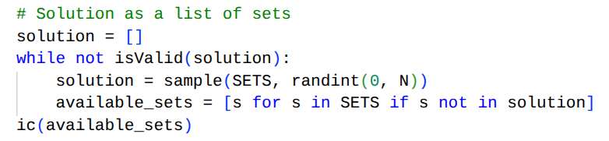
Chosen solution
List of sets
This way a random index can be generated to perform the desired tweak.
The starting point is a valid solution.
After it’s generated, another list is initialized to track sets that are not in the solution.

Slide 3
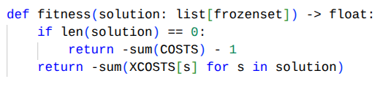
Fitness function
Opposite of the sum of the costs
If the solution is an empty one, the output will be the opposite of the sum of every single cost minus one. This was done to prevent getting a fitness of zero (which would be very high) if the starting solution is an empty list.

Slide 4
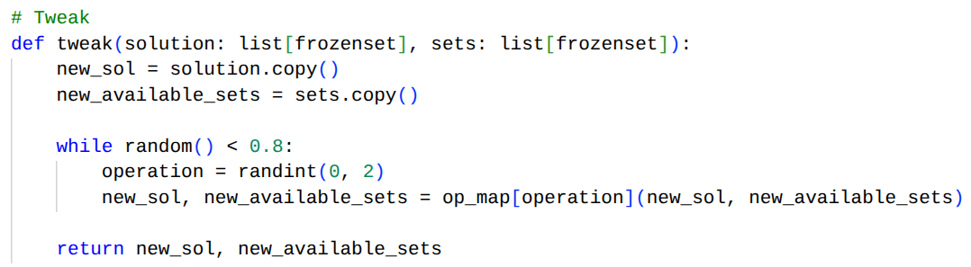
Chosen tweak
Random adding, removal or swap of a set
Each operation has an 80% percent probability of being applied, thus allowing for a wider exploration of the solution space.

Slide 5
Chosen tweak
For each iteration, a random operation is applied:
  Adding a set: a random available set is popped and appended to the solution
  Removing a set: a random set is popped from the solution and appended to the available sets list
  Swapping a set: a random set from the solution is swapped with a random available set

Slide 6
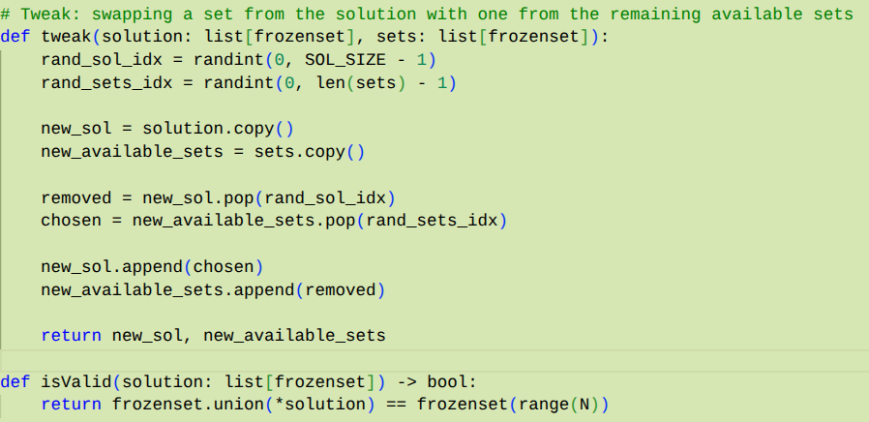
Chosen tweak
Set removal and swapping are useful operation to avoid reaching a local maximum. The removal operation is especially useful to find smaller cover sets.
My initial implementation only allowed for swapping, so the solution was stuck with a fixed number of sets, and an optimal state couldn’t have been reached.

Slide 7
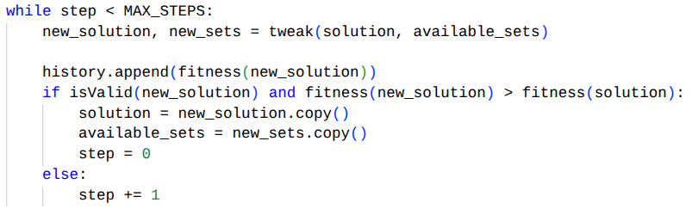
Stopping criterion
Amount of unsuccessful evolutions
A variable is incremented if the solution produced by the tweak is either an illegal state or a state with a lower fitness than the previous solution. Once the threshold is reached, the algorithm stops.
The variable is resetted after a successful tweak

Slide 8
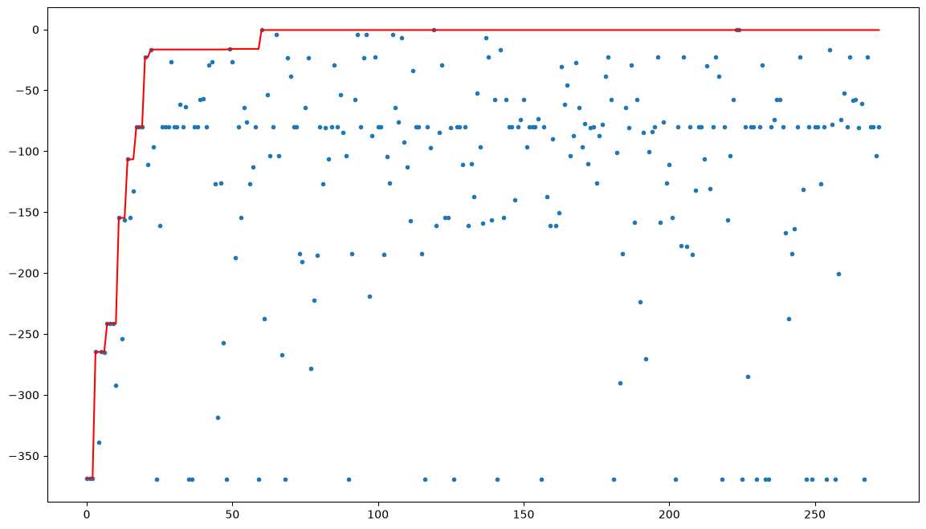
N = 10

Slide 9
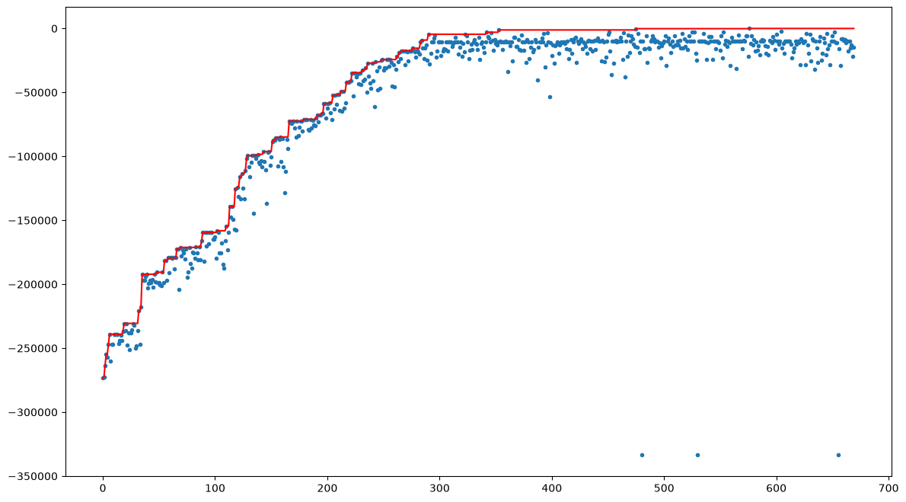
N = 100

Slide 10
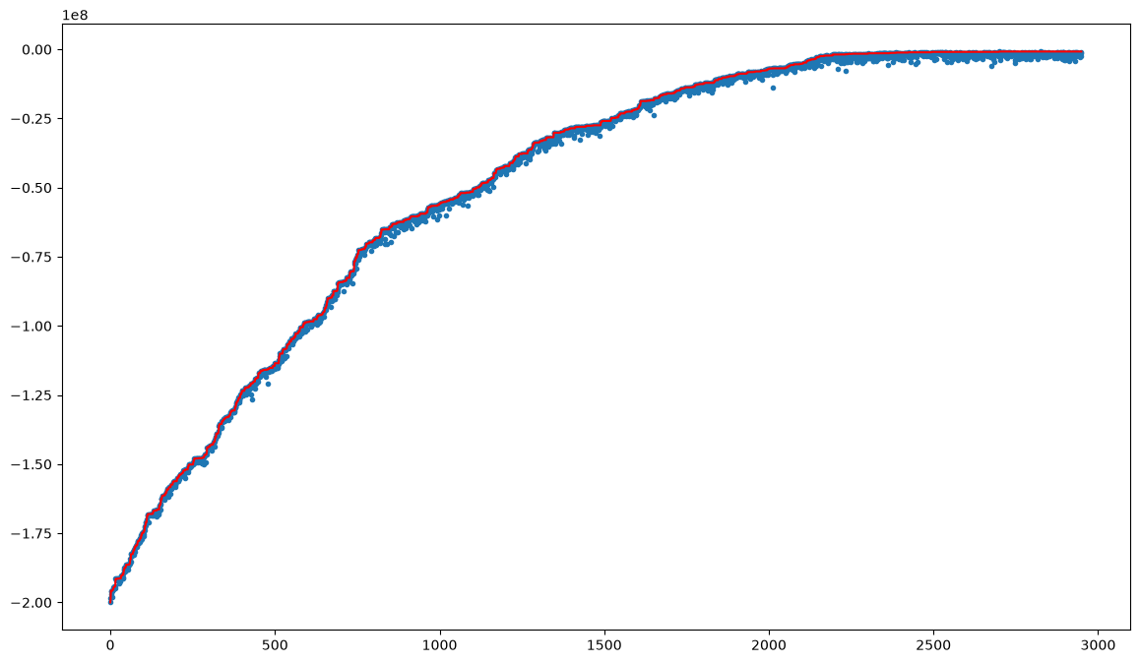
N = 1000

