Slide 1


ALMA MATER STUDIORUM – UNIVERSITÀ DI BOLOGNA
SCUOLA DI INGEGNERIA E ARCHITETTURA
Dipartimento di Informatica – Scienza e Ingegneria – DISI Corso di Laurea Magistrale in Ingegneria Informatica
PROJECT WORK on
DATA MINING
Solutions exploration for the LANL Earthquake
Prediction challenge in Python
CANDIDATES
Valentina Protti
Giuseppe Tempesta
PROFESSOR
Prof. Claudio Sartori
Notes:
The topic of this project activity was a data mining task provided by a famous competition platform, Kaggle.

Slide 2

Problem
Forecasting earthquakes is one of the most important problems in Earth science.
What does “forecasting“ mean?
What can we do?
We can focus on three key points:
when the event will occur
where it will occur
how large it will be
In this competition, we will have to forecast “when”.
Notes:
The task focused on earthquake predictions, and in particular our goal was, given the sets of data, to predict the period of time from a certain point to the next earthquake.

Slide 3
Data
The data comes from a experimental set-up used to study earthquake physics (simulated).
The acoustic_data input signal is used to predict the time remaining before the next laboratory earthquake (time_to_failure).
What about data sets?
Training set: continuous training segment (acoustic_data and time_to_failure)
Test set: folder containing small segments (only acoustic_data)
For each segment, we have to predict its time_to_failure.
The results are evaluated using the mean absolute error
between the predicted and real values.
Notes:
It’s worth mentioning that the data provided, in two large sets as we will see later, is the result of laboratory experiments and not real geophysics data, so the earthquakes are simulated and the outcome, although accurate, has to be considered not that close to a real-world prediction. In fact, real-world earthquake predictors that already exist take many factors into account, while we’ll only work on the acoustic signal data. The training dataset, a huge set of almost 10Gbs of entries, is made of two columns: the acoustic data and a time to failure, which is the continuous value to predict for the challenge and represents the time to the next earthquake. Being it continuous, the data mining task could already be defined to be a regression type of problem. The test set on the other hand is a collection of segments of data split into files that cannot be considered contiguous between each other; each segment contains 150.000 entries made only of one field, the acoustic data. The expected result to be handled to the Kaggle platform is a new dataset containing one entry for each segment, representing the time to failure value computed for it by the data mining model. The score to evaluate the performance of the model can be computed on the test set only by Kaggle, since we do not have the real values of time to failure, and it is computed using the mean absolute error, so the lower, the better.

Slide 4
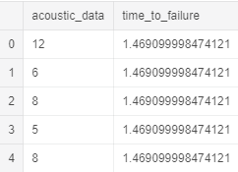
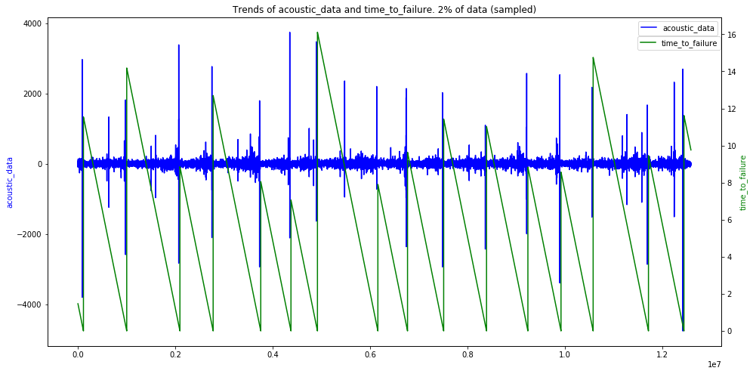
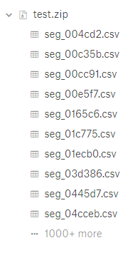
Data (2)
Notes:
Here we can have a look at the data, which is an operation that we did preemptively to any model building attempt, just to have the grasp of what we were working on. As we can tell there’s some kind of connection between acoustic data and time to failure, of course, but aside from the high peaks of the acoustic data there is not a regular pattern, which turned out to be an issue since it is based on those values that the predictions had to be done. Of course, a first problem with the data, aside from the fact that it’s really a huge amount of entries, is that it only had one value to work on in order to predict the time to failure, which is the acoustic signal: building a model only on that would result in computing something overfitted to the training set, so of course the data needed to be preprocessed. With preprocessing, in this particular case, we mean a process of splitting data into chunks and for each of those computing some operations of aggregation, like average, minimum, maximum and standard deviation, the most basic ones. The most intuitive and obvious size for the splitting was of 150.000 entries, resembling the test set segments, but of course other choices wouldn’t have been wrong.

Slide 5
A first approach: Linear Model Regression
Why?
We want to study the impact of different features on the results
using the simplest model, Linear Regression.
How many features?
Two cases:
Only 12 features
More features, 24
What kind of features?
We selected, step by step, the most significant features,
according to the problem
(e.g. mean, std, max, min…).
Notes:
Starting from the basic model given by the competition’s promoters themselves, in which the features computed were the four mentioned previously, the simplest ones, average, minimum, maximum and standard deviations, and the model used was the Support Vector Regression, we decided at first to dig a little bit more into the computed features, keeping the model as simple as possible. The choice was in fact to adopt a Linear Regression model, provided by the scikit learn library for python like all of the following, although other libraries have also been considered despite having little documentation at support. Then we added other features to the four naïve ones, and in particular in a first attempt 8 more, including two types of measures of the probability distribution (kurtosis for the shape, and skew for the asymmetry), mean absolute deviation, median and four quantiles, representing the data falling into a certain percentage of the whole distribution (so for example quantile 01 would consider data of the first 1%, quantile 05 of the 5%, and the same for 95 and 99).

Slide 6
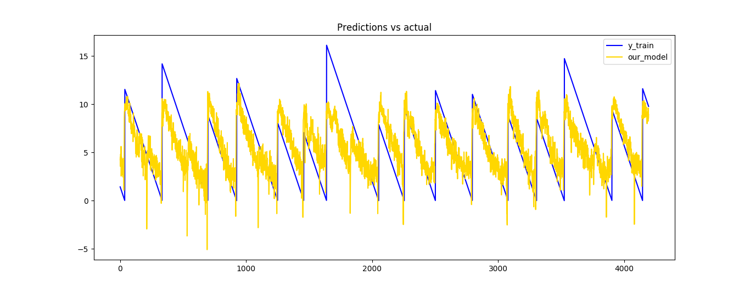
Linear Model Regression results
First case: 12 features
Test set: 2,251
Second case: 24 features
Test set: 2,097
Training set: 1,660 (submitted to Kaggle)
Notes:
For this first attempt the result computed with the mean absolute error on the training set values were not much better than the basic model, so before submitting the solution to the platform we tried to add more features, this time computing the same 12 ones on the absolute values of the data. This decision was made based on the fact that the results of the previous attempt contained many negative values (which were obviously wrong, time to failure had to be a non-negative value) and was made possible thanks to the consideration done seeing the graph of some slides ago that data seems to be kind of symmetrical along the horizontal axis. With these 12 features in addition, the model gave a significatively better score on the training set and a score of 1,66 once submitted to Kaggle, so on the test set. All things considered, above all that this was the first attempt to play with the model building, our result was not that far from the top scores on the leaderboard, which were around 1,3-1,4. Still, as can be seen by the graph, it gave some negative values and it seemed not to be able to capture the higher peaks.

Slide 7
Features selection
Feature selection can be seen as a pre-processing step.
Scikit-learn exposes some choices for this purpose
(SelectKBest and SelectPercentile).
We decided to use SelectKBest,
putting inside more than 60 features.
It selected only the most interesting 10 features.
We used a NuSVR model for this task.
Test set: 2,1138
Training set: 1,588
(submitted to Kaggle)
Notes:
After this attempt, we took again the regression model used in the example, the Support Vector Regression, and we decided to feed it only with a selection of features evaluated as the best ones by a preemptive step of features selection. For this reason, we added more than 60 features to the selection process, which were basically the same seen before but computed on the so-called rolling windows (in short, smaller subsets of the 150.000 entries long segments of data), and the resulting 10 best features were then fed to the model. Although it didn’t seem to improve the previous solution, once submitted to Kaggle the model performed better, giving a score of 1,58.

Slide 8
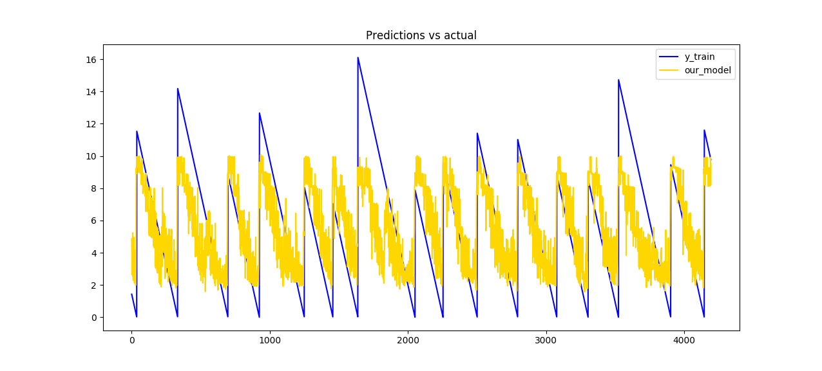
Features selection, a graph
Notes:
In this case there were no negative values, but it looked like it had even less capability to capture the peaks.

Slide 9
Strong overfitting: a wrong attempt with
Gaussian Probability Regression
What is GPR?
Gaussian Processes are supervised learning method that aims at interpolating the observations and predicting results with some confidence intervals.
How many features?
We prepared a set of 24 features.
Result
Training set: approximately zero (order of magnitude of e-10)
Test set: 2,792
(submitted to Kaggle)

Slide 10
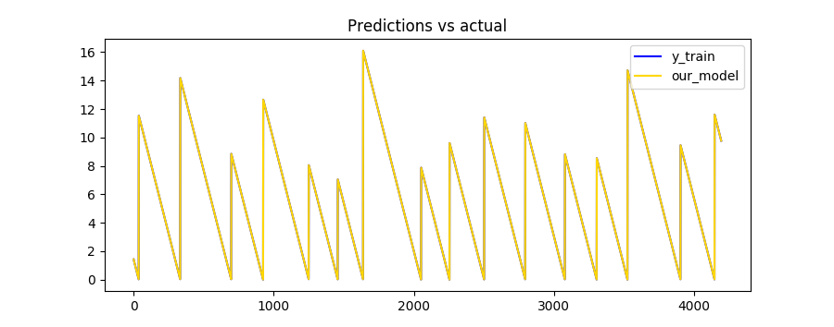
Gaussian Probability Regression,
more results
It is able to detect with strong precision the time_to_failure on training set,
but on the test set the result is very bad.
Perfect correspondence (on training set):

Slide 11
Neural Network Regression
What is NNR?
Multi Layer Perceptron (MLP) is made at least of 3 layers: input, output and one or more hidden layers; thanks to the complexity, MLP can distinguish non-linearly separable data.
The implementation in scikit-learn allows us to set lots of parameters,
but we focused only on these:
hidden_layer_sizes, max_iter, solver, warm_start.
How many features?
We decided to test this model both with less and more features.

Slide 12
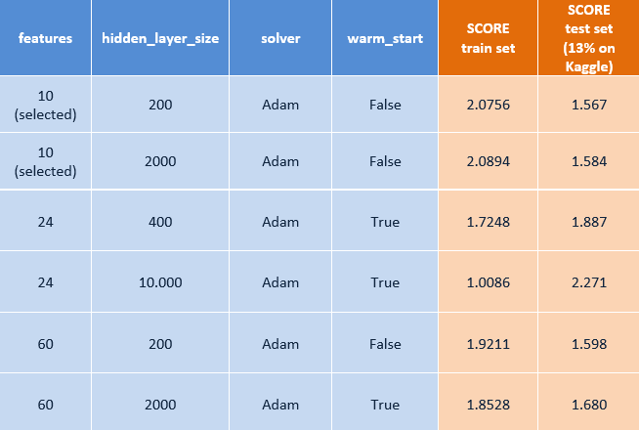
Neural Network Regression results (1)
The table below shows our best results:

Slide 13
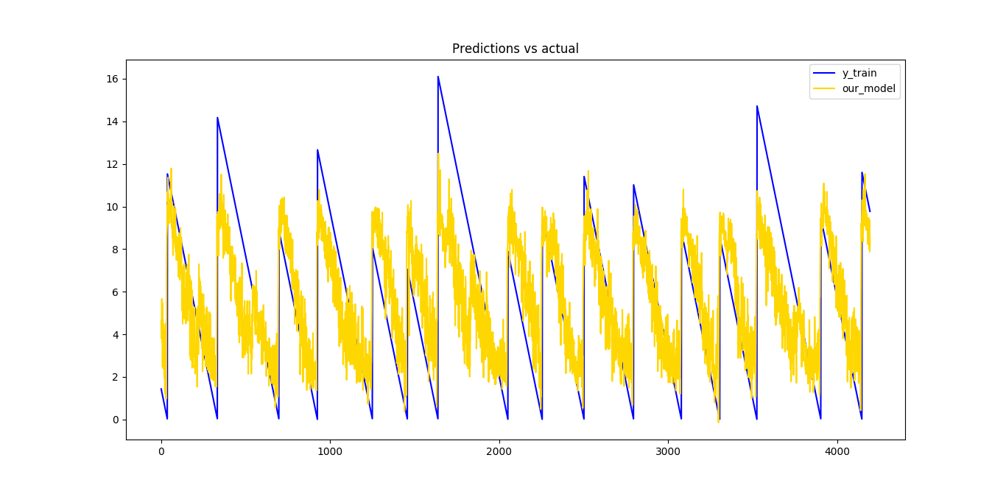
Neural Network Regression results (2)
The best result on test set, submitted on Kaggle, is 1,540.
(max_iter=2500, hidden_layer_sizes=1000, shuffle=False, solver='sgd’)

Slide 14
Tools and platform
We encountered two main problems:
Space: load into memory more than 9 GiB is not easy
Time: computing features, model and predictions takes some time
In order to overcome these problems,
we selected a custom VM on
Microsoft Azure Cloud.
NC6 Standard machine:
6 virtual CPUs, 56 GiB RAM, 30GiB SSD,
Ubuntu (18.04.1 LTS) and tools

Slide 15
How to run
Early steps:
from Windows, launch Xming and PuTTy, then login into VM
git clone https://github.com/GiusTemp/kaggleunibo
cd/kaggleunibo/code
Run code:
python script_name.py
(it could take some minutes)
Submit result:
kaggle competitions submit -c LANL-Earthquake-Prediction -f YOUR_RESULTS.csv -m "MESSAGE"

Slide 16
Conclusions
In this presentation, we proposed our most significant solutions.
Starting from raw data, we pre-processed it by computing aggregated
representative data to be fed to a model of our choice.
Python library (scikit-learn) was used, starting from
the most simple model up until neural networks
(other libraries were explored, but not reported).
Complex models tend to overfit to the training data
(good result on training set, worst on test set).
Simpler models seem to be more general, giving unsatisfactory results
on the training set but better on the test set.

