Slide 1

ALMA MATER STUDIORUM - UNIVERSITA DI BOLOGNA
SCUOLA DI INGEGNERIA E ARCHITETTURA
Dipartimento di Informatica
- Scienza e Ingegneria –
DISI Corso di Laurea Magistrale in Ingegneria Informatica
PROJECT WORK on
DATA MINING
A solution for the LANL Earthquake
Prediction challenge in Python
CANDIDATES
Valentina Protti
Giuseppe Tempesta
PROFESSOR
Prof. Claudio Sartori

Slide 2
problem
Forecasting earthquakes is one of the most important problems in Earth science.
What does it mean “forecasting “?
What can we do?
We can focus on three key points:
when the event will occur
where it will occur
how large it will be
In this competition, we will have to forecast “when”.

Slide 3
data
The data comes from a experimental set-up used to study earthquake physics
(they are not real, but simulated)
The acoustic_data input signal is used to predict the time remaining before the next laboratory earthquake (time_to_failure)
What about sets?
Training set: continuous training segment (acoustic_data and time_to_failure)
Test set: folder containing small segments (only acoustic_data, of course)
For each segment, we have to predict a time_to_failure
The results are evaluated using the mean absolute error
between the predicted and real values

Slide 4
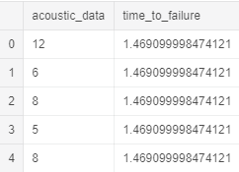
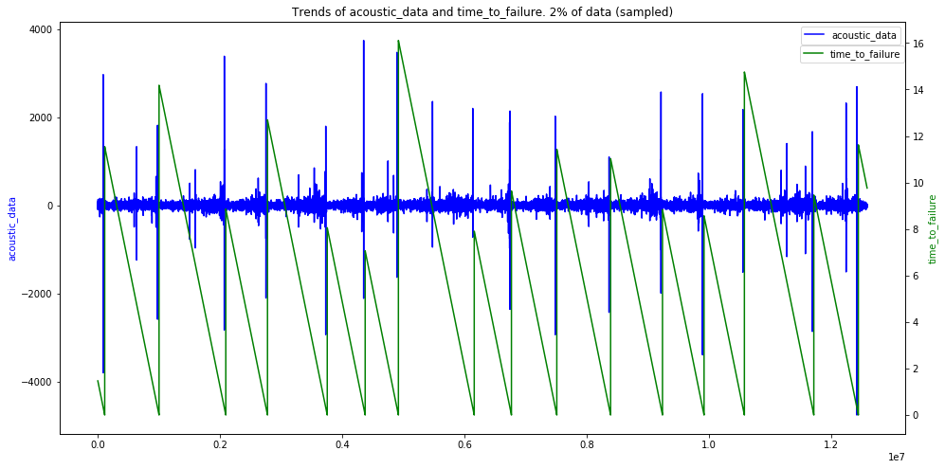
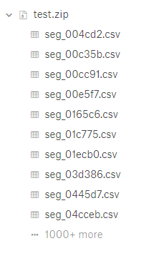
data (2)

Slide 5
a first approach … linear model regression
Why?
We want to study the impact of different features on the results,
using simplest model, Linear Regression
How many features?
Two cases:
Only 12 features
More features, 24
What kind of features?
We selected, step by step, the most significant features,
according to the problem
(e.g. mean, std, max, min …)

Slide 6
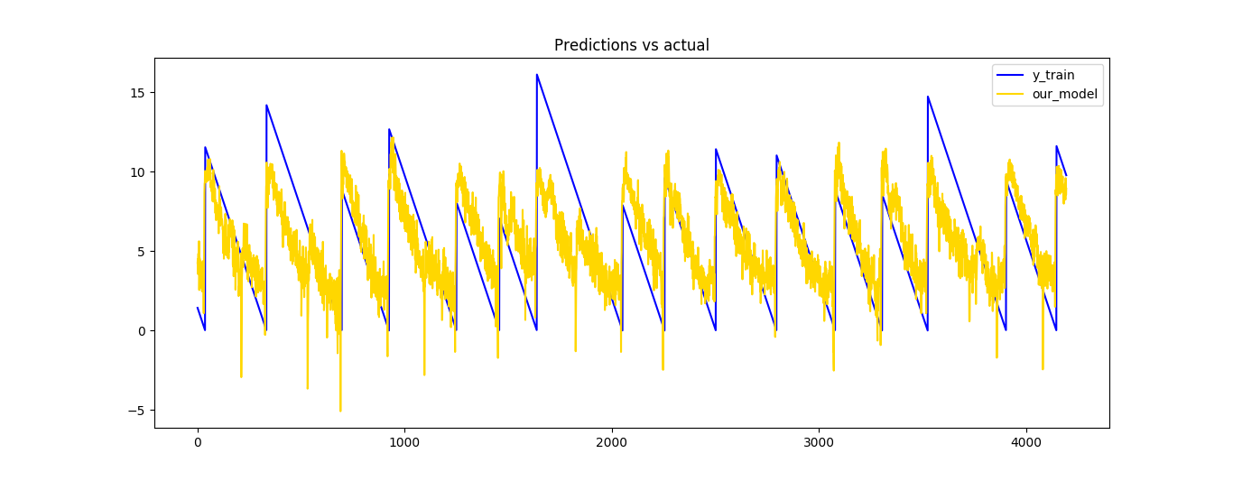
linear model regression … results
First case: 12 features
Test set: 2,251
Second case: 24 features
Test set: 2,097
Training set: 1,660 (submitted to Kaggle)

Slide 7
features selection
Feature selection can be seen as a pre-processing step.
Scikit-learn exposes some choices for this purpose
(SelectKBest and SelectPercentile)
We decided to use SelectKBest,
putting inside more than 60 features.
It selected only the most interesting 10 features.
We used a NuSVR model for this task.
Test set: 2,1138
Training set: 1,588
(submitted to Kaggle)

Slide 8
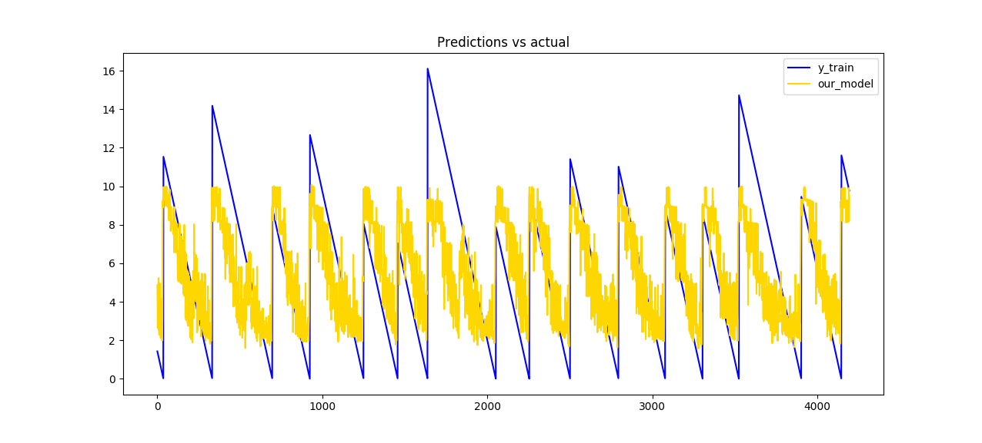
features selection, a graph

Slide 9
strong overfitting … a wrong attempt with
Gaussian Probability Regression
What about?
Gaussian Processes are supervised learning method that aims at interpolating the observations and predicting results with some confidence intervals
How many features?
We prepared a set of 24 features.
Result
Training set: approximately zero (order of magnitude of e-10)
Test set: 2,792
(submitted to Kaggle)

Slide 10
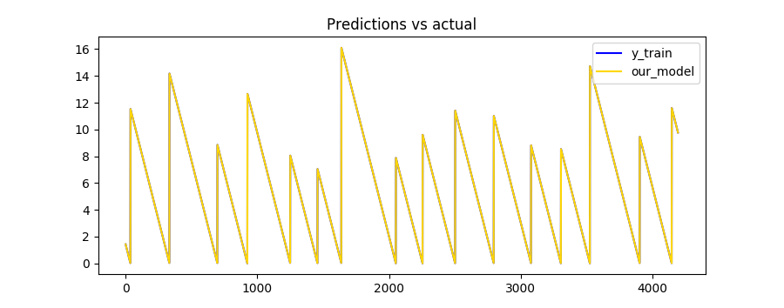
Gaussian Probability Regression,
more about results
It is able to detect with strong precision the time_to_failure on training set,
but on the test set, the result is very bad
Perfect corrispondence (on training set)

Slide 11
neural network regression
What about?
Multi Layer Perceptron (MLP) is made at least of 3 layers: input, output and
one or more hidden layers, thanks to the complexity, MLP can distinguish non-linearly separable data
The implementation in scikit-learn allows us to set lots of parameters,
but we focused only on these:
hidden_layer_sizes, max_iter , solver, warm_start
How many features?
We decided to test this model with less and more features.

Slide 12
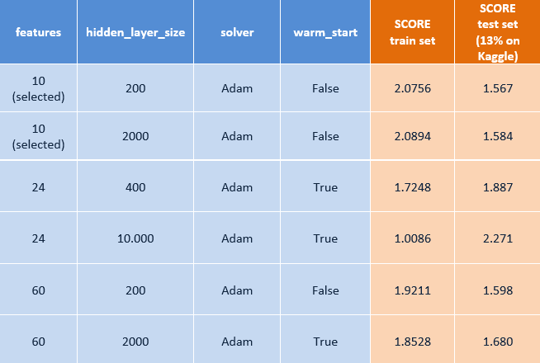
neural network regression … results (1)
The table below show us our best results

Slide 13
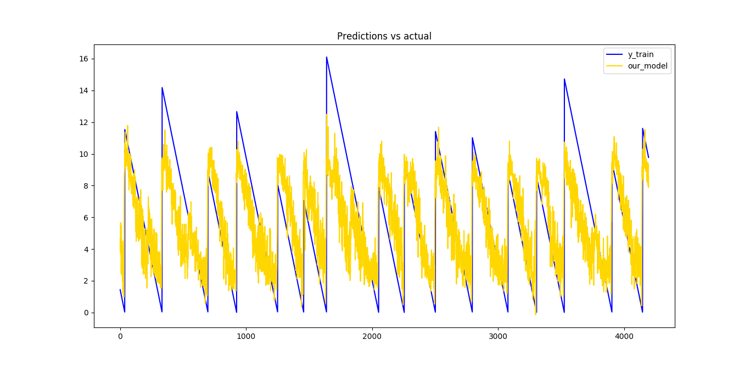
neural network regression … results (2)
The best result on test set, submitted on Kaggle, is 1,540.
(max_iter=2500, hidden_layer_sizes=1000, shuffle=False, solver='sgd’)

Slide 14
tools and platform
Why?
We have two main problems
Space: load into memory more than 9 GiB is not easy
Time: compute features, model and prediction take some time
In order to overcome these problems,
we selected a custom VM on
Microsoft Azure Cloud
NC6 Standard machine:
6 virtual CPUs, 56 GiB RAM, 30GiB SSD,
Ubuntu (18.04.1 LTS) and tools

Slide 15
conclusions
In this presentation, we proposed our most significant solutions
Starting from raw data, we pre-processed it by computing aggregated
representative data to be fed to a model of our choice
Python library (scikit-learn) was used, starting from the most
simple model up until neural networks
(other libraries were explored, but not reported)
Complex models tend to overfit to the training data
(good result on training set, worst on test set).
Simpler models seem to be more general, giving unsatisfactory results
on the training set but better on the test set.

