Slide 1
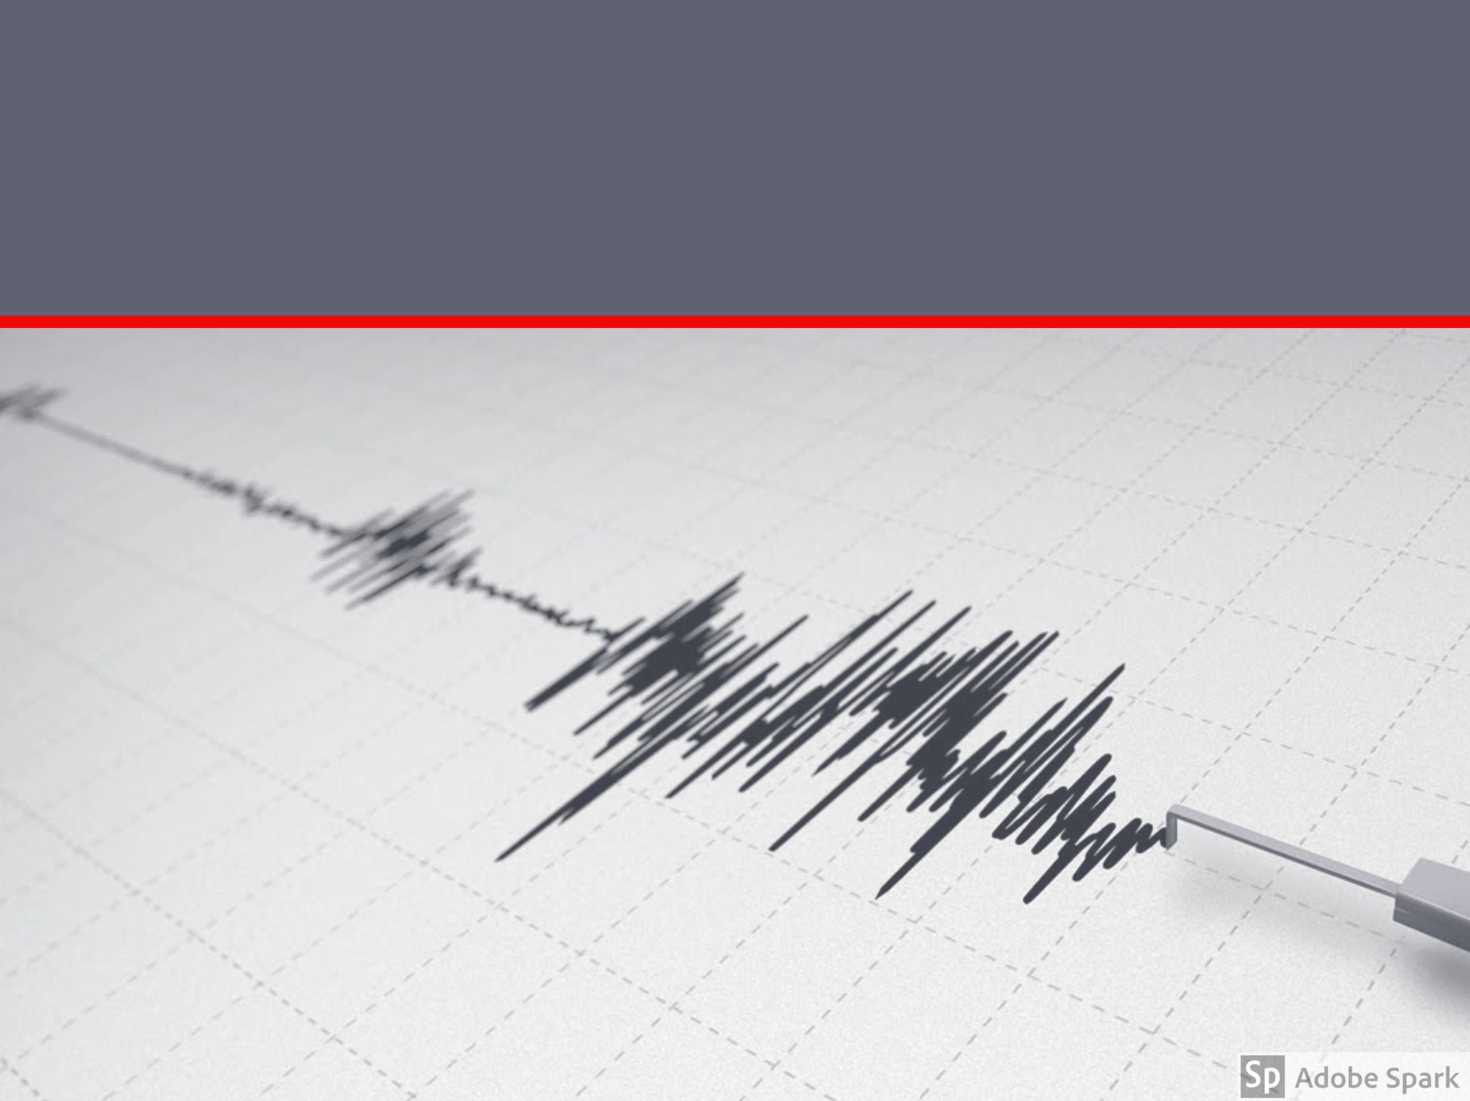

ALMA MATER STUDIORUM – UNIVERSITÀ DI BOLOGNA
SCUOLA DI INGEGNERIA E ARCHITETTURA
Dipartimento di Informatica – Scienza e Ingegneria – DISI Corso di Laurea Magistrale in Ingegneria Informatica
PROJECT WORK on
DATA MINING
Solutions exploration for the LANL Earthquake
Prediction challenge in Python
CANDIDATES
Valentina Protti
Giuseppe Tempesta
PROFESSOR
Prof. Claudio Sartori

Slide 2

Problem
Forecasting earthquakes is one of the most important problems in Earth science.
What does “forecasting“ mean?
What can we do?
We can focus on three key points:
when the event will occur
where it will occur
how large it will be
In this competition, we will have to forecast “when”.

Slide 3
Data
The data comes from a experimental set-up used to study earthquake physics (simulated).
The acoustic_data input signal is used to predict the time remaining before the next laboratory earthquake (time_to_failure).
What about data sets?
Training set: continuous training segment (acoustic_data and time_to_failure)
Test set: folder containing small segments (only acoustic_data)
For each segment, we have to predict its time_to_failure.
The results are evaluated using the mean absolute error
between the predicted and real values.

Slide 4
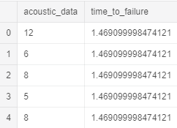
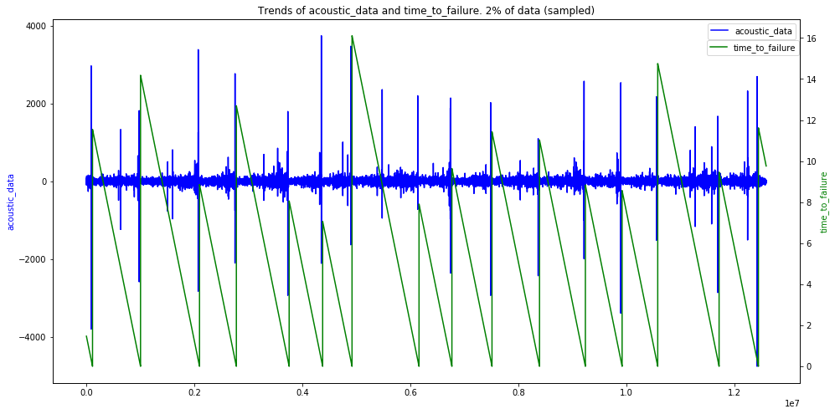
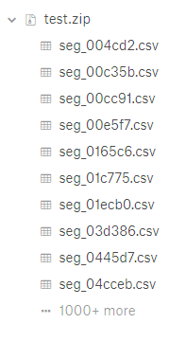
Data (2)

Slide 5
A first approach: Linear Model Regression
Why?
We want to study the impact of different features on the results
using the simplest model, Linear Regression.
How many features?
Two cases:
Only 12 features
More features, 24
What kind of features?
We selected, step by step, the most significant features,
according to the problem
(e.g. mean, std, max, min…).

Slide 6
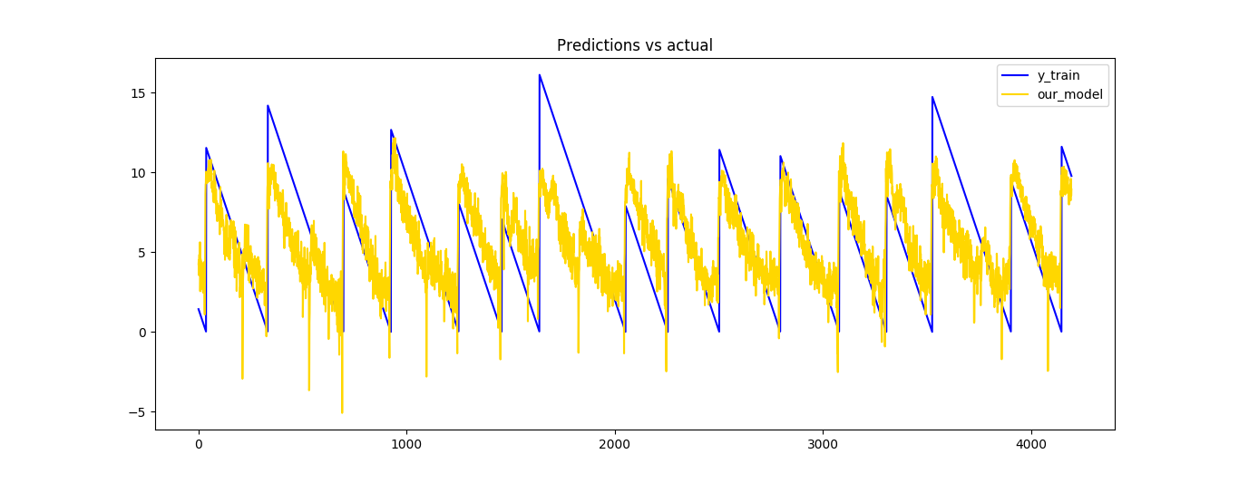
Linear Model Regression results
First case: 12 features
Test set: 2,251
Second case: 24 features
Test set: 2,097
Training set: 1,660 (submitted to Kaggle)

Slide 7
Features selection
Feature selection can be seen as a pre-processing step.
Scikit-learn exposes some choices for this purpose
(SelectKBest and SelectPercentile).
We decided to use SelectKBest,
putting inside more than 60 features.
It selected only the most interesting 10 features.
We used a NuSVR model for this task.
Test set: 2,1138
Training set: 1,588
(submitted to Kaggle)

Slide 8
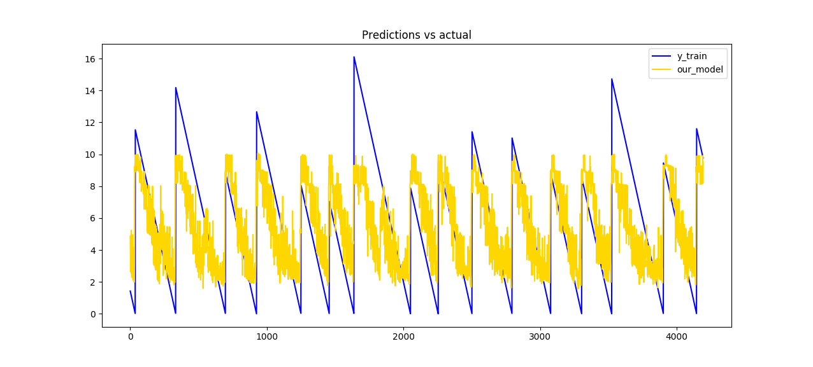
Features selection, a graph

Slide 9
Strong overfitting: a wrong attempt with
Gaussian Probability Regression
What is GPR?
Gaussian Processes are supervised learning method that aims at interpolating the observations and predicting results with some confidence intervals.
How many features?
We prepared a set of 24 features.
Result
Training set: approximately zero (order of magnitude of e-10)
Test set: 2,792
(submitted to Kaggle)

Slide 10
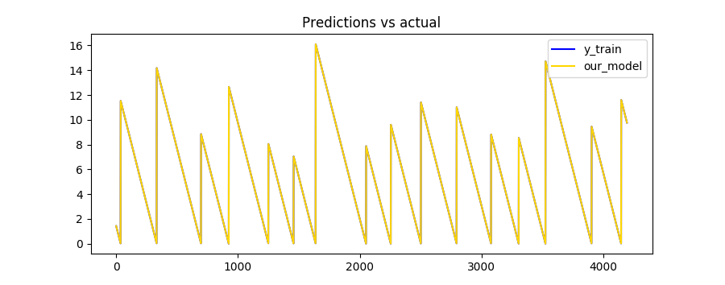
Gaussian Probability Regression,
more results
It is able to detect with strong precision the time_to_failure on training set,
but on the test set the result is very bad.
Perfect correspondence (on training set):

Slide 11
Neural Network Regression
What is NNR?
Multi Layer Perceptron (MLP) is made at least of 3 layers: input, output and one or more hidden layers; thanks to the complexity, MLP can distinguish non-linearly separable data.
The implementation in scikit-learn allows us to set lots of parameters,
but we focused only on these:
hidden_layer_sizes, max_iter, solver, warm_start.
How many features?
We decided to test this model both with less and more features.

Slide 12
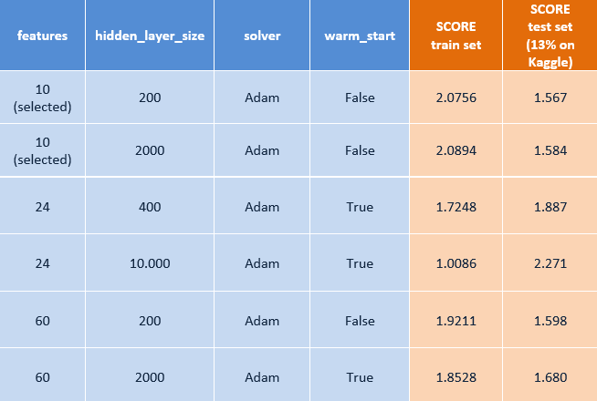
Neural Network Regression results (1)
The table below shows our best results:

Slide 13
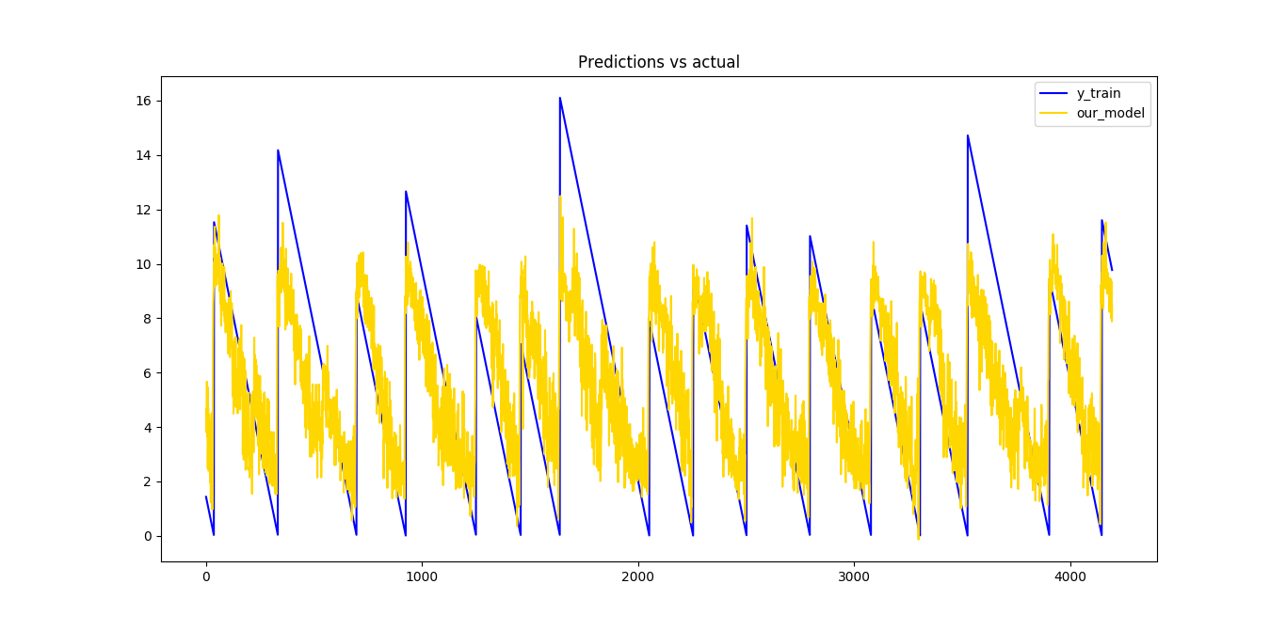
Neural Network Regression results (2)
The best result on test set, submitted on Kaggle, is 1,540.
(max_iter=2500, hidden_layer_sizes=1000, shuffle=False, solver='sgd’)

Slide 14
Tools and platform
We encountered two main problems:
Space: load into memory more than 9 GiB is not easy
Time: computing features, model and predictions takes some time
In order to overcome these problems,
we selected a custom VM on
Microsoft Azure Cloud.
NC6 Standard machine:
6 virtual CPUs, 56 GiB RAM, 30GiB SSD,
Ubuntu (18.04.1 LTS) and tools

Slide 15
How to run
early steps:
from Windows launch Xming and PuTTy, then login into VM
git clone https://github.com/GiusTemp/kaggleunibo
cd/kaggleunibo/code
run code:
python script_name.py
(it could take some minutes)
submit result:
kaggle competitions submit -c LANL-Earthquake-Prediction -f YOUR_RESULTS.csv -m "MESSAGE"

Slide 16
Conclusions
In this presentation, we proposed our most significant solutions.
Starting from raw data, we pre-processed it by computing aggregated
representative data to be fed to a model of our choice.
Python library (scikit-learn) was used, starting from
the most simple model up until neural networks
(other libraries were explored, but not reported).
Complex models tend to overfit to the training data
(good result on training set, worst on test set).
Simpler models seem to be more general, giving unsatisfactory results
on the training set but better on the test set.

