Slide 1

WAVELET TRANSFORM
Advanced Computer Automation - A.A 2019/2020
Università Degli Studi Pavia
Giuseppe Carniglia, Roberto Nour

Slide 2
Introduzione
Our project is based on wavelet transforms specifically using Haar and CDF 9/7 functions.
The project is realized in C style C++ using OpenCV to import and work on images, OpenMP for parallelization.
Tests on serial and parallel versions of programs are executed using images with resolution equal to 3840x2160 (4k UHD)
Execution times have been acquired with OpenMP internal time function.
On GCP we used standard vCPUs with increasing count of processors (namely 4,8 and 16 processors) for testing.
Giuseppe Carniglia, Roberto Nour

Slide 3
Haar wavelet transform and 9/7 wavelet transform
The digital wavelet transform is usually computed through convolution and sub-sampling with a couple of filters to produce an approximation signal a (low pass filter result) and a detail signal d (high pass filter result).
For 2-D signals there exist separable wavelets, for which the computation can be decomposed into horizontal processing (on the rows) followed by vertical processing (on the columns).
Giuseppe Carniglia, Roberto Nour

Slide 4
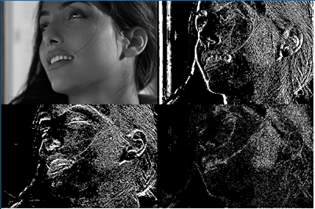
Haar wavelet transform
For an input represented by a list of 2^{n} numbers, the Haar wavelet transform may be considered to simply pair up input values, storing the difference and passing the sum. This process is repeated recursively, pairing up the sums to provide the next scale: finally resulting in 2^{n-1} differences and one final sum.
Giuseppe Carniglia, Roberto Nour

Slide 5
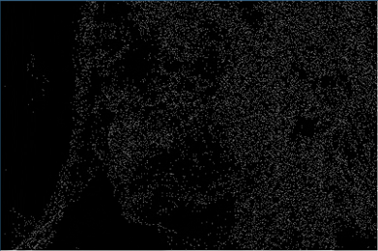
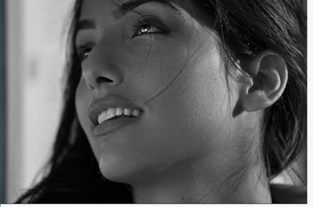
Haar Antitrasformation
To see if our algorithm works properly, we computed the Haar transformation. The image that we obtained with this transformation is very similar to the original image.
subtracting pixel by pixel the two images reveal also that this DWT is lossy, since the resulting image is mostly black (the subtracted pixel values where equal) but there are some white/light gray pixels confirming that it is a lossy transformation.
Giuseppe Carniglia, Roberto Nour

Slide 6
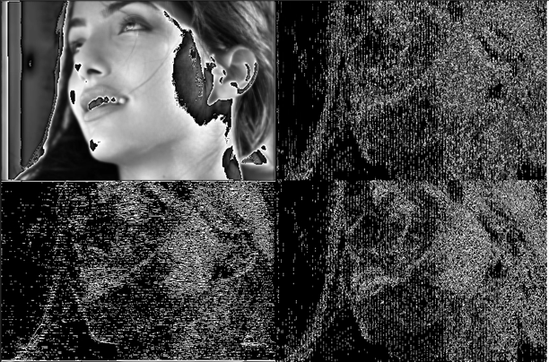
9/7 wavelet transform
The structure of our algorithm is the same as for the Haar but this time we have, as the name implies, nine coefficients for the low-pass filter and seven for the high-pass. As mentioned above the low-pass filter is used to scale down the original image and the high-pass filter to select the contours of the shapes in the image.
Giuseppe Carniglia, Roberto Nour

Slide 7
Parallelism
While studying the algorithm we understood that the only necessary serial part was the succession of row calculations and column calculations, since the second needs the result of the first to proceed. So, everything else could have been parallelized.
Merge two loops because high pass and low pass values are independent
Group the total computation for the first phase into a single for loop
Image never written, but always read
In the second phase temporary images are used to ensure that concurrent write operation could not happen
Giuseppe Carniglia, Roberto Nour

Slide 8

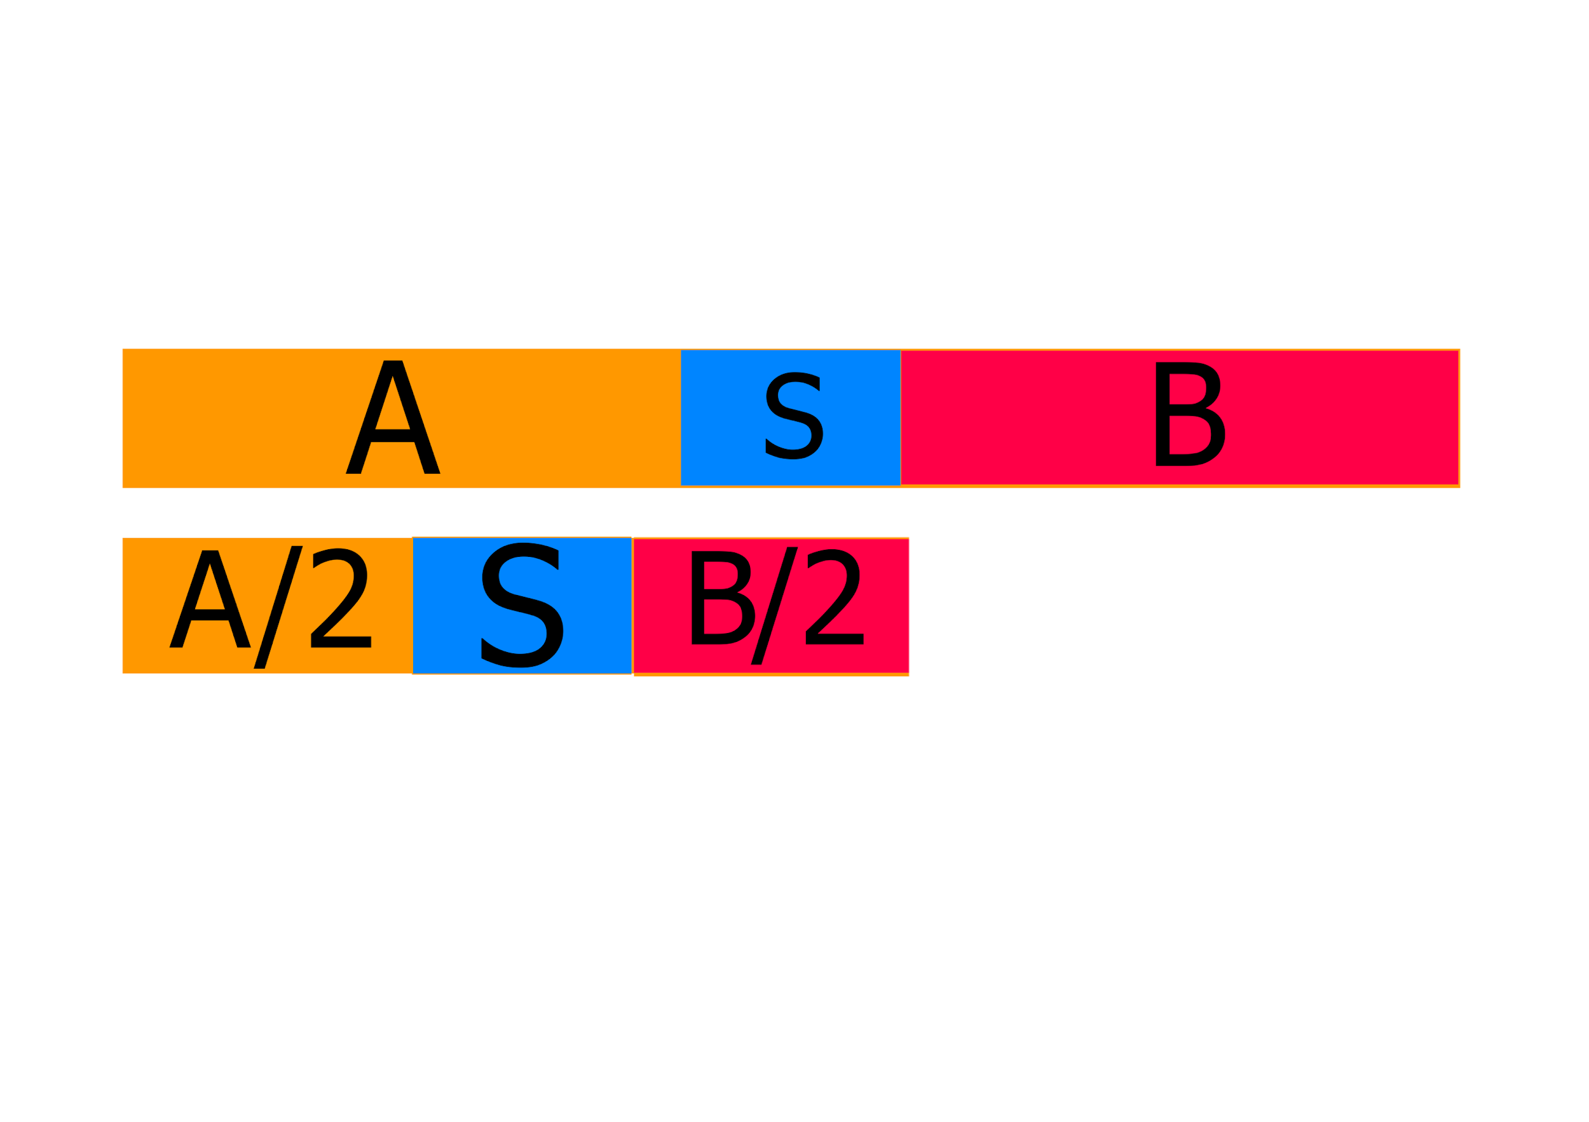
Amdahl’s Law
We can imagine our programs to be divided into 3 parts: first calculation, serial segment and second calculation. Both first and second calculations can be parallelized so are the parts that benefit from a speedup.
Haar serial: 0.782613, 0.529001, 0.000002,0.253610
Haar parallel(expected): 0.3913085, 0.2695005, 0.000002, 0.126805
Speedup(Amdhal): 1.998
CDF 9/7 serial: 1.58700,0.796128, 0.005928, 0.784944
CDF 9/7 parallel (expected): 0.799428, 0.398064, 0.005928, 0.392472
Speedup(Amdhal): 1.993
Giuseppe Carniglia, Roberto Nour

Slide 9
Open points about the overflow
We made different attempts to solve this problem:
Normalize the values of each single pixel of the image at the end of all operations
Create the matrix that would have contained the image with bigger types to accommodate overflowing values on 8 bit, the types of choice were USHORT and INT.
Giuseppe Carniglia, Roberto Nour

Slide 10
Open points about the overflow
Giuseppe Carniglia, Roberto Nour

Slide 11
Computation on GCP
To test our implementation of parallelism for both wavelets and to see if there is an actual improvement in execution time we created 4 virtual machines on Google Cloud Platform and for each program executed two identical test: first test was to compute the transform of one image (immagini/leonessa.jpg, 3840x2160) 100 times to check the average time of execution, the second was to compute the transform on 6 different images with same resolution in an attempt to force cache’s swap. In the end the average times of execution for each program are plotted over the number of VM’s CPUs.
Giuseppe Carniglia, Roberto Nour

Slide 12
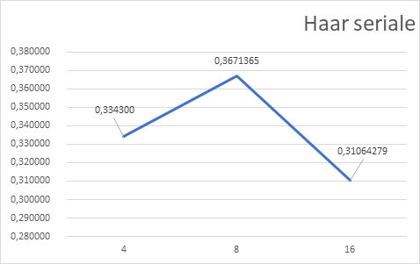
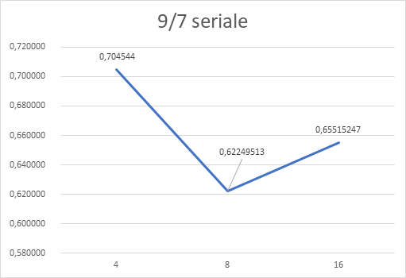
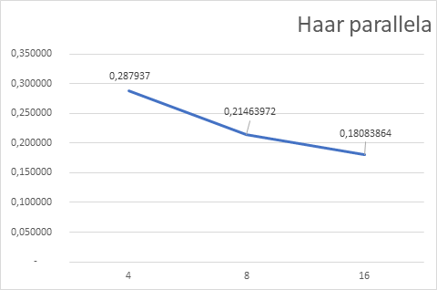
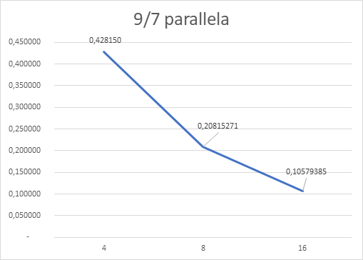
Computation on GCP
Haar:
S4(%) = (1 – 0.287937/0.334300) *100 = 13.86% (Amdahl S4 = 3.988)
S8(%) = (1 – 0.21463972/0.3671365) *100 = 13.86% (Amdahl S8 = 7.944)
S16(%) = (1 – 0.18083864/0.31064279) * 100 = 41.7% (Amdahl S16 = 15,76)
CDF 9/7:
S4(%) = (1 - 0.428150 /0.704544) * 100 = 39.23% (Amdahl S4 = 3.95)
S8(%) = (1 - 0,20815271/0,62249513) * 100 = 66.56% (Amdahl S8 = 7.78)
S16(%) = (1 - 0,10579385/0,65515247) * 100 = 83.85% (Amdahl S16 = 15,09)
Giuseppe Carniglia, Roberto Nour

Slide 13
THANKS FOR THE ATTENTION
Giuseppe Carniglia, Roberto Nour

