Slide 1
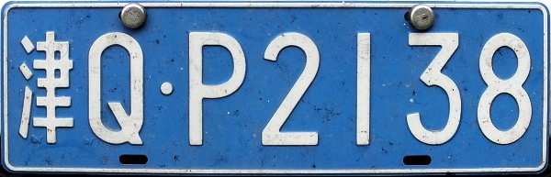
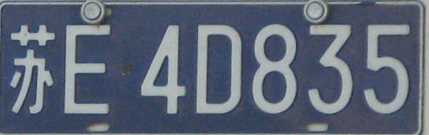

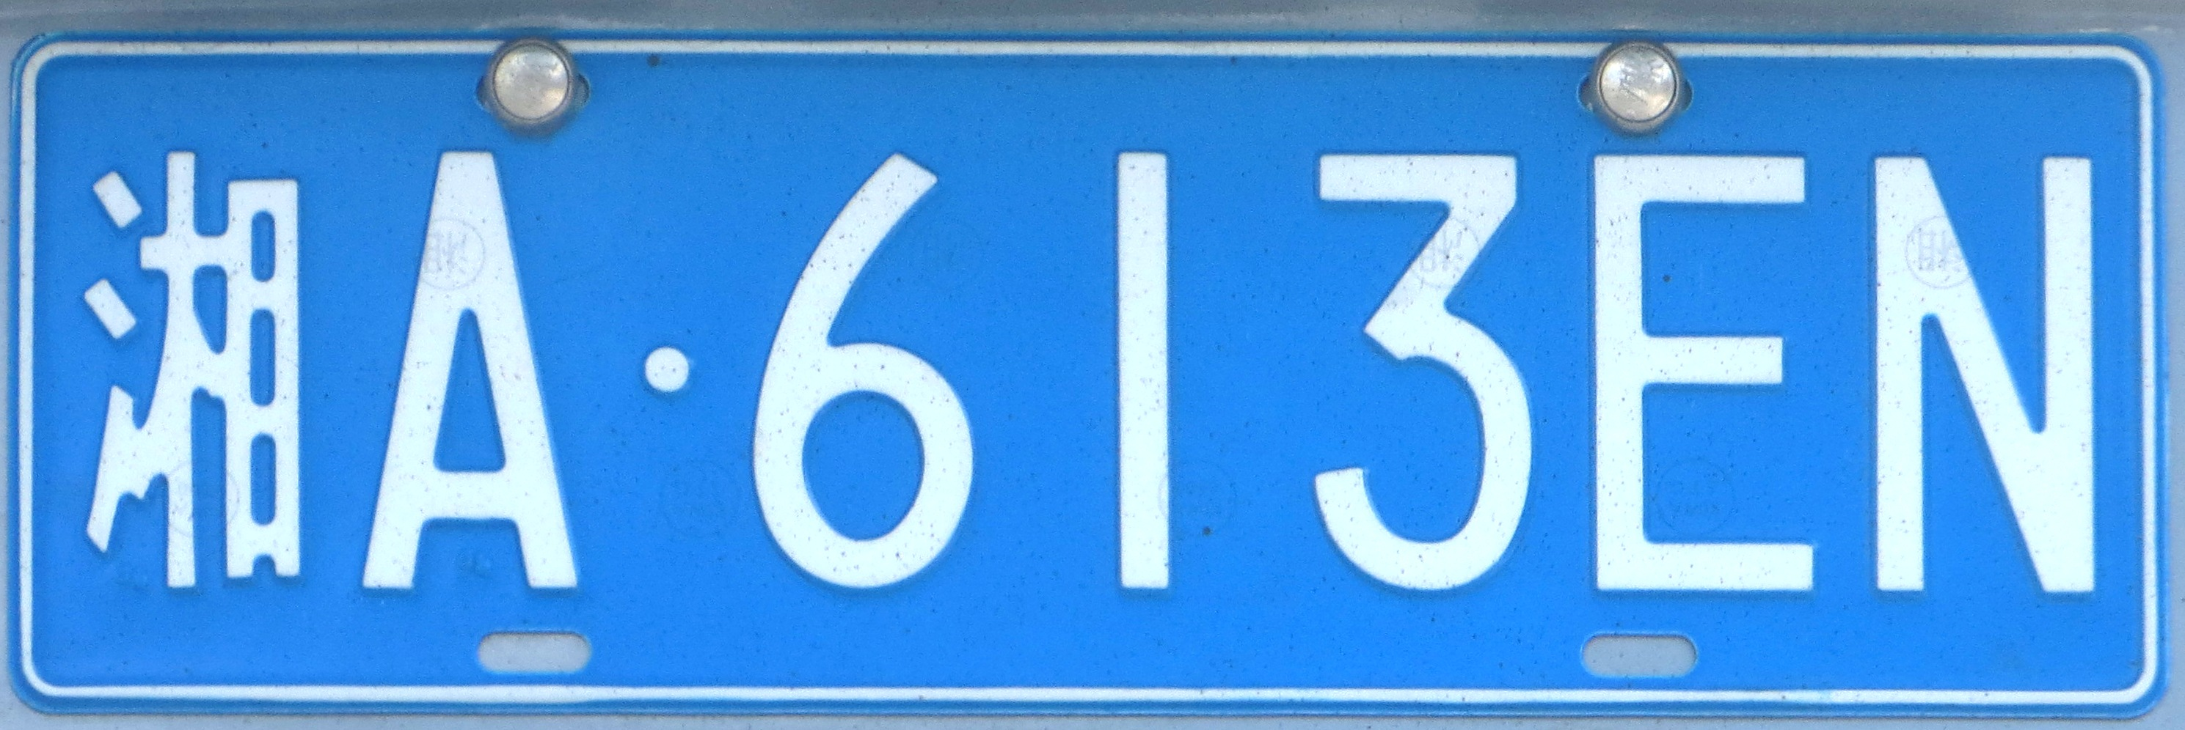

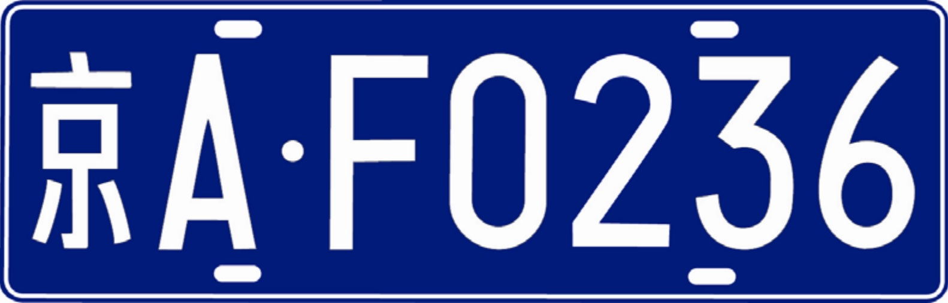
Computer Vision course 2024-2025
Car Plate recognition and reconstruction with Deep Learning
Samuele Tomassacci
Lorenzo Benucci
Giuseppe D’Addario
22126267
2219690
2177530

Slide 2
Outline
Problem statement
Dataset
Related Works
Baseline
Proposed Method
Metrics and Evaluation
Conclusion and Future Works
Computer Vision Project 4 2

Slide 3
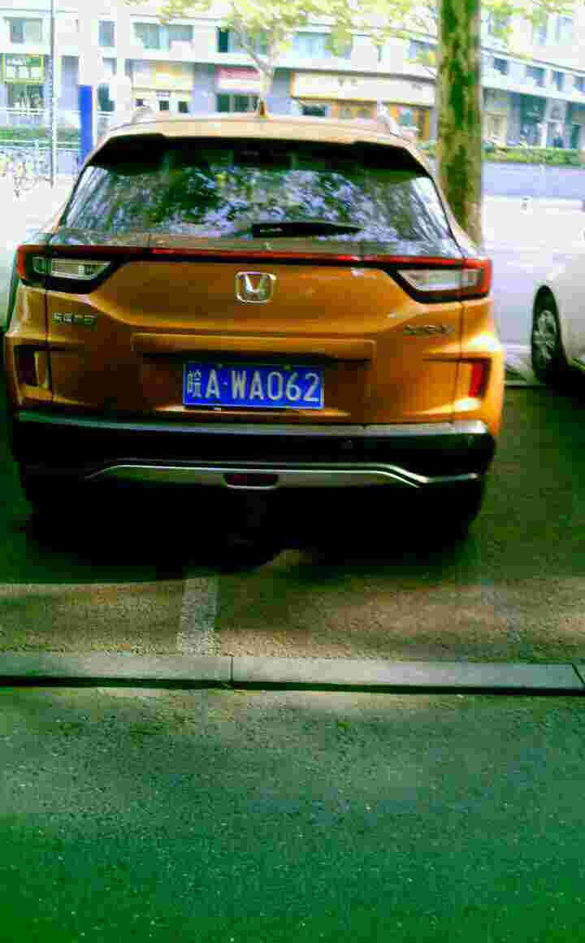
Problem Statement
Given the image of a car, extract the text of the license plate
Detection
Recognition
皖A WA062
Computer Vision
Computer Vision Project 4 3

Slide 4
Dataset
CCPD (Chinese City Parking Dataset)
300k images of Chinese cars taken by parking fee collectors under different lighting conditions, various weather conditions, and from different positions.
Computer Vision Project 4 4

Slide 5
Dataset
Tilt degree
Four vertices locations
Brightness
025 - 95_113 - 154&383_386&473 - 386&473_177&454_154&383_363&402 - 0_0_22_27_27_33_16 – 37 - 15.jpg
Area
Bounding box coordinates
License plate number
Blurriness
Computer Vision
Computer Vision Project 4 5

Slide 6
Dataset
['A', 'B', 'C', 'D', 'E', 'F', 'G', 'H', 'J', 'K', 'L', 'M', 'N', 'P', 'Q', 'R', 'S', 'T', 'U', 'V', 'W’, 'X', 'Y', 'Z', 'O']
0_0_22_27_27_33_16
["皖", "沪", "津", "渝", "冀", "晋", "蒙", "辽", "吉", "黑", "苏", "浙", "京", "闽", "赣", "鲁", "豫", "鄂", "湘", "粤", "桂", "琼", "川", "贵", "云", "藏", "陕", "甘", "青", "宁", "新", "警", "学", "O"]
['A', 'B', 'C', 'D', 'E', 'F', 'G', 'H', 'J', 'K', 'L', 'M', 'N', 'P', 'Q', 'R', 'S', 'T', 'U', 'V', 'W', 'X', 'Y', 'Z', '0', '1', '2', '3', '4', '5', '6', '7', '8', '9', 'O']
Computer Vision
Computer Vision Project 4 4

Slide 7
Per Giuseppe salame per realizzare i grafici
Detection Model
Rete basata su ResNet34 pre-addestrata per la regressione di bounding box.Usa la backbone di ResNet34 senza il classificatore finale per estrarre feature.Applica un AdaptiveAvgPool2d per ottenere una mappa compatta.Il regressor predice 4 coordinate normalizzate (xmin, ymin, xmax, ymax) tramite un multi layer perceptron con attivazione Sigmoid.
Recognition Model
Rete multi-classificazione basata su ResNet34 per il riconoscimento del testo della targa.Utilizza ResNet34 senza l’ultima FC layer come feature extractor. La testa è composta da una ModuleList di classificatori, uno per ciascun carattere della targa.Ogni classificatore predice un singolo carattere della sequenza.
Computer Vision
Project 4

Slide 8
Baseline
The baseline is simple not only for the architecture but also for the pre-processing of the data
No pre-processing of the images
No data augmentation
For the detection just a resize to (224,224) and normalization of bounding box between [0,1]
For the recognition just a resize to (64,128)
Computer Vision
Project 4

Slide 9
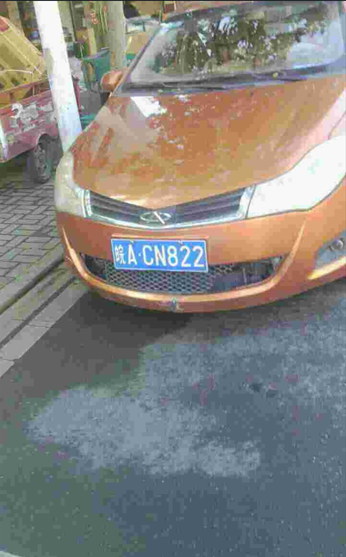
Model Pipeline
Dataset CCPD2019
[DETECTION] YOLO v5
[RECOGNITION] PDLPR
皖ACN822
Computer Vision Project 4 4

Slide 10
YOLOv5 [Detection]
Yolo v5
Computer Vision Project 4 4

Slide 11

PDLPR [Recognition]
皖ACN822
PDLPR
X3 Encoding unit
X3 Decoding unit
IGFE
Computer Vision Project 4 4
Notes:
In the PDLPR pipeline, the cropped image of the plate is passed to the model: the IGFE extracts compact global visual features from the license plate image. The Encoder enriches these features with contextual information through attention mechanisms. The Decoder progressively generates the character sequence, predicting one character at a time based on the encoded features and previously generated tokens.

Slide 12
PDLPR [Recognition]
皖ACN822
PDLPR
X3 Encoding unit
X3 Decoding unit
IGFE
Computer Vision
Computer Vision Project 4 4
Notes:
In the PDLPR pipeline, the cropped image of the plate is passed to the model: the IGFE extracts compact global visual features from the license plate image. The Encoder enriches these features with contextual information through attention mechanisms. The Decoder progressively generates the character sequence, predicting one character at a time based on the encoded features and previously generated tokens.

Slide 13
PDLPR [Recognition]
皖ACN822
PDLPR
X3 Encoding unit
X3 Decoding unit
IGFE
Computer Vision
Computer Vision Project 4 4
Notes:
In the PDLPR pipeline, the cropped image of the plate is passed to the model: the IGFE extracts compact global visual features from the license plate image. The Encoder enriches these features with contextual information through attention mechanisms. The Decoder progressively generates the character sequence, predicting one character at a time based on the encoded features and previously generated tokens.

Slide 14
Focus [PDLPR]
IGFE
FOCUS
R. BLOCK
R. BLOCK
Down Sampl.
R. BLOCK
R. BLOCK
Down Sampl.
Encoding unit
CNN BLOCK
Multi-Head Attention
CNN BLOCK
Add & Norm
Decoding unit
Multi-Head Attention
Add & Norm
Cross Attention
Add & Norm
FFN
Add & Norm
Computer Vision Project 4 4

Slide 15
Focus [PDLPR]
IGFE
FOCUS
R. BLOCK
R. BLOCK
Down Sampl.
R. BLOCK
R. BLOCK
Down Sampl.
Encoding unit
CNN BLOCK
Multi-Head Attention
CNN BLOCK
Add & Norm
Decoding unit
Multi-Head Attention
Add & Norm
Cross Attention
Add & Norm
FFN
Add & Norm
Computer Vision
Computer Vision Project 4 4

Slide 16
Focus [PDLPR]
IGFE
FOCUS
R. BLOCK
R. BLOCK
Down Sampl.
R. BLOCK
R. BLOCK
Down Sampl.
Encoding unit
CNN BLOCK
Multi-Head Attention
CNN BLOCK
Add & Norm
Decoding unit
Multi-Head Attention
Add & Norm
Cross Attention
Add & Norm
FFN
Add & Norm
Computer Vision
Computer Vision Project 4 4

Slide 17







Data Augmentation [PDLPR]
Augmentation
ColorJitter
RandomRotation
RandomAffine
RandomPerspective
GaussianBlur
Computer Vision Project 4 4

Slide 18
Data Augmentation [PDLPR]
Augmentation
ColorJitter
RandomRotation
RandomAffine
RandomPerspective
GaussianBlur
Computer Vision Project 4 4

Slide 19
Data Augmentation [PDLPR]
Augmentation
PDLPR
ColorJitter
RandomRotation
RandomAffine
RandomPerspective
GaussianBlur
皖ACN822
Computer Vision
Computer Vision Project 4 4

Slide 20
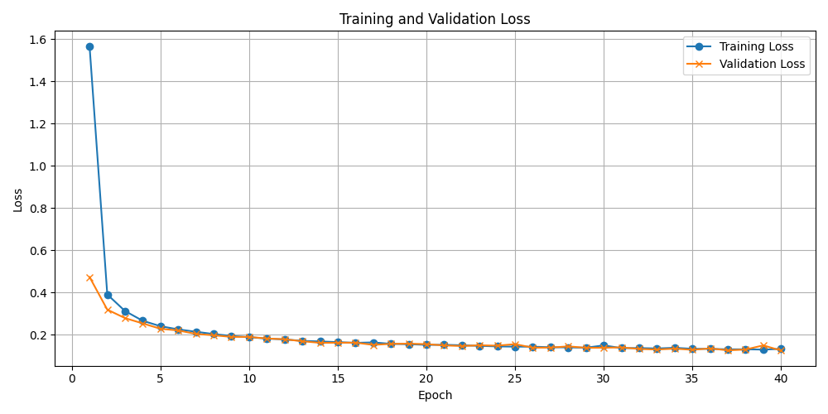
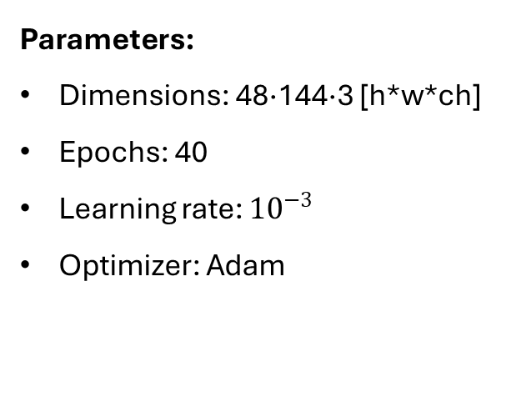
Training and Testing [PDLPR]
Parameters:
Dimensions: 48·144·3 [h*w*ch]
Epochs: 40
Learning rate: ${10}^{−3}$
Optimizer: Adam
Computer Vision Project 4 4

