Slide 1


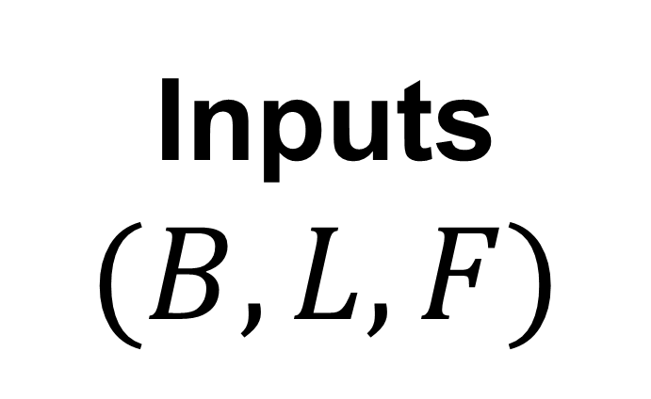
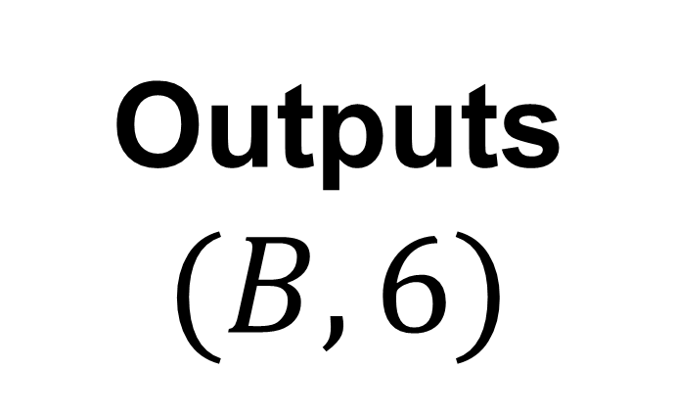
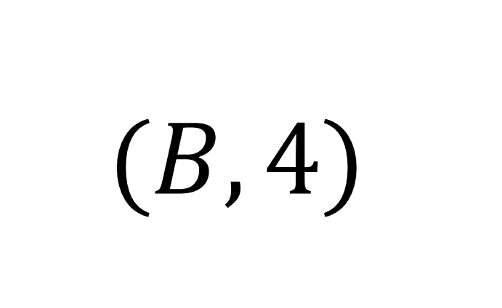


GATv2
Conv
LN
Multi-Strategy
Pooling
Global Feat
MLP
LN
Residual

