Slide 1
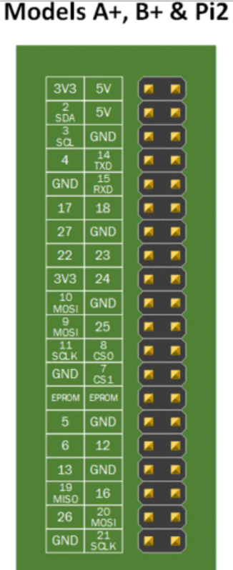
Vcc=5V
GND
Pin 23 controls IN1

