Slide 1



Tecnologie Semantiche
Giuseppe Gaetano 0622701614
Antonio Carbone 0622701554
Relevant Semanti Information Extraction

Slide 2
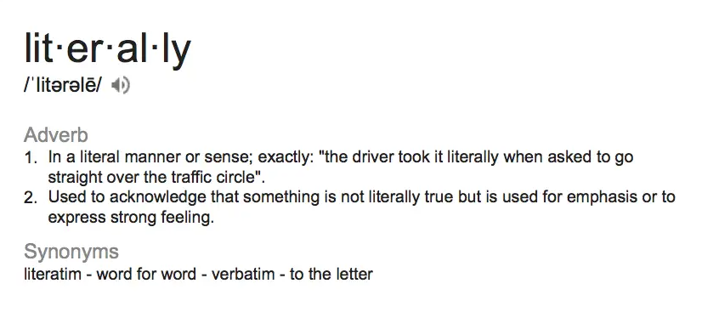

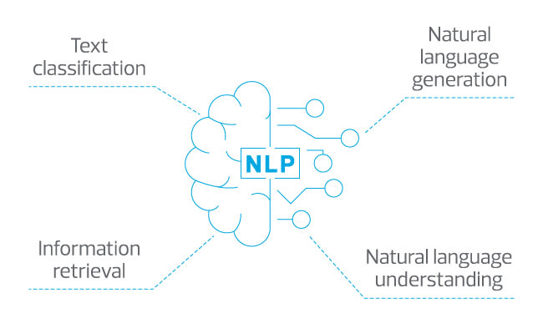


Overview
The scope of the project was the relevant semantic information extraction from natural language text to perform Subject – Verb – Object triples extraction.
Triple
Subj – Verb – Obj
https://github.com/GiuseppeGaetano/TecnologieSemantiche.git

Slide 3
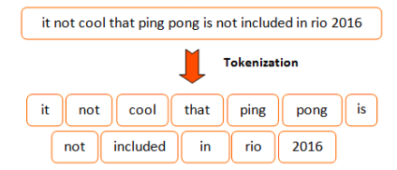

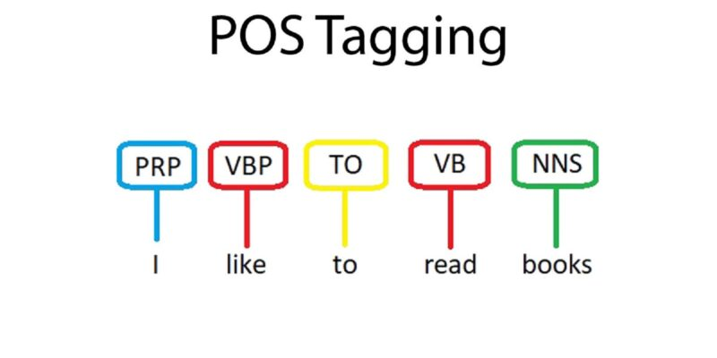
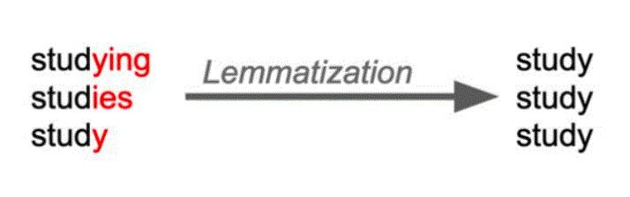
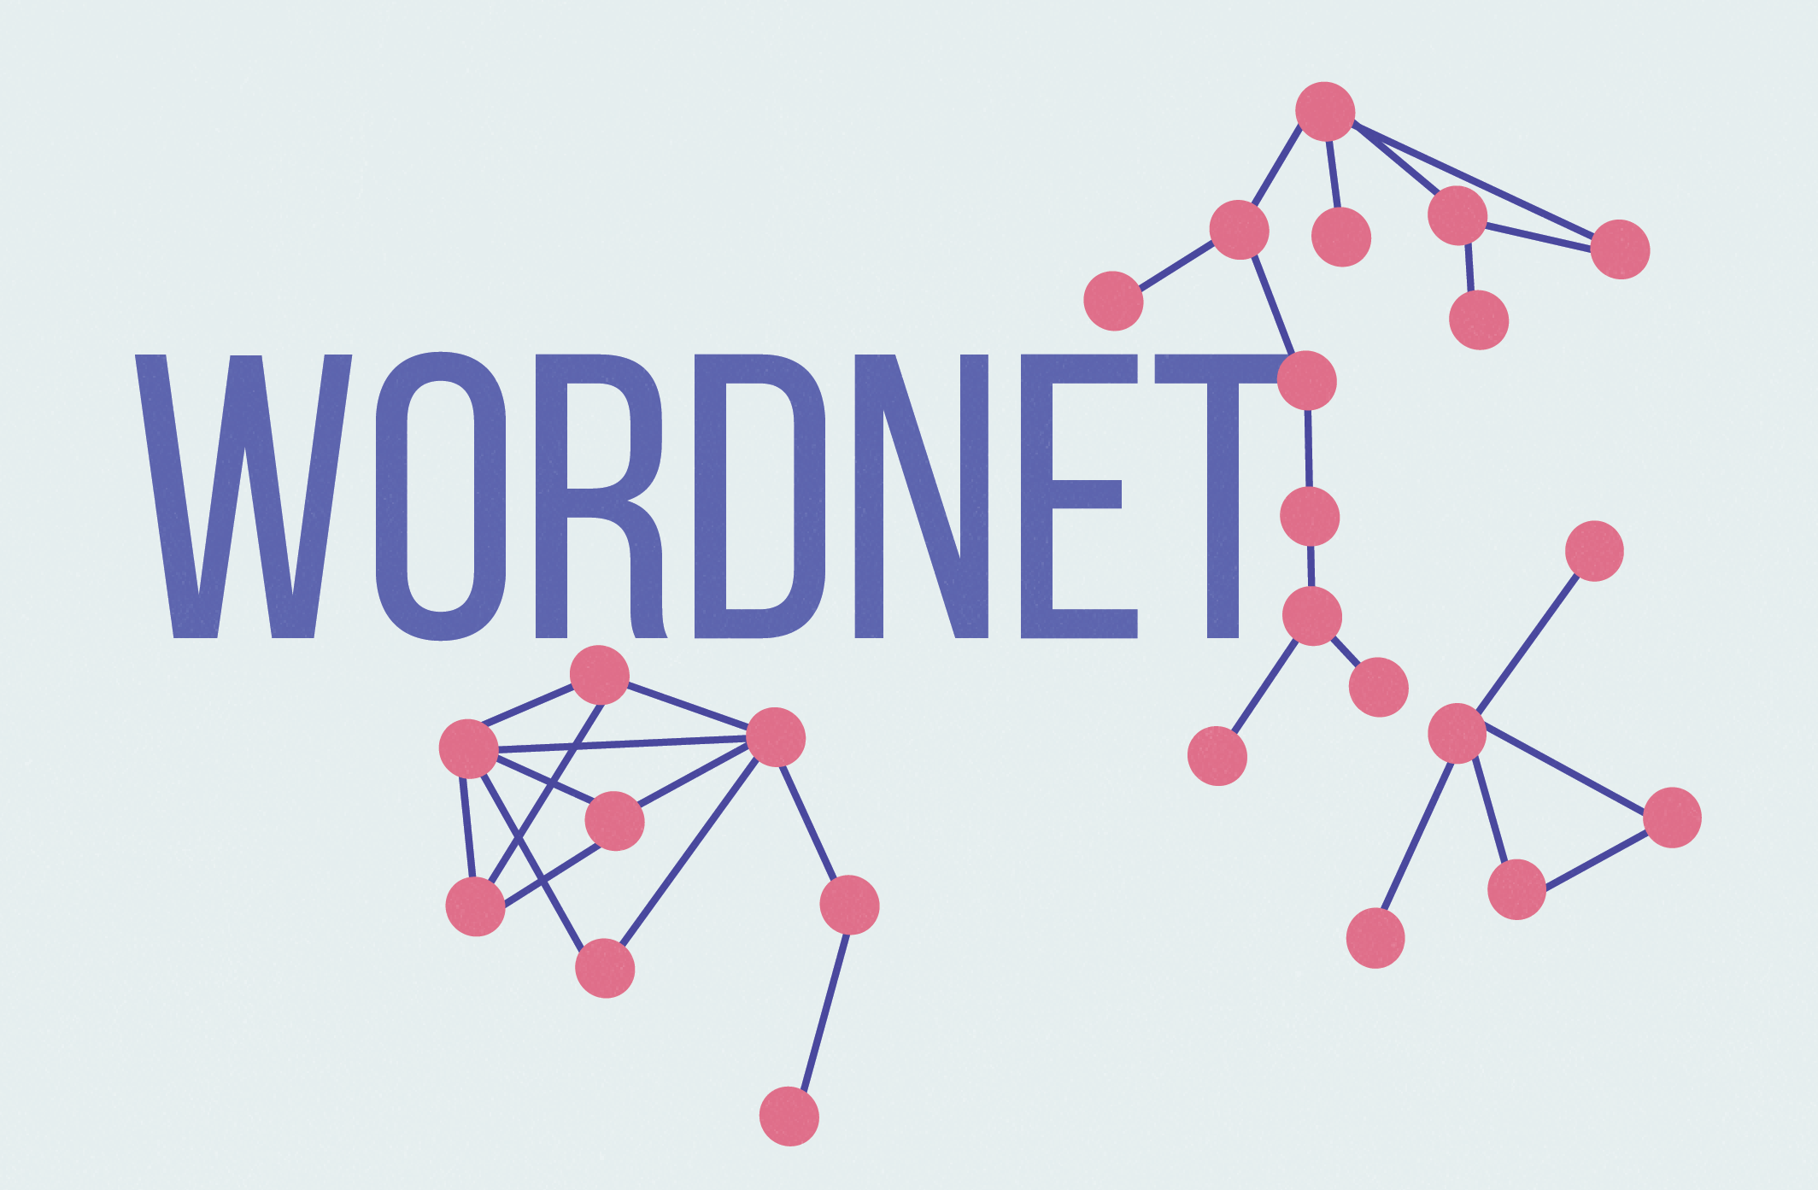
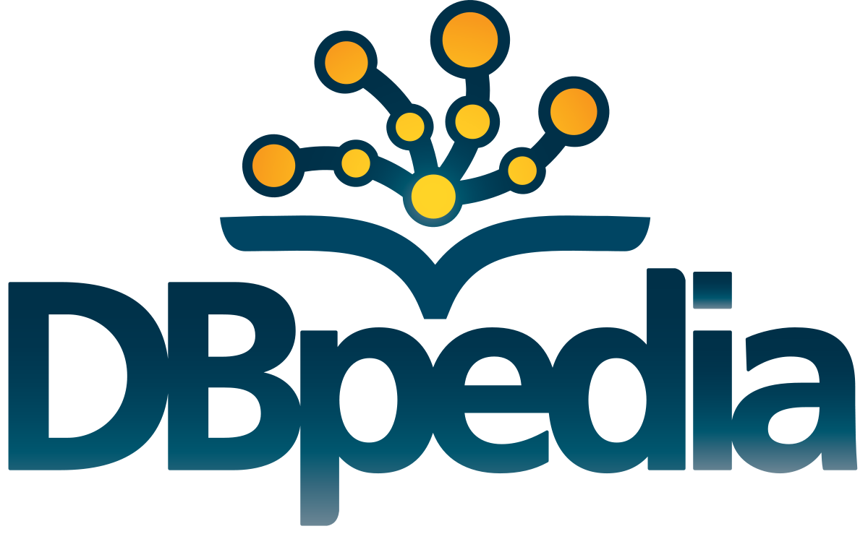
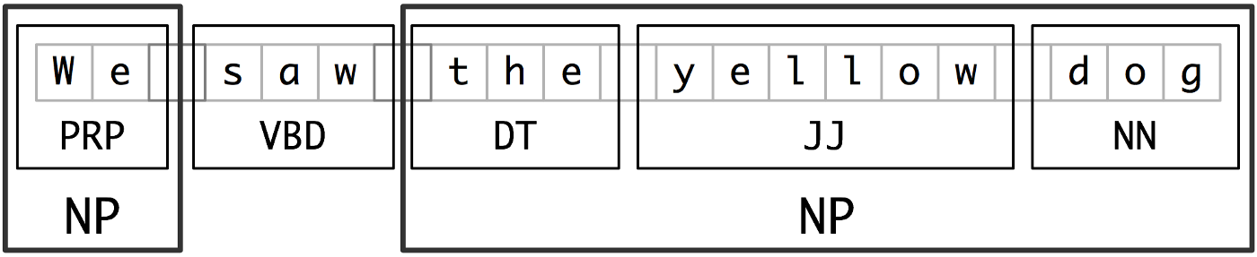
Walkthrough
Word Tokenization and Stop Word Removal
PoS Tagging and Correction
Lemmatization
Semantic Information Extraction

Slide 4

Word Tokenization
Starting from the text in natural language, through the nltk library, the tokens relating to the various words have been extracted using the word_tokenize(text) function, which returns the text given in input as a list of words (token).
text
word_tokenize(text)
tokenized_text

Slide 5
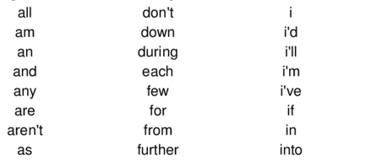
Stop World Removal
Starting from the list of tokens obtained in the previous step, we removed the so-called stop words, obtained through the stopwords.words ('English') function and eliminating all verbs from this list.
The reason to perform this kind of operation is that these kind of words are available in abundance in any human language, and by removing them we remove the low-level information from our text to give more attention to important information becouse the removal of these words does not have any negative consequences and allows us to definitively reduce the size of the data set and therefore reduce the total execution time.
[word for word in word_tokenized_txt if not word in sw_to_remove]
tokenized_text
Stopwords.words(‘English’)

Slide 6

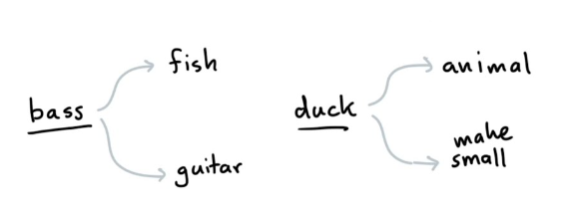
PoS Tagging
Obtained the list of tokens, we performed the Part of Speech Tagging (PoS Tagging) through the pos_tag (tokenized_text) function. This operation classifies the words in a text in correspondence with a particular part of the speech, according to the definition of the word and its context, associating each of these word with a tag that identifies its type.
This operation serves to resolve to a certain extent the lexical ambiguities that can occur when a word can take on different meanings depending on the context.
tokenized_text
pos_tag(tokenized_text)
tokenized_text

Slide 7
Correction
To solve these problems, three different lists have been defined:
ch_list, containing the names and surnames of the characters present in the book;
places, containing the names of the various places described in the book;
ch_titles, containing all possible titles that can be associated with a person in the English language.
These lists were used to associate the NNP tag to all the tokens present in the first two lists, and to combine the tokens relating to the same entity into a single token.
After the PoS Tagging, a quality check was carried out on the tokens and their associated tags, and we noticed some problems:
NNP
NNP
Hogwarts
VBZ
Some tokens were associated with wrong tags;
Some sequences of words referring to the same entity were divided and classified individually;
The titles associated with people were divided by the relative entity and classified individually.
Professor Snape
Professor
Snape
Professor Snape
Harry Potter
Harry
Potter
Harry Potter

Slide 8
Lemmatization
Obtained the list of tokens to which the relative tag has been associated, we operated the lemmatization, a procedure used to obtain the radical form of the word, making use of the vocabulary and the morphological analysis of these tokens.
WordNetLemmatizer().lemmatize(word, pos)
word
lemmatized_text

Slide 9
Word Meaning Extraction
Starting from the list of tokens obtained as the output of the previously described pipeline, we have created three lists, containing respectively all the tokens labeled as noun, as adjective and as verb and, for each element of these lists, the operation of words meaning extraction has been carried out through the use of Wordnet.
a youthful male person
boy
description
subject
wordnet.synsets(subject)
the baby was a boy
example

Slide 10
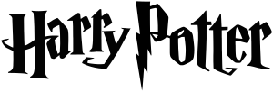
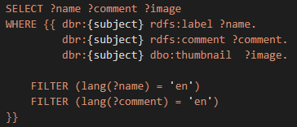
Query on Dbpedia
Starting from the lists of noun, adjective and verb previously described, we made queries on Dbpedia to extract the information associated with the subject in question.
Harry Potter
Harry Potter
subject
Harry Potter is a series of seven fantasy novels written by British author J. K. Rowling. The novels chronicle the lives of a young wizard, Harry Potter, and his friends Hermione Granger and Ron Weasley, all of whom are students at Hogwarts School of Witchcraft and Wizardry.
query

Slide 11
Noun Phrases Chunking
As we have seen, it is possible to decompose a sentence into tokens and then perform PoS Tagging to identify the parts of speech to which those words belong and then identify their type, but these simple operations do not provide enough meaningful information about the sentence, which is why that a chunking operation was performed.
This process, essential for understanding the semantics of the text and in retrieving semantic information, was carried out by first defining a RegExp rule (grammar) for parsing the various tokens, that is
Chunking is the process of breaking down a text into sentences such as Noun Phrases, Verb Phrases, Adjective Phrases, Adverb Phrases, and Preposition Phrases, and is commonly used to extract the Noun Phrases (NP) from the sentence.
NP: {<RB.*>*<DT>?<RB.*>*<JJ.*>*<NN.*> |<RB.*>*<JJ.*>*<PRP><RB.*>*}
VP: {<VB.*>?<RB.*>*<VB.*>*}

Slide 12


Triples Extraction
To extract the triples from the text provided, we started from the Noun Phrases and the Verb Phrases obtained with the chunking operation, to define the triples as NP – VP – NP sequences.
By defining the functions get_nl_text_from_np(np) and get_nl_text_from_vp(vp), we obtained the triples in natural language by eliminating all the constructs inserted during the chunking phase such as the brackets, the PoS tags and the names of the Noun Phrases and Verb Phrases obtained.
It has to be noted that after several tests carried out with and without Stop Word Removal, we noted the information content eliminated by this operation, even if small, negatively affected the quality of the Noun Phrases and Verb Phrases extraction and consequently negatively affected the quality of the triples extracted.
Triple
NP – VP – NP
NP
–
VP
–
NP

Slide 13
Further Semantic Information Extraction
At the end, we carried out two further operation of Semantic Information Extraction, Coreference Resolution and NER Tagging, starting from the natural language text.
Coreference Resolution
NER Tagging

Slide 14

Coreference Resolution
Coreference resolution is the task of finding all expressions that refer to the same entity in a text. It is an important step for a lot of higher-level NLP tasks that involve natural language understanding such as document summarization, question answering, and information extraction.
This operation was performed through the spaCy library
Firstly, we merged the phrases and the punctuatin marks in chunk:
Then, we applied the Coreference Resolution:
merge_phrases(doc)
displacy.render(doc, jupyter=True)
merge_punct(doc)

Slide 15

NER Tagging
Named-entity recognition (NER), also known as Named Entity Identification, Entity Chunking, and Entity Extraction, is a subtask of information extraction that seeks to locate and classify named entities mentioned in unstructured text into pre-defined categories such as person names, organizations, locations, medical codes, time expressions, quantities, percentages, etc.
This operation was performed, as the Coreference Resolution, through the spaCy library:
displacy.render(text_nlp, style=‘ent’, jupyter=True)
Harry Potter was a highly unusual boy in many ways.
text_nlp

Slide 16
Thanks for the attention

