Slide 1
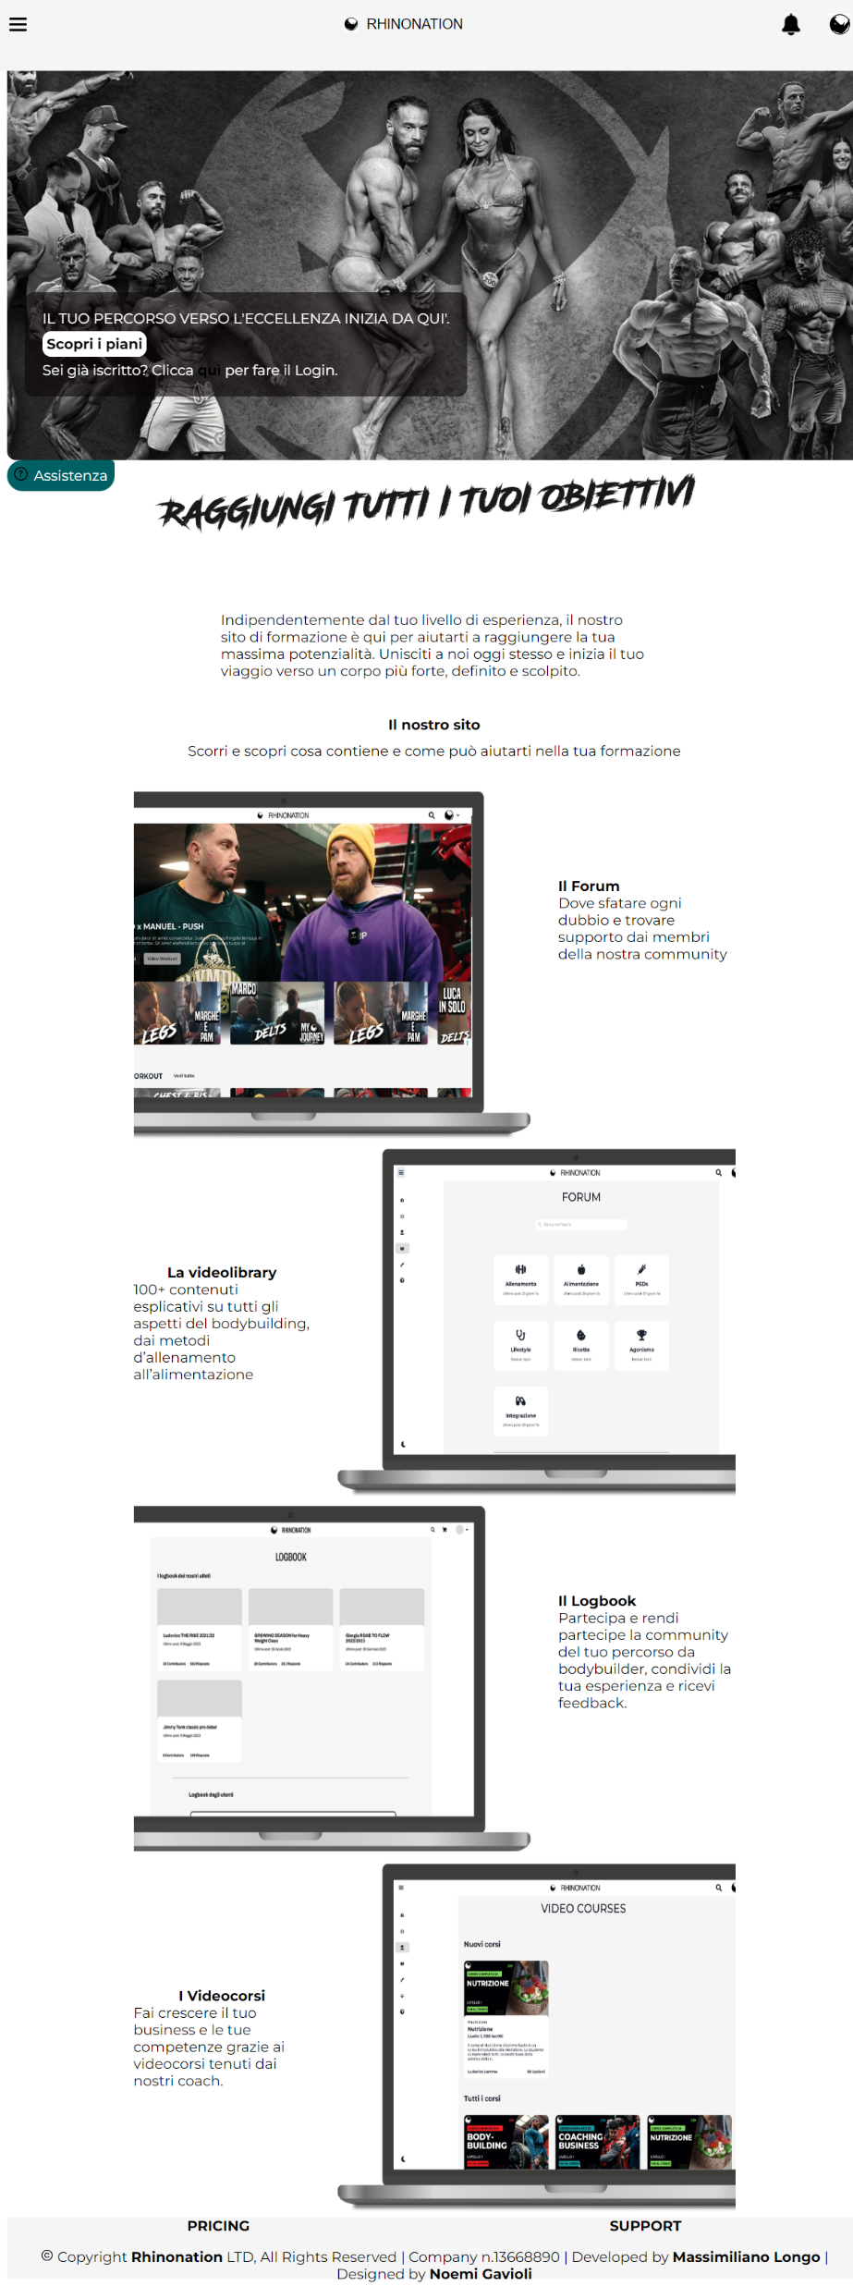
https://www.rhinonation.co.uk

