Slide 1
HC-SR04
Ultrasound sensor module

Slide 2
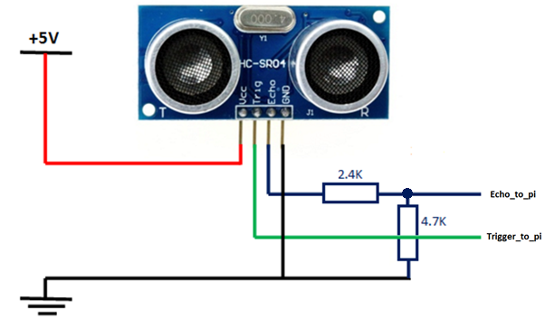
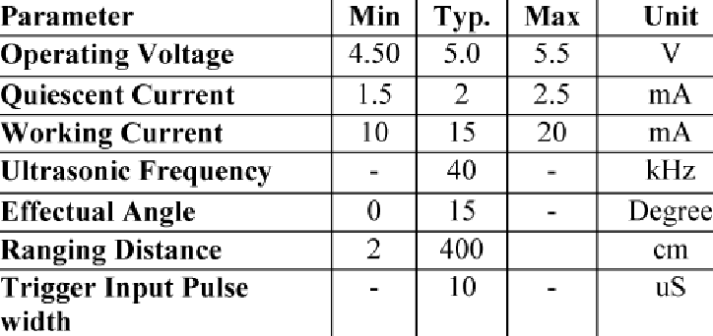
Architecture

Slide 3
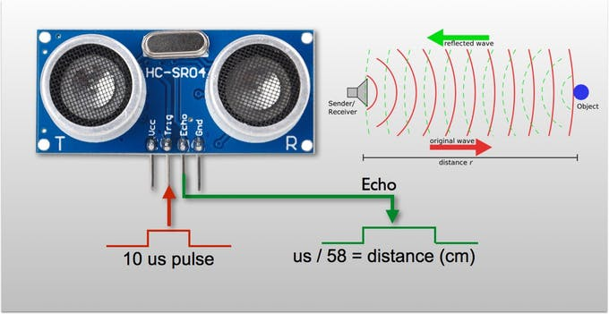
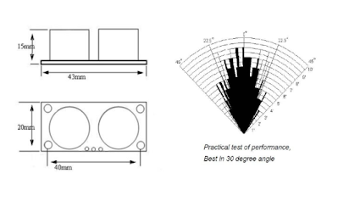
Functionality

Slide 4
References
http://www.raspberrypirobotics.com/connecting-a-ultrasonic-sensor-hc-sr04-distance-sensor-to-a-raspberry-pi/
https://www.researchgate.net/figure/Specification-and-limitation-of-HC-SR04_tbl1_316688934
https://docs.google.com/document/d/1Y-yZnNhMYy7rwhAgyL_pfa39RsB-x2qR4vP8saG73rE/edit
http://101.icrs.io/lesson-4

