Slide 1


COMPUTER ENGINEERING MASTER DEGREE
LARGE-SCALE AND MULTI-STRUCTURED DATABASES
PROJECT DISCUSSION
WeFood
PROFESSORS
GROUP MEMBERS
PIETRO DUCANGE
ALESSIO SCHIAVO
GIOVANNI LIGATO CLETO PELLEGRINO
GIUSEPPE SORIANO
University of Pisa

Slide 2
CLASS DIAGRAM

Slide 3

DATASETS

Slide 4

NON-FUNCTIONAL REQUIREMENTS
Perfomance: The system ensures rapid response times, processing requests within 1.5 seconds. This was achived through the implementation of efficient indexes for database browsing and the inclusion of redundancies.
Availability: High availability is guaranteed through the use of replicas.
Security: Rigorous security is achieved including the hashing of passwords before storage in the database.
Reliability: Consistency across databases is manage to ensure reliable data.
Usability: Achieved by implementing an easy to use user interface
Back-End wrote in Java
PERFORMANCE
RELIABILITY
SECURITY
BACK-END
AVAILABILITY
JAVA
USABILITY

Slide 5

CAP THEOREM
C
A
P
WE ARE HERE

Slide 6



DOCUMENT DB
Post
{
id: ObjectId('...’),
idUser: ObjectId('...’),
username: String,
description: String,
timestamp: Long,
recipe: {
name: String,
image: String,
steps: [String, ...],
totalCalories: Double,
ingredients: [{
name: String,
quantity: Double
}, ...]
},
starRankings: [{
idUser: ObjectId('...’),
username: String,
vote: Double
}, ...],
avgStarRanking: Double,
comments: [{
idUser: ObjectId('...’),
username: String,
text: String,
timestamp: Long
}, ...]
}
Ingredient
USER
{
_id: ObjectId('...’),
type: "Admin", # Only for Admin
username: String,
password: String,
name: String, # Not for Admin
surname: String, # Not for Admin
posts: [{
idPost: ObjectId('...’),
name: String,
image: String
}, ...] # Not for Admin
}
[Ingredient]:
{
_id: ObjectId('...’),
name: String,
calories: Double
}

Slide 7
MOTIVATIONS and QUERIES

Slide 8
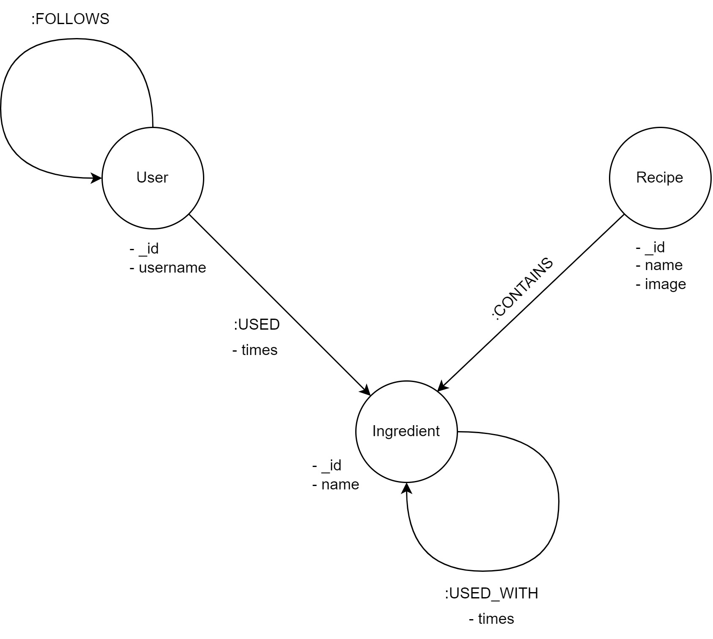
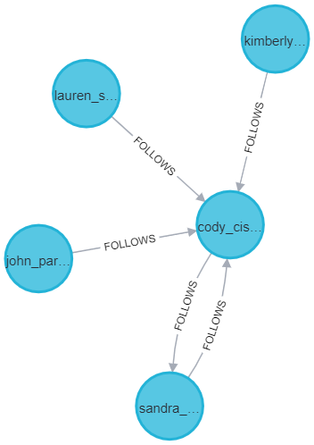
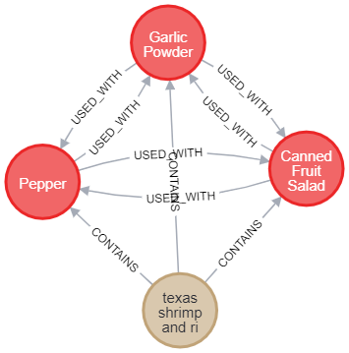
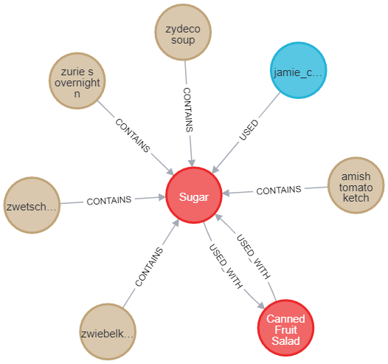
GRAPH DB

Slide 9



MOTIVATIONS and QUERIES

Slide 10


CONSISTENCY
STRICT
EVENTUAL

Slide 11
SHARDING

Slide 12
FINAL CONSIDERATIONS

Slide 13

THANKS
FOR THE ATTENTION

