Slide 1


COMPUTER ENGINEERING MASTER DEGREE
LARGE-SCALE AND MULTI-STRUCTURED DATABASES
PROJECT DISCUSSION
WeFood
PROFESSORS
GROUP MEMBERS
PIETRO DUCANGE
ALESSIO SCHIAVO
GIOVANNI LIGATO CLETO PELLEGRINO
GIUSEPPE SORIANO
University of Pisa

Slide 2
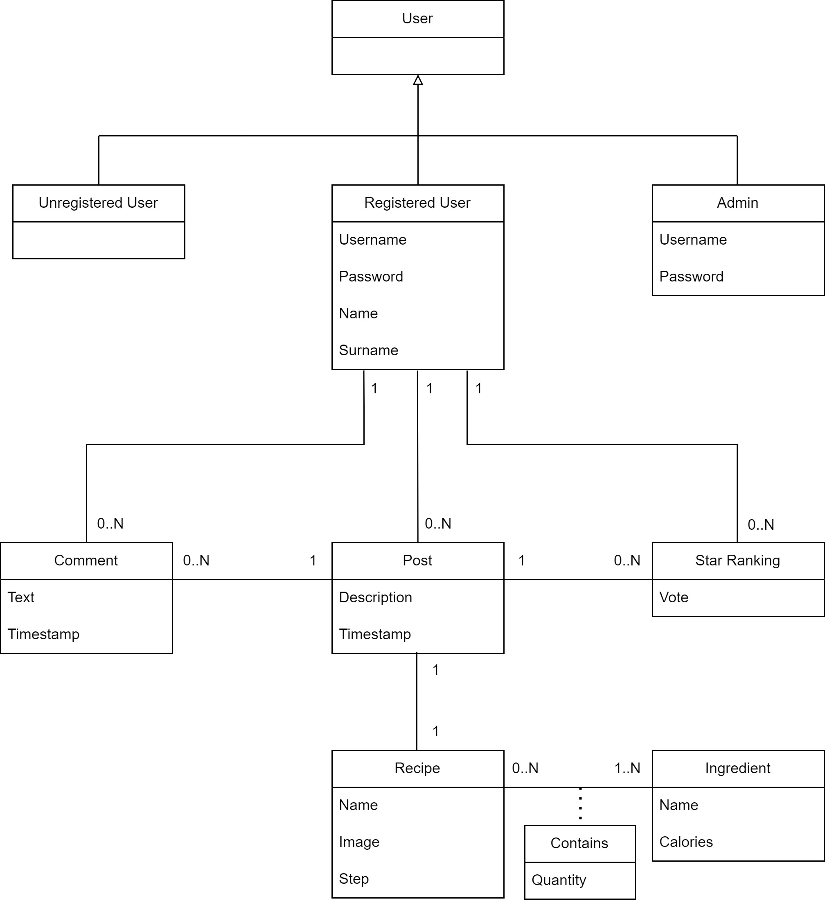
CLASS
DIAGRAM

Slide 3







1
INGREDIENTS
GB
RECIPES
RAW DATA
INTERACTIONS
CLEANING
DATASETS
PYTHON
FAKER
MISSING
ChatGPT
VALUES
PYTHON
FUZZYWUZZY
MERGING
700
MB
POST:
69
MB
USER:
266
INGREDIENT:
KB

Slide 4
1
INGREDIENTS
GB
RECIPES
RAW DATA
INTERACTIONS
CLEANING
PYTHON
FAKER
MISSING
ChatGPT
VALUES
PYTHON
FUZZYWUZZY
MERGING
DATASETS
700
MB
POST:
69
MB
USER:
266
INGREDIENT:
KB

Slide 5






PERFORMANCE
SECURITY
USABILITY
1.5 seconds
HTTPS
GUI
AVAILABILITY
RELIABILITY
BACK-END
24/7
Recover Crashes
JAVA
NON-FUNCTIONAL REQUIREMENTS

Slide 6

CAP
A
THEOREM
WE ARE
HERE
C
P

Slide 7



{
id: ObjectId('...’),
idUser: ObjectId('...’),
username: String,
description: String,
timestamp: Long,
recipe: {
name: String,
image: String,
steps: [String, ...],
totalCalories: Double,
ingredients: [{
name: String,
quantity: Double
}, ...]
},
starRankings: [{
idUser: ObjectId('...’),
username: String,
vote: Double
}, ...],
avgStarRanking: Double,
comments: [{
idUser: ObjectId('...’),
username: String,
text: String,
timestamp: Long
}, ...]
}
{
_id: ObjectId('...’),
type: "Admin", # Only for Admin
username: String,
password: String,
name: String, # Not for Admin
surname: String, # Not for Admin
posts: [{
idPost: ObjectId('...’),
name: String,
image: String
}, ...] # Not for Admin
}
{
_id: ObjectId('...’),
name: String,
calories: Double
}
POST
INGREDIENT
USER
DOCUMENT DB

Slide 8




AGGREGATIONS
Ratio of interactions and the average avgStarRanking by distinguishing between posts with and without images
Given a User, show the number of Comments and StarRankings he/she has done and the average of this StarRankings
After filtering the Recipes by name, retrieve the average amount of calories of the first 10 Recipes ordered by descending avgStarRanking
Given a User, show the average totalCalories of the Recipes published by him/her

Slide 9


SHARDING
WHEN CAN BE USEFUL?
WHY NOT SHARDING?
CATEGORIES
INEFFICIENT

Slide 10
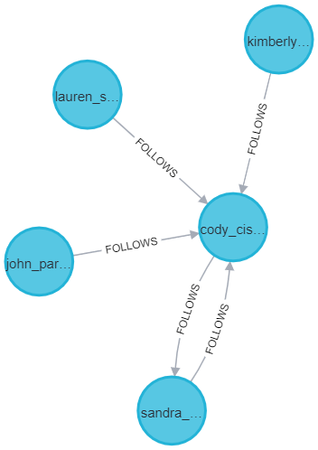
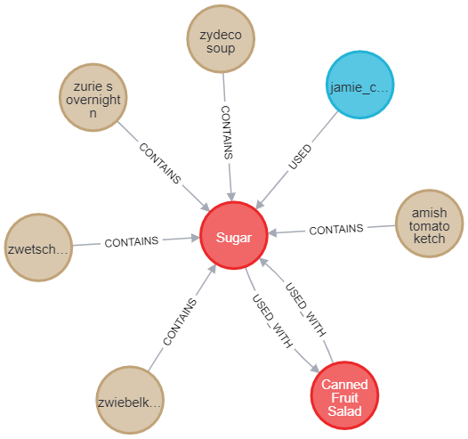
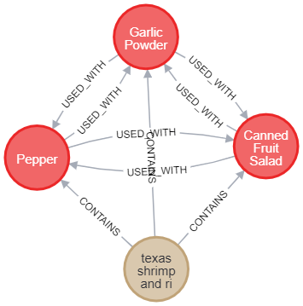
GRAPH DB

Slide 11



SUGGESTIONS
MATCH (u1:User {username: String})-[:FOLLOWS]->(u2:User)-[:FOLLOWS]->(u3:User)
WHERE (u2)-[:FOLLOWS]->(u1)
AND NOT (u1)-[:FOLLOWS]->(u3)
RETURN u3
LIMIT 10
NEW
USERS
TO FOLLOW
MATCH (u1:User)-[:FOLLOWS]->(u2:User)
RETURN u2, COUNT(u1) AS followers
ORDER BY followers DESC
LIMIT 5
MOST
FOLLOWED
USERS
MATCH (u1:User {username: String})-[:FOLLOWS]->(u2:User)-[r:USED]->(i:Ingredient)
WHERE (u2)-[:FOLLOWS]->(u1)
AND NOT (u1)-[:USED]->(i)
RETURN i, r.times AS times
ORDER BY times DESC
LIMIT 5
NEW
INGREDIENTS

Slide 12


CONSISTENCY
neo4jThread.start()
Request
Operation on
MongoDB
Operation on
Neo4j
True
Request
Operation on
MongoDB
True
Operation on
Neo4j
{
{
{
{
Exception
Exception
Exception
Exception
Rollback
ERROR
False
Databases Not
Synchronized
False
False
STRICT
EVENTUAL

Slide 13

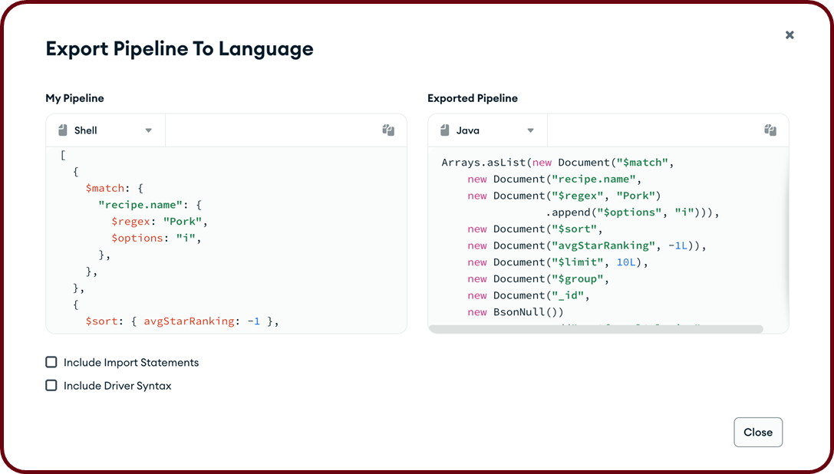



ARCHITECTURE
CONTROLLER
DTO
HTTP
MODEL
DAO
ANGULAR
SPRING
CLIENT
SERVER
SERVICE
VIEW

Slide 14
ARCHITECTURE
DAO

Slide 15



FUTURE ENHANCEMENTS
HTTPS
MOBILE APP
API SECURITY
RESPONSE TIME
NEO4J REPLICAS
DISTRIBUTED
SERVER

Slide 16

THANKS
FOR YOUR ATTENTION

