Slide 1
Unrolling algorithms for tomography of limited angles
Group component:
Kamal Nishantha Angunna Gamage
Matteo Fontana
Giuseppe Spathis
Supervisor:
Elena Loli Piccolomini

Slide 2
Project description
Objective: Reconstruct CT images from limited-angle sinograms using an unrolling method (Adler et al.) with a Residual U-Net architecture.
Comparison: Evaluate the unrolling Plug-and-Play algorithm against a Total Variation (TV) model-based reconstruction.
Dataset: Mayo Clinic CT Dataset Link

Slide 3
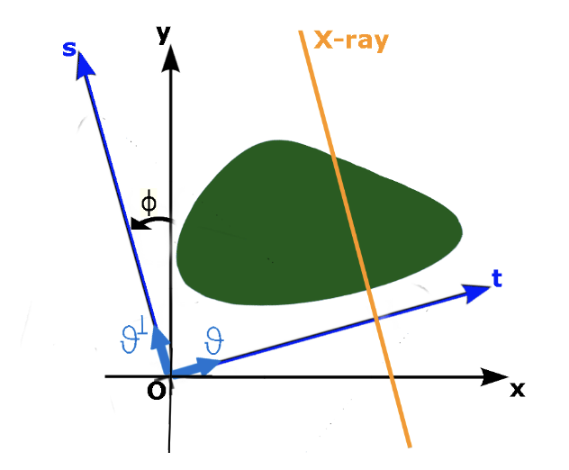
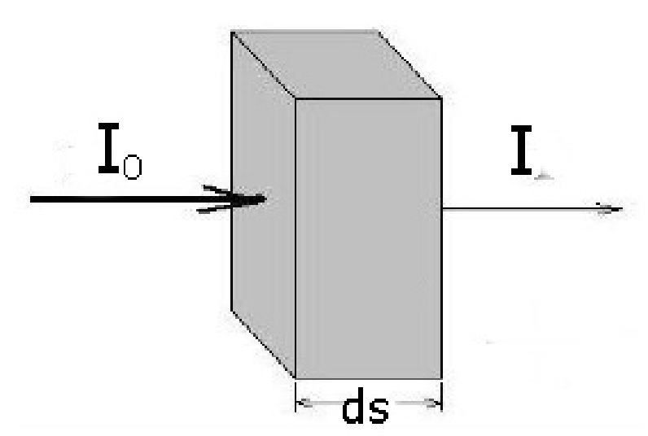
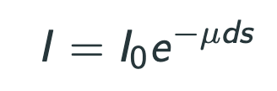

Theory Introduction

Slide 4
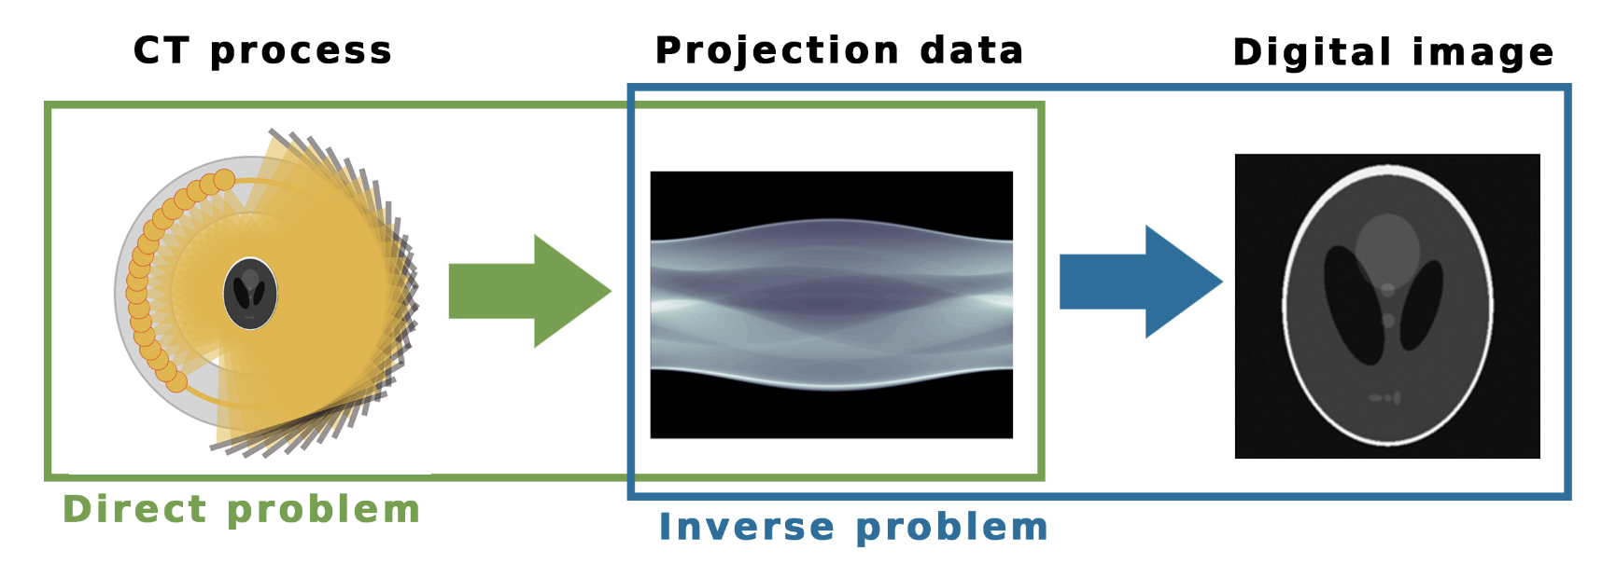
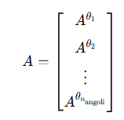

Problem description

Slide 5
Methodology
We have compared 3 algorithms:
Filtered Back Projection.
Total Variation regularization.
The unrolled method: Learned-Primal dual.

Slide 6
FBP - Theory

Slide 7
FBP - Implementation

Slide 8
TV - Theory

Slide 9
TV - Implementation

Slide 10
LPD - Theory

Slide 11
LPD - Implementation

Slide 12
Introducing the experiments
Test Geometries:
30 angles in [-30°, 30°]
30 angles in [-15°, 15°]
30 angles in [0°, 180°]
Each tested with and without noise (noise level = 0.1)
Metrics:
Relative Error (RE)
PSNR
SSIM
Outputs:
Reconstruction results for selected images, with zoom-in area visualizations
Average metrics across a subset of the test set, presented in a .xlsx file

Slide 13
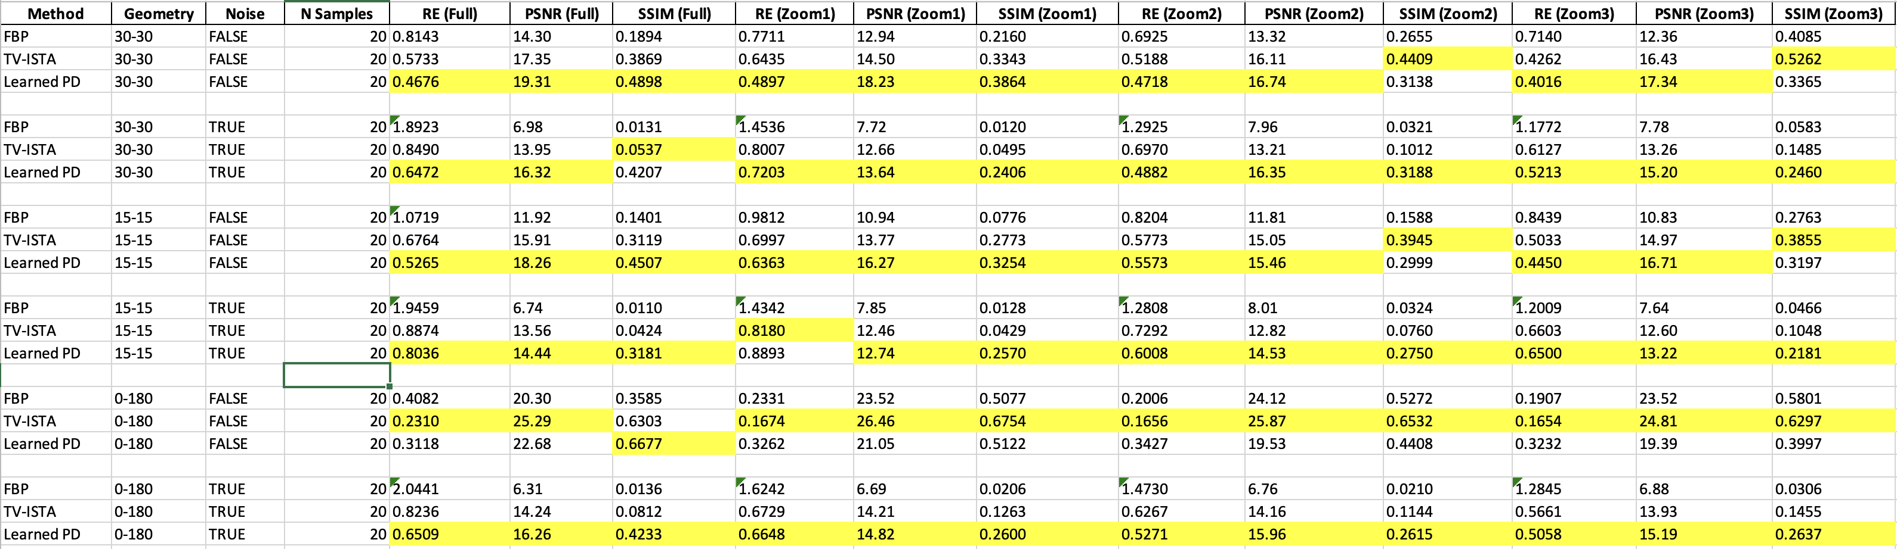
Results

Slide 14
Conclusions

Slide 15
Bibliography
J. Adler and O. Öktem, "Learned Primal-Dual Reconstruction," in IEEE Transactions on Medical Imaging, vol. 37, no. 6, pp. 1322-1332, June 2018, doi: 10.1109/TMI.2018.2799231.

