Slide 1
Unrolling algorithms for tomography of limited angles
Group component:
Kamal Nishantha Angunna Gamage
Matteo Fontana
Giuseppe Spathis
Supervisor:
Elena Loli Piccolomini

Slide 2
Aim of the project
The goal of this project is to apply an unrolling-type algorithm for the reconstruction of limited angle tomographic images and to compare the results with model-based algorithms using Total Variation regularization.

Slide 3
Project description
Objective: Reconstruct CT images from limited-angle sinograms using an unrolling method (Adler et al.) with a Residual U-Net architecture.
Comparison: Evaluate the unrolling Plug-and-Play algorithm against a Total Variation (TV) model-based reconstruction.
Dataset: Mayo Clinic CT Dataset Link

Slide 4
Experiments & Evaluation
Test Geometries:
30 angles in [-30°, 30°]
30 angles in [-15°, 15°]
30 angles in [0°, 180°]
Each tested with and without noise (noise level = 0.1)
Metrics:
Relative Error (RE)
PSNR
SSIM
Outputs:
Reconstruction results for a selected image, with zoom-in visualizations
Average metrics across the entire test set, presented in a table

Slide 5
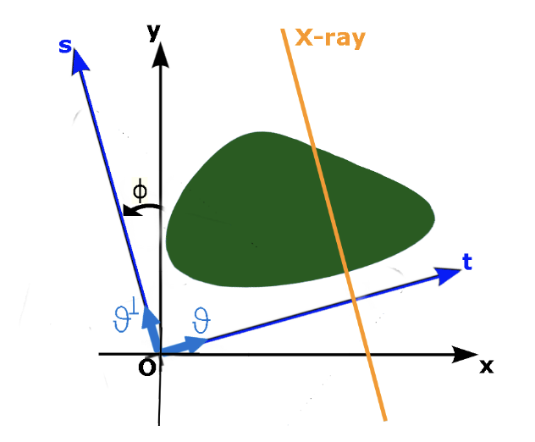
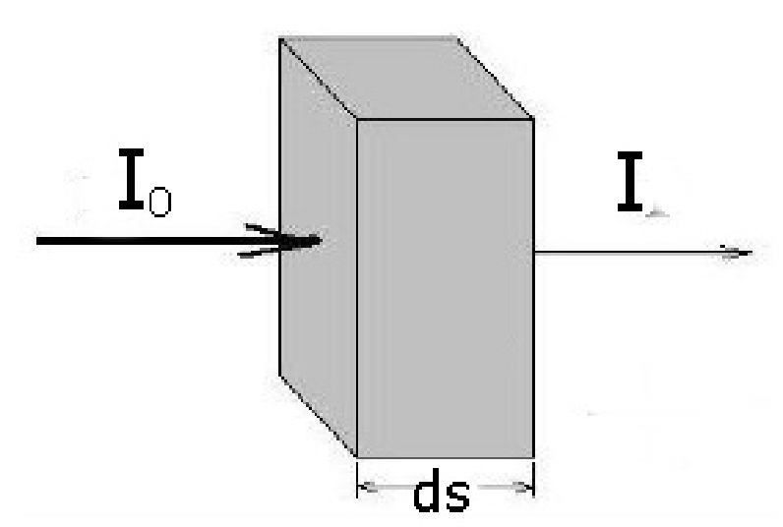
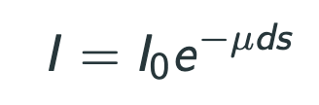

Theory Introduction

Slide 6
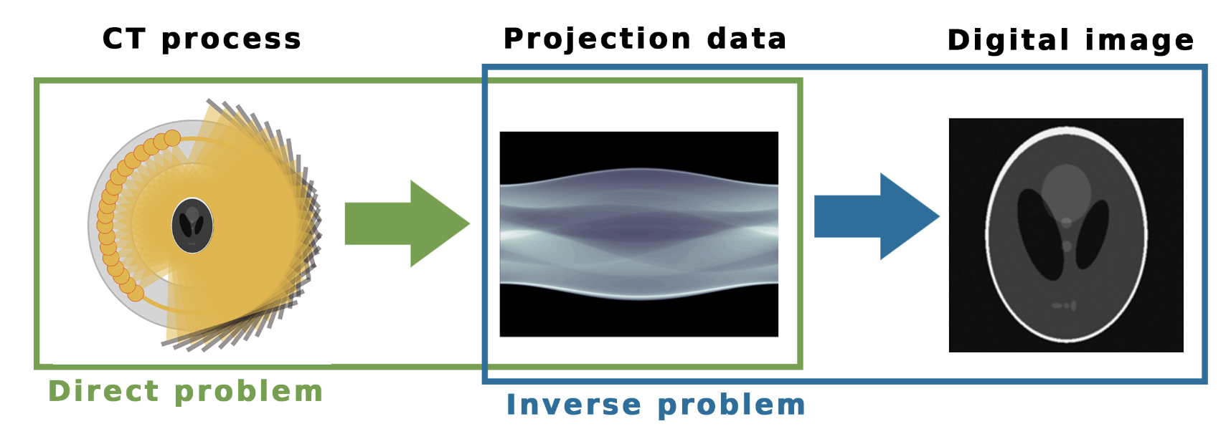
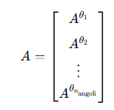

Problem description

Slide 7
Methodology
We have compared 3 algorithms:
Filtered Back Projection.
Total Variation regularization.
The unrolled method: Learned-Primal dual.

Slide 8
FBP

Slide 9
TV

Slide 10
LPD

Slide 11
Implementation

Slide 12
Introducing th experiment

Slide 13
Results

Slide 14
Conclusions

Slide 15
Bibliography
J. Adler and O. Öktem, "Learned Primal-Dual Reconstruction," in IEEE Transactions on Medical Imaging, vol. 37, no. 6, pp. 1322-1332, June 2018, doi: 10.1109/TMI.2018.2799231.

