Slide 1
PROJECT PRESENTATION
ProLancer
A Freelancer Marketplace
Name: Yash Gautam
Enrollment No: 23ADV3CST0152
Date: 19-06-2026
Institute: Institute of Advance Computing

Slide 2



PROJECT OVERVIEW
What is ProLancer?
ProLancer is a freelancer marketplace concept — a platform designed to connect skilled freelancers with clients looking to hire talent, similar in spirit to Upwork or Fiverr. The current build is the front-end landing page, establishing the visual identity, navigation structure, and core user journey before backend development begins.
Find Work
Hire Talent
Community
Freelancers browse and search for relevant projects and services.
Clients post projects and connect with skilled professionals.
Guides, success stories, and resources to help users grow.
Yash Gautam
Institute of Advance Computing

Slide 3




ARCHITECTURE
Tech Stack & Architecture
The landing page is built with pure front-end fundamentals — no frameworks, no JavaScript libraries. A deliberate choice to master the basics before introducing complexity.
HTML5
Semantic structure for navigation, hero section, category grid, guide cards, and footer.
CSS3
All styling, layout (Flexbox/Grid), spacing, color theme, and hover states — no CSS frameworks used.
Font Awesome (CDN)
Icon library loaded via CDN link for UI icons (search, social, navigation glyphs).
Favicon
Custom favicon icon linked in the <head> for brand identity in the browser tab.
Yash Gautam
Institute of Advance Computing

Slide 4
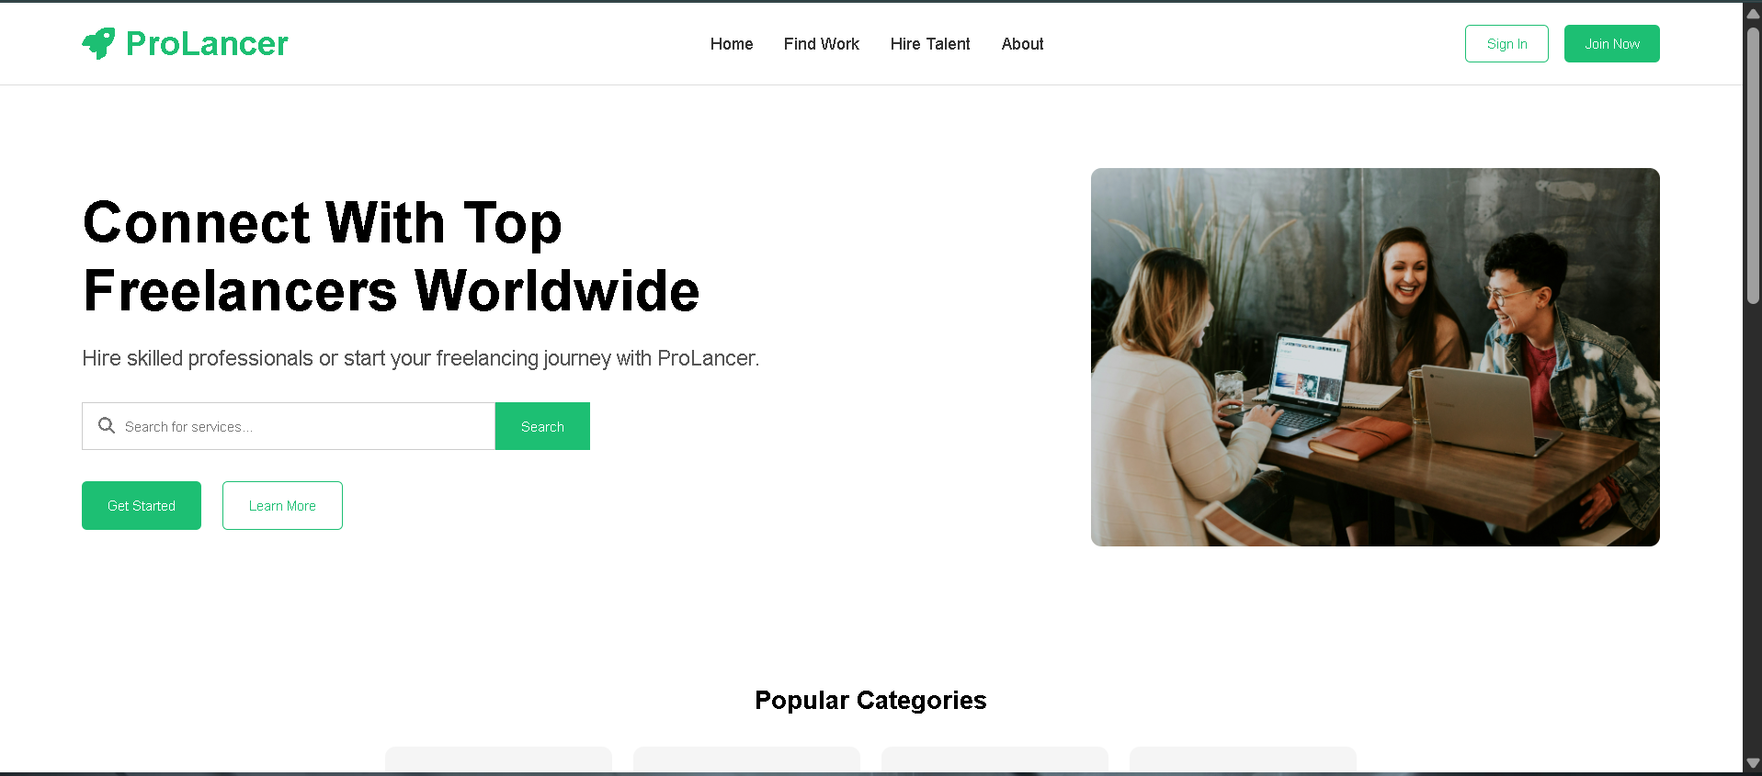
BUILD PROGRESS · 01
Landing Page — Hero Section
Navbar · hero headline with search bar · dual CTAs · hero image — built with semantic HTML and custom CSS.
Yash Gautam
Institute of Advance Computing

Slide 5

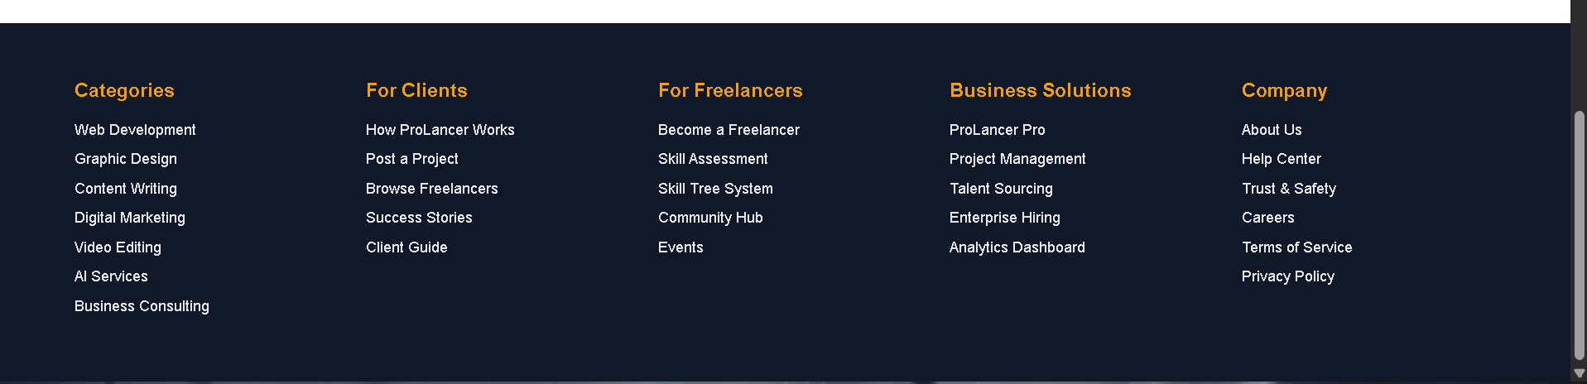
BUILD PROGRESS · 02
Categories, Guides & Footer
Footer — 5-column sitemap: Categories, Clients, Freelancers, Business Solutions, Company
Categories grid + guide cards with hover-highlighted border
Yash Gautam
Institute of Advance Computing

Slide 6


PROGRESS & NEXT STEPS
Where the Build Stands
Completed
Next Up
Static landing page in HTML + CSS
Responsive navbar with brand logo
Hero section with search bar & CTAs
Popular categories grid
Guide cards with hover states
5-column footer sitemap
Font Awesome CDN + custom favicon
Sign In / Join Now UI page
One final touch-ups for this landing page
Become a seller/freelancer page
Overview page : description for profile creation
Do’s page : Instructions for the profile and SEO optimization
Don’ts page : Instructions you need to keep in mind
Yash Gautam
Institute of Advance Computing

