Slide 1
Form 990 Sample Data
Mission and Proj1Desc Text Clustering Analysis
Dave Langer

Slide 2
Mission Cluster Themes Topics
Cluster# | Organization Count | % of Orgs | Theme/Topic
1 | 357 | 0.56% | Theater/Drama/Performing Arts Orgs
2 | 1016 | 1.59% | Homelessness/Housing/Shelter Orgs
3 | 479 | 0.75% | Health Care Orgs
4 | 627 | 0.98% | Museums
5 | 33 | 0.05% | Boy Scouts of America
6 | 1936 | 3.03% | Urban Youth Recreation and Education
7 | 55853 | 87.3% | Education/Housing/Youth
8 | 809 | 1.27% | Education & Families
9 | 1161 | 1.82% | Education
10 | 729 | 1.14% | Education Facilitation
11 | 905 | 1.42% | Education/Health
12 | 73 | 0.11% | YMCA

Slide 3
Proj1Desc Cluster Themes/Topics
Cluster# | Organization Count | % of Orgs | Theme/Topic
1 | 1968 | 3.08% | Culture/Arts Education
2 | 3669 | 5.74% | Housing for Low Income Families
3 | 287 | 0.45% | Health Care
4 | 4318 | 6.75% | Residential Education
5 | 3061 | 4.79% | Health Care Education
6 | 38 | 0.06% | Health Care – Hospitals, Patients, Surgical Outcomes
7 | 2743 | 4.29% | Health Care Education
8 | 45326 | 70.85% | Health Care/Education/Youth
9 | 2568 | 4.01% | Health Care for Youth

Slide 4
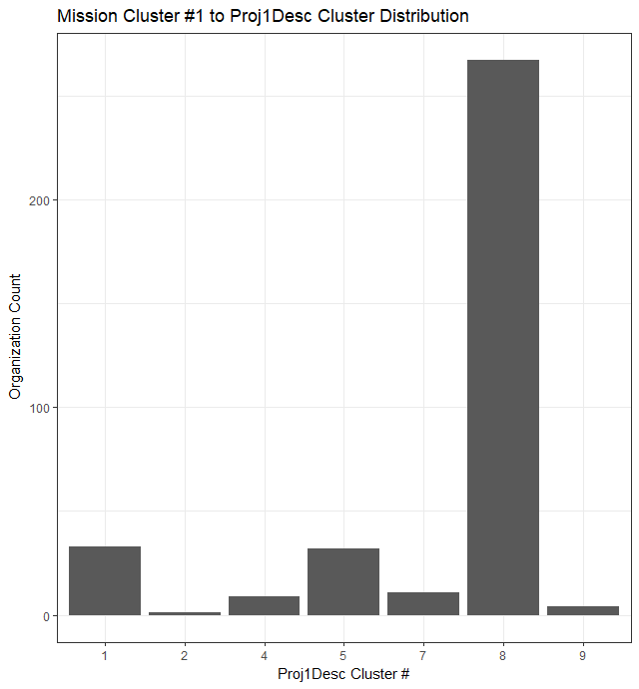
Drill Down - Theater/Drama/Performing Arts
Cluster# | Theme/Topic
1 | Culture/Arts Education
2 | Housing for Low Income Families
3 | Health Care
4 | Residential Education
5 | Health Care Education
6 | Health Care – Hospitals, Patients, Surgical Outcomes
7 | Health Care Education
8 | Health Care/Education/Youth
9 | Health Care for Youth

Slide 5
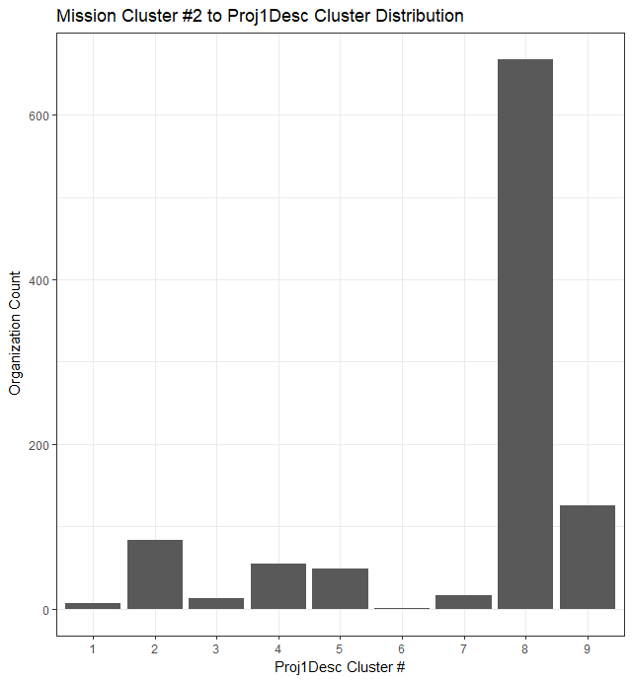
Drill Down - Homelessness/Housing/Shelter
Cluster# | Theme/Topic
1 | Culture/Arts Education
2 | Housing for Low Income Families
3 | Health Care
4 | Residential Education
5 | Health Care Education
6 | Health Care – Hospitals, Patients, Surgical Outcomes
7 | Health Care Education
8 | Health Care/Education/Youth
9 | Health Care for Youth

Slide 6
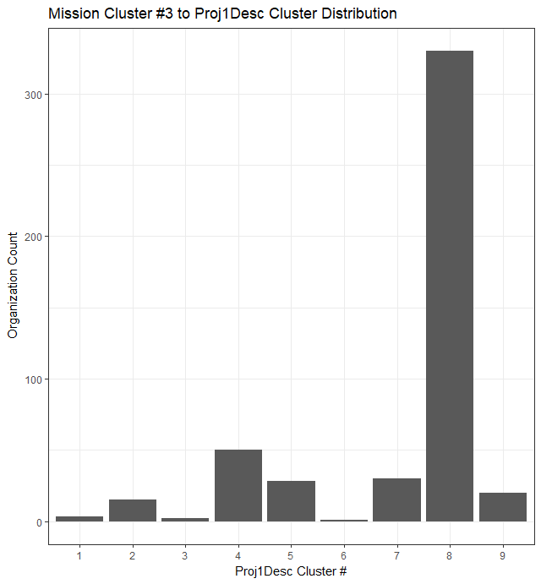
Drill Down - Health Care
Cluster# | Theme/Topic
1 | Culture/Arts Education
2 | Housing for Low Income Families
3 | Health Care
4 | Residential Education
5 | Health Care Education
6 | Health Care – Hospitals, Patients, Surgical Outcomes
7 | Health Care Education
8 | Health Care/Education/Youth
9 | Health Care for Youth

Slide 7
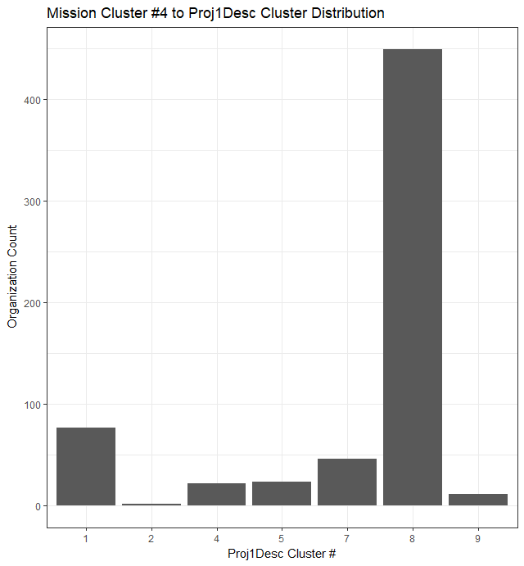
Drill Down - Museums
Cluster# | Theme/Topic
1 | Culture/Arts Education
2 | Housing for Low Income Families
3 | Health Care
4 | Residential Education
5 | Health Care Education
6 | Health Care – Hospitals, Patients, Surgical Outcomes
7 | Health Care Education
8 | Health Care/Education/Youth
9 | Health Care for Youth

Slide 8
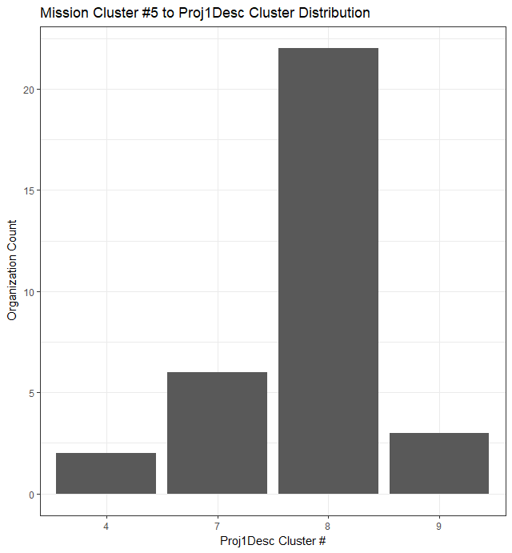
Drill Down - Boy Scouts of America
Cluster# | Theme/Topic
1 | Culture/Arts Education
2 | Housing for Low Income Families
3 | Health Care
4 | Residential Education
5 | Health Care Education
6 | Health Care – Hospitals, Patients, Surgical Outcomes
7 | Health Care Education
8 | Health Care/Education/Youth
9 | Health Care for Youth

Slide 9
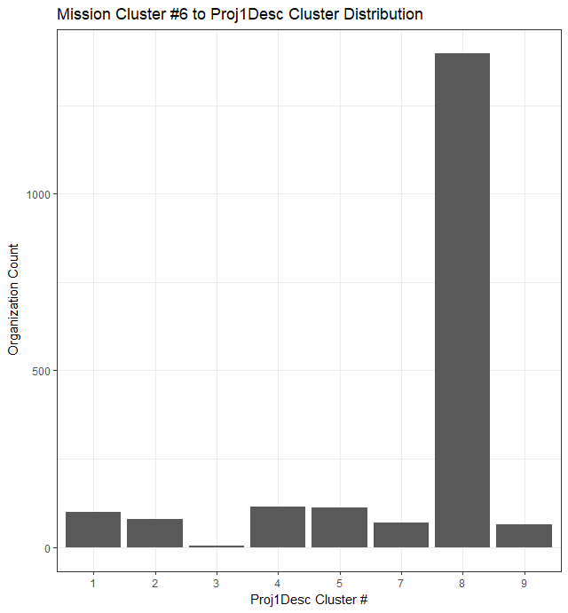
Drill Down - Urban Youth Recreation &Education
Cluster# | Theme/Topic
1 | Culture/Arts Education
2 | Housing for Low Income Families
3 | Health Care
4 | Residential Education
5 | Health Care Education
6 | Health Care – Hospitals, Patients, Surgical Outcomes
7 | Health Care Education
8 | Health Care/Education/Youth
9 | Health Care for Youth

Slide 10
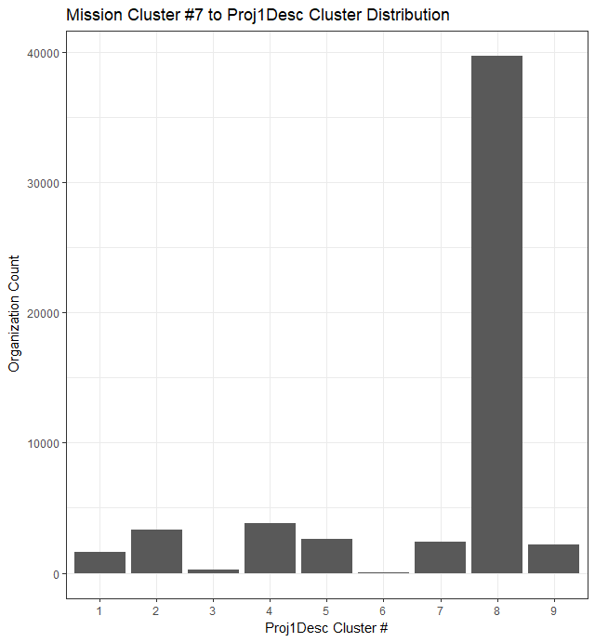
Drill Down - Education/Housing/Youth
Cluster# | Theme/Topic
1 | Culture/Arts Education
2 | Housing for Low Income Families
3 | Health Care
4 | Residential Education
5 | Health Care Education
6 | Health Care – Hospitals, Patients, Surgical Outcomes
7 | Health Care Education
8 | Health Care/Education/Youth
9 | Health Care for Youth

Slide 11
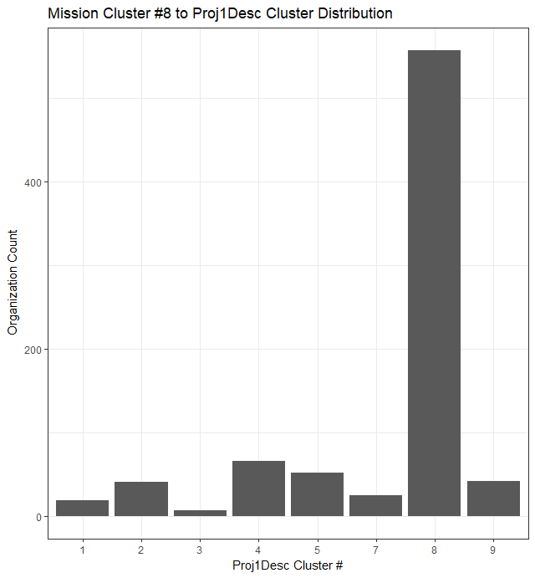
Drill Down – Education & Families
Cluster# | Theme/Topic
1 | Culture/Arts Education
2 | Housing for Low Income Families
3 | Health Care
4 | Residential Education
5 | Health Care Education
6 | Health Care – Hospitals, Patients, Surgical Outcomes
7 | Health Care Education
8 | Health Care/Education/Youth
9 | Health Care for Youth

Slide 12
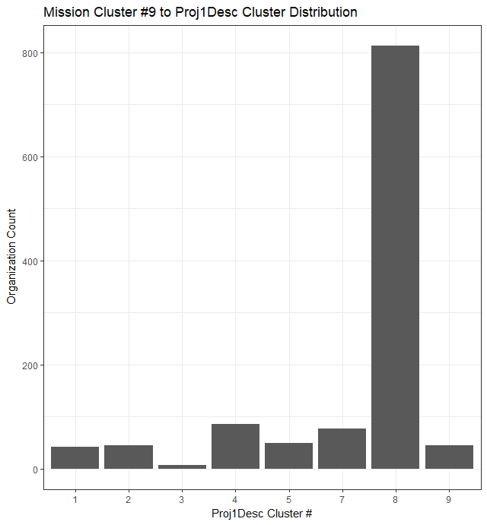
Drill Down - Education
Cluster# | Theme/Topic
1 | Culture/Arts Education
2 | Housing for Low Income Families
3 | Health Care
4 | Residential Education
5 | Health Care Education
6 | Health Care – Hospitals, Patients, Surgical Outcomes
7 | Health Care Education
8 | Health Care/Education/Youth
9 | Health Care for Youth

Slide 13
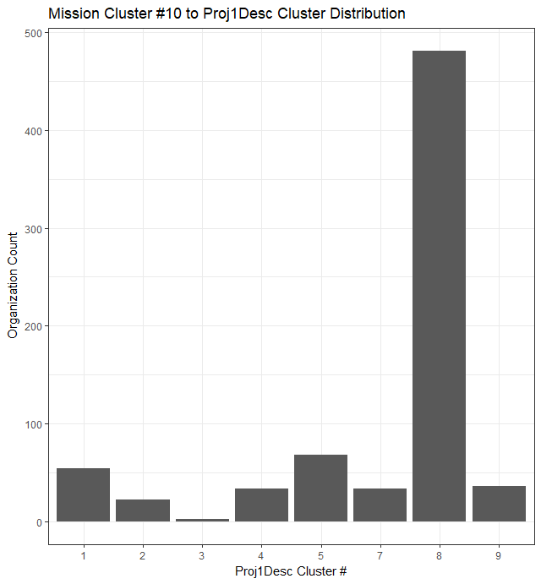
Drill Down – Education Facilitation
Cluster# | Theme/Topic
1 | Culture/Arts Education
2 | Housing for Low Income Families
3 | Health Care
4 | Residential Education
5 | Health Care Education
6 | Health Care – Hospitals, Patients, Surgical Outcomes
7 | Health Care Education
8 | Health Care/Education/Youth
9 | Health Care for Youth

Slide 14
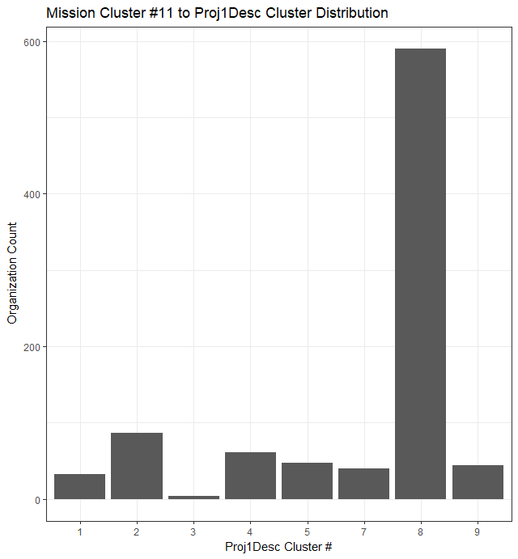
Drill Down - Education/Health
Cluster# | Theme/Topic
1 | Culture/Arts Education
2 | Housing for Low Income Families
3 | Health Care
4 | Residential Education
5 | Health Care Education
6 | Health Care – Hospitals, Patients, Surgical Outcomes
7 | Health Care Education
8 | Health Care/Education/Youth
9 | Health Care for Youth

Slide 15
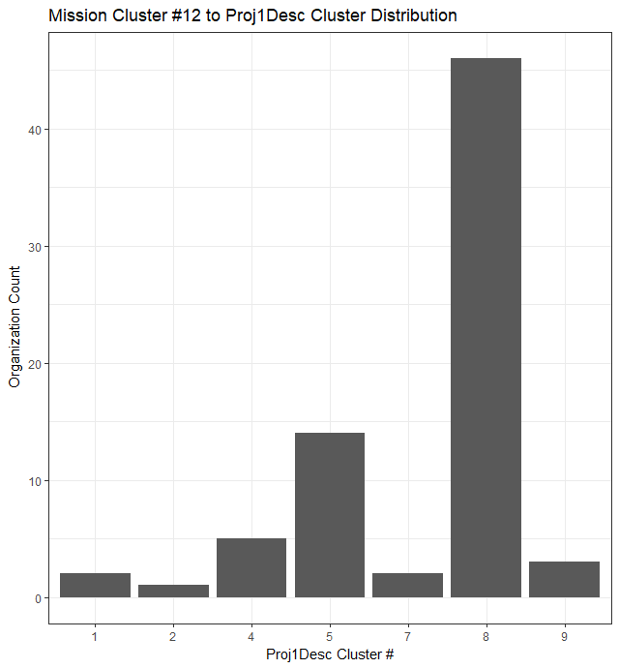
Drill Down - YMCA
Cluster# | Theme/Topic
1 | Culture/Arts Education
2 | Housing for Low Income Families
3 | Health Care
4 | Residential Education
5 | Health Care Education
6 | Health Care – Hospitals, Patients, Surgical Outcomes
7 | Health Care Education
8 | Health Care/Education/Youth
9 | Health Care for Youth

