Slide 1
Part II – Election Year Analysis

Slide 2
Hypothesis
Republican names = traditional
Democrat names = progressive
Analyze commonalities and compare output to 1996 article
"The Most Popular Baby Names In Red and Blue States" published by REAL SIMPLE.
Red state parents go for unique spelling and gender numeral names
Blue state parents choose more traditional and more ethnically diverse names

Slide 3
Data Gathering and Cleaning

Slide 4
Code worth pointing out
Glob.Glob – import multiple txt files
GeoPandas – create US_map
Text with a loop
DF merge, rename columns, replace values, filter, groupby, drop, loop, list,

Slide 5
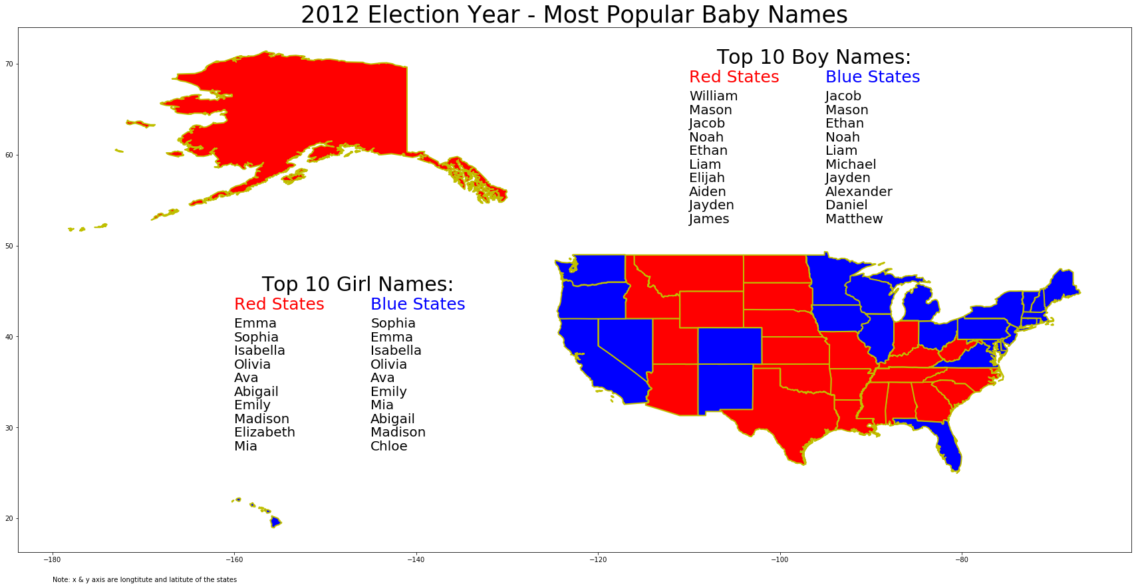

Slide 6
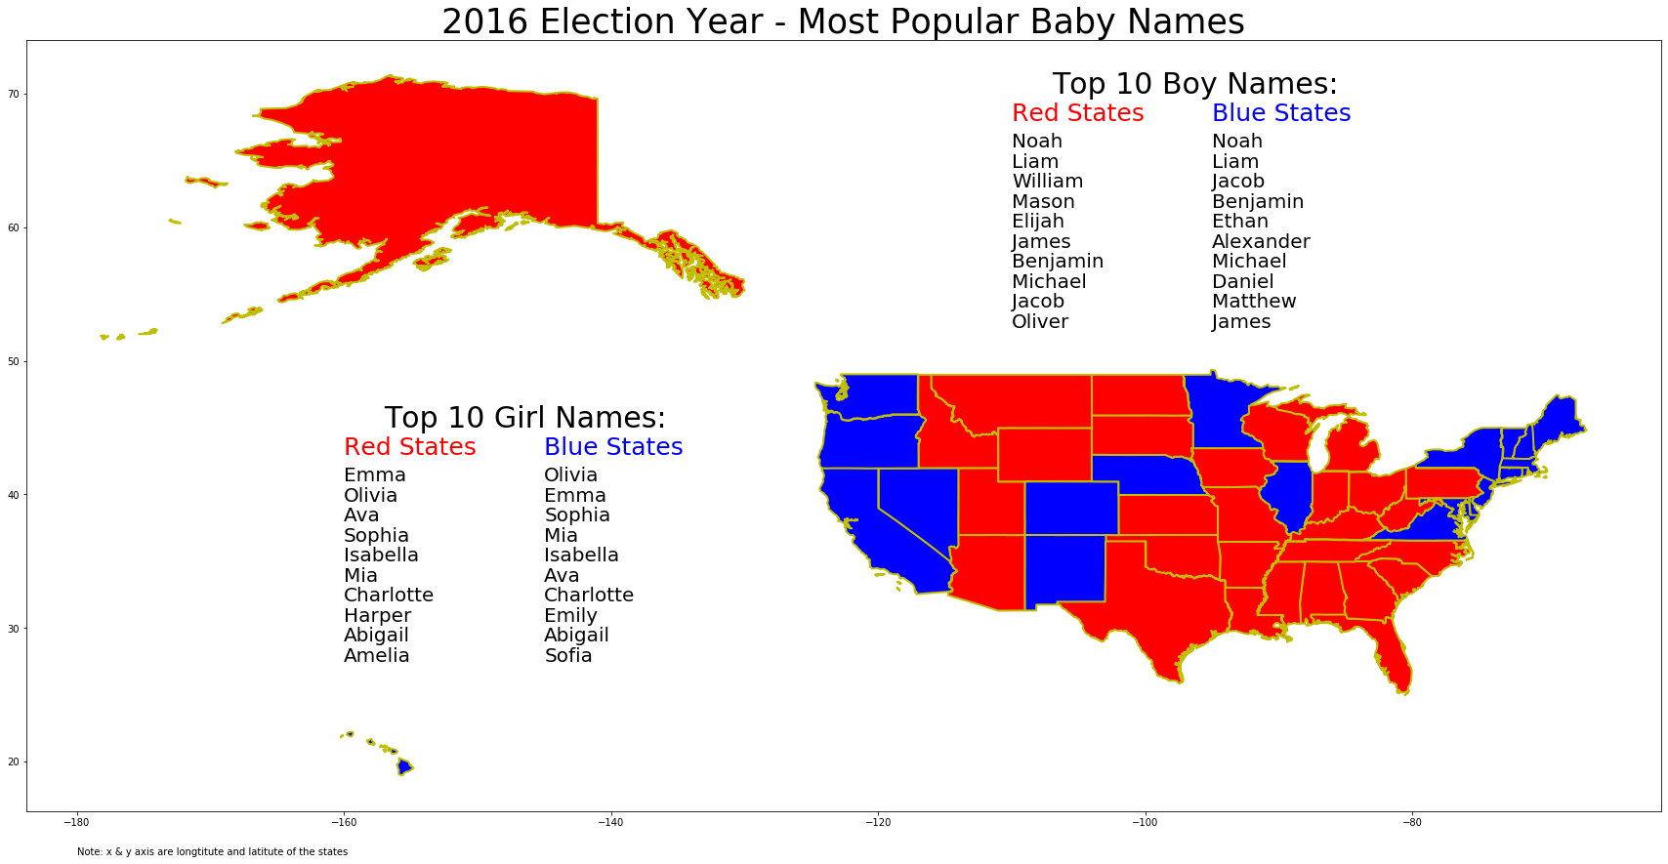

Slide 7
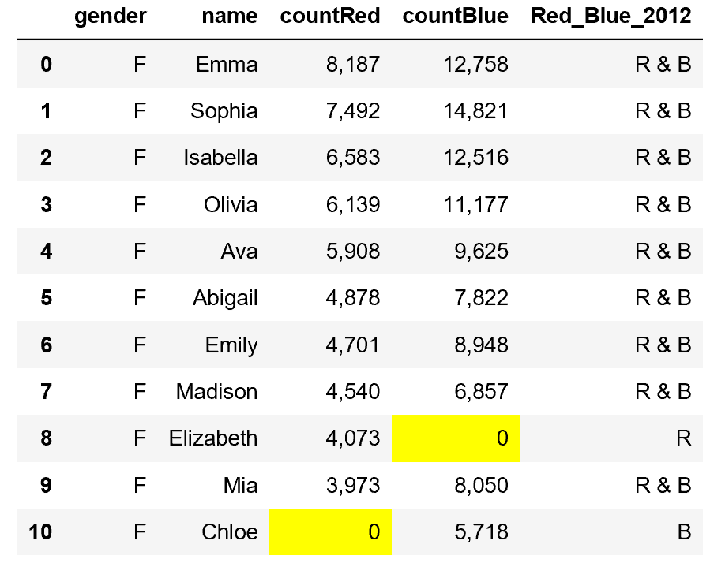
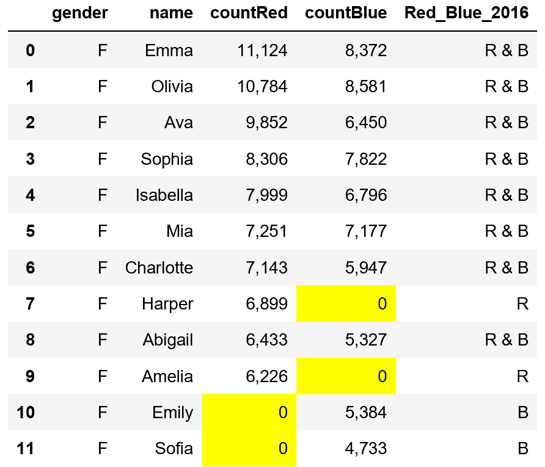
Top Girl Names

Slide 8
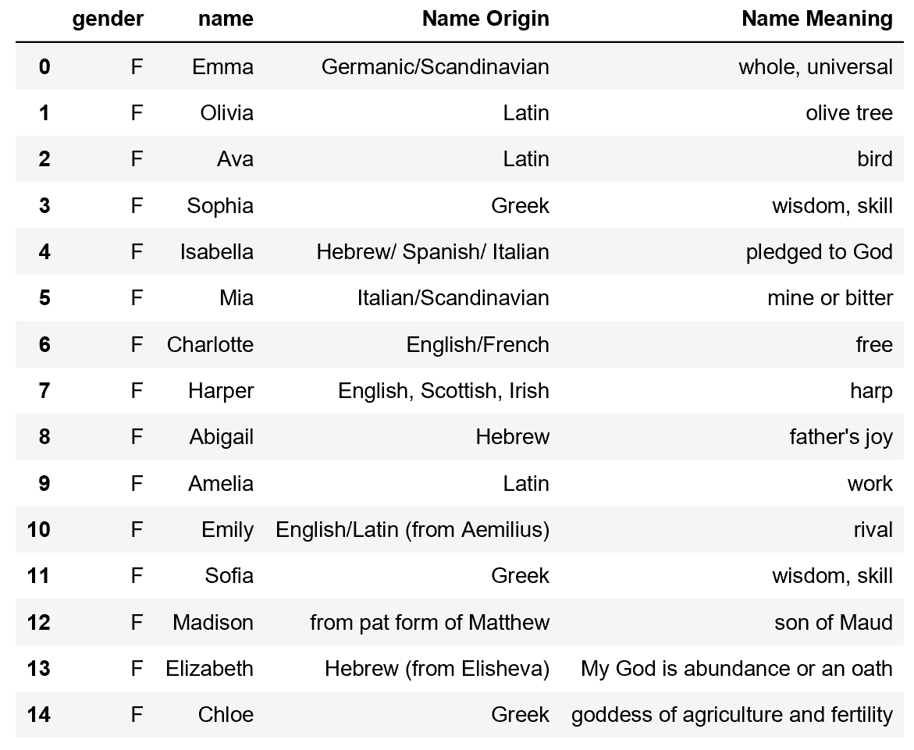
Origin and Meaning of the Girl Names

Slide 9
Conclusions for Female Names Analysis
Selection does not appear to be impacted by political affiliation
All names appear to be traditional names
Both outputs very by one name
Very limited ethnical diversity –
Predominantly Latin, Greek and Western European
No presence of Eastern European, African, Asian or Latin names

Slide 10
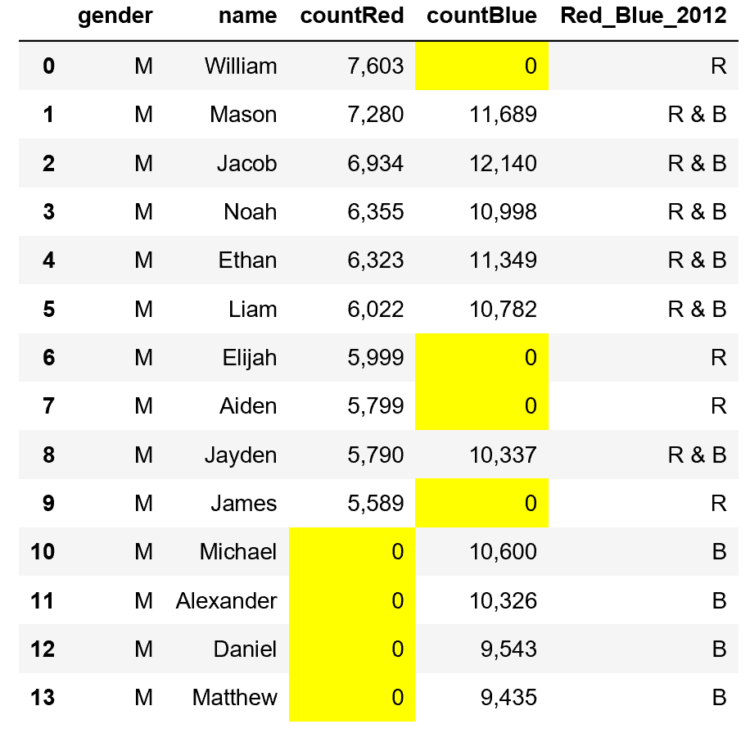
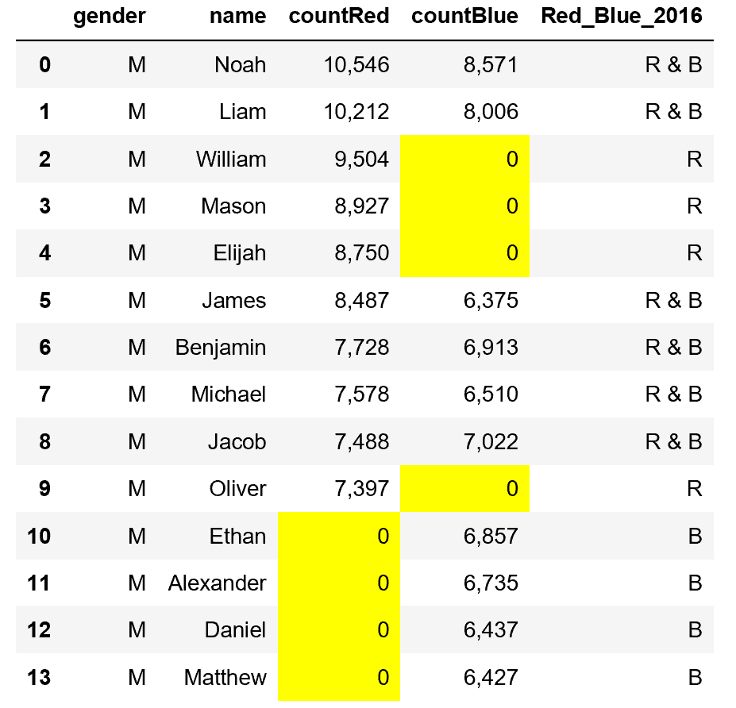
Top Boy Names

Slide 11
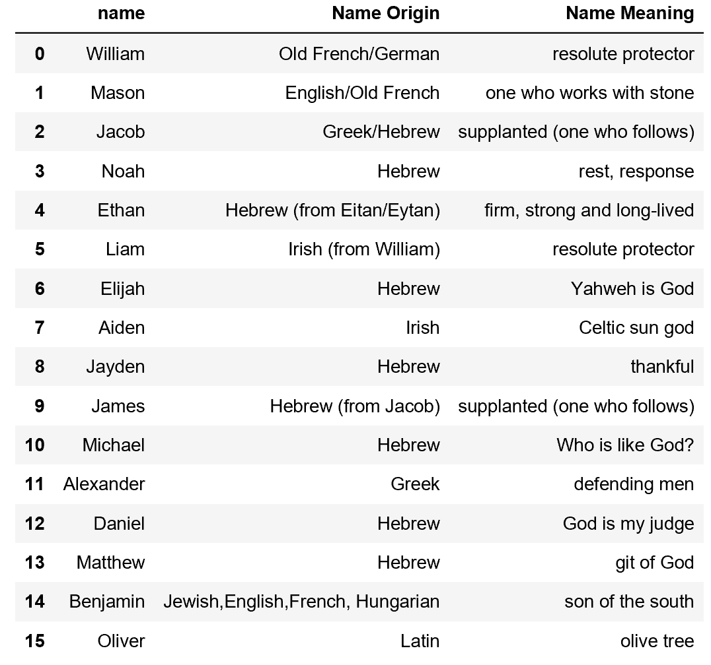
Origin and Meaning of the Boy Names

Slide 12
Conclusions for Male Names Analysis
Selection appears to show impact from political affiliation
All names appear to be traditional names
Both outputs very by four names
Very limited ethnical diversity –
Predominantly Biblical
No presence of Eastern European, African, Asian, Middle Eastern or Latin names

Slide 13
Conclusion – our analysis does not support findings of the noted article. Questions ?

