Slide 1

Yachts "R" Us
Let us help you Slip away!

Slide 2
Yachts “R” Us
Our expert staff of Captains consists of over 200 years experience.
Captain: David Johnson 30 years experience
Captain: William Shanks 22 years experience
Captain: Philip James 21 years experience
Captain: James Fillmore 20 Years experience
Captain: Edward Sims 20 Years experience
Captain: Steven Wells 19 Years experience
Marine Mechanic: Walter Jacobs 35 Years experience
Marine Mechanic: Fred Wilson 32 Years experience
Marine Mechanic: Albert Olson 30 Years experience

Slide 3
Yachts “R” Us
Amenities
Kitchen fully stocked with food and refreshments
Ship to shore radio phones
Marine radio with weather channels programmed.
Weather Radar on all yachts over 30’
Stereo, TV/CD player
Under water camera, Scuba and snorkel gear
Video camera, metal detectors

Slide 4
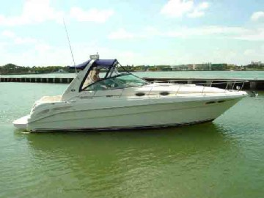
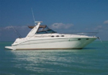
Yachts “R” Us
Superior Rates
Size | Hourly Rate
22’ | $ 95.00/hr
24’ | $137.00/hr
30’ | $160.00/hr
32’ | $192.00/hr
36’ | $250.00/hr
38’ | $400.00/hr
45’ | $550.00/hr
34 ‘ Searay
37’ Searay

Slide 5
Yachts “R” Us
Recap of our Services
A staff of Captains with years of experience to guarantee you total satisfaction & safety on your Charter.
Many amenities to provide you with a secure and enjoyable Charter.
The very best Charter rates you can find.

