Slide 1


dbVybe
2025
dbVybe
No-Code, Multi-Agent Database Exploration Tool
Page
01

Slide 2
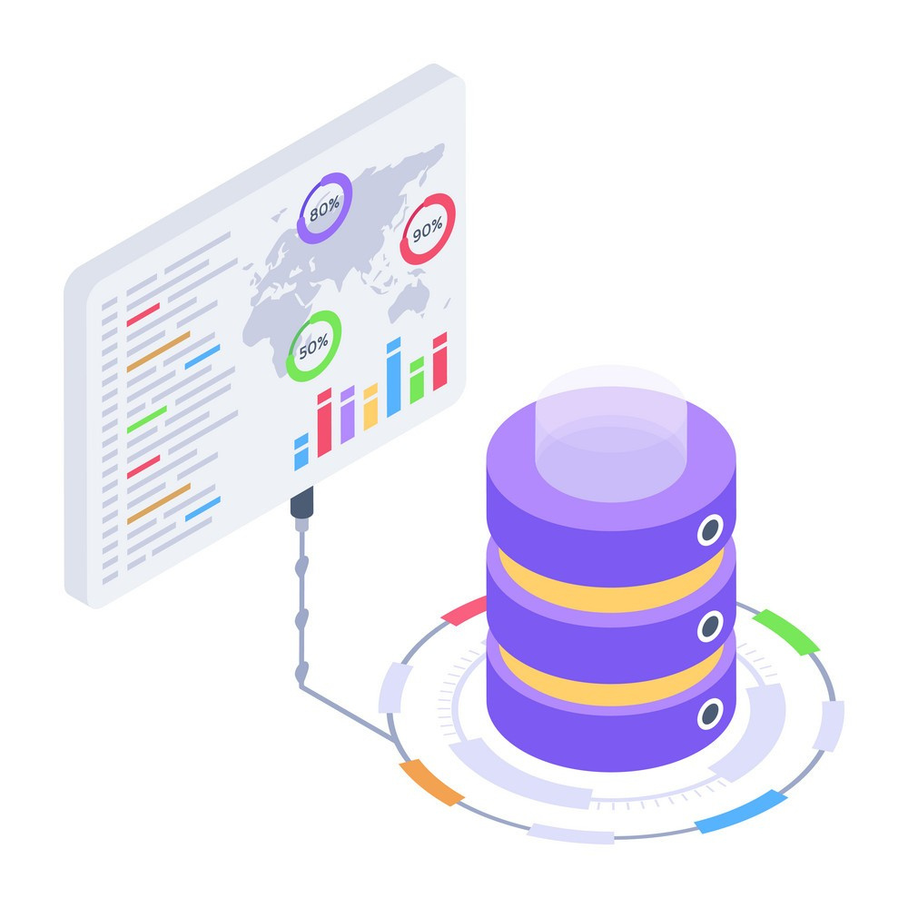
dbVybe
2025
Problem
Statement
Database exploration is a critical aspect of managing and maintaining any system’s data. Simply having a database is not enough, organizations must be able to understand, navigate, and interpret the information it contains. However, most database systems require significant technical expertise to explore and analyze data effectively. This presents a challenge for business owners, stakeholders, and clients without a technical background, making data-driven decision-making more difficult and less accessible.
Page
02

Slide 3
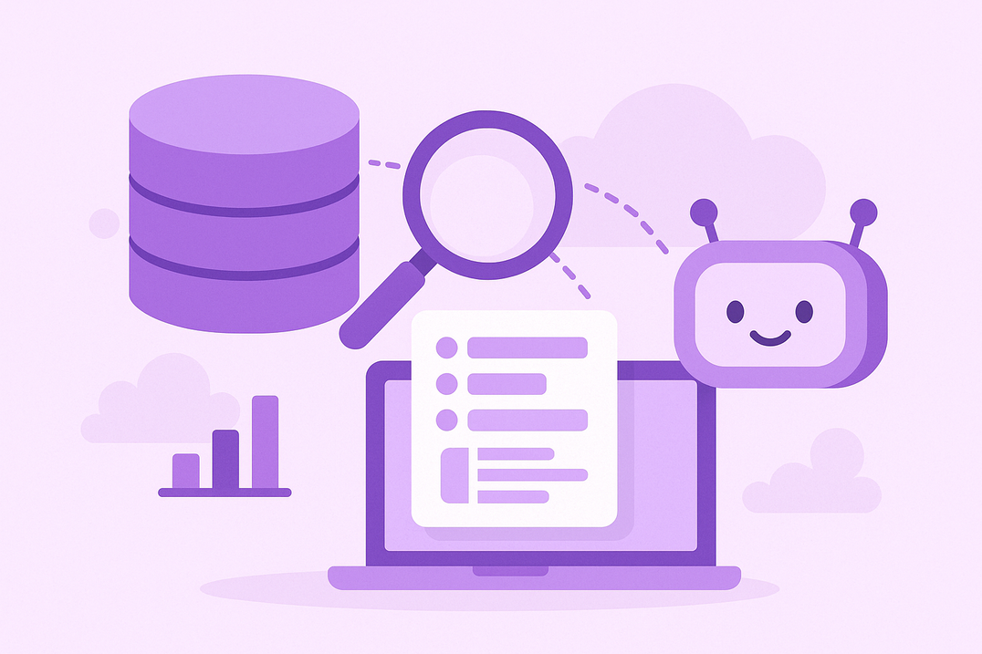
dbVybe
2025
Solution
to the Challenge
Presenting dbVybe
A no-code, multi-agent database exploration tool which allows users to connect a database of their choice and explore it using natural language
By eliminating the need for technical expertise, it empowers users from all backgrounds to seamlessly explore, query, and analyze their data, making insights accessible without prior database or query language knowledge.
Page
03

Slide 4
dbVybe
2025
Architecture Overview
Distributed architecture using Akka Cluster with 3 specialized nodes
Java Spring Boot web framework for REST API implementation
React and Typescript for frontend
Akka Actor Model for concurrency
Multi-Agent System for intelligent tool usage and database operations
Technical
Nuances
Page
04

Slide 5
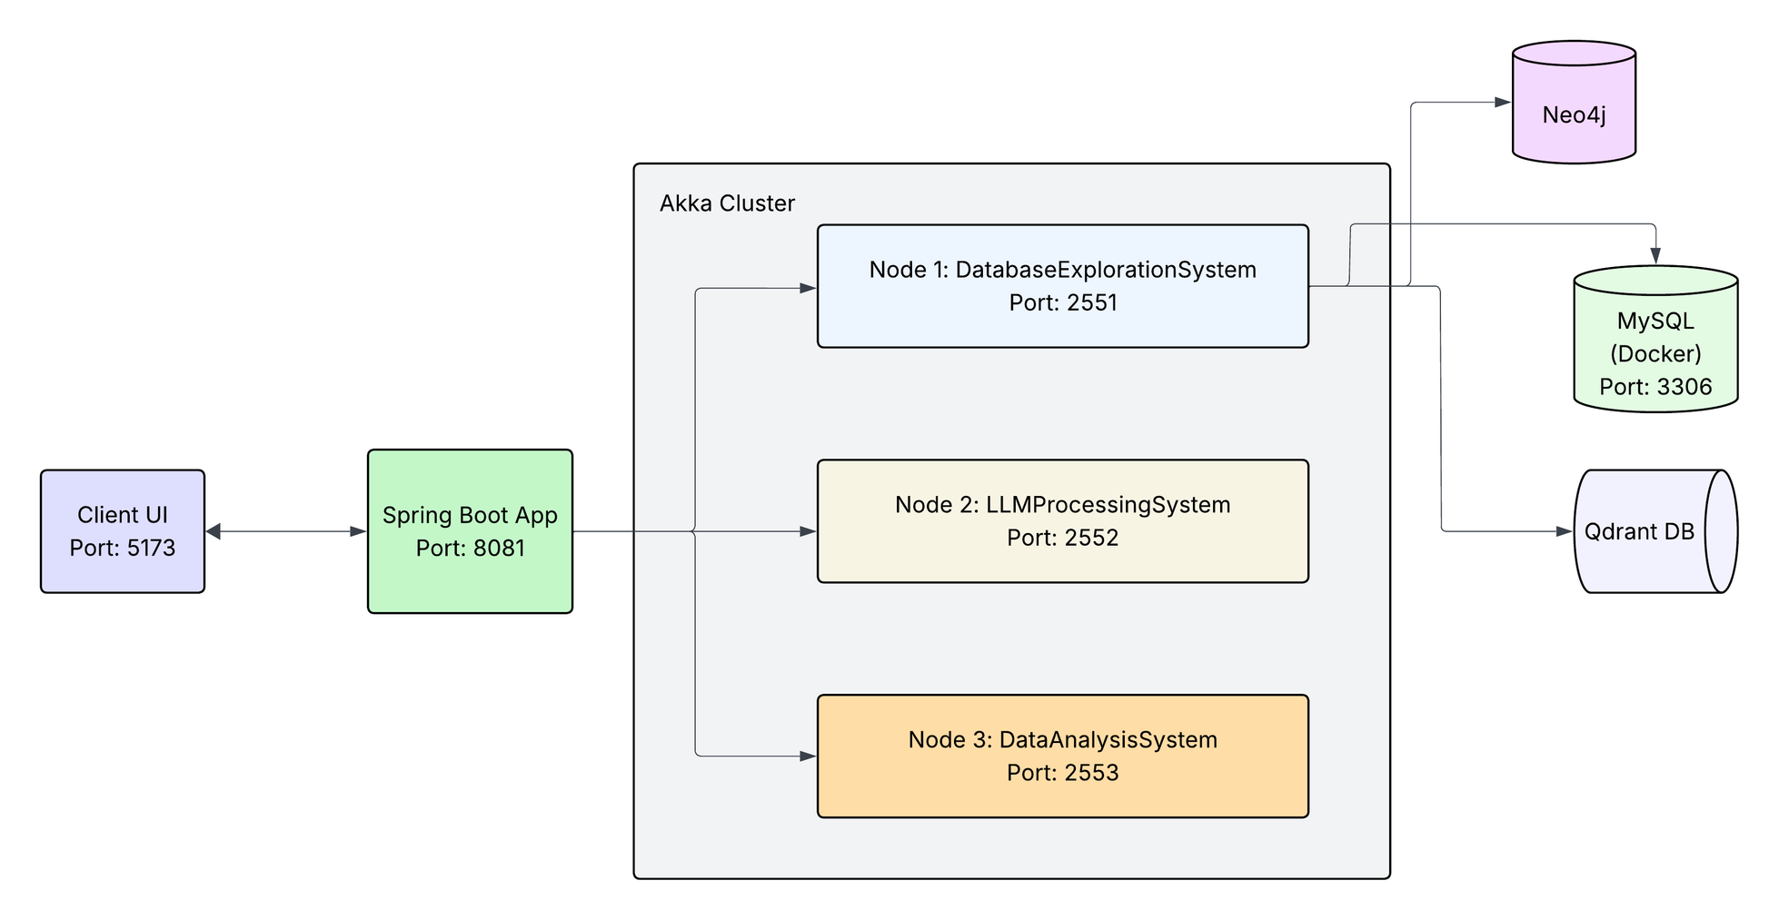
dbVybe
Architecture Flow Diagram
2025
Page
05

Slide 6
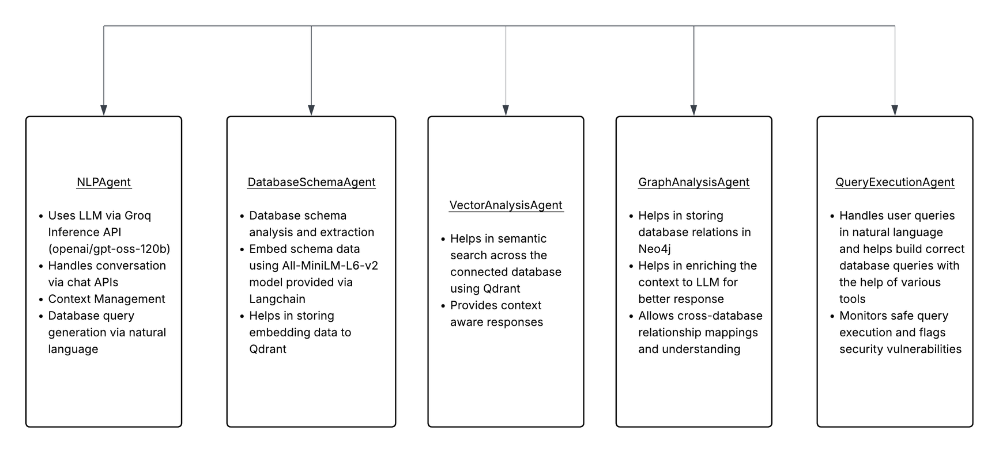
dbVybe
2025
Catalog
of AI Agents
Page
06

Slide 7
dbVybe
2025
Core
Technologies Used
Langchain
Used as a core AI-framework in the project to build and manage AI services, handle memory management, build specialized assistants, prompt engineering, embedded model integration and message classification
Groq Inference Engine
Used as a primary engine for LLM provider in dbVybe. Allows us to connect to GPT models via APIs and is faster than many traditional cloud-based LLMs
Qdrant
Vector database for storing and searching database schema for enhanced schema understanding and context
Neo4j
Graph database for storing and analyzing complex database relations and build enhanced context for the LLM to understand
Page
07

Slide 8
dbVybe
2025
Communication
Protocols
HTTP/REST
Akka Actor Messaging
Database Protocols
Frontend-Backend Communication
Inter-actor communication, Actor-Supervisor communication and Cross-Node Communication
gRPC for Qdrant
JDBC drivers for SQL
MongoDB Wire Protocol
Neo4j Bolt Protocol
WebClient for Async External APIs
Page
08

Slide 9
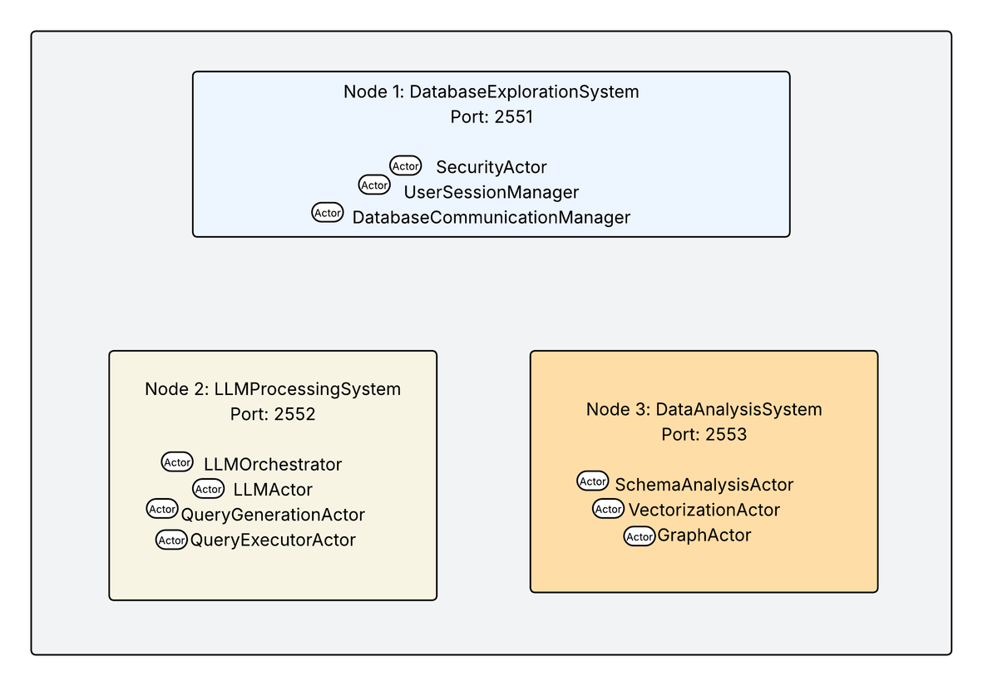
dbVybe
2025
Actor
Communications
Security Actor - connected to UserSessionManager for session validation
UserSessionManager - connected to SecurityActor for authentication
DatabaseCommunicationManager - connected to SchemaAnalysisActor for schema analysis workflows
LLMOrchestrator - connected to LLMActor for message processing
LLMActor - connected to QueryGenerationActor to generate database queries and connected to LLMOrchestrator for coordination of conversations
QueryGenerationActor - connected to LLMActor to receive processing requests
QueryExecutorActor - connects to AI agents to execute queries
SchemaAnalysisActor - connected to DatabaseCommunicationManager for database access
VectorizationActor & GraphActor - connects to AI agents
Page
09

Slide 10
dbVybe
2025
Future
Enhancements
Extend support to more database systems
Fine-tune LLM to maintain longer and clearer context
Add more functionalities such as report generation, API pagination and response sharing
Test the operation on various LLMs and prepare benchmarks to select the best LLM for the job
Add a caching layer for quick retrieval of the data
Add chat persistence to enhance context management across sessions
Page
09

Slide 11
dbVybe
2025
Thank
You.
Page
10

