Slide 1
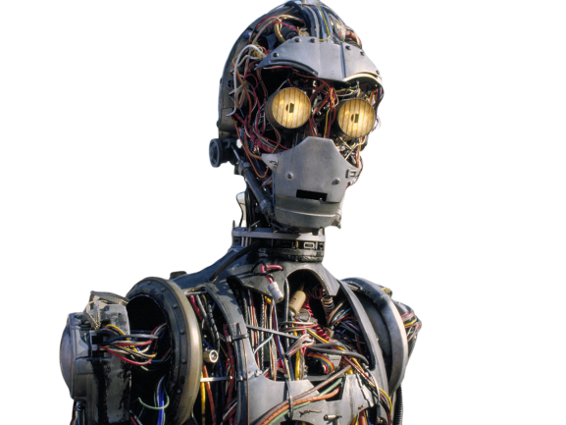
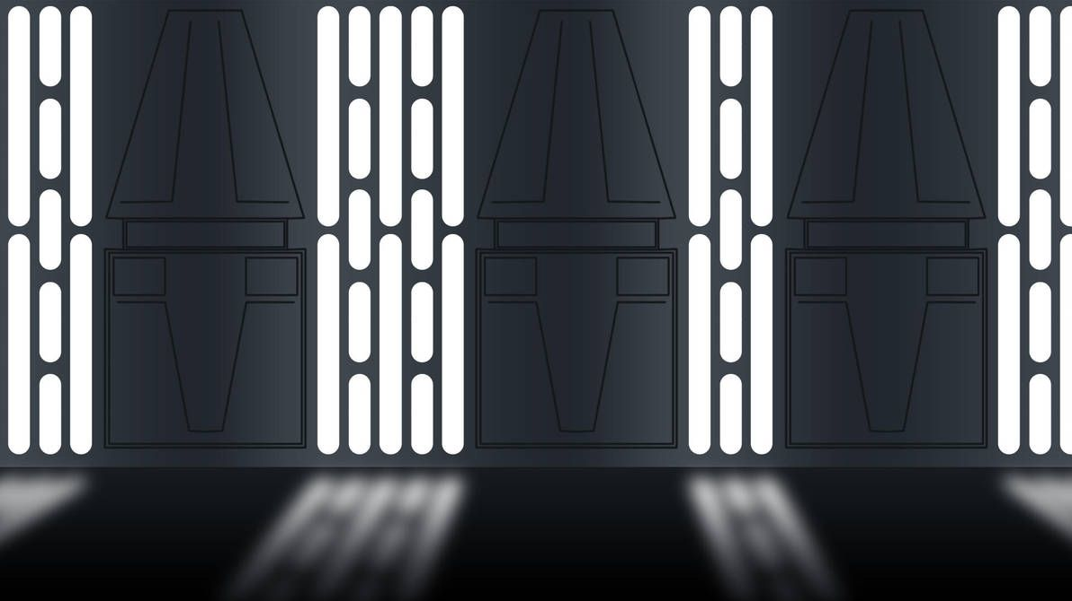
HELP LIAM FINISH HIS DROID!
I’ve been building my droid for the past 2 years now. However, the man has created dumb rules to do with my grant provider, which leaves me out of money and with a half-completed droid. YOU can help me finish my droid, by donating parts. This droid is really important to me and I would be crushed if I didn’t finish it.
Basically I need the a type of Arduino called MarcDuino, wheels and wheel motors, lights, battery, and controller. To view the parts list, go to
http://acord.tech/partslist
Liam
Droidology@alllianceofdroids.org.au, +61 466 225 878

