Slide 1

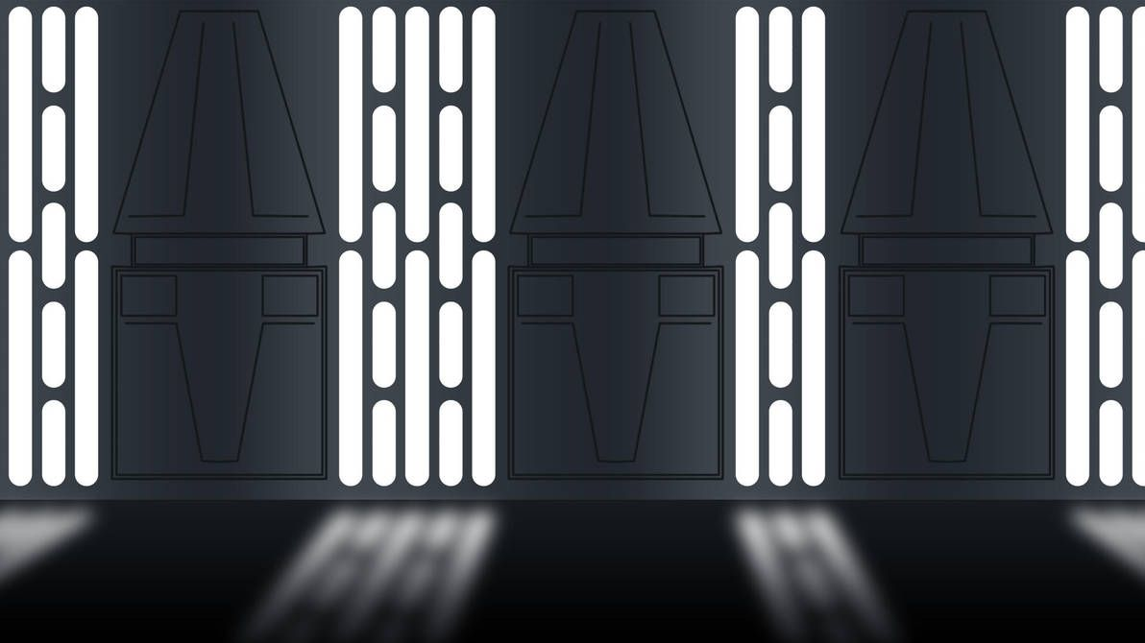
HELP LIAM FINISH HIS DROID!
I’ve been building my droid for the past 2 years now. However, the man has created dumb rules to do with my grant provider, which leaves me out of money and with a half-completed droid. YOU can help me finish my droid, by donating parts. This droid is really important to me and I would be crushed if I didn’t finish it.
The parts list is below
Liam
P.S. F*** you NDIS

