Slide 1


TERM PROJECT
MAÇKOLIK WEBSITE TESTING
•Lecture:
SE2226- Software Quality Assurance and Testing
•Students Name-ID:
Gizem Gültoprak-22070006034
Beren Elçin Polat-22070006064
•Department:
Software Engineering
•Lecturer:
Korhan Karabulut

Slide 2


INTRODUCTION
Unit Testing
Decision Table
Maçkolik is a popular sports website that provides real-time scores, news, and detailed information about various sports events, including football, basketball, and tennis. It serves as an essential hub for sports enthusiasts to stay updated with live scores, match statistics, and the latest sports news.
Test Case
Use Case Testing
Equivalence and Boundary Test
Selenium Webdriver / Chrome IDE
1

Slide 3
For testing of the Maçkolik Website we have used Black Box testing and White Box Testing together
1.Black-Box testing
1.1 Testing Report
1.2 Decision Table
1.3 Equivalence Table
1.4 Boundary Analysis
1.5 Use Case Testing
1.6 Integration Testing
1.7 UI Testing
2.White-Box Technique
2.1 Selenium Webdriver with Java, Selenium ChromeDriver, Junit5
3.Usability Testing
2

Slide 4
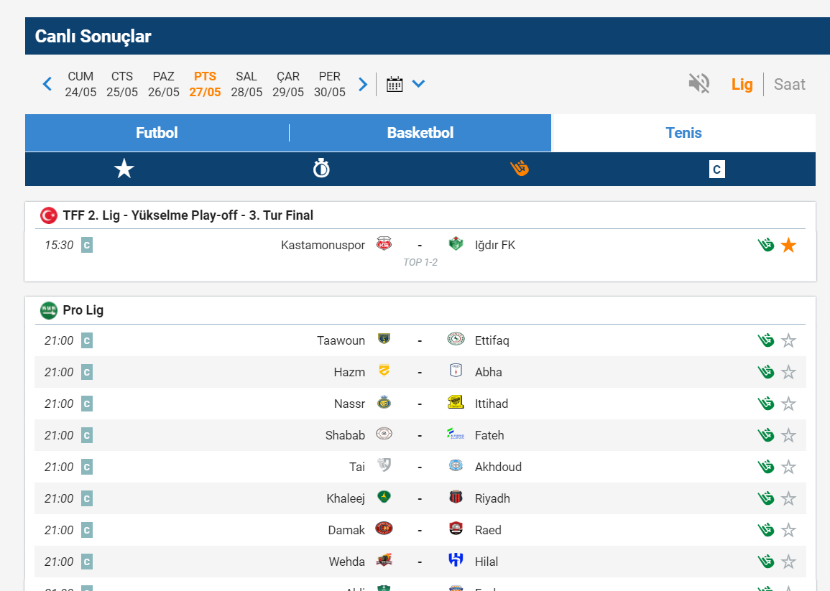
Decision Table
The table provided, outlines the interactions with various buttons and icons on the Maçkolik website. Each row in the table represents a unique action, such as clicking on a date button to view matches for a specific day, selecting a sport tab to filter by sport, or using the star icon to view favorites.
Favorite Matches
Live
Matches
Betting
Football Matches
Basketball
Matches
Tennis
Matches
Match Dates
Listed Elements
3

Slide 5
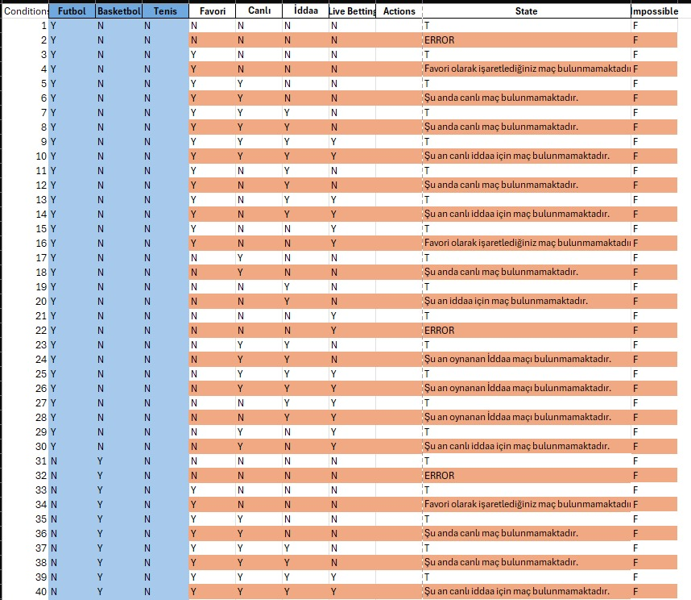
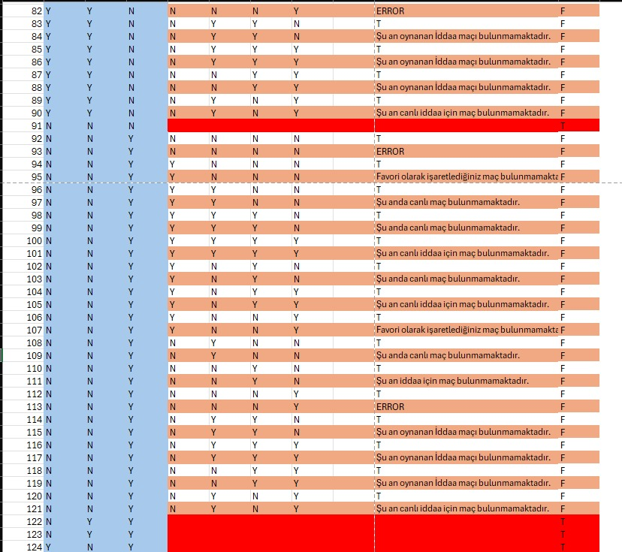
4

Slide 6
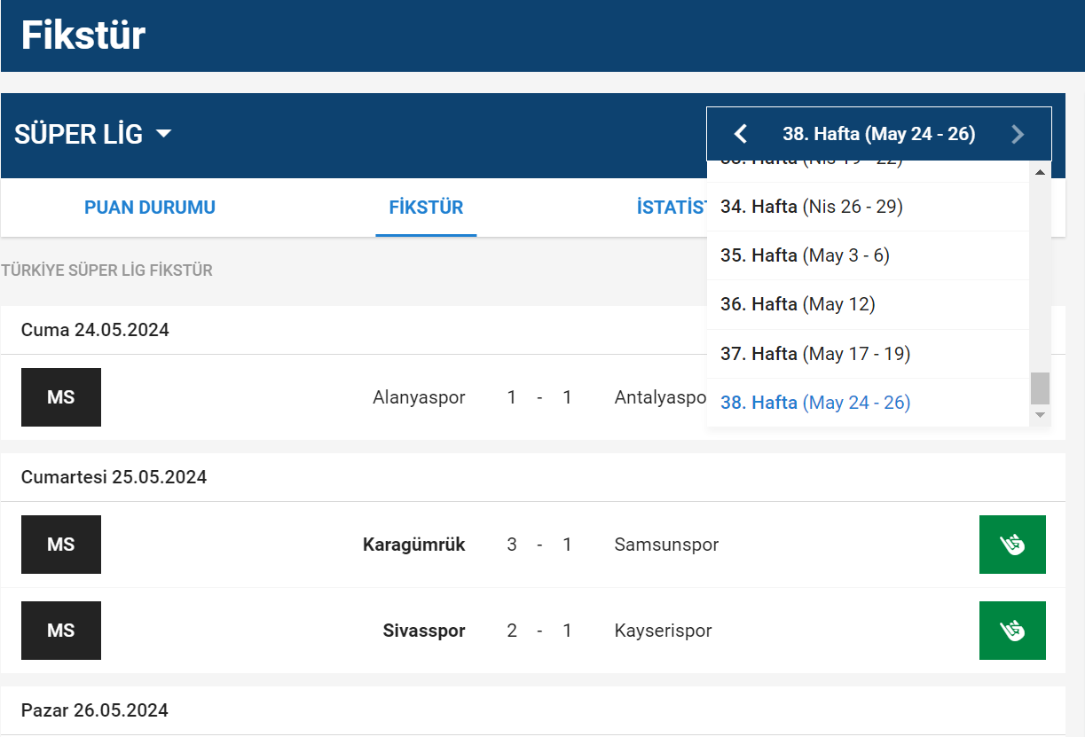
Equivalence Table
In this case, the table tests the functionality of selecting a date range from the fixture dropdown and verifying that the displayed matches fall within the selected date range. For each input date range selected from the dropdown, the expected outcome is that the displayed matches' dates align with the selected date range.
Listed Elements’ Dates
League Date Range
5

Slide 7
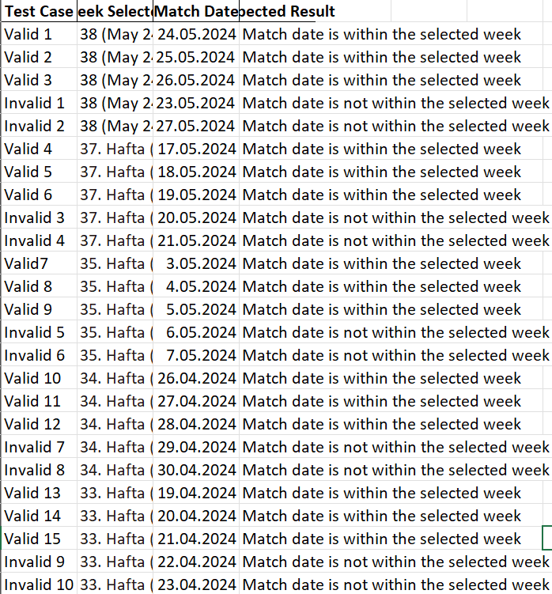
Equivalence Classes
6

Slide 8


Equivalence and Boundary Testing with JUNIT
Boundary table focuses on critical edge cases, especially around the limits of acceptable input lengths.
Search Button
7

Slide 9
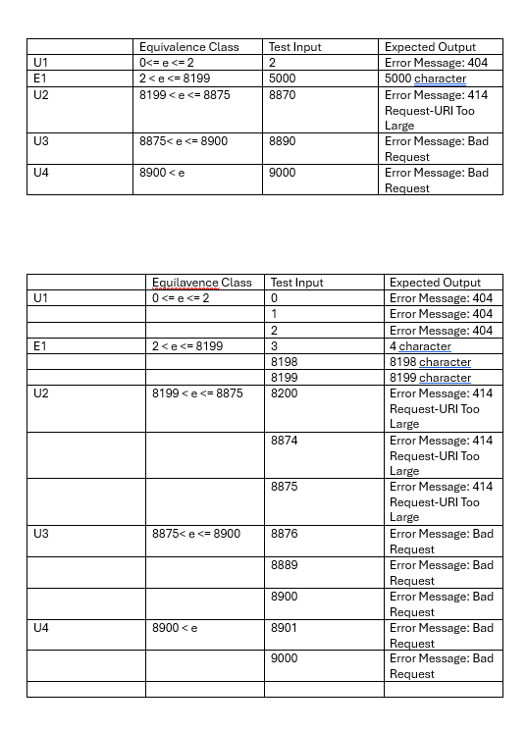
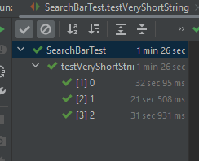
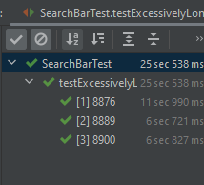
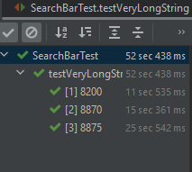
Equivalence Class
8

Slide 10
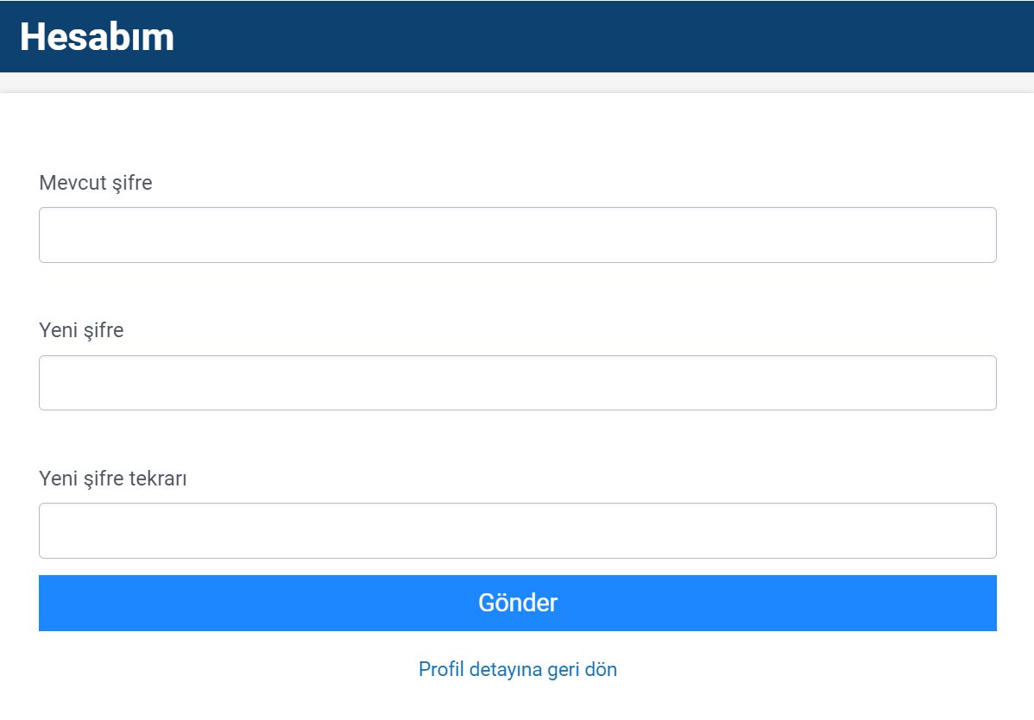
Use Case Testing
The provided tests are examples of Use Case Testing as they focus on validating the application's behavior against various scenarios that users might encounter while trying to change their passwords. This ensures that the password change functionality is robust and user-friendly.
Previous Password Text Box
New Password Text Box
9

Slide 11
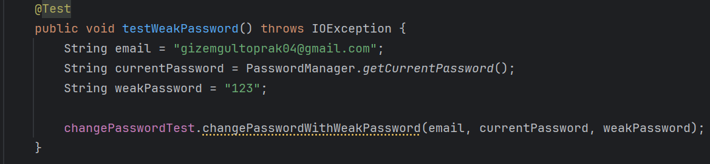
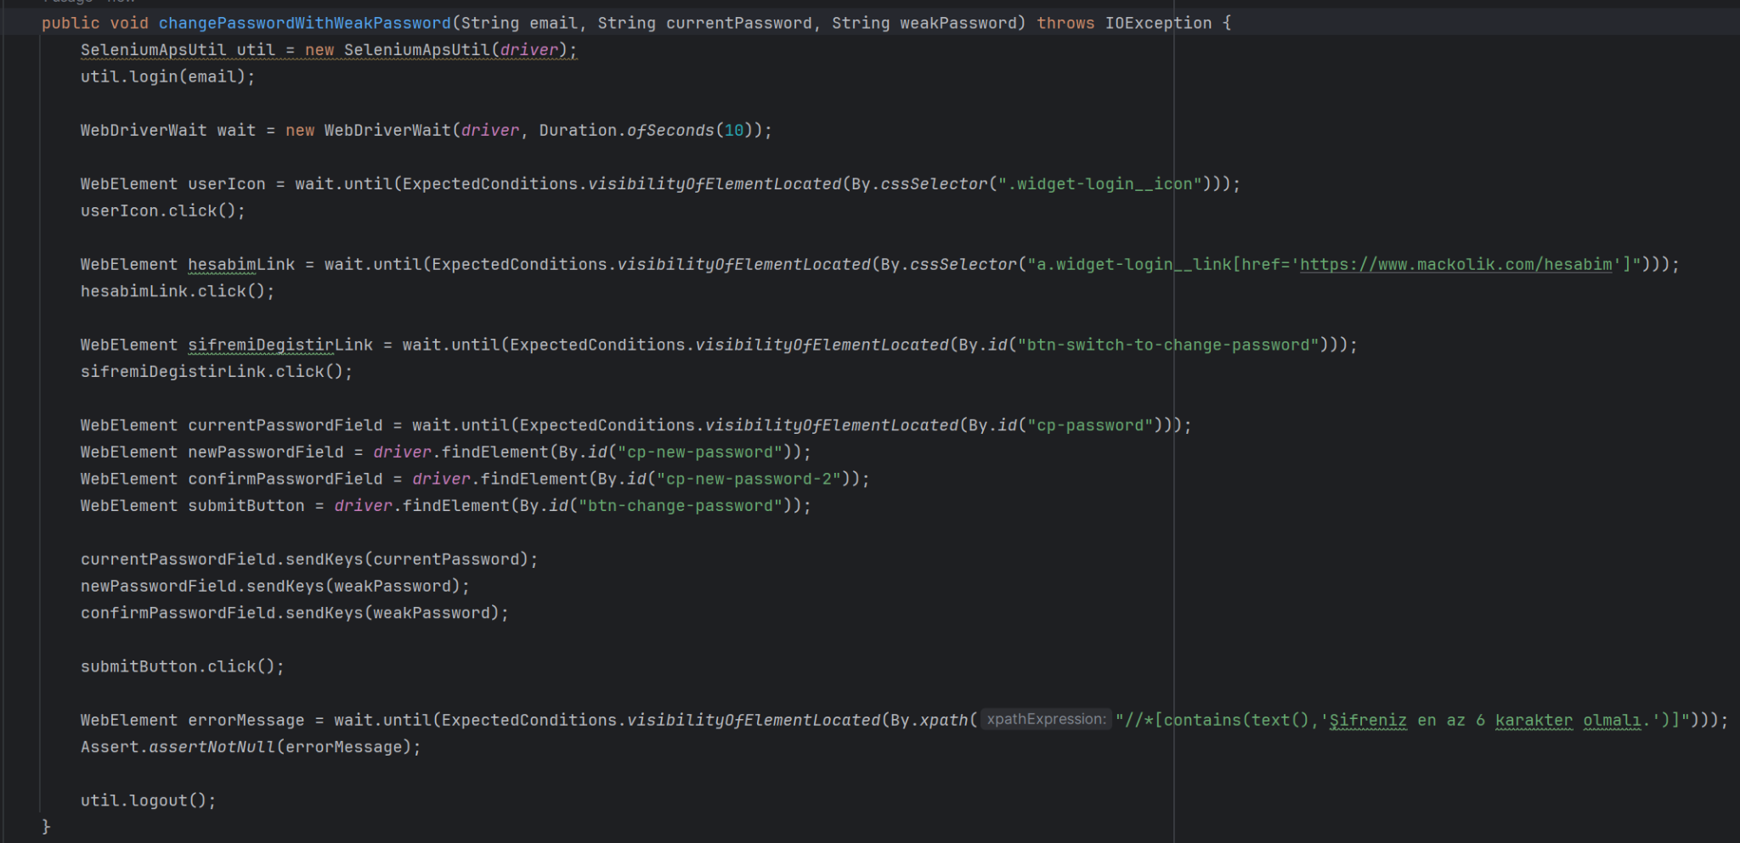
10

Slide 12
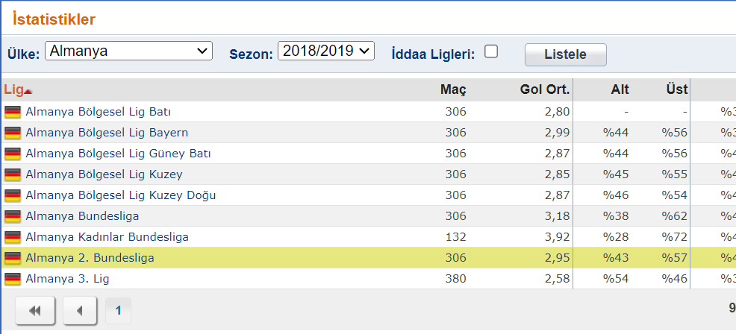
Use Case Testing
This test case is an example of Use Case Testing as it focuses on validating the application's behavior against a specific scenario: filtering statistics for Germany. It ensures that the user can successfully filter the statistics by selecting a country and that the application displays the correct filtered results.
Country Select Box
List Box
Listed Leagues
11

Slide 13

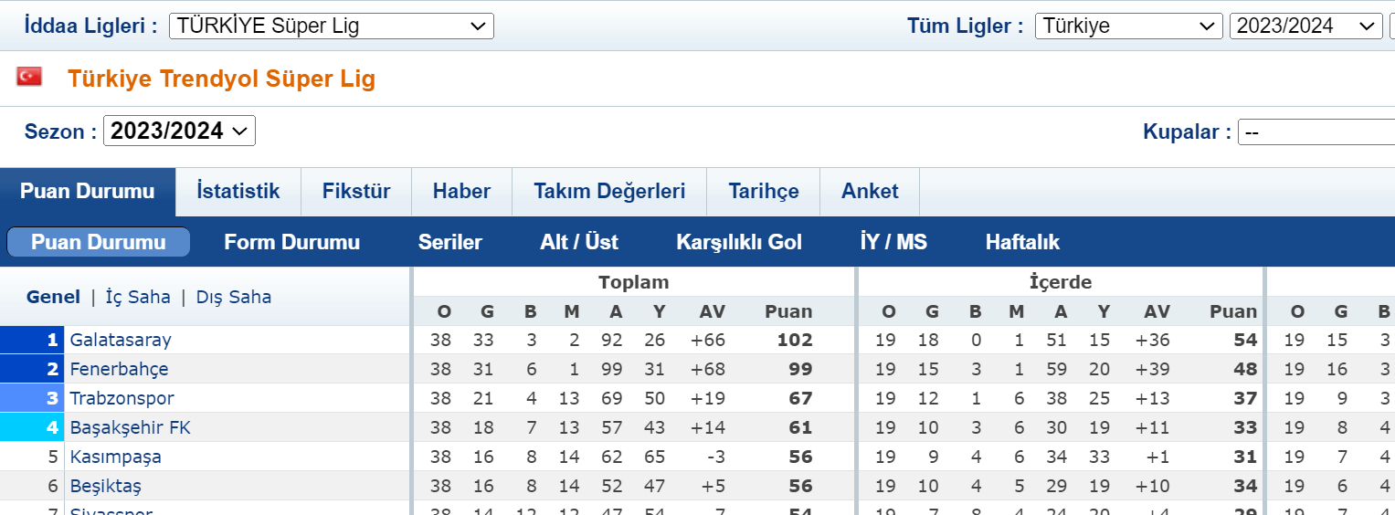

UI Testing
These tests are designed to validate the functionality of various elements on a webpage, specifically on the Maçkolik website.
Video Play Button (assert element present)
General Season Section
Match Season Section(assert value)
New Website Link(Assertion of new website title)
12

Slide 14
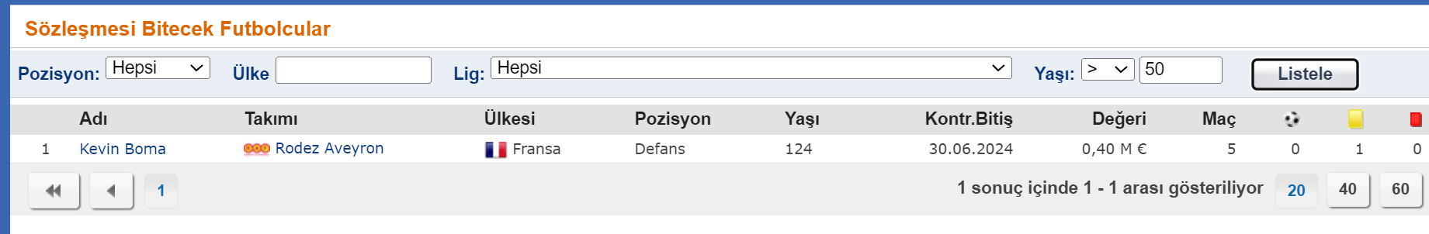
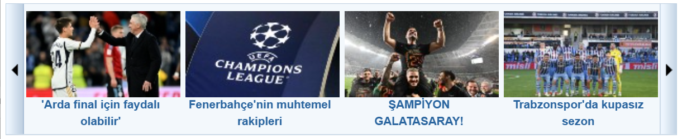

Age Selection Box
List Button
Listed Element
Left Slider
Right Slider(assert element present)
Football Button
13

Slide 15
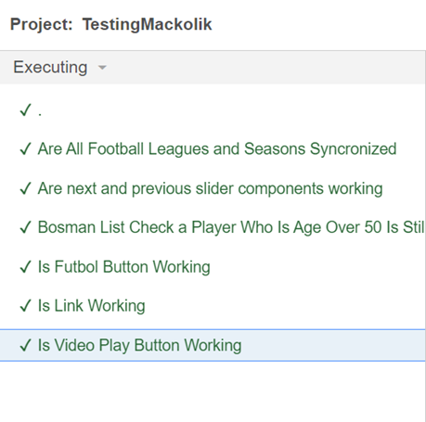
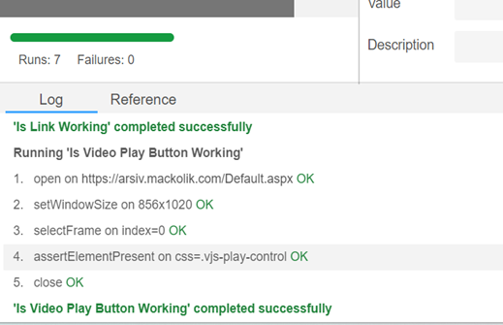

Slide 16
Problem Description
This use case describes how a user interacts with the Maçkolik website to check live scores, match statistics, and news updates related to various sports events.
The actors involved are the users and the Maçkolik website services. The following preconditions must be met: the user's device must be connected to the internet, and there must be an active network connection to the Maçkolik server.
Maçkolik Website does not open via school internet.
14

Slide 17
Conclusion
Testing process and our projects includes testing the websites quantity, reliability and functionality. There is multiple testing design in our code, white and black box methods. Each test case is executed carefully to validate different points of the website, covering both functional and nonfunctional requirements.
Throughout the testing we have found a couple of errors. For example, filtering table error and password change is not user-friendly. To conclusion, the automated test includes user password change, search, filter, favorites and various links.
15

