Slide 1
worker 1.6.x
Geert Jan Bex (geertjan.bex@uhasselt.be)
License: this presentation is released under the Creative Commons, see http://creativecommons.org/publicdomain/zero/1.0/

Slide 2
worker
Scenarios
Parameter exploration
MapReduce
Features
Tuning
Implementation
Conclusions

Slide 3
Use case 1: parameter exploration
temperature | pressure | humidity
293.0 | 1.0e05 | 87
… | … | …
313.0 | 1.3e05 | 75
#!/bin/bash –l
#PBS –l nodes=1:ppn=1
cd $PBS_O_WORKDIR weather –p 1.0e05 –t 293.0 –h 87
job_01.pbs
#!/bin/bash –l
#PBS –l nodes=1:ppn=1
cd $PBS_O_WORKDIR weather –p 1.003e05 –t 293.3 –h 67
job_30.pbs
…
#!/bin/bash –l
#PBS –l nodes=1:ppn=1
cd $PBS_O_WORKDIR weather –p 1.3e05 –t 313.0 –h 75
job_60.pbs
…

Slide 4
Solution 1: –data
temperature | pressure | humidity
293.0 | 1.0e05 | 87
… | … | …
313.0 | 1.3e05 | 75
data.csv
#!/bin/bash –l
#PBS –l nodes=5:ppn=20
cd $PBS_O_WORKDIR weather –p $pressure –t $temperature –h $humidity
job.pbs
$ wsub –data data.csv –batch job.pbs

Slide 5
Data exploration: steps
Write PBS script with parameters
Create Excel sheet with data
Convert to CSV format
Submit with wsub

Slide 6



Example 1: running R
R is not parallelized
or, not efficiently
However, some usage scenario’s can be done in parallel, e.g.,
parameter exploration
for (a, b) in
{(1.3, 5.7), (2.7, 1.4),
(3.4, 2.1), (4.1, 3.8),
…
}
{
res <- c(a, b, soph_func(a + b))
…
}
program.r
args <- commandArgs(TRUE)
a <- as.double(args[1])
b <- as.double(args[2])
result <- c(a, b, soph_func(a + b))
print(result)
program-pe.r

Slide 7
Example 1: running R with worker
Run R on your own computer:
For thinking, create program_pe.pbs and data.csv:
Run the job:
$ Rscript program 1.3 5.7
#!/bin/bash -l
#PBS -N program_pe
#PBS -l walltime=1:00:00,nodes=2:ppn=20
module load R
cd $PBS_O_WORKDIR
Rscript program $a $b
program_pe.pbs
a, b
1.3, 5.7
2.7, 1.4
3.4, 2.1
4.1, 3.8
…
data.csv
$ module load worker/1.6.7-intel-2015a
$ wsub –batch program_pe.pbs –data data.csv

Slide 8
Use case 1a: Torque job arrays
Torque supports job arrays, i.e.,
$ qsub –t 1-100 job.pbs
#!/bin/bash –l
#PBS –l nodes=1:ppn=1
cd $PBS_O_WORKDIR cfd-sim –i "params-$PBS_ARRAYID" \
–o "result-$PBS_ARRAYID"
job_array.pbs
#!/bin/bash –l
#PBS –l nodes=1:ppn=1
cd $PBS_O_WORKDIR cfd-sim –i "params-1" \
–o "result-1"
#!/bin/bash –l
#PBS –l nodes=1:ppn=1
cd $PBS_O_WORKDIR cfd-sim –i "params-100" \
–o "result-100"
…

Slide 9
Solution 1a: –t
wsub simulates job arrays, i.e.,
$ wsub –t 1-100 –batch job.pbs
#!/bin/bash –l
#PBS –l nodes=1:ppn=20
cd $PBS_O_WORKDIR cfd-simulator –i parameters-$PBS_ARRAYID \
–o result-$PBS_ARRAYID
job_array.pbs

Slide 10
worker
Scenarios
Parameter exploration
MapReduce
Features
Tuning
Implementation
Conclusions

Slide 11
Use case 2: MapReduce
data.txt.1
result.txt.1
data.txt.2
result.txt.2
data.txt
result.txt
result.txt
…
…
data.txt.7
result.txt.7
map
reduce

Slide 12
Solution 2: -prolog & -epilog
data.txt.1
batch.sh
result.txt.1
data.txt.2
batch.sh
result.txt.2
data.txt
result.txt
prolog.sh
epilog.sh
…
…
data.txt.7
batch.sh
result.txt.7
$ wsub –prolog prolog.sh –batch batch.sh \
–epilog epilog.sh

Slide 13
worker
Scenarios
Parameter exploration
MapReduce
Features
Tuning
Implementation
Conclusions

Slide 14
More features: logs
Getting a summary of a job
Number of successfully completed items
Number of failed items
Monitoring progress of a running job
$ wsummarize run.pbs.log445948
$ watch -n 60 \
wsummarize run.pbs.log445948

Slide 15
More features: resuming
Resuming a job that hit the walltime
Redoing failed work items
$ wresume -l walltime=1:30:00 -jobid 445948
$ wresume -jobid 445948 -retry

Slide 16
More features: time limits
Limit per work item
Avoid spending all walltime on a few work items that (accidentally) run too long
#!/bin/bash -l #PBS -l nodes=5:ppn=20 #PBS -l walltime=04:00:00
module load timedrun
cd $PBS_O_WORKDIR
timedrun -t 00:20:00 cfd-test -t $temperature \
-p $pressure \
-v $volume
time_limitied.pbs

Slide 17
More features: data aggregation
Sometimes convenient that each work item creates file
Files must be combined later = royal pain
File names are based on values in data
Example for data.csv:
output-1.3-5.7.txt
a, b
1.3, 5.7
2.7, 1.4
3.4, 2.1
4.1, 3.8
…
data.csv
output-2.7-1.4.txt
…
output-4.1-3.8.txt
…

Slide 18
More features: wcat
Almost automatic data aggregation:
Can be done from
worker epilog (-epilog option)
Command line
wcat –data my-data.csv \
-pattern output-[%a%]-[%b%].txt \
-output output.csv
a, b
1.3, 5.7
2.7, 1.4
3.4, 2.1
4.1, 3.8
…

Slide 19
More features: wreduce
More general data aggregation:
Reductor can be any executable
"appends" new data to existing file
takes two command line arguments
name of file with all output data
name of file to "append"
wreduce –data my-data.csv \
-pattern output-[%a%]-[%b%].txt \
-reductor reductor.sh \
-output output.txt

Slide 20
Example reductor
#!/usr/bin/env python
from argparse import ArgumentParser
import pickle
if __name__ == '__main__':
arg_parser = ArgumentParser(description='create new pickle file from '
'two existing files')
arg_parser.add_argument('old', help='name of aggregation pickle file')
arg_parser.add_argument('new', help='name of pickel file to add to '
'aggregation')
options = arg_parser.parse_args()
with open(options.old, 'rb') as old_file:
old_data = pickle.load(old_file)
with open(options.new, 'rb') as new_file:
new_data = pickle.load(new_file)
for word, count in new_data.iteritems():
if word in old_data:
old_data[word] += count
else:
old_data[word] = count
with open(options.old, 'wb') as old_file:
pickle.dump(old_data, old_file)
redactor.py
read aggregated data
read data to add
add new data to aggregate
write aggregated data

Slide 21
More features: wload
Load balance is important!
do all workers approximately the same amount of work?
easy if all work items take the same time
Use wload to analyse runs
report on work items: -workitems
report on workers: -workers
$ wload –workers run.pbs.log445948

Slide 22
Load balance
wsub -l nodes=5:ppn=20 …
100 cores
1 master
99 slaves
wsub -l nodes=5:ppn=20 -master …
100 cores
1 master
100 slaves
⇒ executes 99 work items concurrently
⇒ executes 100 work items concurrently
Not default: violates MPI standard!

Slide 23
worker
Scenarios
Parameter exploration
MapReduce
Features
Tuning
Implementation
Conclusions

Slide 24
How to use worker well?
Many work items, i.e., #work items/#proc >> 1
time(work item) > 1 minute
Work item is not multithreaded
It will work, but user must be careful to request the right resources
Use –threaded <n> flag with wsub

Slide 25
worker & multithreading
Some software uses multithreading automatically, e.g.,
R
Matlab
Will use as many threads as there are cores, regardless of system load
20 cores/node
20 work items/node
20 × 20 threads/node
Oversubscription: very inefficient!!!

Slide 26
Controlling number of threads
R, most of the time: OMP_NUM_THREADS=1
Matlab
Use maxNumCompThreads(1) function call
Use compiler flag: mcc –singleCompThread …
#!/bin/bash -l
#PBS -N my-pe
#PBS -l walltime=1:00:00,nodes=5:ppn=20
module load R
cd $PBS_O_WORKDIR
export OMP_NUM_THREADS=1
Rscript program $a $b
program_pe.pbs

Slide 27
What you hope/expect for…
strong scaling
weak scaling
execution time
nr. processes
Is this going
to happen?
system size
execution time ∼
nr. processes

Slide 28

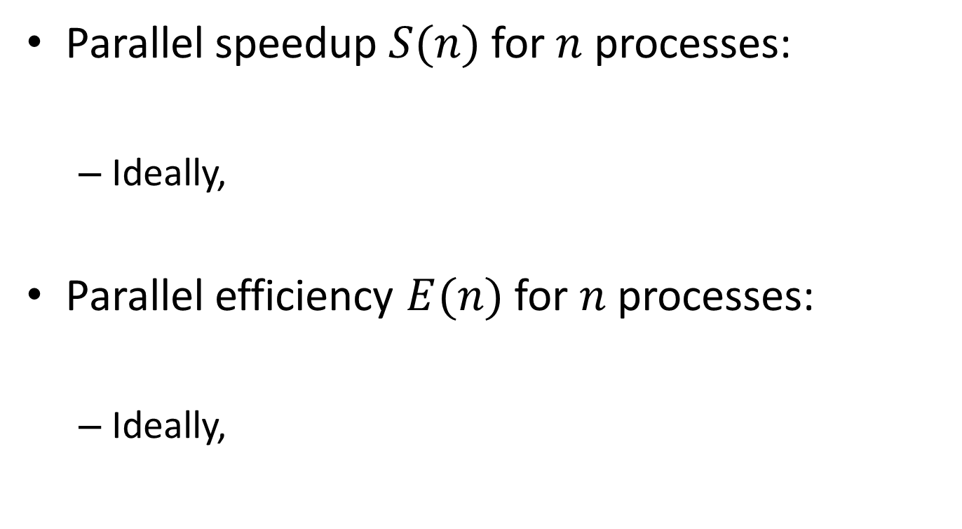



Definitions
Parallel speedup $S(n)$ for $n$ processes:
Ideally,
Parallel efficiency $E(n)$ for $n$ processes:
Ideally,
$$S(n)=\frac{T_{1}}{T_{n}}$$
$$S(n)=n$$
$$E(n)=\frac{T_{1}}{nT_{n}}$$
$$E(n)=1$$

Slide 29
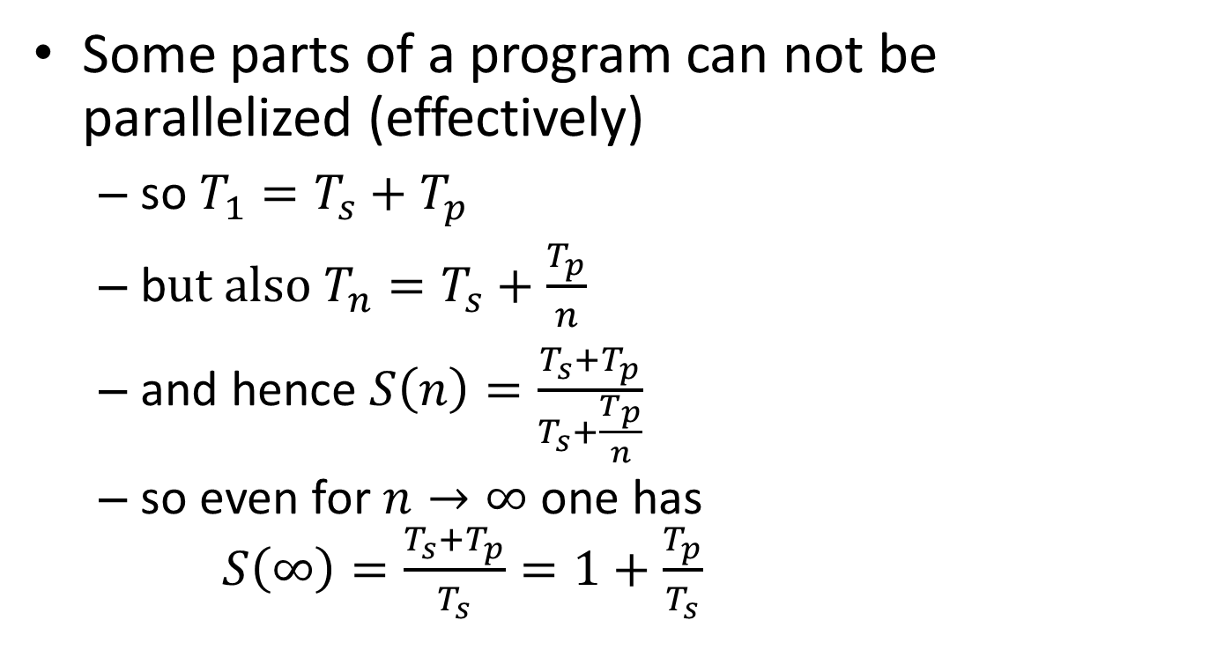
Strong scaling: oops!?!
Some parts of a program can not be parallelized (effectively)
so $T_{1}=T_{s}+T_{p}$
b$ut also T_{n}=T_{s}+\frac{T_{p}}{n}$
and hence $S\left(n\right)=\frac{T_{s}+T_{p}}{T_{s}+\frac{T_{p}}{n}}$
so even for $n→∞$ one has $S\left(∞\right)=\frac{T_{s}+T_{p}}{T_{s}}=1+\frac{T_{p}}{T_{s}}$
Hard limit on speedup due to serial part: Amdahl's law

Slide 30
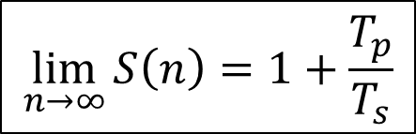

Amdahl's law
speedup
nr. processes
$$\lim_{n→∞}{S\left(n\right)=1+\frac{T_{p}}{T_{s}}}$$
$$\lim_{n→∞}{E\left(n\right)=0}$$

Slide 31
It gets worse…
Overhead!
communication takes time
finite bandwidth
non-zero latency
resource contention
memory subsystem: L3 cache, RAM, QPI
network access
nr. processes
nr. processes

Slide 32
Picking the sweet spot
sweet spot
speedup
sweet spot
2
4
8
nr. processes
efficiency
2
4
8
nr. processes

Slide 33
Throughput computing
N independent tasks
Total number of cores n << N
Execution time single task, 1 thread: t₁
Execution time single task, n threads: t_{n}
Multithreading or not?
However: memory?

Slide 34
worker
Scenarios
Parameter exploration
MapReduce
Features
Tuning
Implementation
Conclusions

Slide 35
wsub processing
data₁
data₂
data_{n}
-t 1-N
…
batch.sh
templ.
engine
worker.pbs
batch.sh.worker

Slide 36






worker processing: informally
slave₁
slave queries for work
/
master sends work
/
slave notifies on success/failure, queries
for more work
master
…
Done!
master sends stop
/
slave_{S}
batch.sh.worker

Slide 37
worker: initialization & operation
slave₁
master
slave₂
ready
prolog
ready
read
work
jobID, scriptSize
script
read
work
jobID, scriptSize
script
computation
jobID, existStatus
computation
log
read
work
jobID, scriptSize
script
computation

Slide 38
worker: termination
slave₁
master
slave₂
computation
computation
jobID, existStatus
log
read
work
jobID, scriptSize
jobID, existStatus
script
terminate
log
computation
jobID, existStatus
log
terminate
epilog

Slide 39
worker
Scenarios
Parameter exploration
MapReduce
Features
Tuning
Implementation
Conclusions

Slide 40
Is worker a panacea?
worker advantages
Easy to use
Supports several scenarios
worker disadvantages
Some overhead (less than 1 % with 800 processes)
worker is not a replacement for
Parsing files in Matlab or R
Using for-loops

Slide 41
References
Website https://github.com/gjbex/worker
Documentation http://worker.readthedocs.io/en/latest/
Developer geertjan.bex@uhasselt.be

