Slide 1

REAL TIME WIRELESS EMBBED ELECTRONICS FOR SOLDIER SECURITY
Presented by
P. RAJESH (20F01A04I8)
G. JAYANTH (20F01A04G5) A. REVANTH SIVA KUMAR (20F01A04E4)
M. MADHUSUDAN REDDY (20F01A04H6) P. SHALEM REDDY (20F01A04I5)
Under the Esteemed Guidance of
G. KOTESWARA RAO, M. Tech,
Assistant Professor
DEPARTMENT OF ELECTRONICS AND COMMUNICATION ENGINEERING
ST. ANN’S COLLEGE OF ENGINEERING & TECHNOLOGY::CHIRALA
(Approved by AICTE New Delhi, Permanently Affiliated to JNTUK, Kakinada)
(Accredited by NAAC with ‘A’ Grade, NBA & IE (I))
2020-2024

Slide 2
CONTENTS
ABSTRACT
INTRODUCTION
OBJECTIVE
LITERATURE REVIEW
EXITSTING SYSTEM
PROPOSED SYSTEM
MAIN CIRCUIT DIAGRAM
MODULE DESCRIPTON
SOFTWARE AND HARDWARE REQUIREMENTS

Slide 3
ABSTRACT
One of the important and vital roles in a country’s defense is played by the army soldiers. Every year Soldiers get strayed or injured and it is time consuming to do search and rescue operations.
Our paper introduces a WSN-based system for real-time monitoring of soldiers environmental and health conditions, vital for national defense. We track diverse factors including blood oxygen levels and body temperature.
Equipped with a camera, our goal is to enhance emergency response times using an embedded system integrated with WBASN, prioritizing power efficiency.

Slide 4
INTRODUCTION
The Army, Navy, and Air Force are pillars of national security, yet soldier safety remains a concern, especially in combat. Connectivity gaps hinder real-time monitoring, underscoring the urgency for location and health tracking.
Wireless Sensor Networks (WSN) offer a crucial solution, gathering soldier data for proactive intervention. WSN ensures comprehensive health and environmental monitoring, aiding in averting life-threatening scenarios.
By leveraging WSN, real-time data collection becomes feasible, empowering rapid response and enhancing soldier safety on the battlefield.

Slide 5
OBJECTIVE
Monitor the environmental and health parameters of soldiers in real time, such as temperature, humidity, air quality, motion, position, geographic location, blood oxygen level, and body temperature.
Detect and prevent critical situations by analyzing the sensor data and sending alerts to the base station.
Reduce the response time for emergencies by using low-cost, low-power, long-range, and secure communication links provided by LoRa network infrastructure.

Slide 6
LITERATURE REVIEW
In 2017, P.S. Kurhe and S.S. Agrawal proposed a soldier tracking system with body sensor networks for real-time GPS communication. This aids in vital sign monitoring via GSM for navigation and fleet management.
[2] Juan G. Parada-Salado, Luis E. Ortega-García, Luis F. Ayala-Ramírez, Francisco J. Pérez Pinal, “A Low-Cost Land Wheeled Autonomous MiniRobot For In-Door Surveillance”
In 2019, Lim, Ma, Wang, Iyer, and Watkin developed soldier health monitoring using lightweight sensors for real-time data, with plans for a streamlined data management system and web portal.

Slide 7
EXISTING SYSTEMS
"Soldier's Health Monitoring System Using GSM" is currently deployed in battlegrounds, focusing on ensuring the safety of soldiers by monitoring their health status.
These systems comprise small physiological sensors, transmission modules, and processing capabilities, offering minimum solutions for health monitoring.
GPS technology is integrated into weapons and firearms, with some militaries exploring embedding GPS devices.

Slide 8
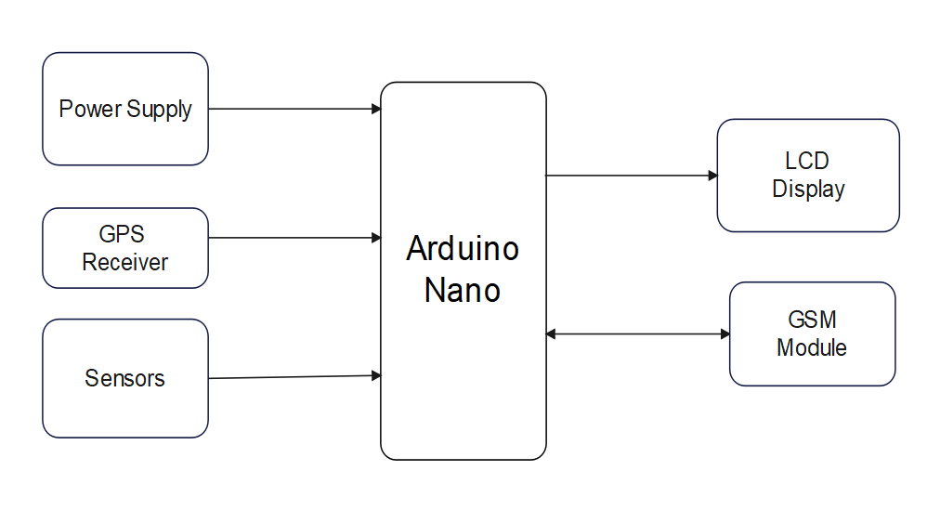
BLOCK DIAGRAM

Slide 9
PROPOSED SYSTEM
Upgraded system: The proposed system, "Realtime Wireless Embedded Electronics for Soldier Security using IoT," addresses flaws in the existing system by replacing Arduino by Raspberry pi for enhanced performance and flexibility.
Integration of IoT cloud: The proposed system incorporates IoT cloud for efficient storage and management of data, ensuring accessibility and reliability in real-time monitoring and analysis.
Sensor Data Analysis: Sensor data from the heartbeat sensor, SpO2 sensor, body temperature sensor, and 3-axis sensor are analyzed to detect anomalies such as irregular heartbeats, low oxygen levels, high body temperature, and falls.

Slide 10
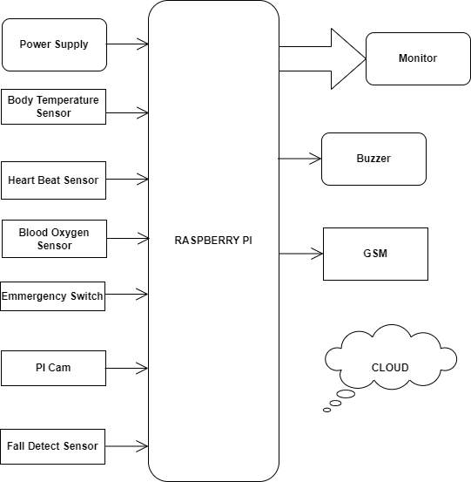
BLOCK DIAGRAM

Slide 11
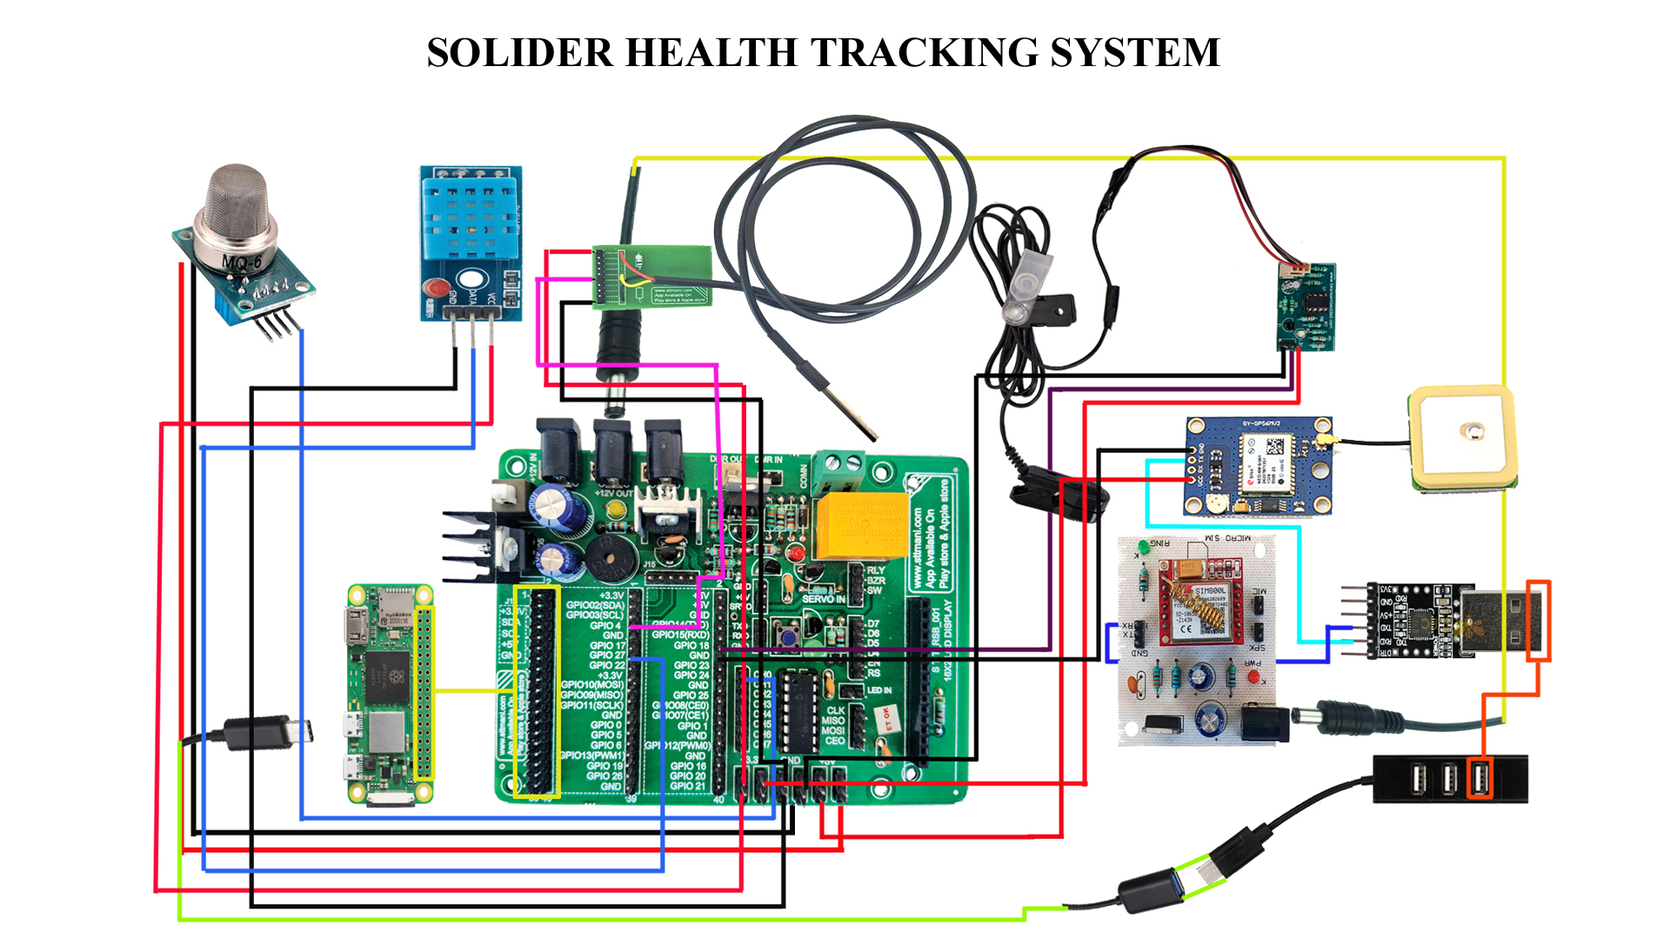
MAIN CIRCUIT DIAGRAM

Slide 12
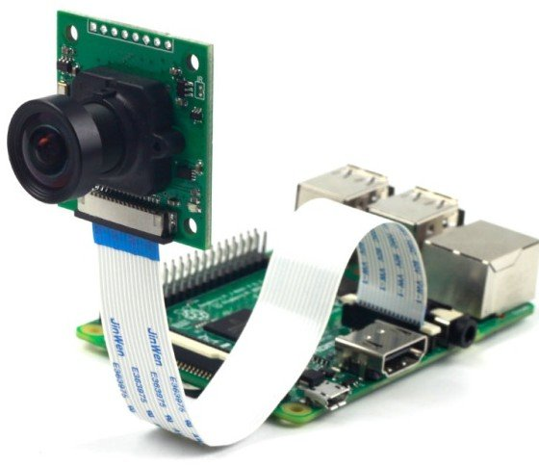
MODULES DESCRIPTON
Raspberry pi with Camera module
Raspberry Pi is a Microprocessor which has 40 pins with 27 GPIO pins, it has a 1 Giga Bytes of RAM and a SD card slot for the storage or the ROM.
It can be used as a mini computer for low computing operations, it has a dual band LAN, faster Ethernet, Bluetooth, it also has USB and HDMI ports for connecting devices.
This device can be used as a server which we are doing in this project.

Slide 13
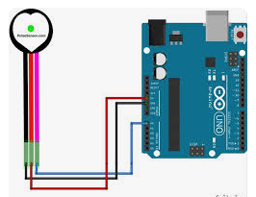
Heartbeat Sensor
The Heart Beat sensor provides a simple way to study the heart’s function.
This sensor monitors the flow of blood through the finger.
As the heart forces blood through the blood vessels in the finger, the amount of blood in the finger changes with time.

Slide 14
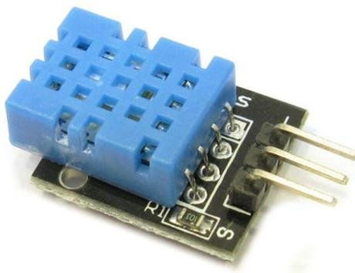
Temperature Sensor
The Temperature can be detected with help of a temperature sensor LM35.
The LM series are precision integrated circuit temperature sensors, whose output voltage is linearly proportional to the Celsius (Centigrade) temperature.

Slide 15
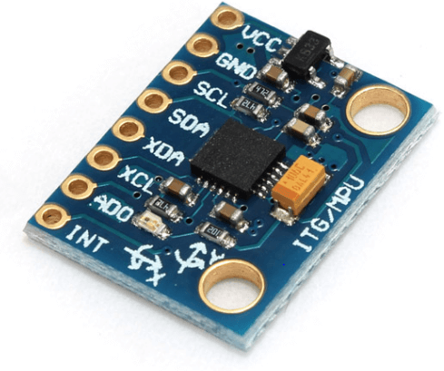
Fall Sensor
For fall detection, accelerometer and gyroscope was used to detect acceleration and body tilt angle of the faller respectively.
The main objective is to alert when fall event has occurred.

Slide 16
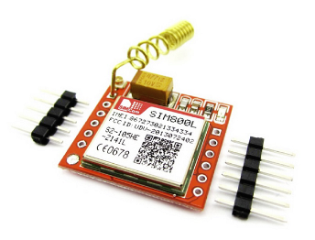
GSM Module
The GSM modem is used to provide the information of the soldier like the heartbeat rate and the body temperature to a remote location.
It is similar to a mobile which requires a SIM card for its operation but the advantage of GSM modem over mobile is that it has an serial connectivity that can be directly connected to the Micro controller for sending the AT(Attention) commands for sending.

Slide 17
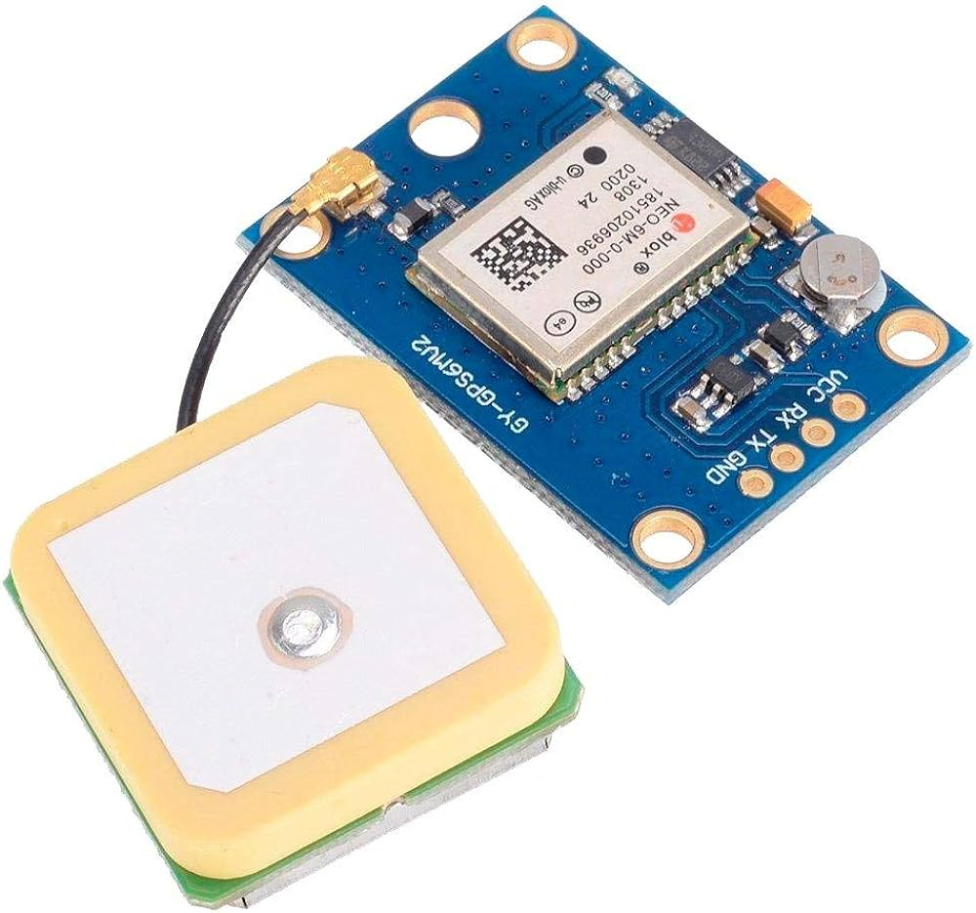
GPS Modem
The location of the soldier can be tracked with the help of a GPS Modem.
The GPS modem receives the signals from the satellite and calculates the Latitude and Longitude of the location of soldier and sends it to the controller in the form of the serial data.

Slide 18
SOFTWARE AND HARDWARE REQUIREMENTS
Software:
Python IDE for Raspberry Pi
Raspbian or Raspberry Pi OS for Raspberry Pi
Hardware:
Raspberry Pi with camera module
Temperature sensor
SPO2 sensor
Heart beat sensor
Fall Detection sensor
GSM and GPS modules
LCD display
Buzzer

Slide 19
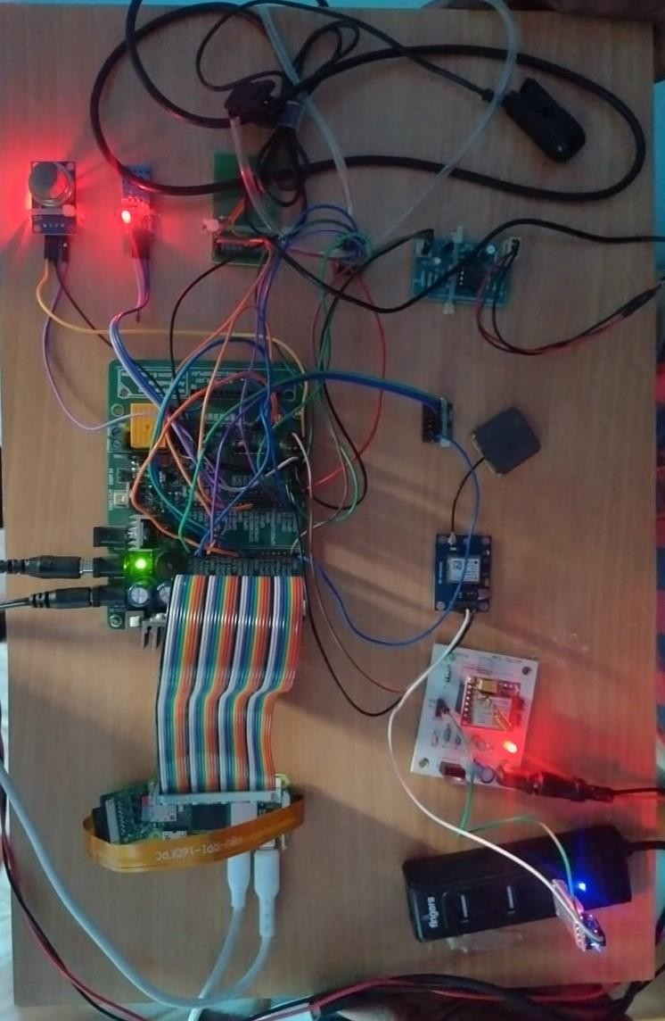
IMPLEMENTATION AND TESTING
Implementation
The implementation of Soldier security system is to monitor the overall health parameters like heart beat, temperature, spo2 etc, and also it detects the live location of the soldier and give live footage at the war fields.

Slide 20
Sensor integration: Various sensors, including heartbeat, blood oxygen, temperature, humidity, and air quality, were seamlessly integrated with the Raspberry Pi for comprehensive data collection.
Anomaly detection: Utilizing Raspberry Pi's processing power, the project implemented algorithms to detect anomalies, triggering automated responses like video capture and SMS alerts, enhancing soldier safety.
Data integrity and scalability: The project ensured seamless data management and scalability by combining local storage on the Raspberry Pi with integration into an IoT cloud platform, facilitating real-time monitoring and future expansion.

Slide 21
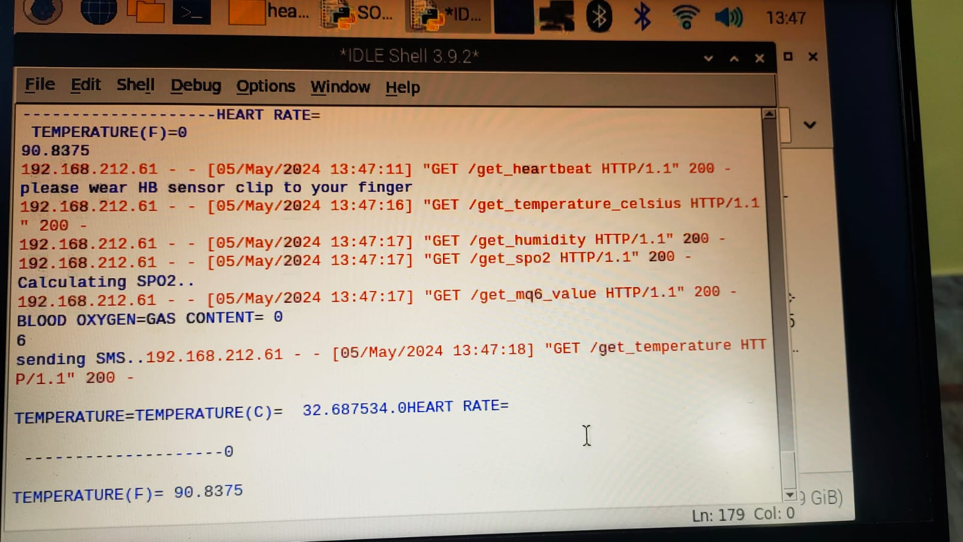
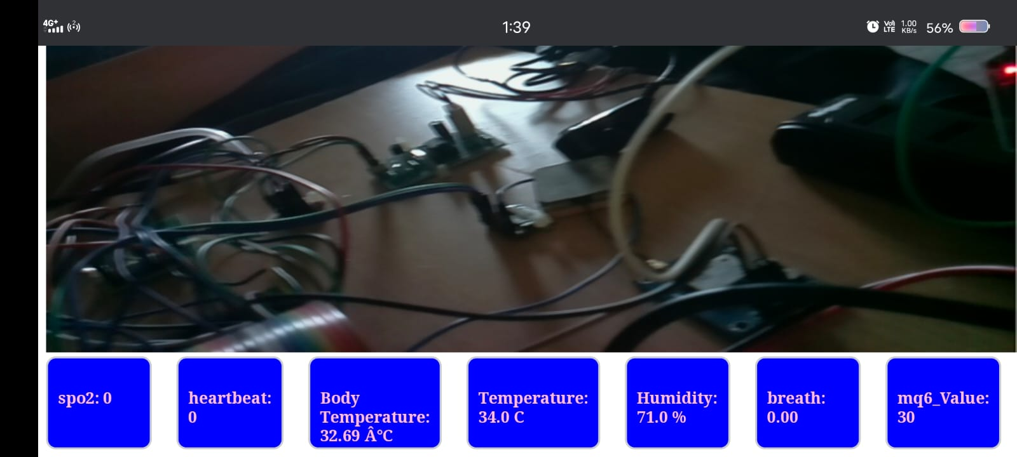
TESTING Outputs

Slide 22


