Slide 1
Game of Life
Naive Implementation
Optimized Implementation
OpenMP Variant
OpenCL Variant
Conclusions

Slide 2
Game of Life
Any live cell with two or three alive neighbours survives
Any dead cell with three live neighbours becomes a live cell
All other live cells die in the next generation. Similarly, all other dead cells stay dead

Slide 3
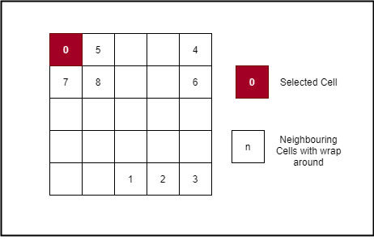
Naive Data Representation
typedef struct
{
std::vector<std::vector<int>> cell_rows;
int row_nr;
int col_nr;
} board_t;

Slide 4
Neighbour Counting
// Select the cell at (row:col) of the board
int cell_state_at(int row, int col, board_t& board)
{
// use % to get wrapping effect at board edges
return board.cell_rows.at((row + board.row_nr) % board.row_nr).at((col + board.col_nr) % board.col_nr);
}
// Get the neighbor count of the cell at (row:col) of the board
int get_neighbour_count(int row, int col, board_t& board)
{
int neighbour_count = 0;
int indexes[3] = { -1, 0, 1 };
// Check col
for (int i : indexes) {
// Check Row
for (int j : indexes) {
// Avoid the current cell
if (j || i) {
// Add cell state (0|1) to neighbour count
neighbour_count += cell_state_at(row + j, col + i, board);
}
}
}
return neighbour_count;
}

Slide 5
State Generation
// Generates the next state of a cell based on the rules of the game
int generate_cell_state(int row, int col, board_t& board) {
int cell_neighbour_count = get_neighbour_count(row, col, board);
int cell_survives = board.cell_rows.at(row).at(col) && (cell_neighbour_count == 2 || cell_neighbour_count == 3);
int cell_birth = !board.cell_rows.at(row).at(col) && (cell_neighbour_count == 3);
return cell_survives || cell_birth;
}
// Loops through all board cells and generates the next board state based on the rules of the game
void generate_next_board_state(board_t& current_board_state)
{
//Store current board state to avoid overriding during cell state generation
board_t temp = current_board_state;
// Loop through rows
for (int row = 0; row < current_board_state.row_nr; row++) {
// Loop through cols
for (int col = 0; col < current_board_state.col_nr; col++) {
// generate new states for row
current_board_state.cell_rows.at(row).at(col) = generate_cell_state(row, col, temp);
}
}
}

Slide 6
Naive Implementation – Open MP
void game_of_life_loop_omp(board_t& board, board_t& temp, int generations, int display) {
int num_threads;
#pragma omp parallel
{
num_threads = omp_get_num_threads();
for (int gen = 0; gen < generations; gen++) {
#pragma omp for
for (int row = 0; row < board.row_nr; row++) {
for (int col = 0; col < board.col_nr; col++) {
int alive_neighbours = get_neighbour_count(row, col, board);
int cell_survives = board.cell_rows.at(row).at(col) && (alive_neighbours == 2 || alive_neighbours == 3);
int cell_birth = !board.cell_rows.at(row).at(col) && (alive_neighbours == 3);
temp.cell_rows.at(row).at(col) = cell_survives || cell_birth;
}
}
#pragma omp master
{
board.cell_rows.swap(temp.cell_rows);
if (display) {
display_board_state(board);
}
}
#pragma omp barrier
}
}
std::cout << "Number of threads: " << num_threads << std::endl;
}

Slide 7
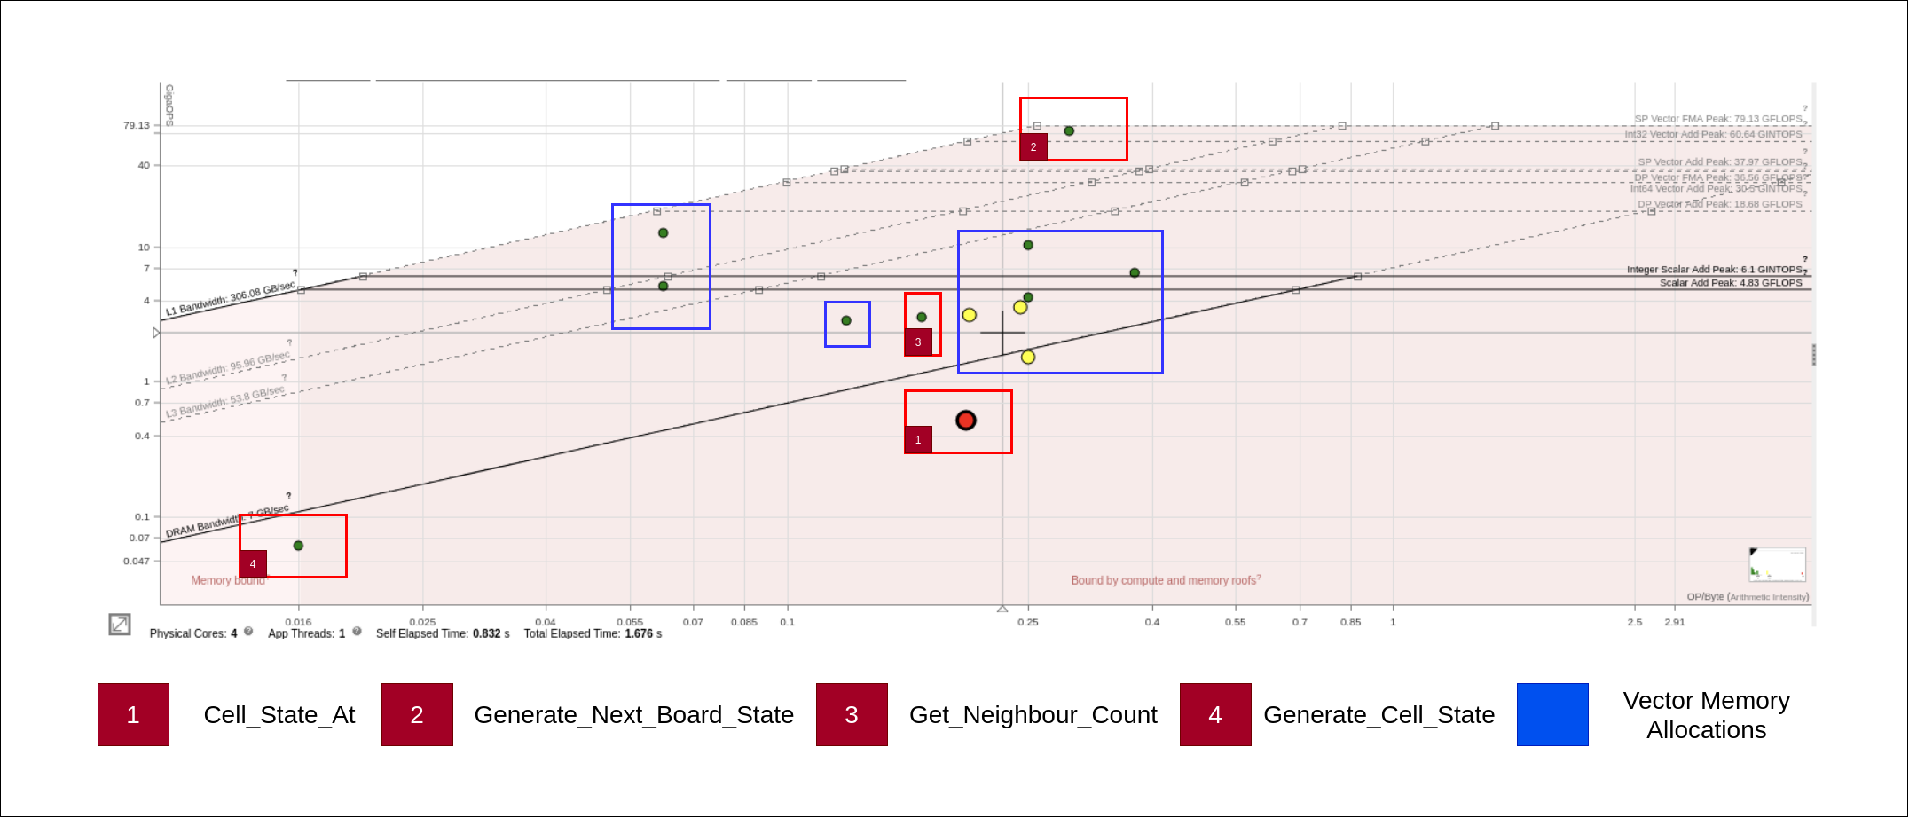
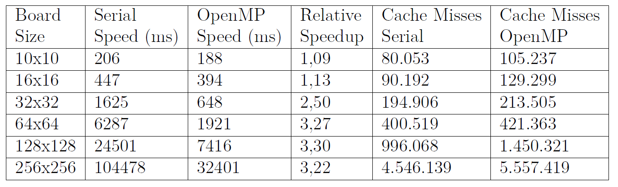
Performance Metrics and Limiting Factors
Vector Memory Allocations
Memory Bound
Cell_State_At

Slide 8
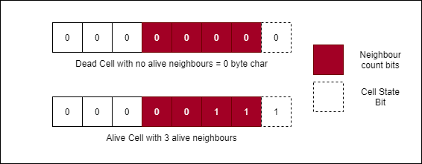
Data Representation
typedef struct
{
u_char* cells = nullptr;
u_int rows;
u_int cols;
u_int length;
} board_t;

Slide 9
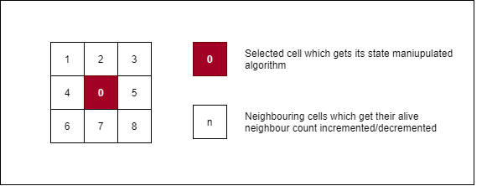
Cell State Manipulation
void spawn_cell(board_t& board,const u_int& row, const u_int& col){
// index 1d array as 2d array
u_char* cell_ptr = board.cells + (col * board.cols) + row;
// make cell alive by setting first bit to 1
*(cell_ptr) |= 0x01;
// Handle indexes if the cell is on the edges of the board
int x_left, x_right, y_above, y_below;
get_wrap_indexes(board, row, col, x_left, x_right, y_above, y_below);
*(cell_ptr + y_above + x_left) += 0x02; //[1]
*(cell_ptr + y_above) += 0x02; //[2]
*(cell_ptr + y_above + x_right) += 0x02; //[3]
*(cell_ptr + x_left) += 0x02; //[4]
*(cell_ptr + x_right) += 0x02; //[5]
*(cell_ptr + y_below + x_left) += 0x02; //[6]
*(cell_ptr + y_below) += 0x02; //[7]
*(cell_ptr + y_below + x_right) += 0x02; //[8]
}

Slide 10
State Generation
void generate_next_board_state(board_t& board, board_t& temp_board) {
memcpy(temp_board.cells, board.cells, board.length);
for (u_int index = 0; index < board.rows * board.cols; index++) {
auto lookup_cell_ptr = temp_board.cells + index;
if (*lookup_cell_ptr == 0)
continue;
auto nb_count = (*lookup_cell_ptr) >> 1;
bool is_alive = (*lookup_cell_ptr) & 0b01;
if (is_alive) {
// if the cell stays alive, skip
if (2 <= nb_count && nb_count <= 3)
continue;
u_int col = index % board.rows;
u_int row = index / board.rows;
// // kill the cell
kill_cell(board, col, row);
} else {
// cell only gains life when it has precisely 3 neighbours
if (nb_count != 3)
continue;
u_int col = index % board.rows;
u_int row = index / board.rows;
spawn_cell(board, col, row);
}
}
}

Slide 11
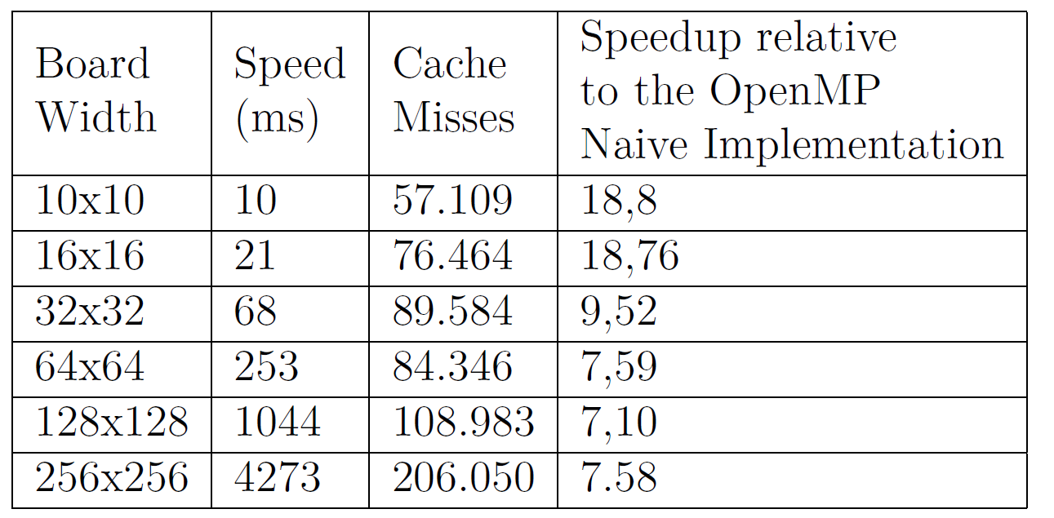
Optimized Version - Performance Metrics

Slide 12
OpenCL Implementation

Slide 13


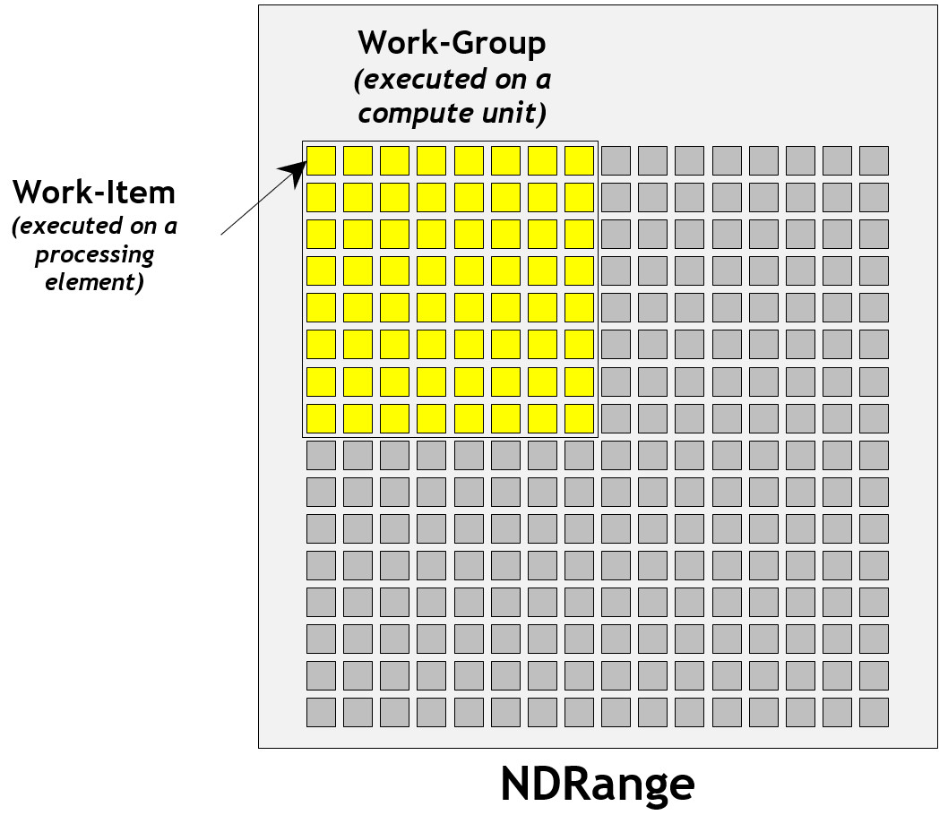
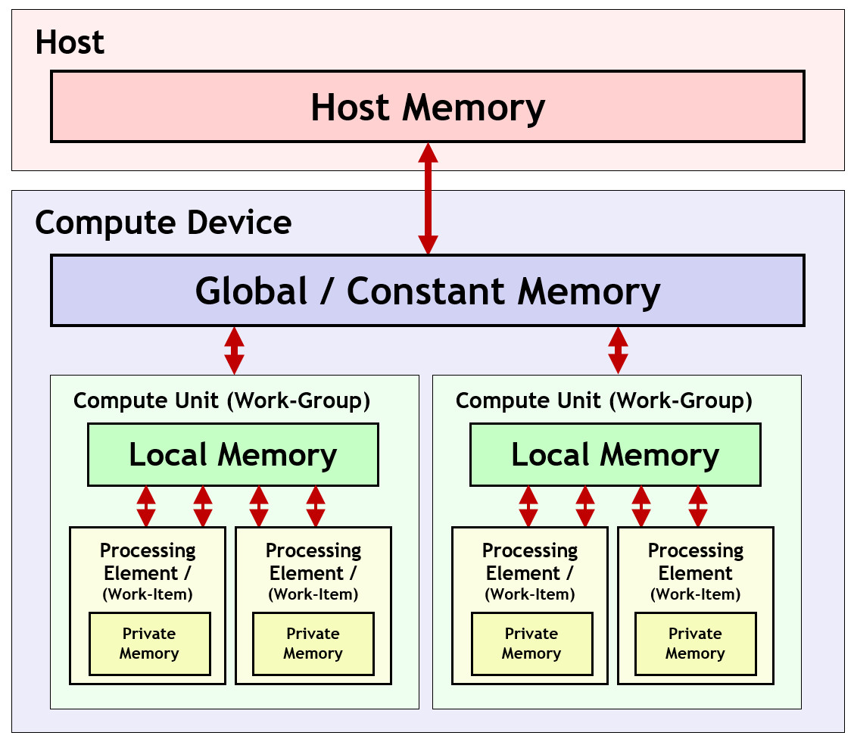
OpenCL

Slide 14
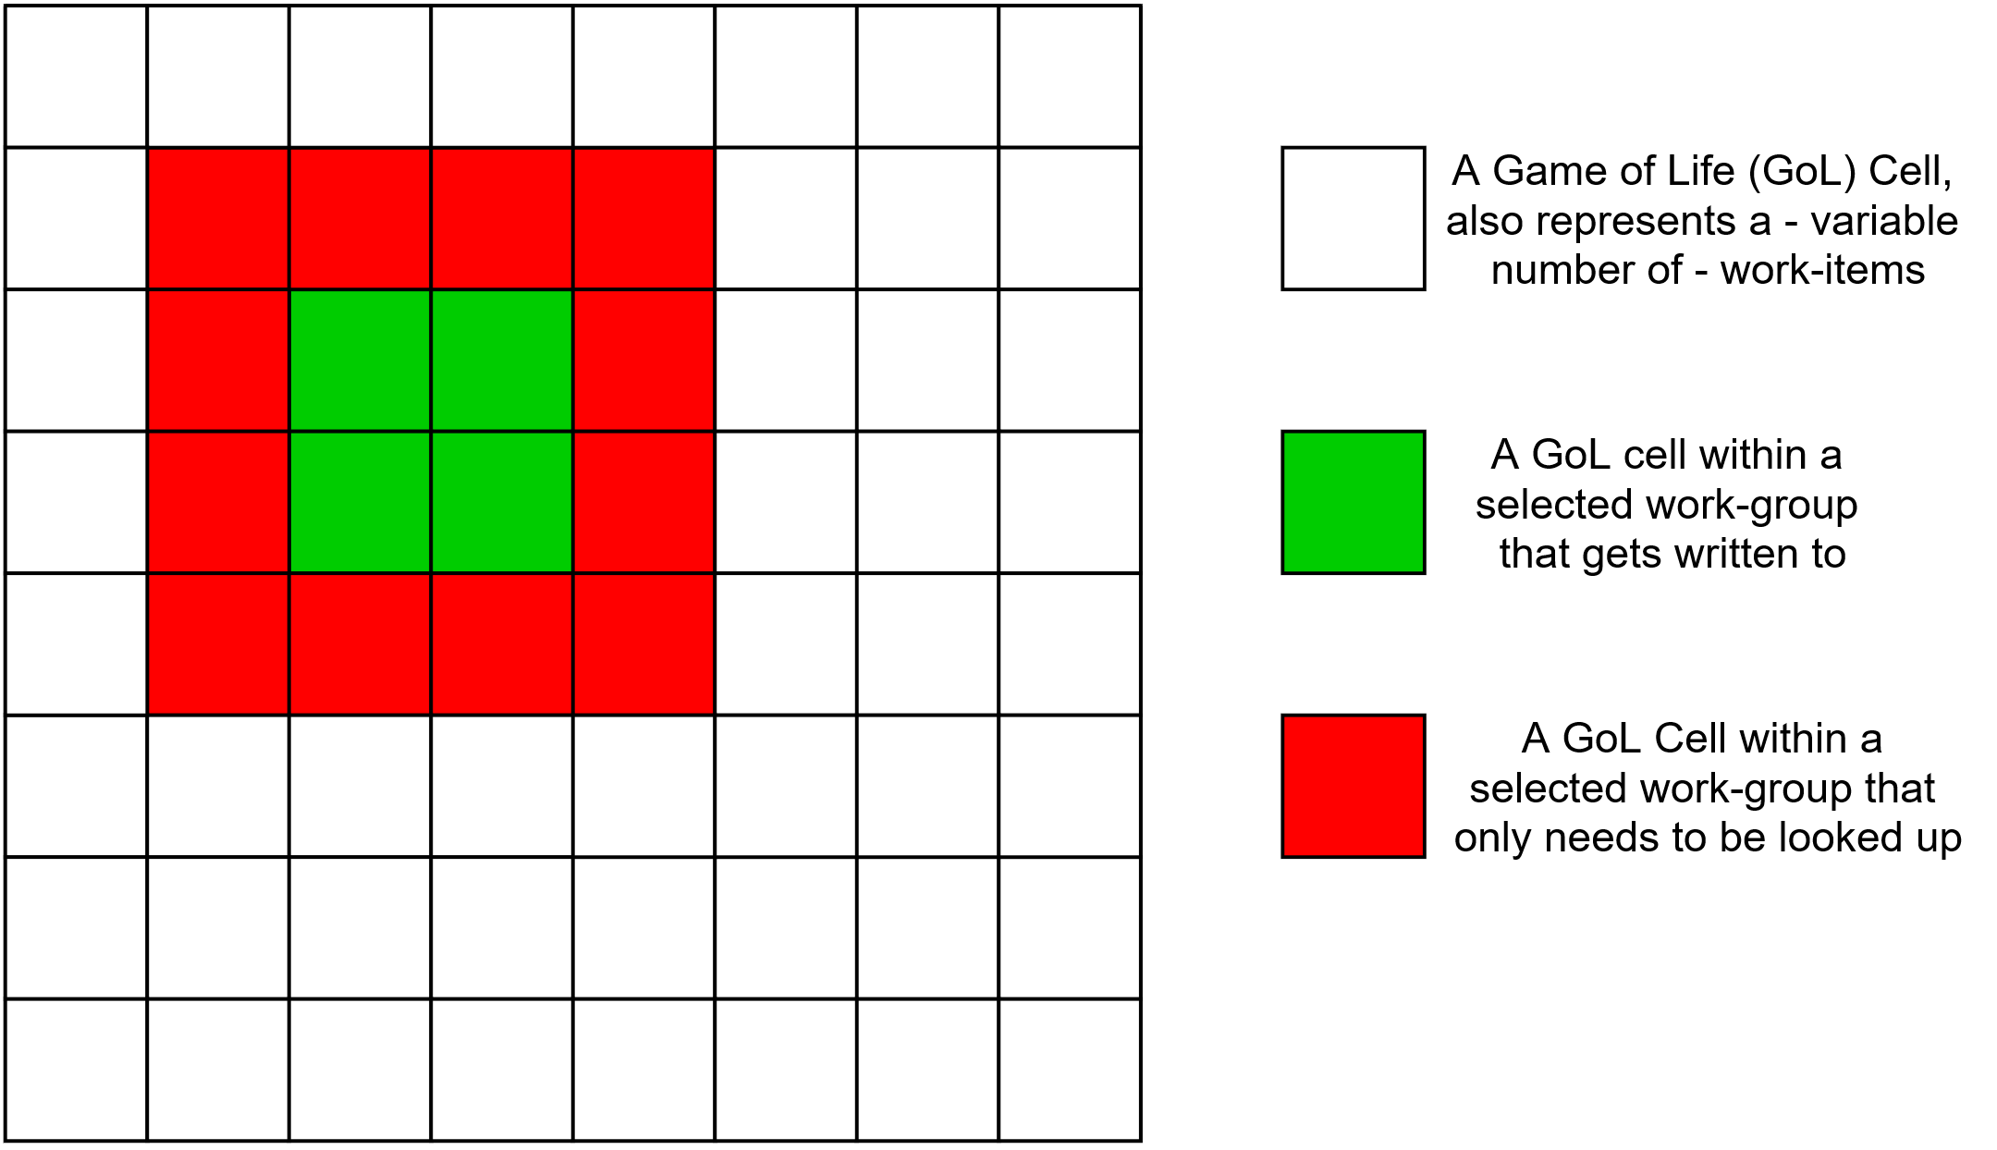
Porting GoL to OpenCL

Slide 15
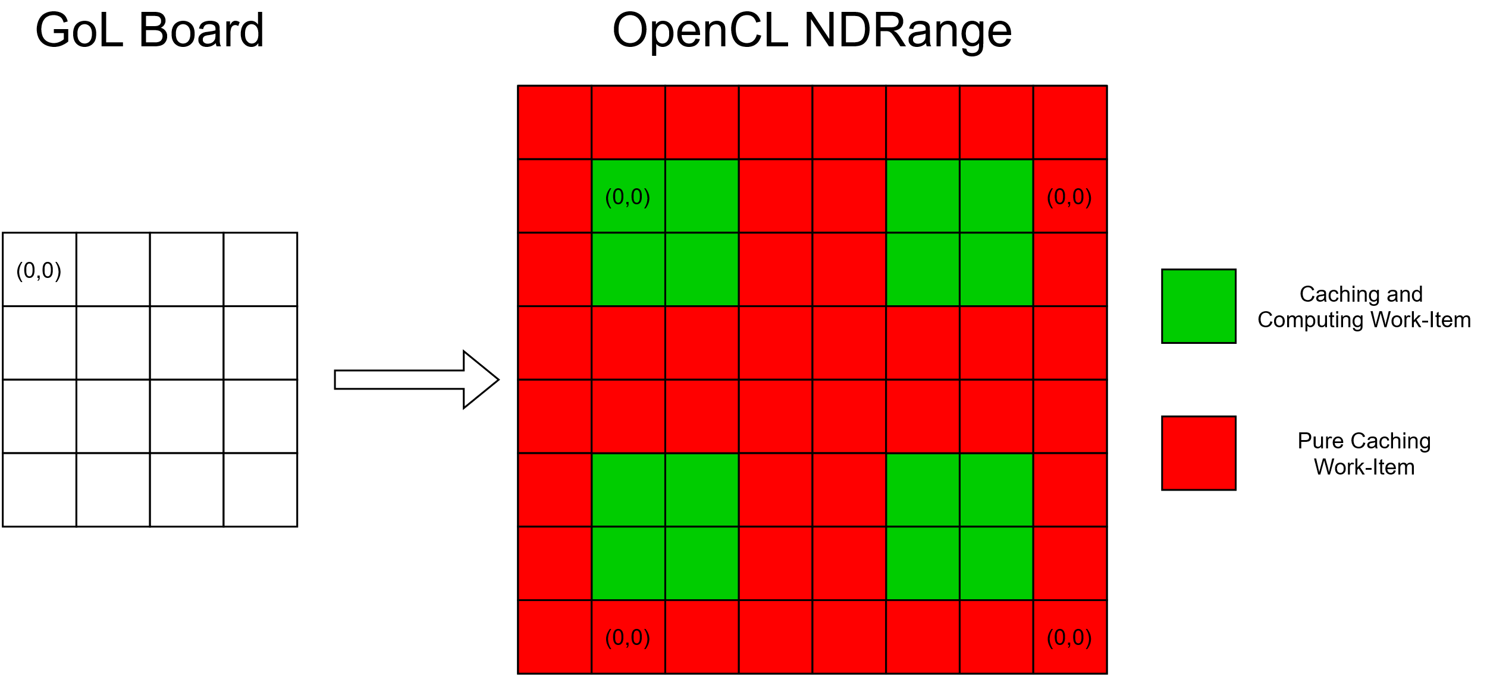
GoL Board vs OpenCL NDRange

Slide 16
OpenCL Kernel (V1)
#define BLOCK_SIZE 6
#define LOCAL_MEM_BLOCK_SIZE (BLOCK_SIZE + 2)
/// fixes modulo for the purposes of this file (maximally negative the modulo range).
int fixed_modulo(int val, int mod) {
return (val + mod) % mod;
}
kernel void game_of_life_split(
int x_width,
int y_width,
global bool* board,
local bool* group_board // has size LOCAL_MEM_BLOCK_SIZE²
)
{
int y_local = get_local_id(0);
int x_local = get_local_id(1);
int y_group = get_group_id(0);
int x_group = get_group_id(1);
// "true" x and y position on the board (not bloated by larger kernel workgroup size for caching, wrapped around)
int y = fixed_modulo(y_group * BLOCK_SIZE + (y_local - 1), y_width);
int x = fixed_modulo(x_group * BLOCK_SIZE + (x_local - 1), x_width);
bool was_alive = board[y * x_width + x];
group_board[y_local * LOCAL_MEM_BLOCK_SIZE + x_local] = was_alive;
// if this is a cell at the border its only real purpose was to write the local memory. I left the other stuff there because it will still realistically be executed like this
bool is_compute_cell = !((y_local == 0) | (y_local == (BLOCK_SIZE + 1)) |
(x_local == 0) | (x_local == (BLOCK_SIZE + 1)));
int nb_count = 0;
barrier(CLK_LOCAL_MEM_FENCE);
// indexing like this is only legal in the actually calculated cells
if (is_compute_cell) {
nb_count += […];
}
bool would_stay_alive = (2 <= nb_count) & (nb_count <= 3);
bool would_gain_live = nb_count == 3;
bool is_alive_now = was_alive ? would_stay_alive : would_gain_live;
barrier(CLK_GLOBAL_MEM_FENCE);
if (is_compute_cell) {
board[y * y_width + x] = is_alive_now;
}
}

Slide 17
OpenCL Kernel (V2)
#define BLOCK_SIZE 6
#define LOCAL_MEM_BLOCK_SIZE (BLOCK_SIZE + 2)
/// fixes modulo for the purposes of this file (maximally negative the modulo range).
int fixed_modulo(int val, int mod) {
return (val + mod) % mod;
}
kernel void game_of_life_split(
int x_width,
int y_width,
global bool* src_board,
global bool* dst_board,
local bool* group_board // has size LOCAL_MEM_BLOCK_SIZE²
)
{
int y_local = get_local_id(0);
int x_local = get_local_id(1);
int y_group = get_group_id(0);
int x_group = get_group_id(1);
// "true" x and y position on the board (not bloated by larger kernel workgroup size for caching, wrapped around)
int y = fixed_modulo(y_group * BLOCK_SIZE + (y_local - 1), y_width);
int x = fixed_modulo(x_group * BLOCK_SIZE + (x_local - 1), x_width);
bool was_alive = src_board[y * x_width + x];
group_board[y_local * LOCAL_MEM_BLOCK_SIZE + x_local] = was_alive;
// if this is a cell at the border its only real purpose was to write the local memory. I left the other stuff there because it will still realistically be executed like this
bool is_compute_cell = !((y_local == 0) | (y_local == (BLOCK_SIZE + 1)) | (x_local == 0) | (x_local == (BLOCK_SIZE + 1)));
int nb_count = 0;
barrier(CLK_LOCAL_MEM_FENCE);
// indexing like this is only legal in the actually calculated cells
if (is_compute_cell) {
nb_count += […];
}
bool would_stay_alive = (2 <= nb_count) & (nb_count <= 3);
bool would_gain_live = nb_count == 3;
bool is_alive_now = was_alive ? would_stay_alive : would_gain_live;
if (is_compute_cell) {
dst_board[y * y_width + x] = is_alive_now;
}
}

Slide 18
OpenCL Kernel (V2)
#define BLOCK_SIZE 6
#define LOCAL_MEM_BLOCK_SIZE (BLOCK_SIZE + 2)
/// fixes modulo for the purposes of this file (maximally negative the modulo range).
int fixed_modulo(int val, int mod) {
return (val + mod) % mod;
}
kernel void game_of_life_split(
int x_width,
int y_width,
global bool* src_board,
global bool* dst_board,
local bool* group_board // has size LOCAL_MEM_BLOCK_SIZE²
)
{
int y_local = get_local_id(0);
int x_local = get_local_id(1);
int y_group = get_group_id(0);
int x_group = get_group_id(1);
// "true" x and y position on the board (not bloated by larger kernel workgroup size for caching, wrapped around)
int y = fixed_modulo(y_group * BLOCK_SIZE + (y_local - 1), y_width);
int x = fixed_modulo(x_group * BLOCK_SIZE + (x_local - 1), x_width);
bool was_alive = src_board[y * x_width + x];
group_board[y_local * LOCAL_MEM_BLOCK_SIZE + x_local] = was_alive;
// if this is a cell at the border its only real purpose was to write the local memory. I left the other stuff there because it will still realistically be executed like this
bool is_compute_cell = !((y_local == 0) | (y_local == (BLOCK_SIZE + 1)) | (x_local == 0) | (x_local == (BLOCK_SIZE + 1)));
int nb_count = 0;
barrier(CLK_LOCAL_MEM_FENCE);
// indexing like this is only legal in the actually calculated cells
if (is_compute_cell) {
nb_count += […];
}
bool would_stay_alive = (2 <= nb_count) & (nb_count <= 3);
bool would_gain_live = nb_count == 3;
bool is_alive_now = was_alive ? would_stay_alive : would_gain_live;
if (is_compute_cell) {
dst_board[y * y_width + x] = is_alive_now;
}
}

Slide 19
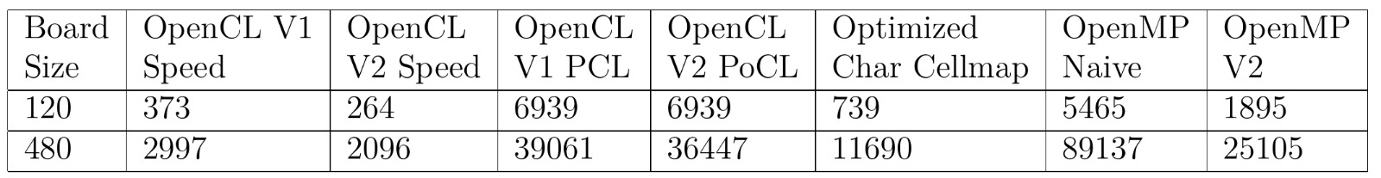
Overall Performance Metrics

Slide 20

Questions?
Sources:
OpenCL Infografiken: https://github.com/KhronosGroup/OpenCL-Guide (CC-BY 4.0)

