Slide 1
TERRAFORM
Presented by
G Kasiraju

Slide 2
Agenda:
What is exactly meaning of terraform ?
Declarative vs imperative language
Ansible vs terraform
Tool for infrastructure provision and where your terraform comes into picture
Terraform Architecture
Terraform commands
Use case with help CI/CD tool

Slide 3
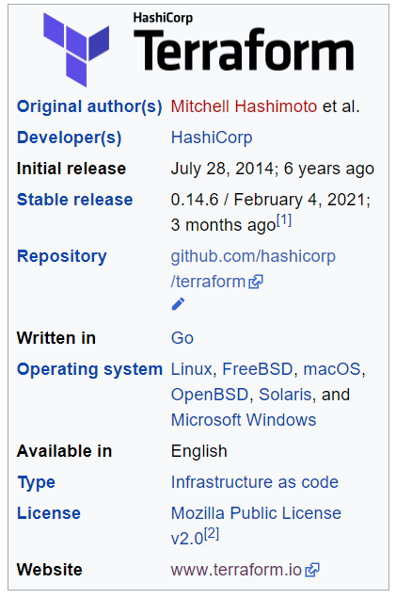
Terraform: Terraform is a tool for building, changing, and versioning infrastructure safely and efficiently. Terraform can manage existing and popular service providers.
Simply we can say “terraform allows to you automate your
infrastructure , and your platform and service that run on that
platform”
It is open source Iac tool
Which is written declarative language
Configuration language called the HashiCrop configuration
Language(HCL) for human readable, automate deployment

Slide 4
Declartaive:
A declarative approach defines the desired state of the system, including what resources you need and any properties they should have, and an IaC tool will configure it for you.
A declarative approach also keeps a list of the current state of your system objects, which makes taking down the infrastructure simpler to manage.
Imperative:
An imperative approach define the specific commands needed to achieve the desired configuration, and those commands then need to be executed in the correct order.
Imperative is procedural language like C, C++

Slide 5
Consistency:
Manual processes result in mistakes, period. Humans are fallible. Our memories fault us. Communication is hard. IaC solves that problem by having the config files themselves be the single source of truth. That way, you guarantee the same configurations will be deployed over and over, without discrepancies.
Idempotency:
We run same command again and again to get same result(getting the same state)

Slide 6
PUSH AND PULL:
The main difference is the manner in which the servers are told how to be configured.
In the pull method the server to be configured will pull its configuration from the controlling server.
In the push method the controlling server pushes the configuration to the destination system
Ansible will work on push mechanism.
It will work as a agentless architecture
Mutable infrastructure is infrastructure that can be modified or updated after it is originally provisioned
immutable infrastructure is infrastructure that cannot be modified once originally provisioned

Slide 7
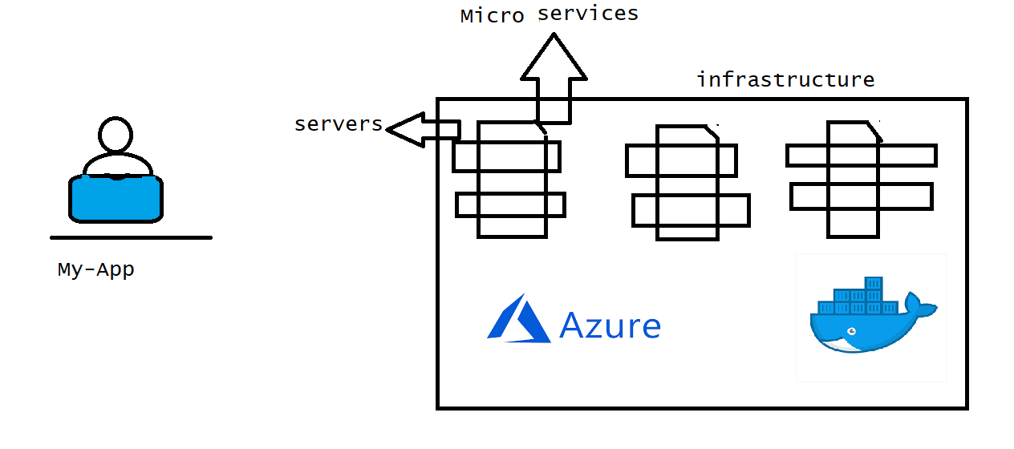
Tool for infrastructure provision:
Create VPC
spin up servers
Creating aws or azure resources
Installing Docker etc.

Slide 8
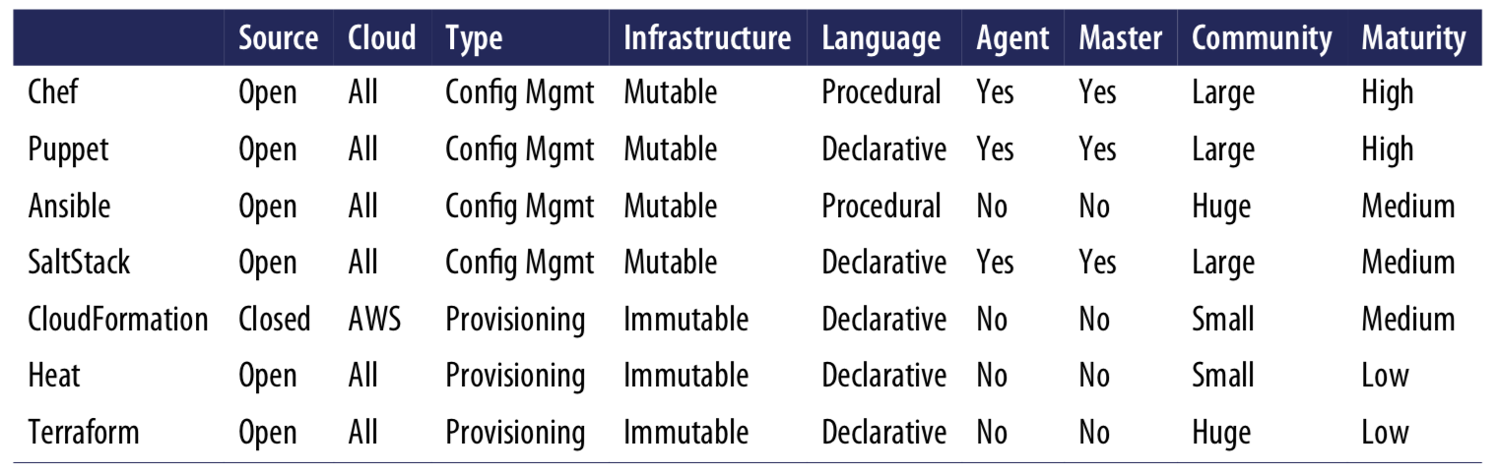
Difference between Iac Tools

Slide 9
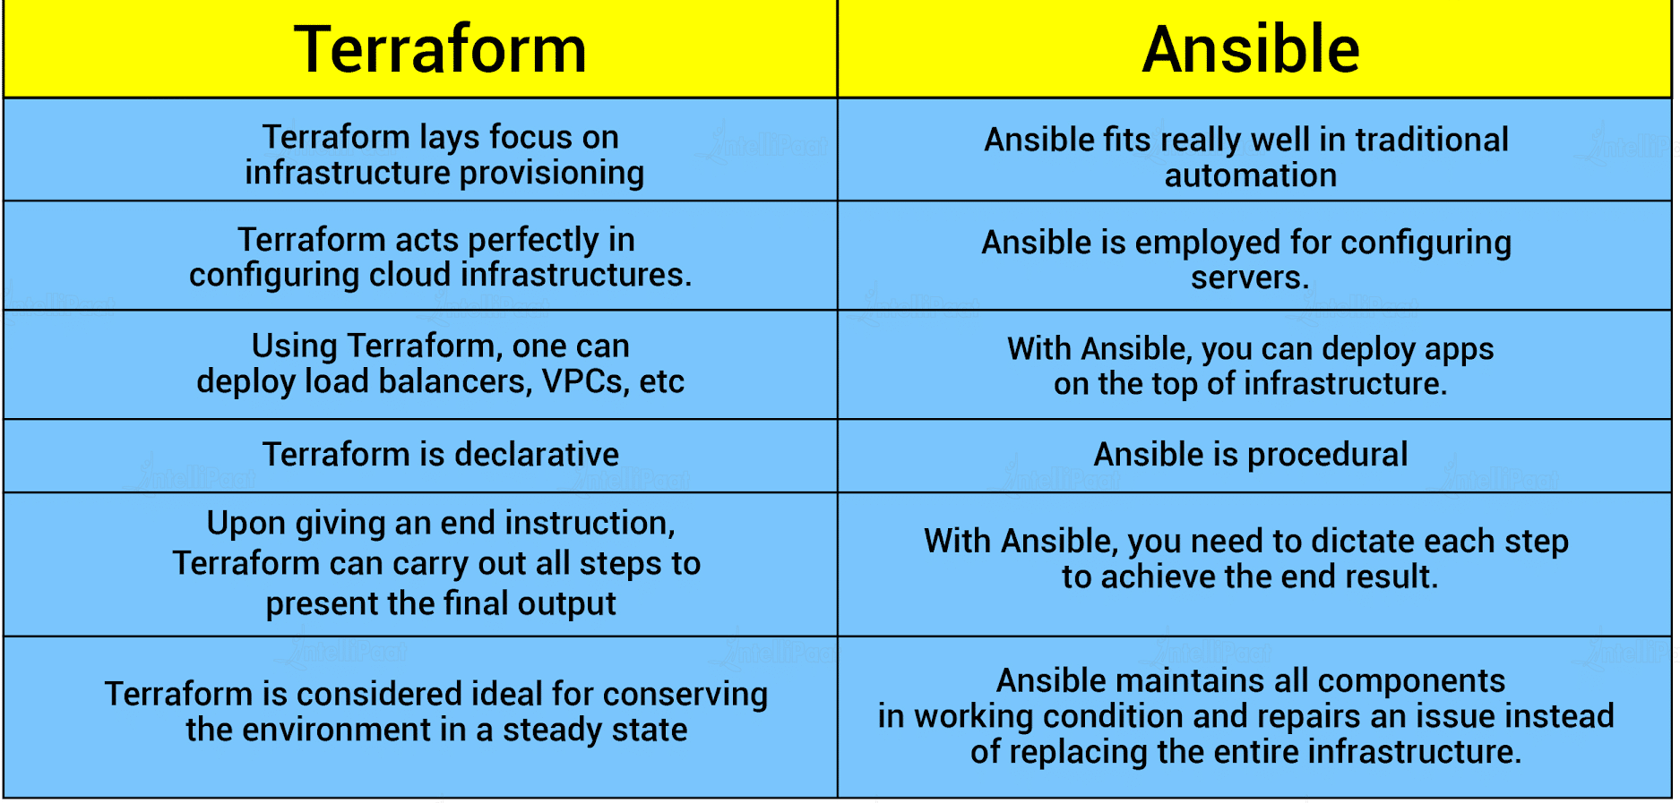

Slide 10
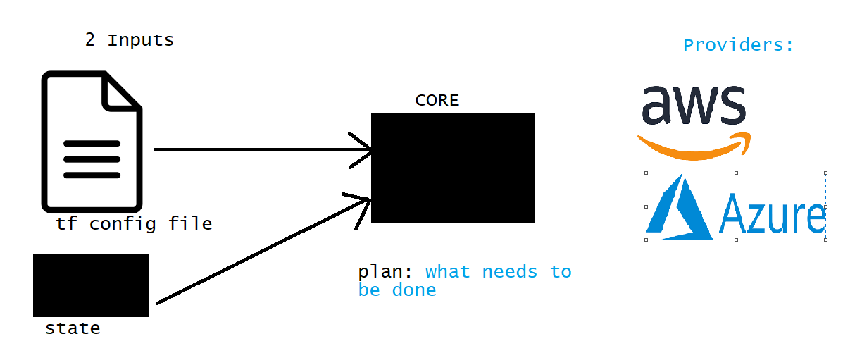
Terraform Architecture:

Slide 11
Terraform commands:
Terraform has five major commands:
$terraform init —initialize a terraform working directory
$terraform validate —confirm the syntax
$terraform plan – it shows what will change and when to run
$terraform apply - builds or change infrastructure
$terraform destroy -deletes and remove managing infrastructure
$terraform refresh- query will give provide to get current state

Slide 12
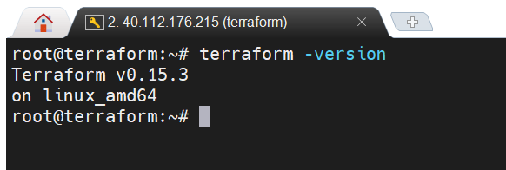
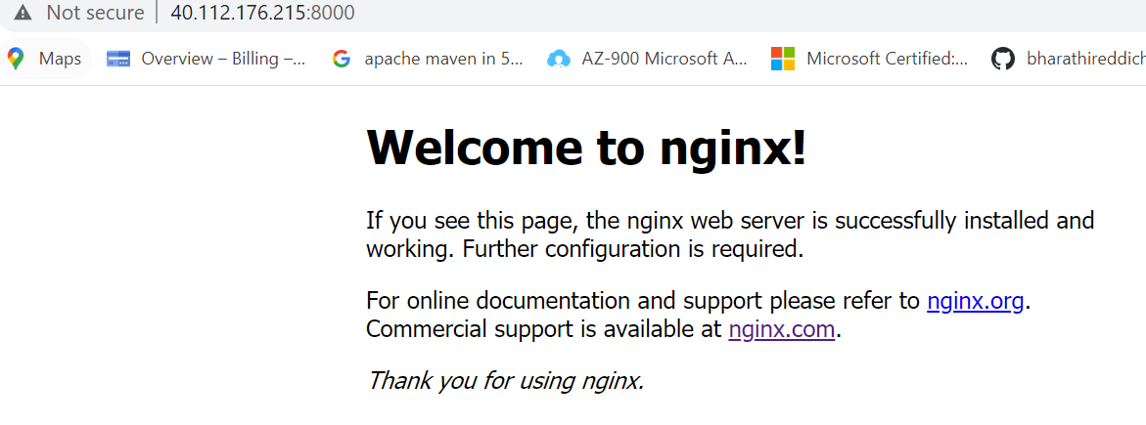
Installation:
terraform –version
Example: pulling the ngnix image from Docker configure in main.tf
terraform apply

Slide 13
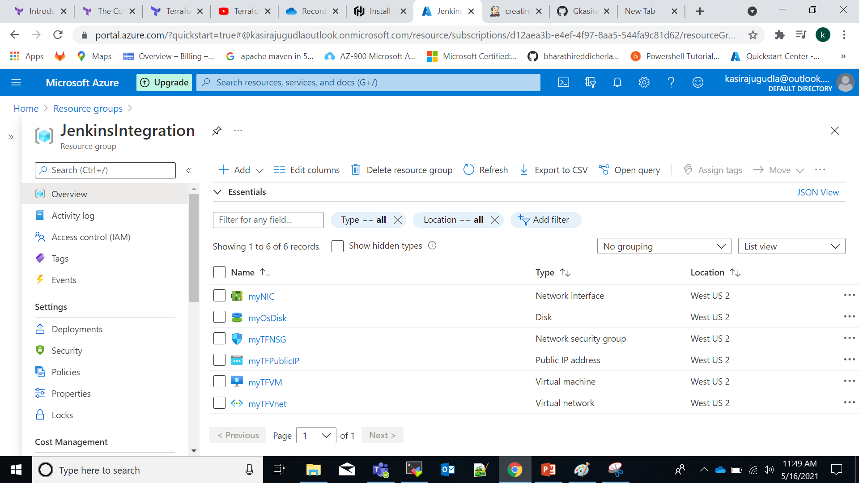
Automate with help of Jenkins:
With help of Jenkins we can automate the above process by writing the pipeline script
Azure login (az login)

