Slide 1

Jenkins g. KASIRAU

Slide 2
Topics:
What is Jenkins and why Jenkins ?
Workflow of Jenkins
How to download Jenkins and steps for download Jenkins
How Jenkins is setup in Tomcat
Some Practical demo on Git

Slide 3
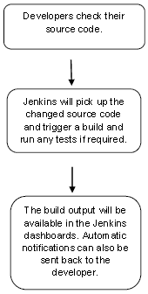
Work flow of Jenkins:
Why Jenkins: Jenkins is a software that allows continuous integration. Jenkins will be installed on a server where the central build will take place

Slide 4
Download Jenkins and steps to follow

Slide 5
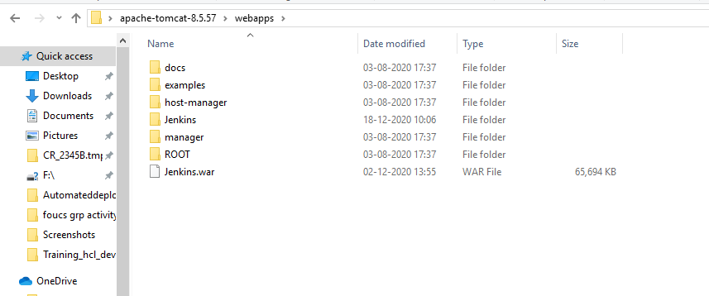
Tomcat setup in Jenkins:
1. Jenkis.war placed in inside webapps of tomcat folder .
2.Restart the server

Slide 6
Git setup:
Download the Git Plugin
Crown the code from GitHub account that is must be public.
Apply and save the changes
Finally Build Now.

Slide 7
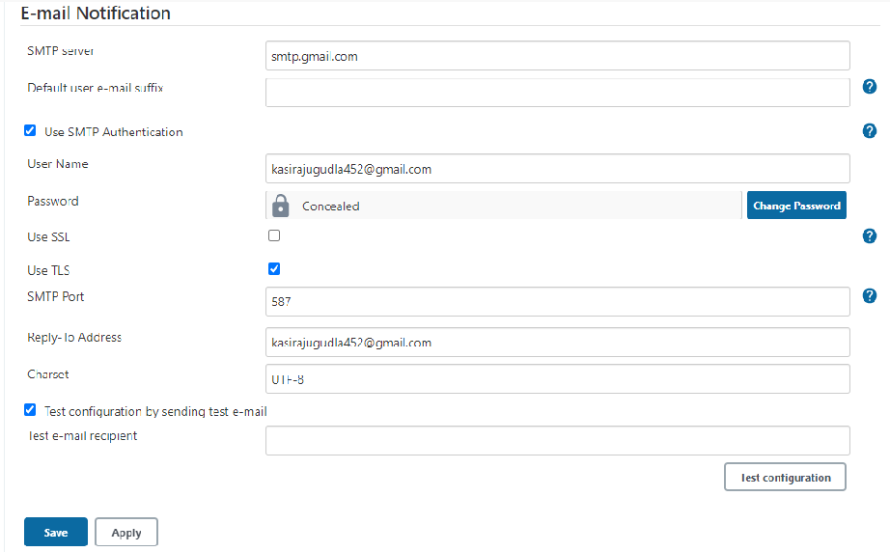
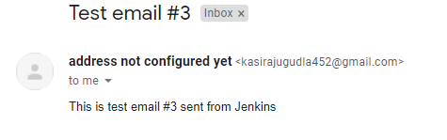
EMAIL NOTIFICATION:
What will be procedure to get email notification from the Jenkins?
Low Secure Apps ?
How to test ?

Slide 8
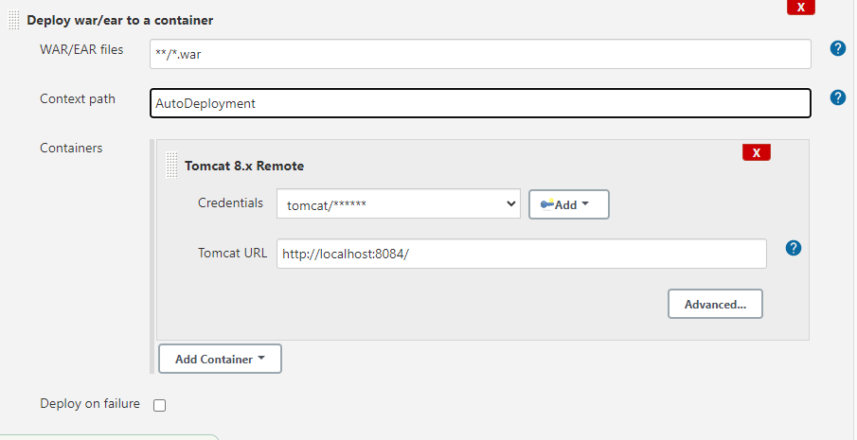
Automatic deploy:
Steps:
Download or install plugins
Crown the code from the LR
Tomcat set up and manager login
Setup the configure and Build it.

Slide 9
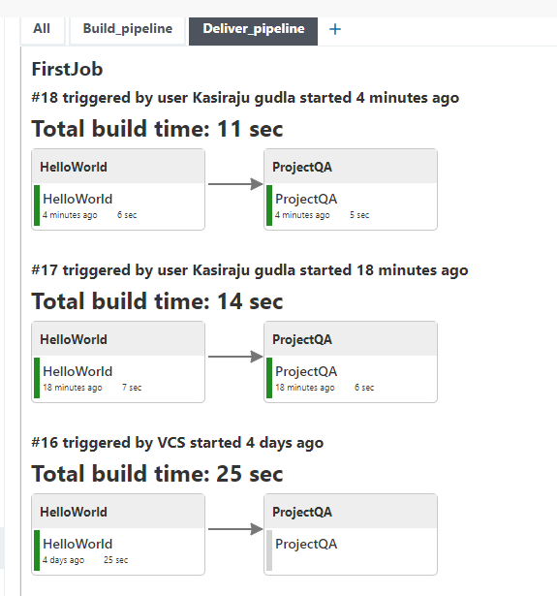
Continuous Deployment
Steps:
Choose ‘Add post-build action’ and choose ‘Build other projects’
We need to install Delivery Pipeline View or Build Pipeline Plugin .
Also we can do Backup of code like we need to install the Backup plugin.

Slide 10
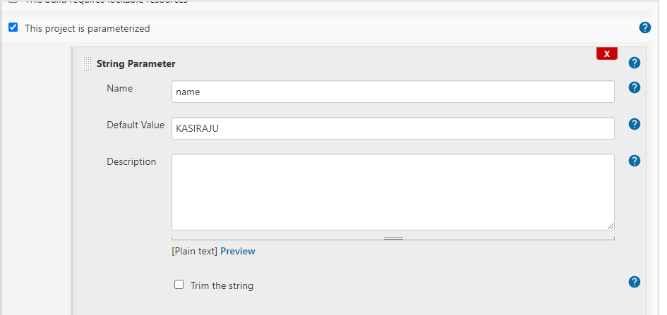
Parametrized jobs
Select THIS PROJECT IS PARAMETRIZED.
In the add build setup select the windows batch command.
Echo %message%

Slide 11
THROUGH CMD
Initial we download the Jenkins-cli
Also we need to change some settings in configure global Security
In the authorization select Anyone can do anything
-f for build process
-s –v for follow the output

Slide 12


