Slide 1
Chapter 10: Storage and File Structure

Slide 2
Chapter 10: Storage and File Structure
Overview of Physical Storage Media
Magnetic Disks
RAID
Tertiary Storage
Storage Access
File Organization
Organization of Records in Files
Data-Dictionary Storage

Slide 3
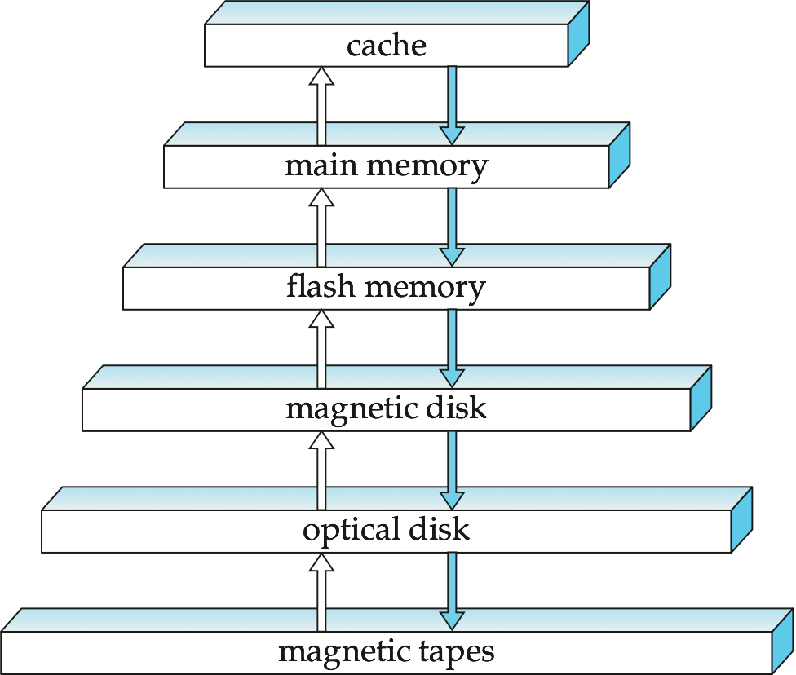
Storage Hierarchy

Slide 4
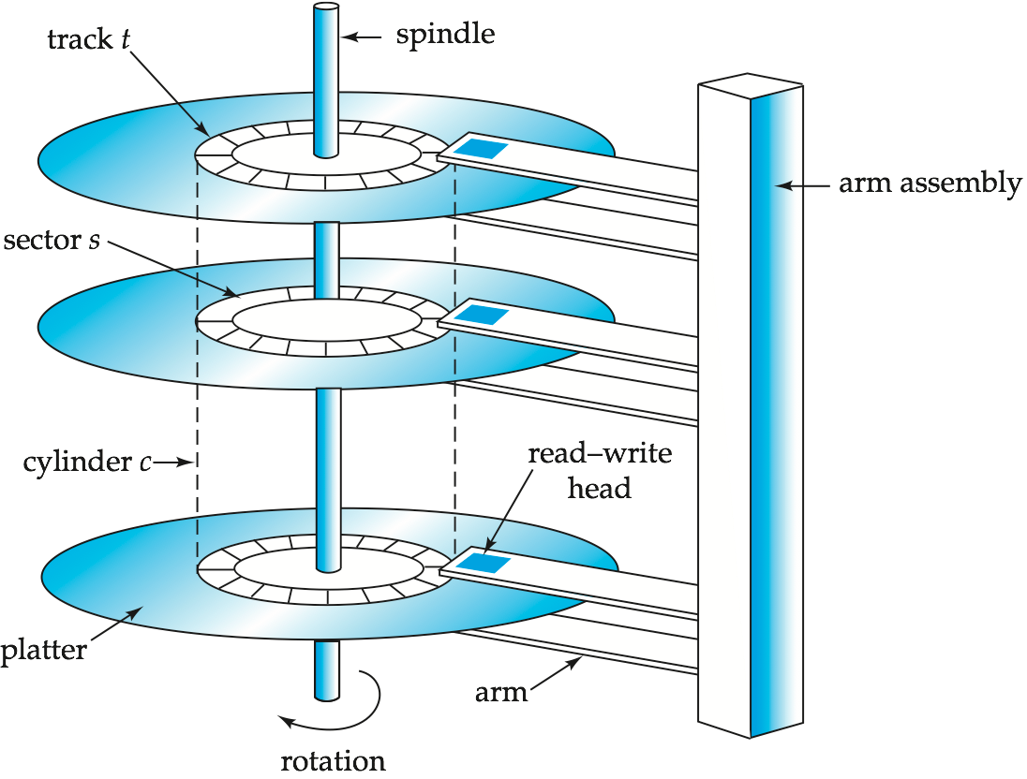
Magnetic Hard Disk Mechanism
NOTE: Diagram is schematic, and simplifies the structure of actual disk drives

Slide 5
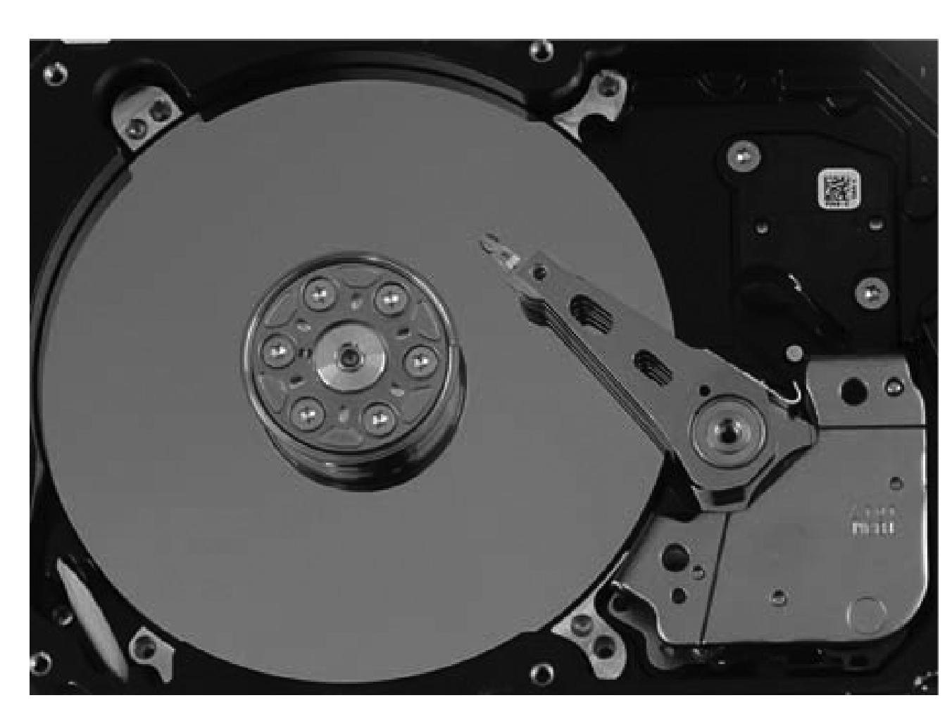
Magnetic Hard Disk Mechanism

Slide 6
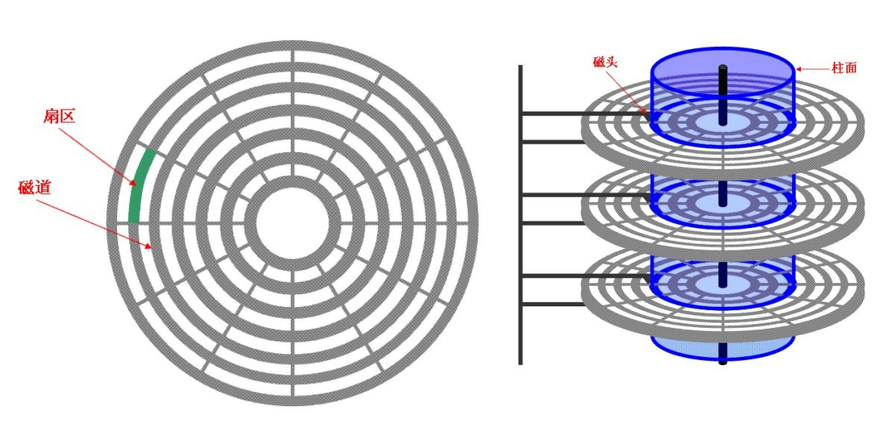

Slide 7
Magnetic Disks
Surface of platter divided into circular tracks
Over 50K-100K tracks per platter on typical hard disks
Each track is divided into sectors.
A sector is the smallest unit of data that can be read or written.
Example. On receiving an instruction to read the disk 1 bit, the read-write head will read the disk 1 sector.
Sector size typically 512 bytes
Typical sectors per track: 500 to 1000 (on inner tracks) to 1000 to 2000 (on outer tracks)
To read/write a sector
disk arm swings to position head on right track
platter spins continually; data is read/written as sector passes under head
Cylinder i consists of i^{th} track of all the platters

Slide 8
Performance Measures of Disks
Tatol time = Seek time + Rotational latency+ transfer time
Access time = – the time it takes from when a read or write request is issued to when data transfer begins.
Access time = Seek time + Rotational latency
Seek time – time it takes to reposition the arm over the correct track.
Average seek time is 1/2 the worst case seek time.
Would be 1/3 if all tracks had the same number of sectors, and we ignore the time to start and stop arm movement
4 to 10 milliseconds (千分之一秒) on typical disks
Rotational latency – time it takes for the sector to be accessed to appear under the head.
Average latency is 1/2 of the worst case latency.
4 to 11 milliseconds on typical disks (5400 to 15000 r.p.m.)
Data-transfer rate – the rate at which data can be retrieved from or stored to the disk.
25 to 100 MB per second max rate, lower for inner tracks
Multiple disks may share a controller, so rate that controller can handle is also important
E.g. SATA: 150 MB/sec, SATA-II 3Gb (300 MB/sec)
Ultra 320 SCSI: 320 MB/s, SAS (3 to 6 Gb/sec)
Fiber Channel (FC2Gb or 4Gb): 256 to 512 MB/s

Slide 9

Optimization of Disk-Block Access
Block – a contiguous sequence of sectors from a single track
data is transferred between disk and main memory in blocks
1 block = multiple consecutive sectors
sizes range from 512 bytes to several kilobytes
Smaller blocks: more transfers from disk
Larger blocks: more space wasted due to partially filled blocks
Typical block sizes today range from 4 to 16 kilobytes

Slide 10
Optimization of Disk Block Access (Cont.)
File organization – optimize block access time by organizing the blocks to correspond to how data will be accessed
E.g. Store related information on the same or nearby cylinders.
Files may get fragmented over time
E.g. if data is inserted to/deleted from the file
Or free blocks on disk are scattered, and newly created file has its blocks scattered over the disk
Sequential access to a fragmented file results in increased disk arm movement
Some systems have utilities to defragment the file system, in order to speed up file access

Slide 11
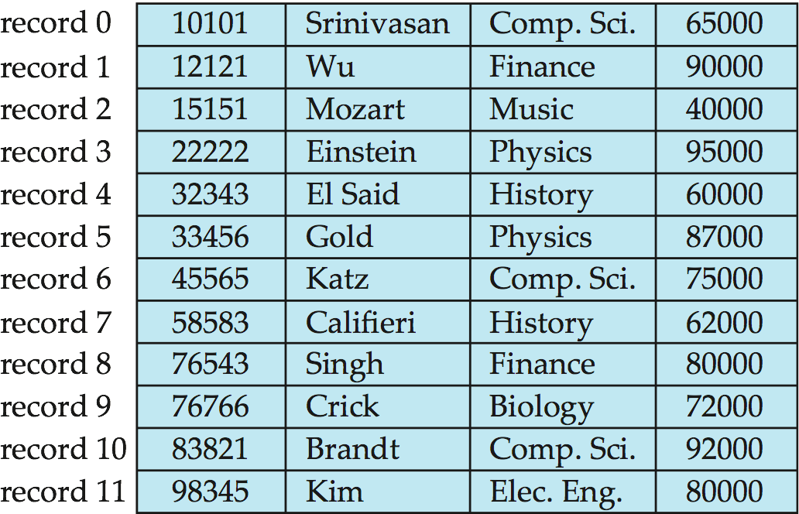
Fixed-Length Records
Simple approach:
Store record i starting from byte n ∗ (i – 1), where n is the size of each record.
Record access is simple but records may cross blocks
Modification: do not allow records to cross block boundaries
Deletion of record i: alternatives:
move records i + 1, . . ., n to i, . . . , n – 1
move record n to i
do not move records, but link all free records on a free list

Slide 12
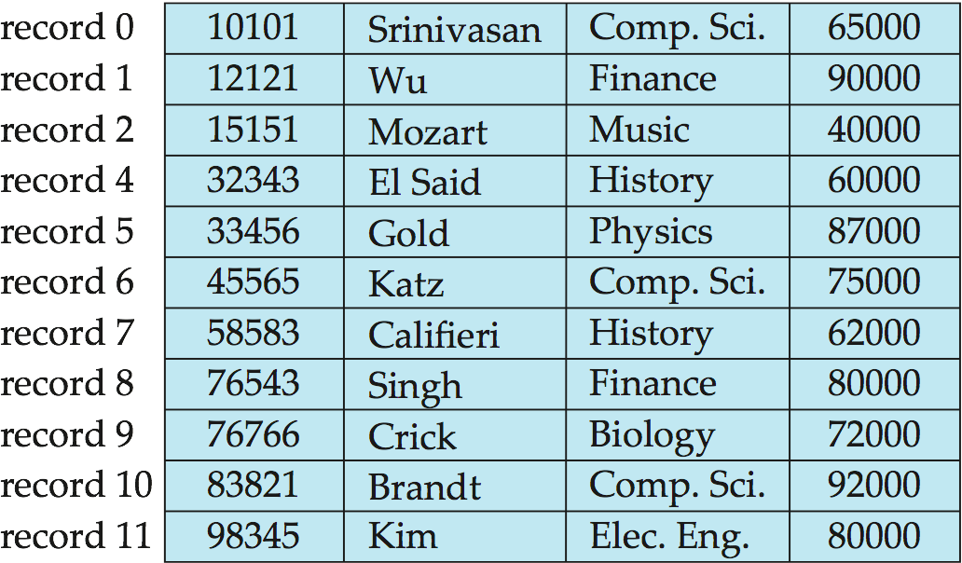
Deleting record 3 and compacting

Slide 13
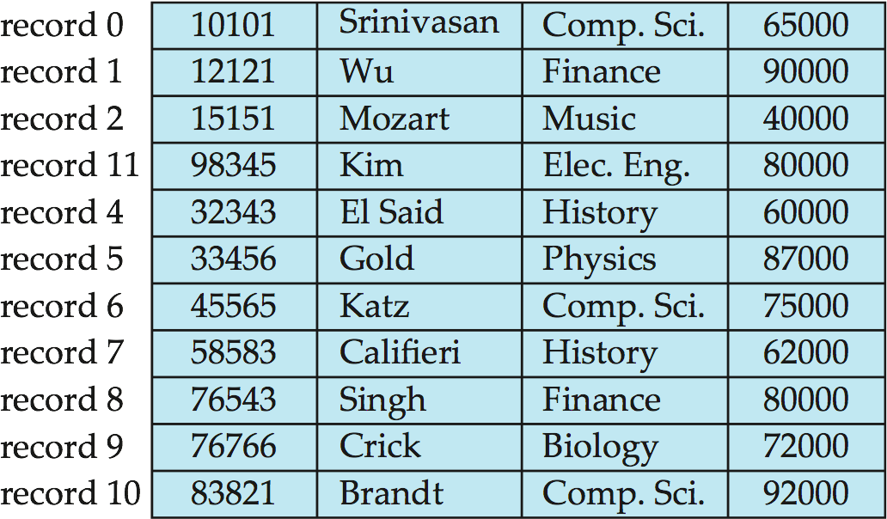
Deleting record 3 and moving last record

Slide 14
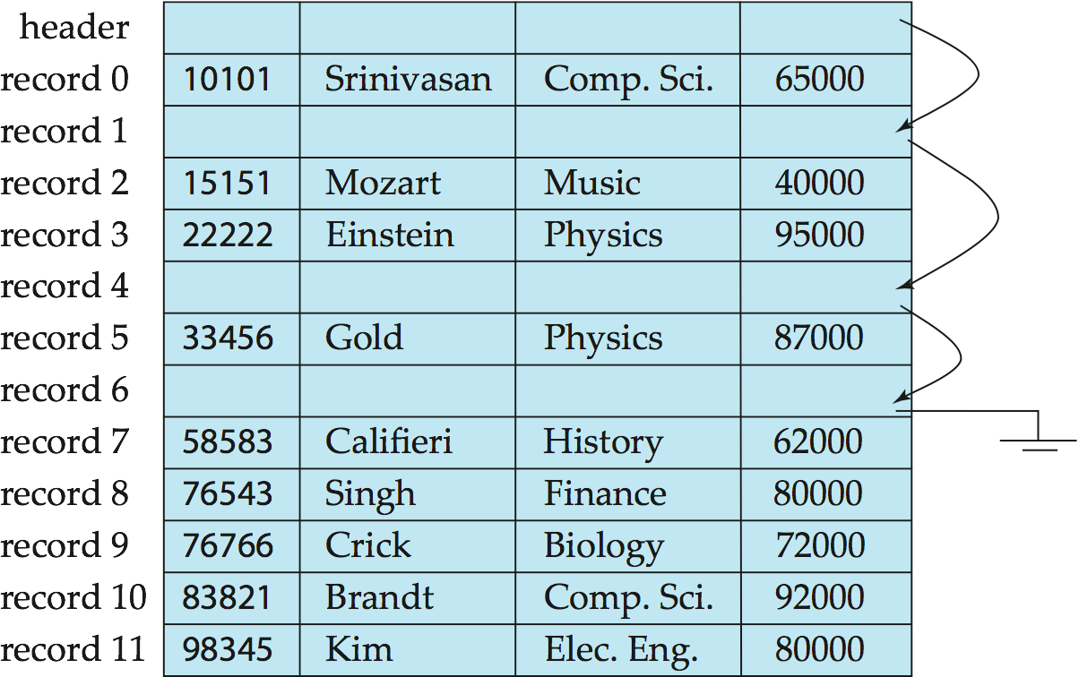
Free Lists
Store the address of the first deleted record in the file header.
Use this first record to store the address of the second deleted record, and so on
Can think of these stored addresses as pointers since they “point” to the location of a record.
More space efficient representation: reuse space for normal attributes of free records to store pointers. (No pointers stored in in-use records.)

Slide 15
Summary
1 file = multiple blocks; 1 block = multiple sectors
Disk & Head
A sector is the smallest unit of data that can be read or written.
Cost of reading disk 1 bit
= Cost of reading disk 1 sector
Disk & Memory
data is transferred in blocks
Cost of transferring 1 bit between disk & memory
=Cost of transferring 1 block between disk & memory

Slide 16
Disk Cost
Tatol time = Seek time + Rotational latency+ transfer time
In database, we only consider:
number of seeks
number of block transfers
These two are independent of devices.
Let an algorithm access two blocks: B1, B2
number of seeks: 1 if B1&B2 are adjacent or in the same track; 2 if B1&B2 are distributed over distinct tracks.
number of block transfers: always 2.

Slide 18
s₁
s₂
s₃
s₄
s₅
001
002
003
004
005
006
007
008
009
010
t₁
t₂
t₃
t₄
t₅
Student table s: 10 records, 5 disk blocks.
Takes table t: 5 disk blocks.
An algorithm accesses the disk blocks as follows:
Access Sequence 1:
s1, t1, t2, t3, s2, t4
Access Sequence 2:
s1, t1, t2, t3, s1, s2, t4
Question: please estimate the disk cost.

Slide 19
Example of Data Access
buffer
Buffer Block A
input(A)
X
A
Buffer Block B
Y
B
output(B)
read(X)
write(Y)
x₂
x₁
y₁
work area
of T₁
work area
of T₂
memory
disk

Slide 20
