Slide 1
Chapter 2: Intro to Relational Model

Slide 2

Example of a Relation
attributes
(or columns)
tuples
(or rows)

Slide 3
Attribute Types
The set of allowed values for each attribute is called the domain of the attribute
Attribute values are (normally) required to be atomic; that is, indivisible
The special value null is a member of every domain
The null value causes complications in the definition of many operations

Slide 4
Relation Schema and Instance
A₁属性名字; D₁属性A₁的取值范围; a₁范围D₁中的一个元素
Example : A₁ = Name, D₁ =all possible names, a₁ = Einstein.
A₁, A₂, …, A_{n} are attributes
R = (A₁, A₂, …, A_{n} ) is a relation schema
Example:
instructor = (ID, name, dept_name, salary)
Formally, given sets D₁, D₂, …. D_{n} a relation r is a subset of
D₁ x D₂ x … x D_{n}
Thus, a relation is a set of n-tuples (a₁, a₂, …, a_{n}) where each a_{i} ∈ D_{i}
The current values (relation instance) of a relation are specified by a table
An element t of r is a tuple, represented by a row in a table

Slide 5
Example of a Relation
attributes
(or columns)
tuples
(or rows)

Slide 6

Database term | Math term
table | relation
domain | set of allowed values of an attribute
row | tuple
Database term | Math term
table | relation
attribute name /columns name | set name
domain | set
row | tuple

Slide 7

Relations are Unordered
Order of tuples is irrelevant (tuples may be stored in an arbitrary order)
Example: instructor relation with unordered tuples

Slide 8
Database
A database consists of multiple relations
Information about a university is broken up into parts
instructor
student
advisor
Bad design:
univ (instructor -ID, name, dept_name, salary, student_Id, ..)
results in
  repetition of information (e.g., two students have the same instructor)
  the need for null values (e.g., represent an student with no advisor)
Normalization theory (Chapter 7) deals with how to design “good” relational schemas

Slide 9
Keys
Let K ⊆ R, ( R 关系模式, 由多个属性组成)
K is a superkey of R if values for K are sufficient to identify a unique tuple of each possible relation r(R)
  Example: {ID} and {ID,name} are both superkeys of instructor.
Superkey K is a candidate key if K is minimal
Example: {ID} is a candidate key for Instructor
One of the candidate keys is selected to be the primary key.
  which one?
Foreign key constraint: Value in one relation must appear in another
  Referencing relation
  Referenced relation

Slide 10
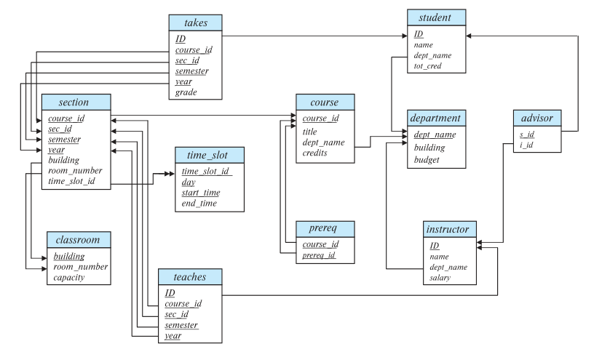
Schema Diagram for University Database

Slide 11
Relational Query Languages
Procedural vs.non-procedural, or declarative
“Pure” languages:
  Relational algebra
  Tuple relational calculus
  Domain relational calculus
Relational operators

Slide 12

Selection of tuples
Relation r
Select tuples with A=B and D > 5
σ _{A=B and D > 5} (r)

Slide 13

Selection of Columns (Attributes)
Relation r:
Select A and C
  Projection
  Π _{A, C} (r)

Slide 14

Joining two relations – Cartesian Product
Relations r, s:
r x s:

Slide 15

Union of two relations
Relations r, s:
r ∪ s:

Slide 16

Set difference of two relations
Relations r, s:
r – s:

Slide 17

Set Intersection of two relations
Relation r, s:
r ∩ s

Slide 18
Joining two relations – Natural Join
Let r and s be relations on schemas R and S respectively.
Then, the “natural join” of relations R and S is a relation on schema R ∪ S obtained as follows:
  Consider each pair of tuples t_{r} from r and t_{s} from s.
  If t_{r} and t_{s} have the same value on each of the attributes in R ∩ S, add a tuple t to the result, where
    t has the same value as t_{r} on r
    t has the same value as t_{s} on s

Slide 19

Natural Join Example
Relations r, s:
Natural Join
  r s

Slide 20

Figure in-2.1

Slide 21
End of Chapter 2

