Slide 1
Chapter 8: Relational Database Design

Slide 2
Chapter 8: Relational Database Design
Features of Good Relational Design
Atomic Domains and First Normal Form
Decomposition Using Functional Dependencies
Functional Dependency Theory
Algorithms for Functional Dependencies
Decomposition Using Multivalued Dependencies
More Normal Form
Database-Design Process
Modeling Temporal Data

Slide 3

Combine Schemas-- a bad example
Suppose we combine instructor and department into inst_dept
  (No connection to relationship set inst_dept)
Result is possible repetition of information

Slide 4
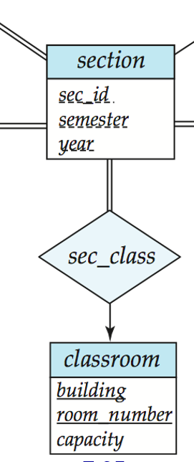
Combine Schemas-- a good example
Consider combining relations
  sec_class(sec_id, building, room_number) and
  section(course_id, sec_id, semester, year)
  into one relation
  section(course_id, sec_id, semester, year,
  building, room_number)
No repetition in this case

Slide 5
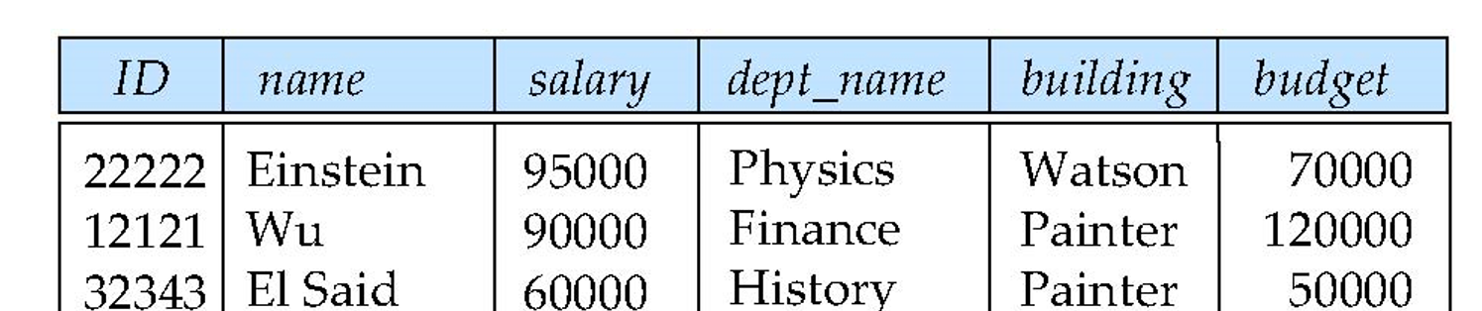
What About Smaller Schemas?
Suppose we had started with inst_dept. How would we know to split up (decompose) it into instructor and department?
Write a rule “if there were a schema (dept_name, building, budget), then dept_name would be a candidate key”
Denote as a functional dependency:
dept_name → building, budget

Slide 6
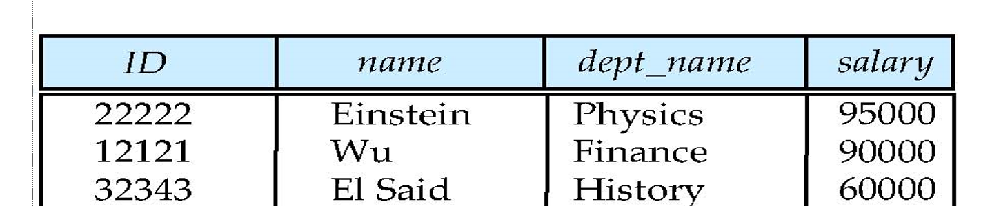
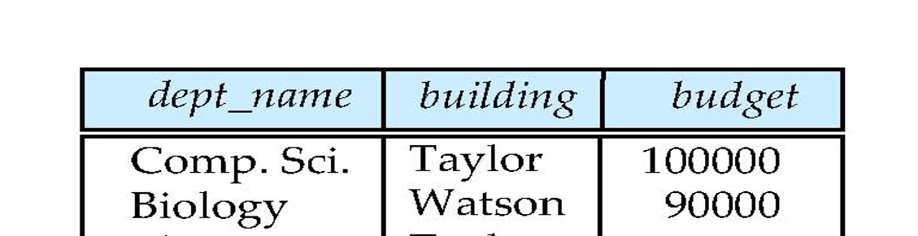
What About Smaller Schemas?
In inst_dept, because dept_name is not a candidate key, the building and budget of a department may have to be repeated.
  This indicates the need to decompose inst_dept .

Slide 7
What About Smaller Schemas?
Not all decompositions are good. Suppose we decompose
employee(ID, name, street, city, salary) into
employee1 (ID, name)
employee2 (name, street, city, salary)
The next slide shows how we lose information -- we cannot reconstruct the original employee relation -- and so, this is a lossy decomposition.

Slide 8
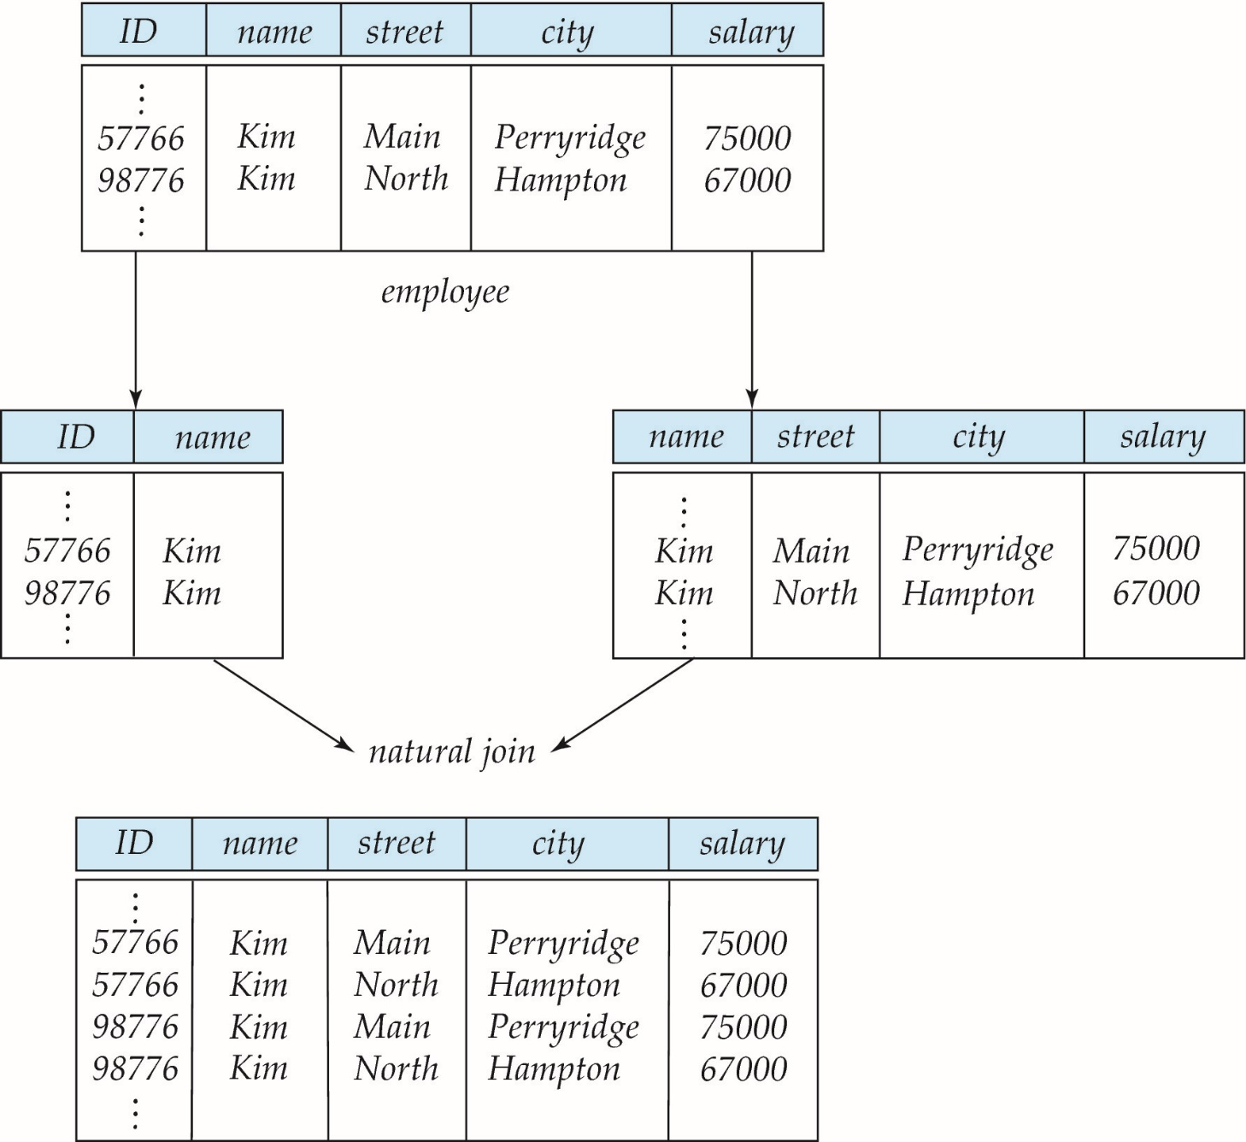
A Lossy Decomposition

Slide 9
Example of Lossless-Join Decomposition
Lossless join decomposition
Decomposition of R = (A, B, C):
  R₁ = (A, B)
  R₂ = (B, C)
A
B
C
A
B
B
C
α
β
1
2
A
B
α
β
1
2
1
2
A
B
r
∏_{A,B}(r)
∏_{B,C}(r)
A
B
C
α
β
1
2
A
B
Decomposition is lossless join if
R= R₁ R₂

Slide 10
Goal — Devise a Theory for the Following
Decide whether a particular relation R is in “good” form.
  “good” means "no redundancy".
If R is not in “good” form, decompose it into a set of relations {R₁, R₂, ..., R_{n}} such that
  each relation is in good form
  the decomposition is
    a lossless-join decomposition (necessary)
    dependency preserving (optional)
R
R1
R2
R3
R4

Slide 11
Goal — Devise a Theory for the
FollowingDecomposition: 3NF VS BCNF
  N: not guarantee the feature with probability 100%
  Y: guarantee the feature with probability 100%
 | lossless-join? | dependency-preserving? | Remove redundancy?
BCNF | Y | N | Y
3NF | Y | Y | N

Slide 12
Goal — Devise a Theory for the Following
Our theory is based on:
  functional dependencies
  multivalued dependencies

Slide 13
First Normal Form
Domain is atomic if its elements are considered to be indivisible units
  Examples of non-atomic domains:
    Set of names, composite attributes
    Identification numbers like CS101 that can be broken up into parts
A relational schema R is in first normal form if the domains of all attributes of R are atomic
Non-atomic values complicate storage and encourage redundant (repeated) storage of data
  Example: Set of accounts stored with each customer, and set of owners stored with each account
  We assume all relations are in first normal form (and revisit this in Chapter 22: Object Based Databases)

Slide 14
First Normal Form (Cont’d)
Atomicity is actually a property of how the elements of the domain are used.
  Example: Strings would normally be considered indivisible
  Suppose that students are given roll numbers which are strings of the form SE0012 or EE1127
  If the first two characters are extracted to find the department, the domain of roll numbers is not atomic.
  Doing so is a bad idea: leads to encoding of information in application program rather than in the database.

Slide 15
Functional Dependencies
Constraints on the set of legal relations.
Require that the value for a certain set of attributes determines uniquely the value for another set of attributes.
A functional dependency is a generalization of the notion of a key.

Slide 16
Functional Dependencies (Cont.)
Let R=(A1, A2, …,An) be a relation schema
α ⊆ R and β ⊆ R
Definition (α → β). If α is a superkey of shcema (α , β), then we say that there is a functional dependency from α to β, which is denoted by α → β.
Definition (α → β). If there is a function
f: domain(α) → domain(β),
then we say that there is a functional dependency from
α to β, which is denoted by α → β.
Example: Consider r(A,B ) with the following instance of r.
On this instance, A → B does NOT hold, but B → A does hold.
4
1 5
3 7

Slide 17
Functional Dependencies (Cont.)
Let R=(A1, A2, …,An) be a relation schema
α ⊆ R and β ⊆ R
The functional dependency
α → β
holds on R if and only if for any legal relations r(R), whenever any two tuples t₁ and t₂ of r agree on the attributes α, they also agree on the attributes β. That is,
t₁[α] = t₂ [α] ⇒ t₁[β ] = t₂ [β ]

Slide 18
Boyce-Codd Normal Form
A relation schema R is in BCNF with respect to a set F of functional dependencies if for all functional dependencies in F⁺ of the form
α→ β
where α ⊆ R and β ⊆ R, at least one of the following holds:
α ⊇ β
α is a superkey for R
Example schema not in BCNF:
instr_dept (ID, name, salary, dept_name, building, budget )
because
dept_name→ building, budget
holds on instr_dept, but dept_name is not a superkey

Slide 19
Third Normal Form
A relation schema R is in third normal form (3NF) if for all:
α → β in F⁺
at least one of the following holds:
  α ⊇ β
  α is a superkey for R
  Each attribute A in β – α is contained in a candidate key for R.
  (NOTE: each attribute may be in a different candidate key)
If a relation is in BCNF, it is in 3NF (since in BCNF one of the first two conditions above must hold).
Third condition is a minimal relaxation of BCNF to ensure dependency preservation (will see why later).

Slide 20
Functional-Dependency Theory
We now consider the formal theory that tells us which functional dependencies are implied logically by a given set of functional dependencies.
We then develop algorithms to generate lossless decompositions into BCNF and 3NF
We then develop algorithms to test if a decomposition is dependency-preserving

Slide 21
Functional Dependencies and superkey
K is a superkey for relation schema R if and only if K → R
K is a candidate key for R if and only if
  K → R, and
  for no α ⊂ K, α → R
Functional dependencies allow us to express constraints that cannot be expressed using superkeys. Consider the schema:
inst_dept (ID, name, salary, dept_name, building, budget ).
We expect these functional dependencies to hold:
dept_name→ building
and ID → building
but would not expect the following to hold:
dept_name → salary

Slide 22
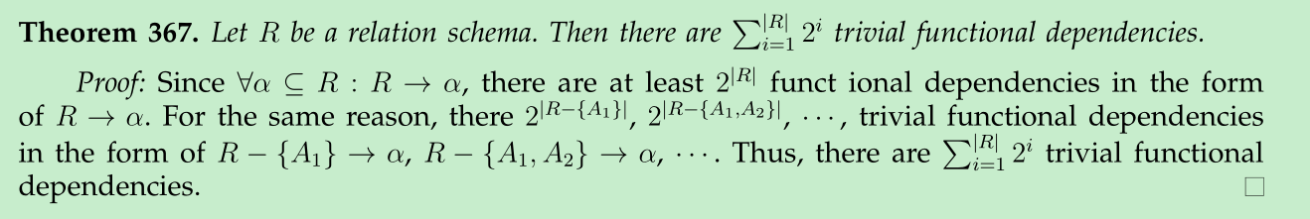
Functional Dependencies
A functional dependency is trivial if it is satisfied by all instances of a relation
  Example:
    ID, name → ID
    name → name
  In general, α → β is trivial if α ⊇ β

Slide 23
Use of Functional Dependencies
We use functional dependencies to:
  test relations to see if they are legal under a given set of functional dependencies.
    If a relation r is legal under a set F of functional dependencies, we say that r satisfies F.
  specify constraints on the set of legal relations
    We say that F holds on schema R if all legal relations r on schema R satisfy the set of functional dependencies F.
Note: A specific instance of a relation schema may satisfy a functional dependency even if the functional dependency does not hold on all legal instances.
  For example, a specific instance of instructor may, by chance, satisfy
  name → ID.

Slide 24
Lossless-join Decomposition
For the case of R = (R₁, R₂), we require that for all possible relations r on schema R
r = ∏_{R1} (r ) ∏_{R2} (r )
A decomposition of R into R₁ and R₂ is lossless join if at least one of the following dependencies is in F⁺:
  R₁ ∩ R₂ → R₁
  R₁ ∩ R₂ → R₂
The above functional dependencies are a sufficient condition for lossless join decomposition; the dependencies are a necessary condition only if all constraints are functional dependencies

Slide 25
Lossless-join Decomposition
Example

Slide 26
Closure of a Set of Functional Dependencies
Given a set F of functional dependencies, there are certain other functional dependencies that are logically implied by F.
  For example: If A → B and B → C, then we can infer that A → C
Definition (closure of F). The set of all functional dependencies logically implied by F is the closure of F. We denote the closure of F by F⁺.
F⁺ ⊇ F.

Slide 27
Closure of a Set of Functional Dependencies
We can find F^{+,} the closure of F, by repeatedly applying
Armstrong’s Axioms:
  if α ⊇ β , then α → β (reflexivity)
  if α → β, then γ α → γ β (augmentation)
  if α → β, and β → γ, then α → γ (transitivity)
These rules are
  sound (generate only functional dependencies that actually hold), and
  complete (generate all functional dependencies that hold).

Slide 28
Example
R = (A, B, C, G, H, I)
F = { A → B
A → C
CG → H
CG → I
B → H}
some members of F⁺
  A → H
    by transitivity from A → B and B → H
  AG → I
    A → C ⇒ AG → CG
    CG → I
  CG → HI
    CG → I ⇒ CGCG → CGI ⇒ CG → CGI
    CG → H ⇒ CGI → HI,

Slide 29
Procedure for Computing F⁺
To compute the closure of a set of functional dependencies F:
F ⁺ = F
repeat
for each functional dependency f in F⁺
apply reflexivity and augmentation rules on f
add the resulting functional dependencies to F ⁺
for each pair of functional dependencies f₁and f₂ in F ⁺
if f₁ and f₂ can be combined using transitivity
then add the resulting functional dependency to F ⁺
until F ⁺ does not change any further
  if α ⊇ β , then α → β (reflexivity)
  if α → β, then γ α → γ β (augmentation)
  if α → β, and β → γ, then α → γ (transitivity)
NOTE: We shall see an alternative procedure for this task later

Slide 30
Closure of Functional Dependencies (Cont.)
Additional rules:
  If α → β holds and α → γ holds, then α → β γ holds (union)
  If α → β γ holds, then α → β holds and α → γ holds (decomposition)
  If α → β holds and β γ → δ holds, then α γ → δ holds (pseudotransitivity)
  The above rules can be inferred from Armstrong’s axioms.

Slide 31

Closure of Attribute Sets
Given a set of attributes α, define the closure of α under F (denoted by α⁺) as the set of attributes that are functionally determined by α under F
α⁺ is a set of all attributes which are reachable from α.

Slide 32
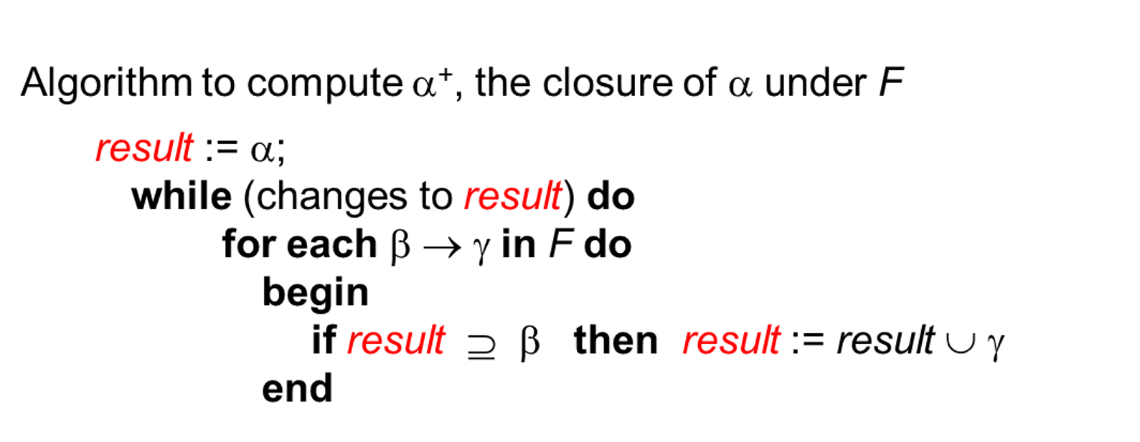
Closure of Attribute Sets
Cost is O(n³)

Slide 33
Example of Attribute Set Closure
R = (A, B, C, G, H, I)
F = {A → B
A → C
CG → H
CG → I
B → H}
(AG)⁺
  1. result = AG
  2. result = ABCG (A → C and A → B)
  3. result = ABCGH (CG → H and CG ⊆ AGBC)
  4. result = ABCGHI (CG → I and CG ⊆ AGBCH)
Is AG a candidate key?
  Is AG a super key?
    Does AG → R? == Does (AG)⁺ ⊇ R ?
  Is any subset of AG a superkey?
    Does A → R? == Does (A)⁺ ⊇ R
    Does G → R? == Does (G)⁺ ⊇ R

Slide 34
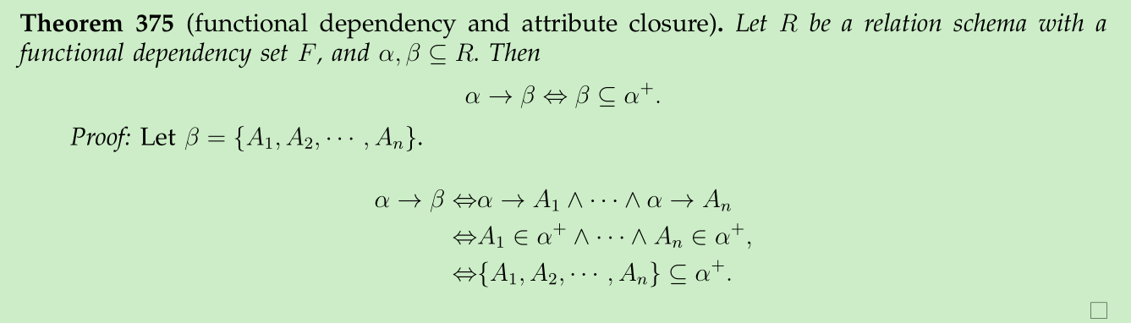
1. Attribute Closure and functional dependency

Slide 35
1. Attribute Closure and functional dependency
How to check α → β holds ?
  we compute α⁺
  check if α⁺ ⊇ β
a simple and cheap test, and very useful

Slide 36
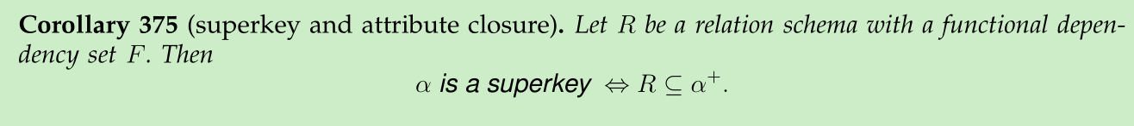
2. Attribute Closure and superkey
How to test if α is a superkey?
  compute α⁺,
  check if α⁺ ⊇ R.

Slide 37
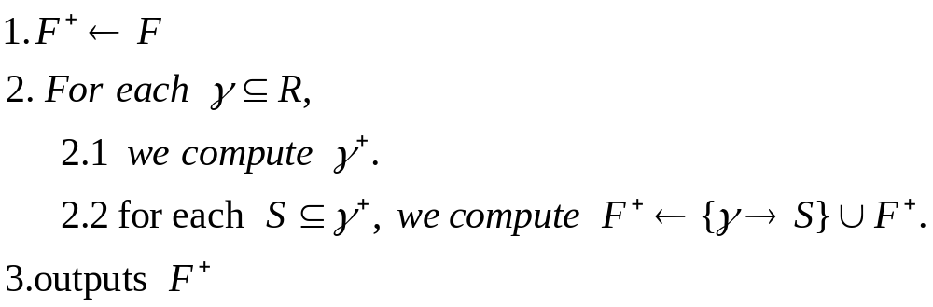
3 Attribute Closure and functional dependency Closure
Computing closure F⁺ of F?
idea : F⁺ can be viewed as a set of all attribute closure.

Slide 38
Boyce-Codd Normal Form
A relation schema R is in BCNF with respect to a set F of functional dependencies if for all functional dependencies in F⁺ of the form
α→ β
where α ⊆ R and β ⊆ R, at least one of the following holds:
α ⊇ β
α is a superkey for R
Example schema not in BCNF:
instr_dept (ID, name, salary, dept_name, building, budget )
because dept_name→ building, budget
holds on instr_dept, but dept_name is not a superkey

Slide 39
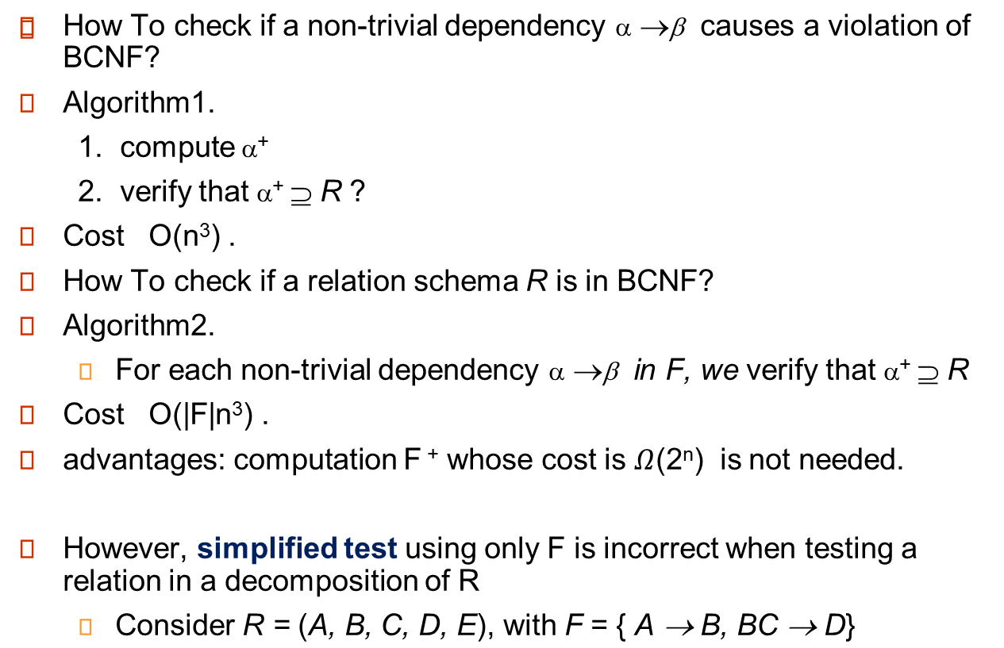
Testing for BCNF

Slide 40
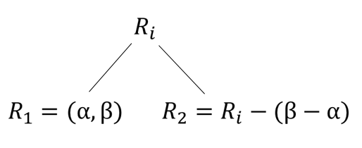
Decomposing a Schema into BCNF
Suppose we have a schema R and a non-trivial dependency α→β causes a violation of BCNF.
We decompose R into:
Example, instr_dept (ID, name, salary, dept_name, building, budget )
  α = {dept_name}
  β = {building, budget}
  R1= (αU β ) = ( dept_name, building, budget )
  R2=( R - ( β - α ) ) = ( ID, name, salary, dept_name )

Slide 41
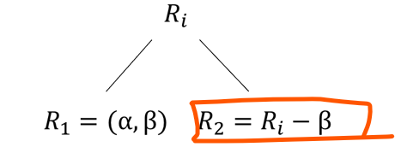

Decomposing a Schema into BCNF
we can prove that
We need to considering only functional dependences of the form α →β (α ∩ β = ∅ ) .
The right decomposition works well.

Slide 42

BCNF Decomposition Algorithm
result := {R };
done := false;
compute F ⁺;
while (not done) do
if (there is a schema R_{i} in result that is not in BCNF)
then begin
let α→ β be a nontrivial functional dependency that
holds on R_{i} such that α → R_{i} is not in F ⁺,
and α ∩ β = ∅;
result := (result – R_{i} ) ∪ (R_{i} – β) ∪ (α, β );
end
else done := true;
Note: each R_{i} is in BCNF, and decomposition is lossless-join.

Slide 43

BCNF Decomposition Algorithm
Properties of Decomposition Algorithm
  Each final leaf is in BCNF
  decomposition is lossless-join.

Slide 44
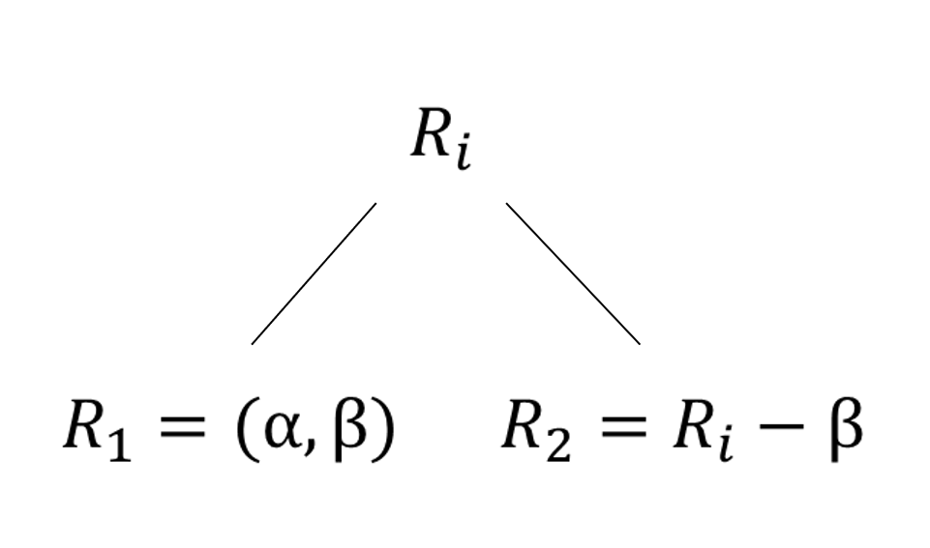

Example
R = (A, B, C)
F = {A → B, B → C)
Can be decomposed in two different ways
R is not in BCNF (B → C but B is not superkey)
R₁ = (A, B), R₂ = (B, C)
  Lossless-join decomposition:
  R₁ ∩ R₂ = {B} and B → BC, B is a superkey of R₂
  Dependency preserving
R₁ = (A, B), R₂ = (A, C)
  Lossless-join decomposition:
  R₁ ∩ R₂ = {A} and A → AB
  Not dependency preserving
  (cannot check B → C without computing R₁ R₂)

Slide 45

Example of BCNF Decomposition
class (course_id, title, dept_name, credits, sec_id, semester, year, building, room_number, capacity, time_slot_id)
Functional dependencies:
  course_id→ title, dept_name, credits
  building, room_number→capacity
  course_id, sec_id, semester, year→building, room_number, time_slot_id
A candidate key {course_id, sec_id, semester, year}.
BCNF Decomposition:
  course_id→ title, dept_name, credits holds
    but course_id is not a superkey.
  We replace class by:
    course(course_id, title, dept_name, credits)
    R- (title, dept_name, credits )
    = class1 (course_id, sec_id, semester, year, building,
    room_number, capacity, time_slot_id)

Slide 46
BCNF Decomposition (Cont.)
course is in BCNF ?
class1 (course_id, sec_id, semester, year, building,
room_number, capacity, time_slot_id) ?
building, room_number→capacity holds on class1
  but {building, room_number} is not a superkey for class1.
  We replace class1 by:
    classroom (building, room_number, capacity)
    Section = class1 – {capacity}
    section (course_id, sec_id, semester, year, building, room_number, time_slot_id)
classroom and section are in BCNF.

Slide 47
Testing for BCNF
Decompose R into R₁, R₂ , R₃ .....
How to check that R₁, R₂ , R₃ ..... are BCNF?
simplified test using only F is incorrect when testing a relation in a decomposition of R
  Consider R = (A, B, C, D, E), with F = { A → B, BC → D}
    Decompose R into R₁ = (A,B) and R₂ = (A,C,D, E)
    Neither of the dependencies in F contain only attributes from (A,C,D,E) so we might be mislead into thinking R₂ satisfies BCNF.
    In fact, dependency AC → D in F⁺ shows R₂ is not in BCNF.

Slide 48
Testing Decomposition for BCNF
How to check that R₁, R₂ , R₃ ..... are BCNF?
To check if a relation R_{i} in a decomposition of R is in BCNF,
  Either test R_{i} for BCNF with respect to the restriction of F to R_{i} (that is, all FDs in F⁺ that contain only attributes from R_{i})
  or use the original set of dependencies F that hold on R, but with the following test:
      for every set of attributes α ⊆ R_{i}, check that α⁺ (the attribute closure of α) either includes no attribute of R_{i}- α, or includes all attributes of R_{i}.

Slide 49
BCNF and Dependency Preservation
It is not always possible to get a BCNF decomposition that is
dependency preserving
R = (J, K, L )
F = {JK → L
L → K }
Two candidate keys = JK and JL?
BCNF decomposition: (L, K) , (J, L)
Any decomposition of R will fail to preserve
JK → L
This implies that testing for JK → L requires a join

Slide 50
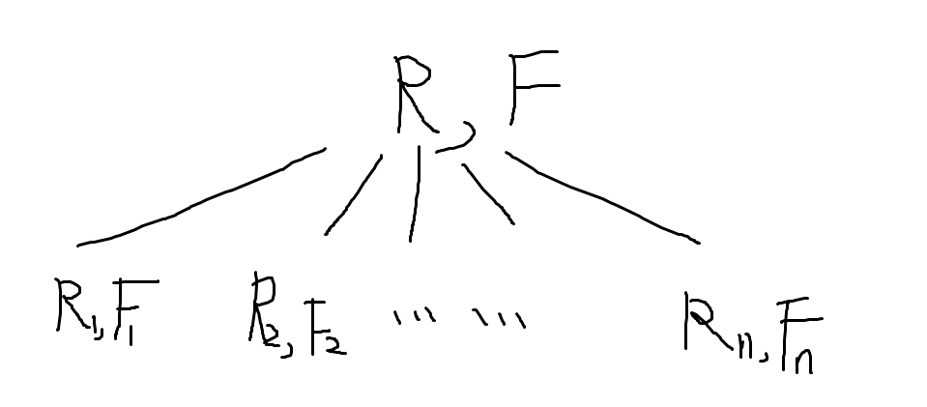
Dependency Preservation
Let F_{i} be the set of dependencies F ⁺ that include only attributes in R_{i}.
    A decomposition is dependency preserving, if
    (F₁ ∪ F₂ ∪ … ∪ F_{n} )⁺ = F ⁺
    If it is not, then checking updates for violation of functional dependencies may require computing joins, which is expensive.

Slide 51
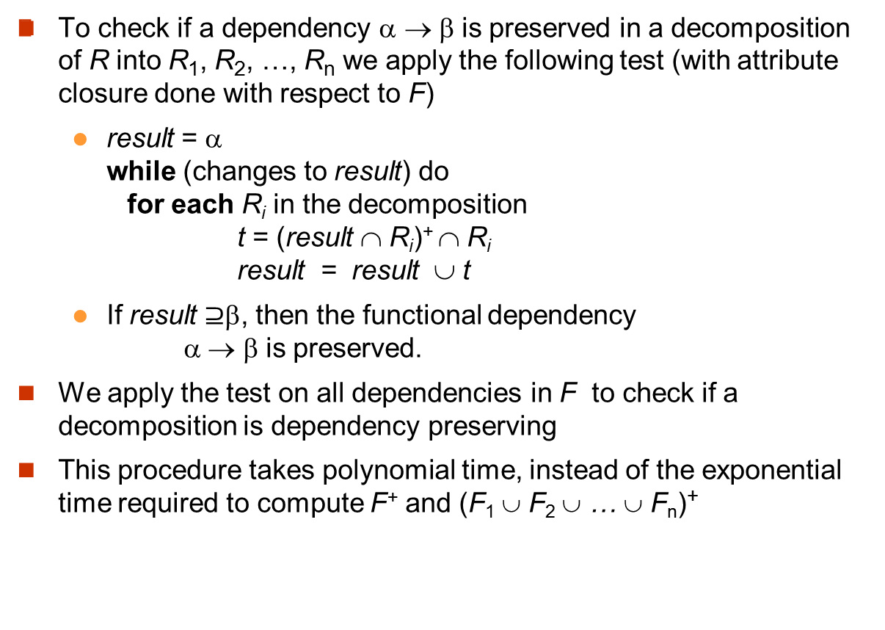

Testing for Dependency Preservation

Slide 52
Dependency Preservation
Sufficient conditions for dependency preservation：
  each functional dependence of F is contained in a schema. That is, for each α →β of F, there is a R_{i}=(α,β, .... ) .
We do not need to preserve functional dependence of F⁺, because they are implied by F.

Slide 53
Dependency Preservation
Further, we do not need to preserve all functional dependence of F, because they are implied by F_{c}
Conclusion. we only need to preserve all functional dependence of F_{c}

Slide 54
Example
R = (A, B, C )
F = {A → B, B → C}
Key = {A}
R is not in BCNF, B → C violates BCNF
Decomposition R₁ = (A, B), R₂ = (B, C)
  R₁ and R₂ in BCNF
  Lossless-join decomposition
  Dependency preserving

Slide 55
BCNF and Dependency Preservation
Constraints, including functional dependencies, are costly to check in practice unless they pertain to only one relation
If it is sufficient to test only those dependencies on each individual relation of a decomposition in order to ensure that all functional dependencies hold, then that decomposition is dependency preserving.
Because it is not always possible to achieve both BCNF and dependency preservation, we consider a weaker normal form, known as third normal form.

Slide 56
Third Normal Form: Motivation
There are some situations where
  BCNF is not dependency preserving, and
  efficient checking for FD violation on updates is important
Solution: define a weaker normal form, called Third Normal Form (3NF)
  Allows some redundancy (with resultant problems; we will see examples later)
  But functional dependencies can be checked on individual relations without computing a join.
  There is always a lossless-join, dependency-preserving decomposition into 3NF.

Slide 57
Third Normal Form
A relation schema R is in third normal form (3NF) if for all:
α → β in F⁺
at least one of the following holds:
  α ⊇ β
  α is a superkey for R
  Each attribute A in β – α is contained in a candidate key for R.
  (NOTE: each attribute may be in a different candidate key)
BCNF ⊆ 3NF (since in BCNF one of the first two conditions above must hold).
Third condition is a minimal relaxation of BCNF to ensure dependency preservation (will see why later).

Slide 58
3NF Example
Relation dept_advisor:
  dept_advisor (s_ID, i_ID, dept_name)
  F = {s_ID, dept_name → i_ID, i_ID → dept_name}
  Two candidate keys: {s_ID, dept_name }and{ i_ID, s_ID}
  R is in 3NF
    s_ID, dept_name → i_ID
      s_ID, dept_name is a superkey
    i_ID → dept_name
      dept_name is contained in a candidate key

Slide 59

Testing for 3NF
Given scheme R, functional dependence set F, test R is in 3NF
Algorithm: for each non-trivial α → β,
test α is a superkey :
If α is not a superkey, we have to verify if each attribute in
β is contained in a candidate key of R
  this test is rather more expensive, since it involve finding candidate keys
  testing for 3NF has been shown to be NP-hard
  Interestingly, decomposition into third normal form (described shortly) can be done in polynomial time

Slide 60

Redundancy in 3NF
There is some redundancy in this schema
Example of problems due to redundancy in 3NF
  R = (J(s_ID ), K(dept_name ), L(i_ID)),
  F = {JK → L, L → K }
J
L
K
j₁
j₂
j₃
null
l₁
l₁
l₁
l₂
k₁
k₁
k₁
k₂
repetition of information
need to use null values (e.g., to represent the relationship
l₂, k₂ where there is no corresponding value for J).

Slide 61
Goals of Normalization
Let R be a relation scheme with a set F of functional dependencies.
Decide whether a relation scheme R is in “good” form.
In the case that a relation scheme R is not in “good” form, decompose it into a set of relation scheme {R₁, R₂, ..., R_{n}} such that
  each relation scheme is in good form
  the decomposition is a lossless-join decomposition
  Preferably, the decomposition should be dependency preserving.

Slide 62
Canonical Cover
Intuitively, a canonical cover of F is a “minimal” set of functional dependencies equivalent to F, having no redundant dependencies or redundant parts of dependencies
Case 1. Sets of functional dependencies may have redundant dependencies that can be inferred from the others
  For example: A → C is redundant in: {A → B, B → C, A→ C}
Case 2. Parts of a functional dependency may be redundant
  E.g.: on RHS: {A → B, B → C, A → CD} can be simplified to
  {A → B, B → C, A → D}
  E.g.: on LHS: {A → B, B → C, AC → D} can be simplified to
  {A → B, B → C, A → D}

Slide 63
Extraneous Attributes
Example: Given F = {A → C, AB → C }, B is extraneous?
{A → C, AB → C } ⬄ {A → C} ？
Delete B, we get a new functional dependency set H={A → C}
Old set F ⬄ new set H ?
Definition (extraneous Attribute). Consider functional dependency αx → β in F. We delete x and get new functional dependency set H. If H satisfies
  F ⬄ H ,
  then attribute x is extraneous. Formally speaking, if
  F ⬄(F – {αx → β}) ∪ {α → β},
  then x is extraneous
Note: implication in the opposite direction is trivial in each of the cases above, since a “stronger” functional dependency always implies a weaker one

Slide 64
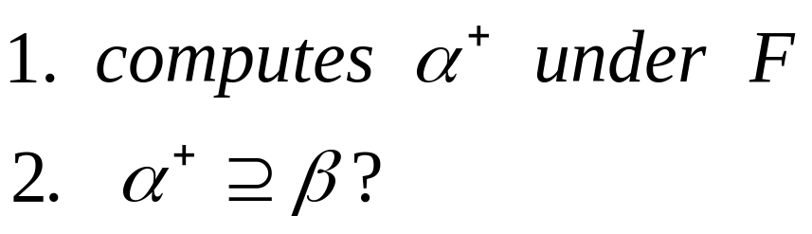

Testing if an Attribute is Extraneous
How to check attribute x is extraneous, given αx → β and F ?
Example.
F = {A → C, AB → C } , B is extraneous?

Slide 65
Extraneous Attributes
Consider functional dependency α → βx in F,
  Attribute x is extraneous in if
  F ⬄ (F – {α → β x }) ∪ {α → β}.
Example: Given F = {A → C, AB → CD}, C is extraneous?
F = {A → C, AB → CD} ⬄ {A → C, AB → D}??

Slide 66
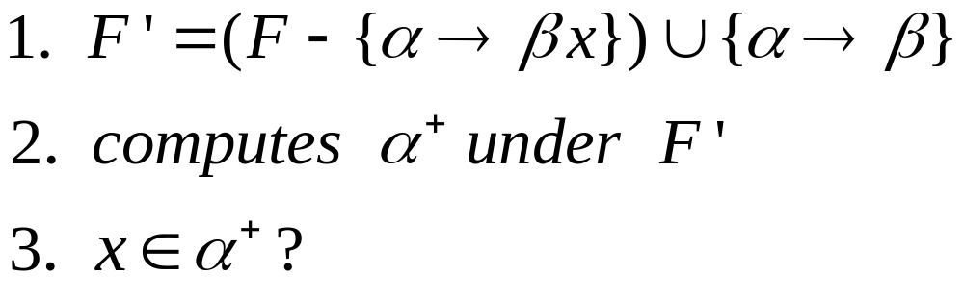
Testing if an Attribute is Extraneous
α → βx in F. How to test if attribute x is extraneous

Slide 67
Canonical Cover
A canonical cover for F is a set of dependencies F_{c} such that
  F ⇔ F_{c,} and
  No functional dependency in F_{c} contains an extraneous attribute, and
  Each left side of functional dependency in F_{c} is unique. That is, α₁ → β₁ and α₁ → β₂ are not allowed, while α₁ → β₁ β₂ are allowed.
To compute a canonical cover for F:
repeat
Use the union rule to replace any dependencies in F
α₁ → β₁ and α₁ → β₂ with α₁ → β₁ β₂
Find a functional dependency α → β with an
extraneous attribute either in α or in β
/* Note: test for extraneous attributes done using F_{c,} not F*/
If an extraneous attribute is found, delete it from α → β
until F does not change
Note: Union rule may become applicable after some extraneous attributes have been deleted, so it has to be re-applied

Slide 68
Computing a Canonical Cover
R = (A, B, C)
F = {A → BC
B → C
A → B
AB → C}
Combine A → BC and A → B into A → BC
  F_{c} = {A → BC, B → C, AB → C}
A is extraneous in AB → C ?
  F_{c} = {A → BC, B → C}
C is extraneous in A → BC ?
    F_{c} = {A → B, B → C}
The canonical cover F_{c} is: A → B
B → C

Slide 69
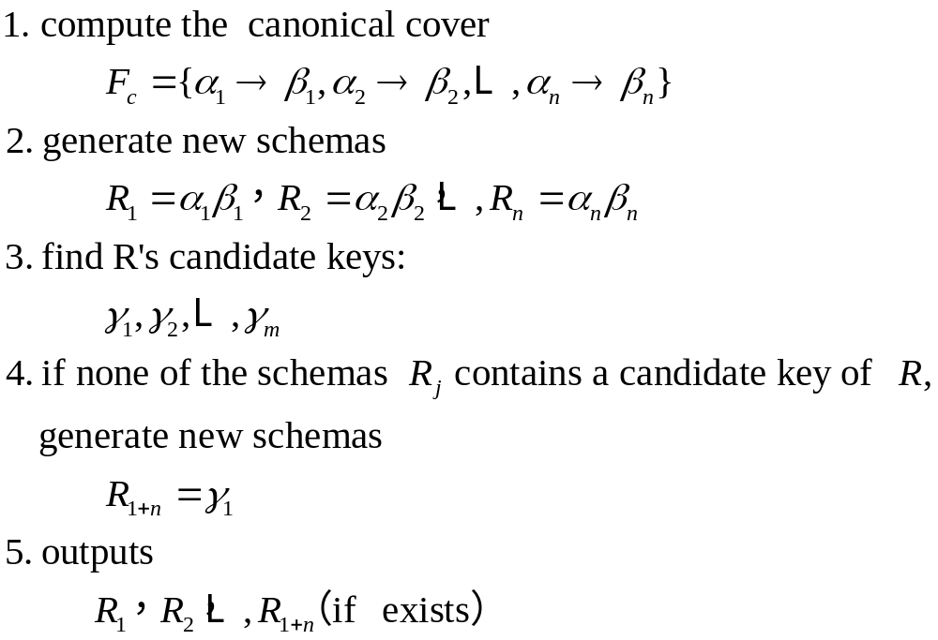
3NF Decomposition Algorithm
Why 3NF decomposition is dependency preserving ? each α → β is persevered in a schema.

Slide 70
3NF Decomposition Algorithm
Let F_{c} be a canonical cover for F;
i := 0;
for each functional dependency α → β in F_{c} do
if none of the schemas R_{j}, 1 ≤ j ≤ i contains α β
then begin
i := i + 1;
R_{i} := α β
end
if none of the schemas R_{j}, 1 ≤ j ≤ i contains a candidate key for R
then begin
i := i + 1;
R_{i} := any candidate key for R;
end
/* Optionally, remove redundant relations */
repeat
if any schema R_{j} is contained in another schema R_{k}
then /* delete R_{j} */
R_{j} = R;;
i=i-1;
return (R₁, R₂, ..., R_{i})

Slide 71
3NF Decomposition Algorithm (Cont.)
Above algorithm ensures:
  each relation schema R_{i} is in 3NF
  decomposition is dependency preserving and lossless-join
  Proof of correctness is at end of this presentation (click here)

Slide 72
3NF Decomposition: An Example
Relation schema:
  cust_banker_branch = (customer_id, employee_id, branch_name, type )
The functional dependencies for this relation schema are:
  customer_id, employee_id → branch_name, type
  employee_id → branch_name
  customer_id, branch_name → employee_id
Candidate keys:
  (customer_id, employee_id ), (customer_id, branch_name )
We first compute a canonical cover
  branch_name is extraneous in the r.h.s. of the 1st dependency
  No other attribute is extraneous, so we get F_{C} =
  customer_id, employee_id → type
  employee_id → branch_name
  customer_id, branch_name → employee_id

Slide 73
  F_{C} ={ customer_id, employee_id → type
  employee_id → branch_name
  customer_id, branch_name → employee_id}
The for loop generates following 3NF schema:
(customer_id, employee_id, type )
(employee_id, branch_name)
(customer_id, branch_name, employee_id)
Observe that (customer_id, employee_id, type ) contains a candidate key of the original schema, so no further relation schema needs be added

Slide 74
3NF Decompsition Example (Cont.)
At end of for loop, detect and delete schemas, such as (employee_id, branch_name), which are subsets of other schemas
  result will not depend on the order in which FDs are considered
The resultant simplified 3NF schema is:
(customer_id, employee_id, type)
(customer_id, branch_name, employee_id)

Slide 75
3NF Decompsition Example (Cont.)
Notation!
cust_banker_branch = (customer_id, employee_id, branch_name, type ) is 3NF.
Decompose it to exemplify 3NF algorithm.

Slide 76
Comparison of BCNF and 3NF
It is always possible to decompose a relation into a set of relations that are in 3NF such that:
  the decomposition is lossless
  the dependencies are preserved
It is always possible to decompose a relation into a set of relations that are in BCNF such that:
  the decomposition is lossless
  it may not be possible to preserve dependencies.

Slide 77
3NF VS BCNF
N: not guarantee the feature with probability 100%
Y: guarantee the feature with probability 100%
 | lossless-join? | dependency-preserving? | Remove redundancy?
BCNF | Y | N | Y
3NF | Y | Y | N

Slide 78
Design Goals
Goal for a relational database design is:
  BCNF.
  Lossless join.
  Dependency preservation.
If we cannot achieve this, we accept one of
  Lack of dependency preservation
  Redundancy due to use of 3NF
Interestingly, SQL does not provide a direct way of specifying functional dependencies other than superkeys.
Can specify FDs using assertions, but they are expensive to test, (and currently not supported by any of the widely used databases!)
Even if we had a dependency preserving decomposition, using SQL we would not be able to efficiently test a functional dependency whose left hand side is not a key.

Slide 79
Overall Database Design Process
We have assumed schema R is given
  R could have been generated when converting E-R diagram to a set of tables.
  R could have been a single relation containing all attributes that are of interest (called universal relation).
  Normalization breaks R into smaller relations.
  R could have been the result of some ad hoc design of relations, which we then test/convert to normal form.

Slide 80
ER Model and Normalization
When an E-R diagram is carefully designed, identifying all entities correctly, the tables generated from the E-R diagram should not need further normalization.
However, in a real (imperfect) design, there can be functional dependencies from non-key attributes of an entity to other attributes of the entity
  Example: an employee entity with attributes
  department_name and building,
  and a functional dependency
  department_name→ building
  Good design would have made department an entity
Functional dependencies from non-key attributes of a relationship set possible, but rare --- most relationships are binary

Slide 81
Denormalization for Performance
May want to use non-normalized schema for performance
For example, displaying prereqs along with course_id, and title requires join of course with prereq
Alternative 1: Use denormalized relation containing attributes of course as well as prereq with all above attributes
  faster lookup
  extra space and extra execution time for updates
  extra coding work for programmer and possibility of error in extra code
Alternative 2: use a materialized view defined as
course prereq
  Benefits and drawbacks same as above, except no extra coding work for programmer and avoids possible errors

Slide 82
Other Design Issues
Some aspects of database design are not caught by normalization
Examples of bad database design, to be avoided:
Instead of earnings (company_id, year, amount ), use
  earnings_2004, earnings_2005, earnings_2006, etc., all on the schema (company_id, earnings).
    Above are in BCNF, but make querying across years difficult and needs new table each year
  company_year (company_id, earnings_2004, earnings_2005,
  earnings_2006)
    Also in BCNF, but also makes querying across years difficult and requires new attribute each year.
    Is an example of a crosstab, where values for one attribute become column names
    Used in spreadsheets, and in data analysis tools

Slide 83
End of Chapter

