Slide 1
Chapter 12: Query Processing

Slide 2
Chapter 12: Query Processing
Overview
Measures of Query Cost
Selection Operation
Sorting
Join Operation
Other Operations
Evaluation of Expressions

Slide 3

Basic Steps in Query Processing
1. Parsing and translation
2. Optimization
3. Evaluation

Slide 4
Basic Steps in Query Processing (Cont.)
Parsing and translation
  translate the query into its internal form. This is then translated into relational algebra.
  Parser checks syntax, verifies relations
Evaluation
  The query-execution engine takes a query-evaluation plan, executes that plan, and returns the answers to the query.

Slide 5
Basic Steps in Query Processing : Optimization
A relational algebra expression may have many equivalent expressions
  E.g., σ_{salary<75000}(∏_{salary}(instructor)) is equivalent to
  ∏_{salary}(σ_{salary<75000}(instructor))
Each relational algebra operation can be evaluated using one of several different algorithms
  Correspondingly, a relational-algebra expression can be evaluated in many ways.
Annotated expression specifying detailed evaluation strategy is called an evaluation-plan.
  E.g., use an index on salary to find instructors with salary < 75000,
  or perform complete relation scan and discard instructors with salary ≥ 75000

Slide 6
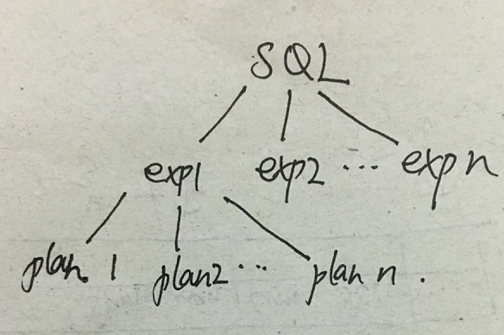
Basic Steps: Optimization (Cont.)
Query Optimization: Amongst all equivalent evaluation plans choose the one with lowest cost.
  Cost is estimated using statistical information from the
  database catalog
    e.g. number of tuples in each relation, size of tuples, etc.

Slide 7
Basic Steps: Optimization (Cont.)
In this chapter we study
  How to measure query costs
  Algorithms for evaluating relational algebra operations
  How to combine algorithms for individual operations in order to evaluate a complete expression
In Chapter 14
  We study how to optimize queries, that is, how to find an evaluation plan with lowest estimated cost

Slide 8
Measures of Query Cost
Cost is generally measured as total elapsed time for answering query
  Many factors contribute to time cost
    disk accesses, CPU, or even network communication
Typically disk access is the predominant cost, and is also relatively easy to estimate. Measured by taking into account
  Number of seeks * average-seek-cost
  Number of blocks read * average-block-read-cost
  Number of blocks written * average-block-write-cost
    Cost to write a block is greater than cost to read a block
      data is read back after being written to ensure that the write was successful

Slide 9
Measures of Query Cost (Cont.)
For simplicity we just use the number of block transfers from disk and the number of seeks as the cost measures
  t_{T} – time to transfer one block
  t_{S} – time for one seek
  Cost for b block transfers plus S seeks
  b * t_{T} + S * t_{S}
We ignore CPU costs for simplicity
  Real systems do take CPU cost into account
We do not include cost to writing output to disk in our cost formulae

Slide 10
Measures of Query Cost (Cont.)
Several algorithms can reduce disk IO by using extra buffer space
In the best case, all data can be read into the buffers, and the disk does not need to be accessed again.
In the worst case, we assume that the buffer can hold only a few blocks of data—approximately one block per relation.
we generally assume the worst case.

Slide 11
Selection Operation
File scan
select * from instructor where name="Einstein";
Algorithm A1 (linear search). Scan each file block and test all records to see whether they satisfy the selection condition.
  Cost estimate = b_{r} block transfers + 1 seek
    b_{r} denotes number of blocks containing records from relation r
  If selection is on a key attribute, can stop on finding record
    cost = (b_{r} /2) block transfers + 1 seek
  Linear search can be applied regardless of
    selection condition or
    ordering of records in the file, or
    availability of indices
Note: binary search generally does not make sense since data is not stored consecutively
  except when there is an index available,
  and binary search requires more seeks than index search

Slide 12
Selection Operation
File scan
select * from instructor where name="Einstein";
Algorithm A1 (linear search). b_{r} denotes number of blocks of relation r
  Worst case
  Average case (If selection is on a key attribute, can stop on finding record)
seek
transfer
seek
transfer

Slide 13
Selections Using Indices
Index scan – search algorithms that use an index
  selection condition must be on search-key of index.
A2 (primary index, equality on key).
Retrieve a single record that satisfies the corresponding equality condition
Example query:
select * from instructor where ID=“007“, a primary index on ID ;
 | index | file
seek
transfer

Slide 14
Selections Using Indices
Index scan – search algorithms that use an index
  selection condition must be on search-key of index.
A3 (primary index, equality on nonkey)
  Example query:
  select * from instructor where name="Einstein", a primary index on name;
Retrieve multiple records.
  Records will be on consecutive blocks
    Let b = number of blocks containing matching records
 | index | file
seek
transfer

Slide 15
Selections Using Indices
A4 (secondary index, equality on nonkey).
Example query: select * from instructor where name="Einstein", a primary index on ID, a secondary index on name.
Assume that it retrieve n records.
Can be very expensive! For example, h=4, n=100.
 | index | file
seek
transfer

Slide 16
Selections Involving Comparisons
Can implement selections of the form σ_{A≤V} (r) or σ_{A ≥ V}(r) by using
  a linear file scan,
  or by using indices in the following ways:
A5 (primary index, comparison). (Relation is sorted on A)
    Example query:
      select * from instructor where ID<=“9999", a primary index on ID
    Algorithm: For σ_{A≤V} (r) just scan relation sequentially till first tuple > v; do not use index
    Example query:
      select * from instructor where ID>=“9999", a primary index on ID
Algorithm: For σ_{A ≥ V}(r) use index to find first tuple ≥ v and scan relation sequentially from there

Slide 17
Selections Involving Comparisons
A6 (secondary index, comparison).
    Example query:
      select * from instructor where name<="Einstein", a primary index on ID, secondary index on name.
    Algorithm: For σ_{A≤V} (r) just scan leaf pages of index finding pointers to records, till first entry > v.
    Example query:
      select * from instructor where name>="Einstein", a primary index on ID, secondary index on name
    Algorithm: For σ_{A ≥ V}(r) use index to find first index entry ≥ v and scan index sequentially from there, to find pointers to records.
    In either case, retrieve records that are pointed to
      requires an I/O for each record
      Linear file scan may be cheaper

Slide 18
Join Operation
Several different algorithms to implement joins
  Nested-loop join
  Block nested-loop join
  Indexed nested-loop join
  Merge-join
  Hash-join
Choice based on cost estimate
Examples use the following information

Slide 19
Nested-Loop Join
  Example query:
    select * from student, takes where student.ID=takes.ID
  To compute the theta join r _{θ} s = σ_{θ} (r x s)
  for each tuple t_{r} in r do begin // load a disk block into memory
  for each tuple t_{s} in s do begin // load a disk block into memory
  test pair (t_{r},t_{s}) to see if they satisfy the join condition θ
  if they do, add t_{r} • t_{s} to the result.
  end
  end
r is called the outer relation and s the inner relation of the join.
Requires no indices and can be used with any kind of join condition.
Expensive since it examines every pair of tuples in the two relations.

Slide 20
Nested-Loop Join (Cont.)
A good case: If the smaller relation fits entirely in memory, use that as the outer relation r.
Example
A good case | r (outer) | s (inner)
disk traverse
transfers
seeks
relation | records | blocks
student | 5,000 | 100
takes | 10,000 | 400
A good case | r (outer) | s (inner)
disk traverse
transfers
seeks

Slide 21
Worst case example
  Worst case: r,s are bigger than memory
  Example query:
    select * from student, takes where student.ID=takes.ID
_{Student block}
r₁
r₂
r₃
……
r₁₀₀
_{Takes} _{block}
s₁
_{S2}
s₃
…….
s₄₀₀
records
001
002
003
…..
…..
…..
…..
050
relation | records | blocks
student | 5,000 | 100
takes | 10,000 | 400

Slide 22
To process record 001, disk block sequence accessed by algorithm ?
  r1, s1, s2,…., s400
To process record 002, disk block sequence accessed by algorithm ?
  r1, s1, s2,…., s400
_{Student block}
r₁
r₂
r₃
……
r₁₀₀
_{Takes} _{block}
s₁
_{S2}
s₃
…….
s₄₀₀
records
001
002
003
…..
…..
…..
…..
050
record ID | seeks | transfers
001
002
003
050
total of r1
total

Slide 23
To process record 001, disk block sequence accessed by algorithm ?
To process record 002, disk block sequence accessed by algorithm ?
_{Student block}
r₁
r₂
r₃
……
r₁₀₀
_{Takes} _{block}
s₁
_{S2}
s₃
…….
s₄₀₀
records
001
002
003
…..
…..
…..
…..
050
record ID | seeks | transfers
001
002
003
050
total of r1
total

Slide 24
Nested-Loop Join (Cont.)
In the worst case, if there is enough memory only to hold one block of each relation, the estimated cost is
      n_{r} : record number of r
      b_{r} : block number of r
      b_{s} : block number of s
Worst case | r(outer) | s (inner)
disk traverse
transfers
seeks

Slide 25
Nested-Loop Join (Cont.)
In the worst case, if there is enough memory only to hold one block of each relation, the estimated cost is
Example
Worst case | r(outer) | s (inner)
disk traverse
transfers
seeks
relation | records | blocks
student | 5,000 | 100
takes | 10,000 | 400
Worst case | r =student | s =takes
disk traverse
transfers
seeks

Slide 26
Nested-Loop Join (Cont.)
Worst case | r | s
disk traverse
transfers
seeks
relation | records | blocks
student | 5,000 | 100
takes | 10,000 | 400
Worst case | r = takes | s=student
disk traverse
transfers | ?
seeks

Slide 27
Block Nested-Loop Join
Variant of nested-loop join in which every block of inner relation is paired with every block of outer relation.
for each block B_{r} of r do begin // load disk block B_{r}
for each block B_{s} of s do begin // load disk block B_{s}
// the following loop executed in memory
for each tuple t_{r} in B_{r} do begin
for each tuple t_{s} in B_{s} do begin
Check if (t_{r},t_{s}) satisfy the join condition
if they do, add t_{r} • t_{s} to the result.
end
end
end
end

Slide 28
example
relation | records | blocks
student | 5,000 | 100
takes | 10,000 | 400
_{Student block}
r₁
r₂
r₃
……
r₁₀₀
_{Takes} _{block}
s₁
_{S2}
s₃
…….
s₄₀₀
records
001
002
003
…..
…..
…..
…..
050
  Example query:
    select * from student, takes where student.ID=takes.ID

Slide 29
To process block r1, disk block sequence accessed by algorithm ?
  r1, s1, s2,…., s400
To process block r2, disk block sequence accessed by algorithm ?
  r2, s1, s2,…., s400
_{Student block}
r₁
r₂
r₃
……
r₁₀₀
_{Takes} _{block}
s₁
_{S2}
s₃
…….
s₄₀₀
records
001
002
003
…..
…..
…..
…..
050
block ID | seeks | transfers
r1
r2
total

Slide 30
To process block r1, disk block sequence accessed by algorithm ?
To process block r2, disk block sequence accessed by algorithm ?
_{Student block}
r₁
r₂
r₃
……
r₁₀₀
_{Takes} _{block}
s₁
_{S2}
s₃
…….
s₄₀₀
records
001
002
003
…..
…..
…..
…..
050
block ID | seeks | transfers
r1
r2
total

Slide 31
Block Nested-Loop Join (Cont.)
Compare to Nested-Loop Join, the difference is colored in red
A good case: the smaller relation fits entirely in memory.
Worst case | r | s
disk traverse
transfers
seeks
A good case | r | s
disk traverse
transfers
seeks

Slide 32
Block Nested-Loop Join (Cont.)
Improvements to nested loop and block nested loop algorithms:
  In block nested-loop, use M — 2 disk blocks as blocking unit for outer relations, where M = memory size in blocks; use remaining two blocks to buffer inner relation and output
    Cost = ⎡b_{r} / (M-2)⎤ ∗ b_{s} + b_{r} block transfers +
    2 ⎡b_{r} / (M-2)⎤ seeks
  If equi-join attribute forms a key or inner relation, stop inner loop on first match
  Scan inner loop forward and backward alternately, to make use of the blocks remaining in buffer (with LRU replacement)
  Use index on inner relation if available (next slide)

Slide 33
Indexed Nested-Loop Join
Index lookups can replace file scans if
  join is an equi-join or natural join and
  an index is available on the inner relation’s join attribute
    Can construct an index just to compute a join.
  Example query:
    select * from student, takes where student.ID=takes.ID
  An index on takes.ID
Algorithm: For each tuple t_{r} in the outer relation r, use the index to look up tuples in inner relation s that satisfy the join condition with tuple t_{r}.
Worst case: buffer has space for only one page of r, and, for each tuple in r, we perform an index lookup on s.

Slide 34
Example
relation | records | blocks
student | 5,000 | 100
takes | 10,000 | 400
_{Student block}
r₁
r₂
r₃
……
r₁₀₀
_{Takes} _{block}
s₁
_{S2}
s₃
…….
s₄₀₀
records
001
002
003
…..
…..
…..
…..
050
  Example query:
    select * from student, takes where student.ID=takes.ID
    A primary index (B+-tree) on takes.ID
    In B+-tree, each internal node has 20 children, and each leaf has 20 values.

Slide 35
Example
To process record 001, disk block sequence accessed by algorithm ?
To process record 002, disk block sequence accessed by algorithm ?
The following problems are unclear
  The cost of B+ tree ? The height of B+ tree?
  The cost of s?
_{Student block}
r₁
r₂
r₃
……
r₁₀₀
_{Takes} _{block}
s₁
_{S2}
s₃
…….
s₄₀₀
records
001
002
003
…..
…..
…..
…..
050

Slide 36
Problem 1. The cost of B+ tree ?
Problem 1. The cost of B+ tree ? The height of B+ tree?
Example query:
  select * from student, takes where student.ID=takes.ID
  A primary index (B+-tree) on takes.ID
  In B+-tree, each internal node has 20 children, and each leaf has 20 values.
Solution

Slide 37
Problem 2. The cost of s?
relation | records | blocks
student | 5,000 | 100
takes | 10,000 | 400
A primary index (B+-tree) on takes.ID
In relation takes, we know
  each student takes 10000/5000=2 courses on average.
  each block has 10000/400=25 records.
Thus each record in relation student, the algorithm has to load a bock into memory. This cost 1 seek and 1 block transfer.

Slide 38
Example
To process record 001, disk block sequence accessed by algorithm ?
To process record 002, disk block sequence accessed by algorithm ?
_{Student block}
r₁
r₂
r₃
……
r₁₀₀
_{Takes} _{block}
s₁
_{S2}
s₃
…….
s₄₀₀
records
001
002
003
…..
…..
…..
…..
050
record ID | seeks | transfers
001
002
003
050
total of r1
total

Slide 39
Example
To process record 001, disk block sequence accessed by algorithm ?
To process record 002, disk block sequence accessed by algorithm ?
_{Student block}
r₁
r₂
r₃
……
r₁₀₀
_{Takes} _{block}
s₁
_{S2}
s₃
…….
s₄₀₀
records
001
002
003
…..
…..
…..
…..
050
record ID | seeks | transfers
001
002
003
050
total of r1
total

Slide 40
Indexed Nested-Loop Join
Indexed Nested-Loop Join Cost:
  n_{r} : record number of r
  br : block number of r
  (c,d): is the cost of traversing index and fetching all matching s tuples for one tuple or r.
    (c,d) can be estimated as cost of a single selection on s using the join condition.
    (c,d) value depends on concrete conditions.
 | r | B⁺ + s
 | 1 disk traverse | n_{r} access
transfers
seeks

Slide 41
Indexed Nested-Loop Join
Indexed Nested-Loop Join Cost:
Block Nested-Loop Join cost:
 | r | B⁺ + s
 | 1 disk traverse | n_{r} access
transfers
seeks
Worst case | r | s
disk traverse
transfers
seeks

Slide 42
Indexed Nested-Loop Join
Worst case: buffer has space for only one page of r, and, for each tuple in r, we perform an index lookup on s.
Cost of the join: b_{r} (t_{T} + t_{S}) + n_{r} ∗ c
  Where c is the cost of traversing index and fetching all matching s tuples for one tuple or r
  c can be estimated as cost of a single selection on s using the join condition.
If indices are available on join attributes of both r and s,
use the relation with fewer tuples as the outer relation.

Slide 43
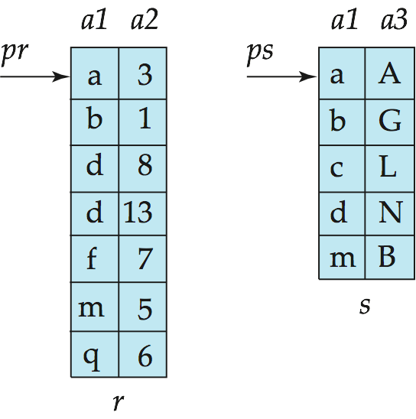
Merge-Join
Sort both relations on their join attribute (if not already sorted on the join attributes).
Merge the sorted relations to join them
  Join step is similar to the merge stage of the sort-merge algorithm.
  Main difference is handling of duplicate values in join attribute — every pair with same value on join attribute must be matched
  Detailed algorithm in book

Slide 44
Merge-Join (Cont.)
Can be used only for equi-joins and natural joins
Each block needs to be read only once (assuming all tuples for any given value of the join attributes fit in memory
Cost= sorting cost+ merging cost
merging cost is:
      b_{b} : size of work buffer
      b_{r} : block number of r
      b_{s} : block number of s
 | r | s
disk traverse | 1 | 1
transfers
seeks

Slide 45
Hash-Join 了解
Applicable for equi-joins and natural joins.
A hash function h is used to partition tuples of both relations
h maps JoinAttrs values to {0, 1, ..., n}, where JoinAttrs denotes the common attributes of r and s used in the natural join.
  r₀, r₁, . . ., r_{n} denote partitions of r tuples
    Each tuple t_{r} ∈ r is put in partition r_{i} where i = h(t_{r} [JoinAttrs]).
  s₀, s₁. . ., s_{n} denotes partitions of s tuples
    Each tuple t_{s} ∈s is put in partition s_{i}, where i = h(t_{s} [JoinAttrs]).
Note: In book, r_{i} is denoted as H_{ri,} s_{i} is denoted as H_{si} and
n is denoted as n_{h.}

Slide 46
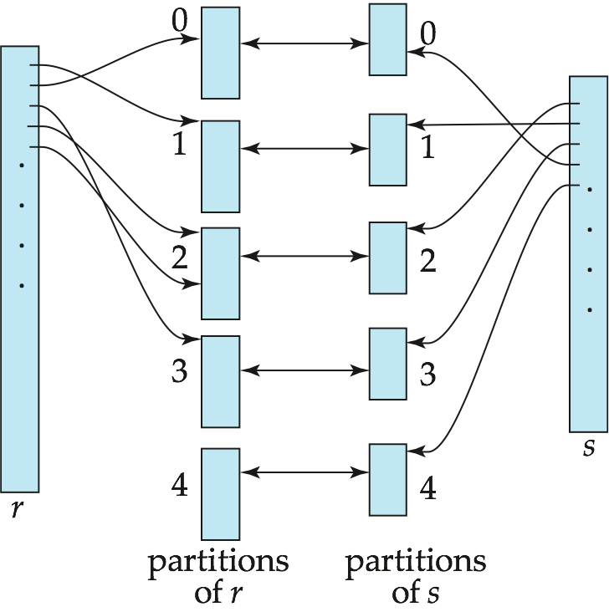
Hash-Join (Cont.)

Slide 47
Hash-Join (Cont.)
r tuples in r_{i} need only to be compared with s tuples in s_{i} Need not be compared with s tuples in any other partition, since:
  an r tuple and an s tuple that satisfy the join condition will have the same value for the join attributes.
  If that value is hashed to some value i, the r tuple has to be in r_{i} and the s tuple in s_{i}.

Slide 48
Hash-Join Algorithm
The hash-join of r and s is computed as follows.
1. Partition the relation s using hashing function h. When partitioning a relation, one block of memory is reserved as the output buffer for each partition.
2. Partition r similarly.
3. For each i:
  (a) Load s_{i} into memory and build an in-memory hash index f on it using the join attribute. This hash index f is different from h.
  (b) Read the tuples in r_{i} from the disk one by one. For each tuple t_{r} locate each matching tuple t_{s} in s_{i} using the in-memory hash index f. Output the concatenation of their attributes.
Relation s is called the build input and r is called the probe input.

Slide 49
Hash-Join algorithm (Cont.)
The value n (桶子个数) and the hash function h is chosen such that each s_{i} should fit in memory.
  Typically n is chosen as ⎡b_{s}/M⎤ * f where f is a “fudge factor”,经验系数 typically around 1.2
  The probe relation partitions r_{i} need not fit in memory
Recursive partitioning required if number of partitions n is greater than number of pages M of memory.
  instead of partitioning n ways, use M – 1 partitions for s
  Further partition the M – 1 partitions using a different hash function
  Use same partitioning method on r
  Rarely required: e.g., with block size of 4 KB, recursive partitioning not needed for relations of < 1GB with memory size of 2MB, or relations of < 36 GB with memory of 12 MB

Slide 50
Handling of Overflows
Partitioning is said to be skewed if some partitions have significantly more tuples than some others
Hash-table overflow occurs in partition s_{i} if s_{i} does not fit in memory. Reasons could be
  Many tuples in s with same value for join attributes
  Bad hash function
Overflow resolution can be done in build phase
  Partition s_{i} is further partitioned using different hash function.
  Partition r_{i} must be similarly partitioned.
Overflow avoidance performs partitioning carefully to avoid overflows during build phase
  E.g. partition build relation into many partitions, then combine them
Both approaches fail with large numbers of duplicates
  Fallback option: use block nested loops join on overflowed partitions

Slide 51
Cost of Hash-Join
If recursive partitioning is not required: cost of hash join is
3(b_{r} + b_{s}) +4 ∗ n_{h} block transfers +
2( ⎡b_{r} / b_{b}⎤ + ⎡b_{s} / b_{b}⎤) seeks
可忽略4 ∗ n_{h}
If recursive partitioning required:
  number of passes required for partitioning build relation
  s is ⎡log_{M–1}(b_{s}) – 1⎤
  best to choose the smaller relation as the build relation.
  Total cost estimate is:
  2(b_{r} + b_{s}) ⎡log_{M–1}(b_{s}) – 1⎤ + b_{r} + b_{s} block transfers +
  2(⎡b_{r} / b_{b}⎤ + ⎡b_{s} / b_{b}⎤) ⎡log_{M–1}(b_{s}) – 1⎤ seeks
If the entire build input can be kept in main memory no partitioning is required
  Cost estimate goes down to b_{r} + b_{s}.

Slide 52
Example of Cost of Hash-Join
instructor teaches
Assume that memory size is 20 blocks
b_{instructor}= 100 and b_{teaches} = 400.
instructor is to be used as build input. Partition it into five partitions, each of size 20 blocks. This partitioning can be done in one pass.
Similarly, partition teaches into five partitions,each of size 80. This is also done in one pass.
Therefore total cost, ignoring cost of writing partially filled blocks:
  3(100 + 400) = 1500 block transfers +
  2( ⎡100/3⎤ + ⎡400/3⎤) = 336 seeks

Slide 53

Hybrid Hash–Join
Useful when memory sized are relatively large, and the build input is bigger than memory.
Main feature of hybrid hash join:
Keep the first partition of the build relation in memory.
E.g. With memory size of 25 blocks, instructor can be partitioned into five partitions, each of size 20 blocks.
  Division of memory:
    The first partition occupies 20 blocks of memory
    1 block is used for input, and 1 block each for buffering the other 4 partitions.
teaches is similarly partitioned into five partitions each of size 80
  the first is used right away for probing, instead of being written out
Cost of 3(80 + 320) + 20 +80 = 1300 block transfers for
hybrid hash join, instead of 1500 with plain hash-join.
Hybrid hash-join most useful if M >>

Slide 54
Evaluation of Expressions
So far: we have seen algorithms for individual operations
Alternatives for evaluating an entire expression tree
  Materialization: generate results of an expression whose inputs are relations or are already computed, materialize (store) it on disk. Repeat.
  Pipelining: pass on tuples to parent operations even as an operation is being executed
We study above alternatives in more detail

Slide 55
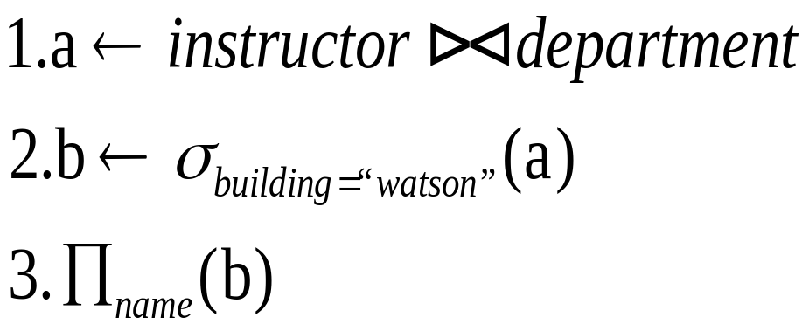
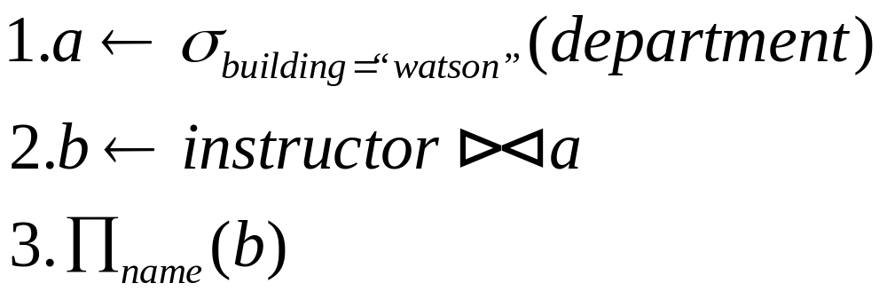
Materialization
Materialized evaluation: evaluate one operation at a time, starting at the lowest-level. Use intermediate results materialized into temporary relations to evaluate next-level operations.
Example query：
  Select name
  from instructor natural join department
  Where building=“watson”

Slide 56

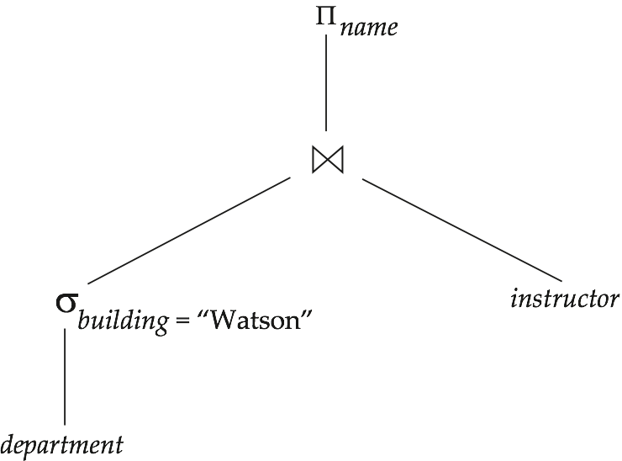
Materialization
E.g., in figure below, compute and store
then compute the store its join with instructor, and finally compute the projection on name.

Slide 57
Materialization (Cont.)
Materialized evaluation is always applicable
Cost of writing results to disk and reading them back can be quite high
  Our cost formulas for operations ignore cost of writing results to disk, so
    Overall cost = Sum of costs of individual operations +
    cost of writing intermediate results to disk
Double buffering: use two output buffers for each operation, when one is full write it to disk while the other is getting filled
  Allows overlap of disk writes with computation and reduces execution time

Slide 58
Pipelining
Pipelined evaluation : evaluate several operations simultaneously, passing the results of one operation on to the next.
E.g., in previous expression tree, don’t store result of
  instead, pass tuples directly to the join.. Similarly, don’t store result of join, pass tuples directly to projection.
Much cheaper than materialization: no need to store a temporary relation to disk.

Slide 59
Pipelining
Pipelining may not always be possible – e.g., sort, hash-join.
For pipelining to be effective, use evaluation algorithms that generate output tuples even as tuples are received for inputs to the operation.
Pipelines can be executed in two ways:
  demand driven
  and producer driven
Alternative name: pull and push models of pipelining

Slide 60
Pipelining (Cont.)
In demand driven or lazy evaluation
  system repeatedly requests next tuple from top level operation
  Each operation requests next tuple from children operations as required, in order to output its next tuple
  In between calls, operation has to maintain “state” so it knows what to return next

Slide 61
Pipelining (Cont.)
In producer-driven or eager pipelining
  Operators produce tuples eagerly and pass them up to their parents
    Buffer maintained between operators, child puts tuples in buffer, parent removes tuples from buffer
    if buffer is full, child waits till there is space in the buffer, and then generates more tuples
  System schedules operations that have space in output buffer and can process more input tuples

Slide 62
Pipelining (Cont.)
Implementation of demand-driven pipelining
  Each operation is implemented as an iterator implementing the following operations
    open()
      E.g. file scan: initialize file scan
        state: pointer to beginning of file
      E.g.merge join: sort relations;
        state: pointers to beginning of sorted relations
    next()
      E.g. for file scan: Output next tuple, and advance and store file pointer
      E.g. for merge join: continue with merge from earlier state till next output tuple is found. Save pointers as iterator state.
    close()

Slide 63
Evaluation Algorithms for Pipelining
Some algorithms are not able to output results even as they get input tuples
  E.g. merge join, or hash join
  intermediate results written to disk and then read back
Algorithm variants to generate (at least some) results on the fly, as input tuples are read in
  E.g. hybrid hash join generates output tuples even as probe relation tuples in the in-memory partition (partition 0) are read in
  Double-pipelined join technique: Hybrid hash join, modified to buffer partition 0 tuples of both relations in-memory, reading them as they become available, and output results of any matches between partition 0 tuples
    When a new r₀ tuple is found, match it with existing s₀ tuples, output matches, and save it in r₀
    Symmetrically for s₀ tuples

Slide 64
End of Chapter

