Slide 1
Chapter 2: Intro to Relational Model

Slide 2

Example of a Relation
attributes
(or columns)
tuples
(or rows)

Slide 3
Attribute Types
The set of allowed values for each attribute is called the domain of the attribute
Attribute values are (normally) required to be atomic; that is, indivisible
The special value null is a member of every domain
The null value causes complications in the definition of many operations

Slide 4
Relation Schema and Instance
Notations:
A_{i}: attribute name;
D_{i}: domain of attribute A_{i};
a_{i}： a value of A_{i} , an element of domain D_{i};
Example : A₁ = Name, D₁ ={Einstein, Biden, Musk,.... }, a₁ = Einstein.
R = (A₁, A₂, …, A_{n} ) is a relation schema
Relation schema example: instructor = (ID, name, dept_name, salary)

Slide 5
Relation Schema and Instance
Formally, given sets D₁, D₂, …. D_{n} a relation r is a subset of
D₁ x D₂ x … x D_{n}
Thus, a relation is a set of n-tuples (a₁, a₂, …, a_{n}) where each a_{i} ∈ D_{i}
The current values (relation instance) of a relation are specified by a table
An element t of r is a tuple, represented by a row in a table

Slide 6
Example of a Relation
attributes
(or columns)
tuples
(or rows)

Slide 7

Database term | Math term
table | relation
domain | set of allowed values of an attribute
row | tuple
Database term | Math term
table | relation
attribute name /columns name | set name
domain | set
row | tuple

Slide 8

Relations are Unordered
Order of tuples is irrelevant (tuples may be stored in an arbitrary order)
Example: instructor relation with unordered tuples

Slide 9
Database
A database consists of multiple relations
Information about a university is broken up into parts
instructor
student
advisor
Bad design:
univ (instructor -ID, name, dept_name, salary, student_Id, ..)
results in
  repetition of information (e.g., two students have the same instructor)
  the need for null values (e.g., represent an student with no advisor)
Normalization theory (Chapter 7) deals with how to design “good” relational schemas

Slide 10
Keys
Let R =(A₁, A₂, A₃, ...., ) be relation schema.
Let K ⊆ R (we view R as a set of attributes).
K is a superkey of R if values for K are sufficient to identify a unique tuple of each possible relation r(R)
  Example: {ID} and {ID,name} are both superkeys of instructor.
Superkey K is a candidate key if K is minimal
Example: {ID} is a candidate key for Instructor
One of the candidate keys is selected to be the primary key.
  which one?

Slide 11
Keys
Foreign key constraint: Value in one relation must appear in another
  Referencing relation
  Referenced relation

Slide 12
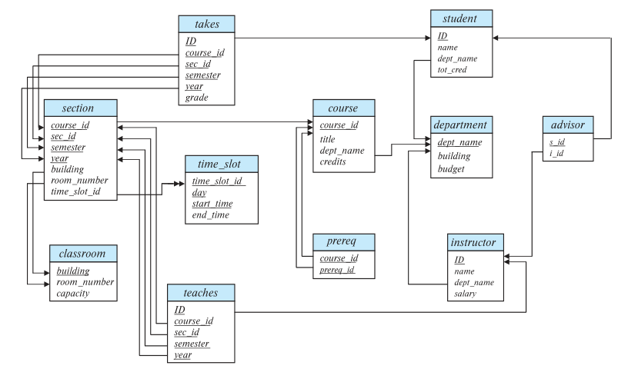
Schema Diagram for University Database

Slide 13
End of Chapter 2

