Slide 1
Chapter 6: Formal Relational Query Languages

Slide 2
Chapter 6: Formal Relational Query Languages
Relational Algebra
Tuple Relational Calculus
Domain Relational Calculus

Slide 3
Relational Algebra
Procedural language
Six basic operators
  select: σ
  project: ∏
  union: ∪
  set difference: –
  Cartesian product: x
  rename: ρ
The operators take one or two relations as inputs and produce a new relation as a result.

Slide 4

Select Operation – Example
Relation r
σ_{A=B ^ D > 5} (r)

Slide 5
Select Operation
Notation: σ _{p}(r)
p is called the selection predicate
Defined as:
σ_{p}(r) = {t | t ∈ r and p(t)}
  p is a formula in propositional calculus consisting of terms connected by : ∧, ∨ , ¬
  Each term is one of:
      <attribute> op <attribute>
      <attribute> op <constant>
  op is one of: =, ≠, >, ≥. <. ≤
Example of selection:
σ _{dept_name=“Physics”}(instructor)

Slide 6

Project Operation – Example
Relation r:
∏_{A,C} (r)

Slide 7

Project Operation
Notation:
where A₁, A₂ are attribute names and r is a relation name.
The result is defined as the relation of k columns obtained by erasing the columns that are not listed
Duplicate rows removed from result, since relations are sets
Example: To eliminate the dept_name attribute of instructor
∏_{ID, name, salary} (instructor)

Slide 8

Union Operation – Example
Relations r, s:
r ∪ s:

Slide 9
Union Operation
Notation: r ∪ s
Defined as:
r ∪ s = {t | t ∈ r or t ∈ s}
For r ∪ s to be valid.
1. r, s must have the same arity (same number of attributes)
2. The attribute domains must be compatible (example: 2nd column
of r deals with the same type of values as does the 2nd
column of s)
Example: to find all courses taught in the Fall 2009 semester, or in the Spring 2010 semester, or in both

Slide 10

Set difference of two relations
Relations r, s:
r – s:

Slide 11
Set Difference Operation
Notation r – s
Defined as:
r – s = {t | t ∈ r and t ∉ s}
Set differences must be taken between compatible relations.
  r and s must have the same arity
  attribute domains of r and s must be compatible
Example: to find all courses taught in the Fall 2009 semester, but not in the Spring 2010 semester

Slide 12

Cartesian-Product Operation – Example
Relations r, s:
r x s:

Slide 13
Cartesian-Product Operation
Notation r x s
Defined as:
r x s = {t q | t ∈ r and q ∈ s}
Assume that attributes of r(R) and s(S) are disjoint. (That is, R ∩ S = ∅).
If attributes of r(R) and s(S) are not disjoint, then renaming must be used.

Slide 14

Composition of Operations
Can build expressions using multiple operations
Example: σ_{A=C}(r x s)
r x s
σ_{A=C}(r x s)

Slide 15

Rename Operation
Allows us to name, and therefore to refer to, the results of relational-algebra expressions.
Allows us to refer to a relation by more than one name.
Example:
ρ _{x} (E)
returns the expression E under the name X
If a relational-algebra expression E has arity n, then
returns the result of expression E under the name X, and with the
attributes renamed to A₁ , A₂ , …., A_{n} .

Slide 16
Example Query
Find the largest salary in the university
  Step 1: find instructor salaries that are less than some other instructor salary (i.e. not maximum)
      using a copy of instructor under a new name d
  Step 2: Find the largest salary

Slide 17
Example Queries
Find the names of all instructors in the Physics department, along with the course_id of all courses they have taught
  Query 1
  Query 2

Slide 18
Formal Definition
A basic expression in the relational algebra consists of either one of the following:
  A relation in the database
  A constant relation
Let E₁ and E₂ be relational-algebra expressions; the following are all relational-algebra expressions:
  E₁ ∪ E₂
  E₁ – E₂
  E₁ x E₂
  σ_{p} (E₁), P is a predicate on attributes in E₁
  ∏_{s}(E₁), S is a list consisting of some of the attributes in E₁
  ρ _{x} (E₁), x is the new name for the result of E₁

Slide 19
Additional Operations
We define additional operations that do not add any power to the
relational algebra, but that simplify common queries.
Set intersection
Natural join
Assignment
Outer join

Slide 20
Set-Intersection Operation
Notation: r ∩ s
Defined as:
r ∩ s = { t | t ∈ r and t ∈ s }
Assume:
  r, s have the same arity
  attributes of r and s are compatible
Note: r ∩ s = r – (r – s)

Slide 21

Set-Intersection Operation – Example
Relation r, s:
r ∩ s

Slide 22
Natural-Join Operation
Notation: r s
Let r and s be relations on schemas R and S respectively.
Then, r s is a relation on schema R ∪ S obtained as follows:
  Consider each pair of tuples t_{r} from r and t_{s} from s.
  If t_{r} and t_{s} have the same value on each of the attributes in R ∩ S, add a tuple t to the result, where
    t has the same value as t_{r} on r
    t has the same value as t_{s} on s
Example:
  R = (A, B, C, D)
  S = (E, B, D)
  Result schema = (A, B, C, D, E)
  r s is defined as:
  ∏_{r.A, r.B, r.C, r.D, s.E} (σ_{r.B = s.B ∧ r.D = s.D} (r x s))

Slide 23

Natural Join Example
Relations r, s:
r s

Slide 24
Natural Join and Theta Join
Find the names of all instructors in the Soft. Eng. department together with the course titles of all the courses that the instructors teach
  ∏ _{name, title} (σ instructor.dept_name =“Soft. Eng” (
  instructor teaches course))
Natural join is associative
  (instructor teaches) course is equivalent to
  instructor (teaches course)
Natural join is commutative
  instruct teaches is equivalent to
  teaches instructor

Slide 25
Natural Join and Theta Join
The theta join operation r _{θ} s is defined as
  r _{θ} s = σ_{θ} (r x s)
Find the names of all instructors in the Soft. Eng. department together with the course titles of all the courses that the instructors teach

Slide 26
Assignment Operation
The assignment operation (←) provides a convenient way to express complex queries.
  Write query as a sequential program consisting of
    a series of assignments
    followed by an expression whose value is displayed as a result of the query.
  Assignment must always be made to a temporary relation variable.

Slide 27
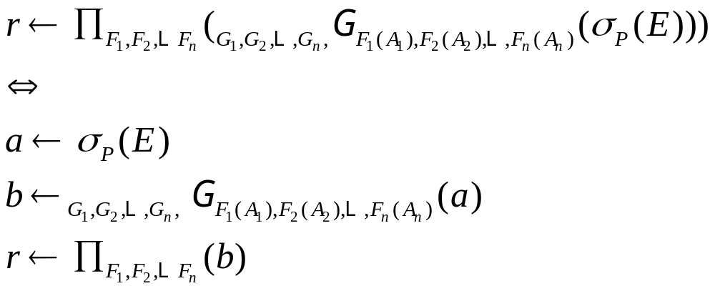

Slide 28
Outer Join
An extension of the join operation that avoids loss of information.
Computes the join and then adds tuples form one relation that does not match tuples in the other relation to the result of the join.
Uses null values:
  null signifies that the value is unknown or does not exist
  All comparisons involving null are (roughly speaking) false by definition.
    We shall study precise meaning of comparisons with nulls later

Slide 29
Outer Join – Example
Relation instructor1
ID
name
dept_name
10101
12121
15151
Srinivasan
Wu
Mozart
Comp. Sci.
Finance
Music
Relation teaches1
ID
course_id
10101
12121
76766
CS-101
FIN-201
BIO-101

Slide 30
Outer Join – Example
Join
instructor teaches
ID
name
dept_name
course_id
10101
12121
Srinivasan
Wu
Comp. Sci.
Finance
CS-101
FIN-201
Left Outer Join
instructor teaches
ID
name
dept_name
course_id
10101
12121
15151
Srinivasan
Wu
Mozart
Comp. Sci.
Finance
Music
CS-101
FIN-201
null

Slide 31
Outer Join – Example
Right Outer Join
instructor teaches
ID
name
dept_name
course_id
10101
12121
76766
Srinivasan
Wu
null
Comp. Sci.
Finance
null
CS-101
FIN-201
BIO-101
Full Outer Join
instructor teaches
ID
name
dept_name
course_id
10101
12121
15151
76766
Srinivasan
Wu
Mozart
null
Comp. Sci.
Finance
Music
null
CS-101
FIN-201
null
BIO-101

Slide 32
Outer Join using Joins
Outer join can be expressed using basic operations
  e.g. r s can be written as
  (r s) U (r – ∏_{R}(r s) x {(null, …, null)}

Slide 33
Null Values
It is possible for tuples to have a null value, denoted by null, for some of their attributes
null signifies an unknown value or that a value does not exist.
  The result of any arithmetic expression involving null is null.
  Aggregate functions simply ignore null values (as in SQL)
  For duplicate elimination and grouping, null is treated like any other value, and two nulls are assumed to be the same (as in SQL)

Slide 34
Null Values
Comparisons with null values return the special truth value: unknown
  If false was used instead of unknown, then not (A < 5)
  would not be equivalent to A >= 5
Three-valued logic using the truth value unknown:
  OR: (unknown or true) = true,
  (unknown or false) = unknown
  (unknown or unknown) = unknown
  AND: (true and unknown) = unknown,
  (false and unknown) = false,
  (unknown and unknown) = unknown
  NOT: (not unknown) = unknown
  In SQL “P is unknown” evaluates to true if predicate P evaluates to unknown
Result of select predicate is treated as false if it evaluates to unknown

Slide 35
Extended Relational-Algebra-Operations
Generalized Projection
Aggregate Functions

Slide 36
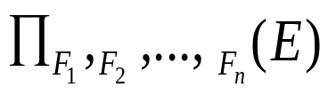
Generalized Projection
Extends the projection operation by allowing arithmetic functions to be used in the projection list.
E is any relational-algebra expression
Each of F₁, F₂, …, F_{n} are are arithmetic expressions involving constants and attributes in the schema of E.
Given relation instructor(ID, name, dept_name, salary) where salary is annual salary, get the same information but with monthly salary
∏_{ID, name, dept_name, salary/12} (instructor)

Slide 37
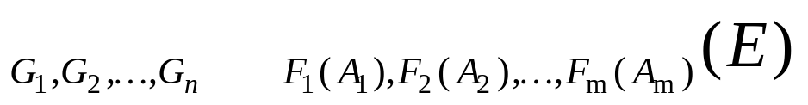

Aggregate Functions and Operations
Aggregation function takes a collection of values and returns a single value as a result.
avg: average value
min: minimum value
max: maximum value
sum: sum of values
count: number of values
Aggregate operation in relational algebra
  E is any relational-algebra expression
  G₁, G₂ …, G_{n} is a list of attributes on which to group (can be empty)
  Each F_{i} is an aggregate function
  Each A_{i} is an attribute name
  result relation has n+m attributes:

Slide 38
Aggregate Operation – Example
Relation r:
A
B
C
α
α
β
β
α
β
β
β
7
7
3
10
_{sum(c)} (r)
sum(c )
27

Slide 39


Aggregate Operation – Example
Find the average salary in each department
_{dept_name} _{avg(salary) as avg_salary} (instructor)
avg_salary

Slide 40
Aggregate Functions (Cont.)
Result of aggregation does not have a name
  Can use rename operation to give it a name
  For convenience, we permit renaming as part of aggregate operation
_{dept_name} _{avg(salary) as avg_sal} (instructor)

Slide 41
Modification of the Database
The content of the database may be modified using the following operations:
  Deletion
  Insertion
  Updating
All these operations can be expressed using the assignment operator

Slide 42
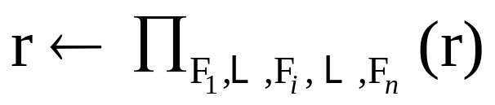
Modification of the Database
A deletion is expressed in relational algebra by:
r ← r – E
an insertion is expressed by:
r ← r ∪ E
Use the generalized projection operator to do this task
  if the i-th attribute is not updated, then F_{i} is the i-th attribute of r
  if the attribute is to be updated, then F_{i} is an expression, involving only constants and the attributes of r .

Slide 43
Multiset Relational Algebra
Pure relational algebra removes all duplicates
  e.g. after projection
Multiset relational algebra retains duplicates, to match SQL semantics
  SQL duplicate retention was initially for efficiency, but is now a feature
Multiset relational algebra defined as follows
  selection: has as many duplicates of a tuple as in the input, if the tuple satisfies the selection
  projection: one tuple per input tuple, even if it is a duplicate
  cross product: If there are m copies of t1 in r, and n copies of t2 in s, there are m x n copies of t1.t2 in r x s
  Other operators similarly defined
    E.g. union: m + n copies, intersection: min(m, n) copies
    difference: max (0, m – n) copies

Slide 44
SQL and Relational Algebra
select A1, A2, .. An
from r1, r2, …, rm
where P
is equivalent to the following expression in multiset relational algebra
∏ _{A1, .., An} (σ _{P} (r1 x r2 x .. x rm))
select A1, A2, sum(A3)
from r1, r2, …, rm
where P
group by A1, A2
is equivalent to the following expression in multiset relational algebra
_{A1, A2} _{sum(A3)} (σ _{P} (r1 x r2 x .. x rm)))

Slide 45
SQL and Relational Algebra
More generally, the non-aggregated attributes in the select clause may be a subset of the group by attributes, in which case the equivalence is as follows:
select A1, sum(A3)
from r1, r2, …, rm
where P
group by A1, A2
is equivalent to the following expression in multiset relational algebra
∏ _{A1,sumA3}( _{A1,A2} _{sum(A3)} _{as sumA3}(σ _{P} (r1 x r2 x .. x rm)))

