Slide 1



Green Pace
Security policy Presentation
Project two
Michael Farag

Slide 2
Coding Standards
Do not cast to an out-of-range enumeration value
Do not rely on the value of a moved from object.
Do not attempt to create a std::string from a null pointer
Do not store already-owned pointer value in an unrelated smart pointer
Do not access freed memory
Use a static assertion to test the value of a constant expression
Do not let exceptions escape from destructors and deallocation functions
Store a new value in pointers immediately after free()
Be careful when using functions that use file names for identification.
Do not make assumptions about the size of environment variable

Slide 3
10 Principles
1. Validate Input Data
2. Heed Compiler Warnings
3. Architect and Design for Security Policies.
4. Keep it Simple
5. Default Deny
6. Adhere to the Principle of Least Privilege
7. Sanitize Data Sent to Other Systems
8. Practice Defense in Depth
9. Use Effective Quality Assurance Techniques
10. Adopt a Secure Coding Standard

Slide 4

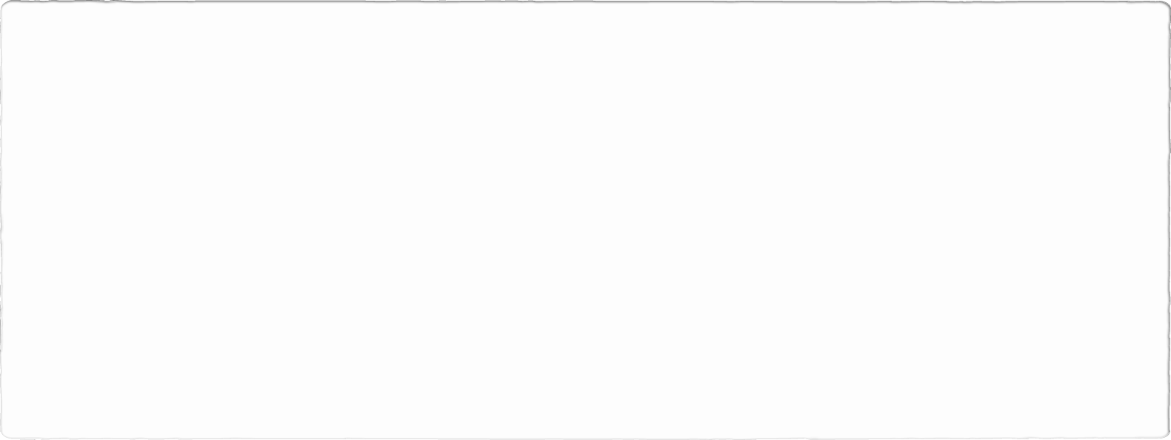
This model demonstrates a detailed method of defense that are standard, accepted secure coding models.

Slide 5

Automation Summary

Slide 6
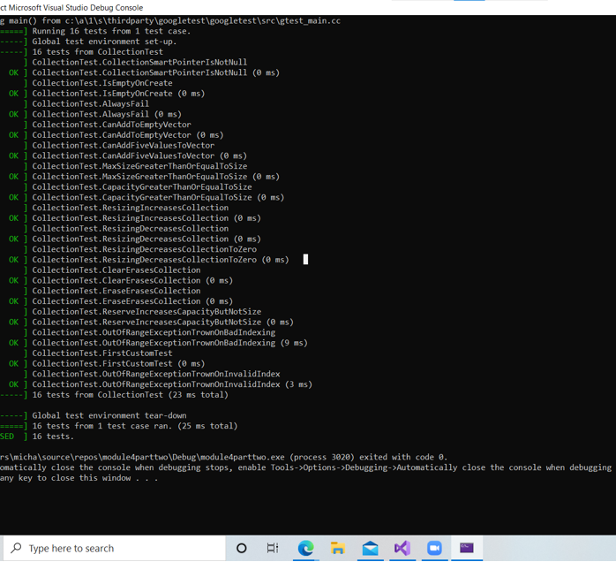
Unit Testing

Slide 7

Triple A Policies
Authentication | Authentication is verifying the identify of users and granting access to authenticated users according to clearance protocols. Authentication is needed in implementing security protocols. We need to ensure that only authenticated users can gain access to their designated accounts.
Authorization | Granting the authenticated users the content based on the proper privileges. Often centralizing and externalization authorization makes the entity safer. Users must gain authorization for doing tasks.
Accounting | Accounting measures the resources a user consumes during access. This can be the amount of time the data is sent/received during a session.

Slide 8
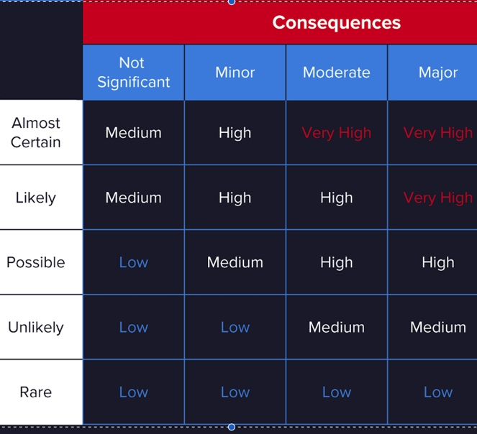
Level of Threats
Secure Coding standards come with certain levels of vulnerability to measure the impact of vulnerabilities and the risks posed.

Slide 9
Encryption Policies
Encryption in rest | Encryption at rest refers to encryption the data on the disk to prevent any unauthorized access by encrypting any unencrypted data. Examples ( Encrypting and decrypting files and databases)
Encryption at flight | Encryption at flight refers to the data being transmitted. The data needs to be encrypted while transmitted otherwise, we risk sensitive data being exposed. Data in movement is protected within channels. Examples (IPsec VPN, HTTPS(SSL, TLS)
Encryption in use | In use Encryption refers to ensuring sensitive data is always encrypted. This protects sensitive data at all times

Slide 10
Risk and Benefits
Programming will always include vulnerabilities in the coding and design. Testing and implementing secure coding practice does not ensure the code is clear of any vulnerability. It is ideal to keep up to date with up-to-date practices and coding standards. It is critical to code with the awareness of common threats and implement techniques to prevent such occurrences.

Slide 11
References
Cyber espionage. VMware. (n.d.). https://www.vmware.com/topics/glossary/content/cyber-espionage.
Confluence. EXP63-CPP. Do not rely on the value of a moved-from object - SEI CERT C++ Coding Standard - Confluence. (n.d.). https://wiki.sei.cmu.edu/confluence/display/cplusplus/EXP63-CPP.+Do+not+rely+on+the+value+of+a+moved-from+object#:~:text=invoking%20its%20destructor.-,Do%20not%20rely%20on%20the%20value%20of%20a%20moved%2Dfrom,values%20leads%20to%20unspecified%20behavior
Svoboda, M. (n.d.). Ken Thompson quote #1931969. Quotepark.com. https://quotepark.com/quotes/1931969-ken-thompson-you-cant-trust-code-that-you-did-not-totally-crea/.
Why encrypt? Senetas. (2021, March 11). https://www.senetas.com/encryption-overview/why-encrypt/?gclid=CjwKCAjw9uKIBhA8EiwAYPUS3Or_627tu5HosqOKV6tagcbrTRNJyoRlj2GRtvd6bgSbbC9eD-r2KRoCMNAQAvD_BwE.

