Slide 1
Employee Retention
HR Analytics

Slide 2
Agenda
A Structured Walkthrough of Our Analytical Journey
Analytical Workflow Overview
Insights & Key Findings
Dashboards & Visualizations

Slide 3
People Powering the Mission
From Data to Design – Our Core Contributors
Chaitanya Girish Pawar
Vinita Pal
Ankit Jaysingh Bramhane
Kodandaram Gedela
Khalique Ur Rahman
Koppula Praveen

Slide 4

Project Overview
Campaign Data, Simplified and Compared
Project Focus:
Objective
Tool Used
Excel
Power BI
Tableau
SQL
Analyzing HR data to uncover key factors driving employee performance and organizational success.
Apply HR analytics and visualization techniques to identify workforce trends and drive data-backed organizational decisions
Methodology
Insights
Applied a consistent set of HR analytical questions across all tools to systematically examine employee attributes, performance metrics, workforce trends, and organizational outcomes
Identified key workforce patterns and predictors of employee performance and retention through comprehensive multi-tool HR analysis
.

Slide 5

Analytical Workflow Overview
From Raw Data to Actionable Insights
Data Preparation
& Exploration
Cleaned the dataset by removing duplicates, handling missing values, and fixing formatting issues
Used Excel and SQL to compute summary statistics and uncover early trends in attrention, employee satisfaction,
Tool Evaluation & Comparison
Assessed analytical depth and visualization flexibility across all platforms
Highlighted each tool’s strengths for storytelling and decision-making
Visualization
Across Platforms
Insight Generation
Built interactive dashboards in Excel, Power BI, and Tableau
visualized attrition rate, employee satisfaction and performance.
It reveals patterns of employee satisfaction. Hight workload and early tenure employee also show higher attrition.
This highlights key problem area that he needs to address and improve

Slide 6




Insights & Key Findings
What Drives Employee Success in the Workplace
High Attrition in Specific Departments
Workload & Tenure Impact Performance
Work-Life Balance Correlates with Retention
Income & Job Role Trends
Sales and HR show the highest turnover compared to other teams
Employees with balanced workload and 2–5 years of experience perform the strongest.
Lower work-life balance scores align with higher attrition rates.
Mid-level roles with moderate salaries show better retention than entry-level, low-income staff.

Slide 7
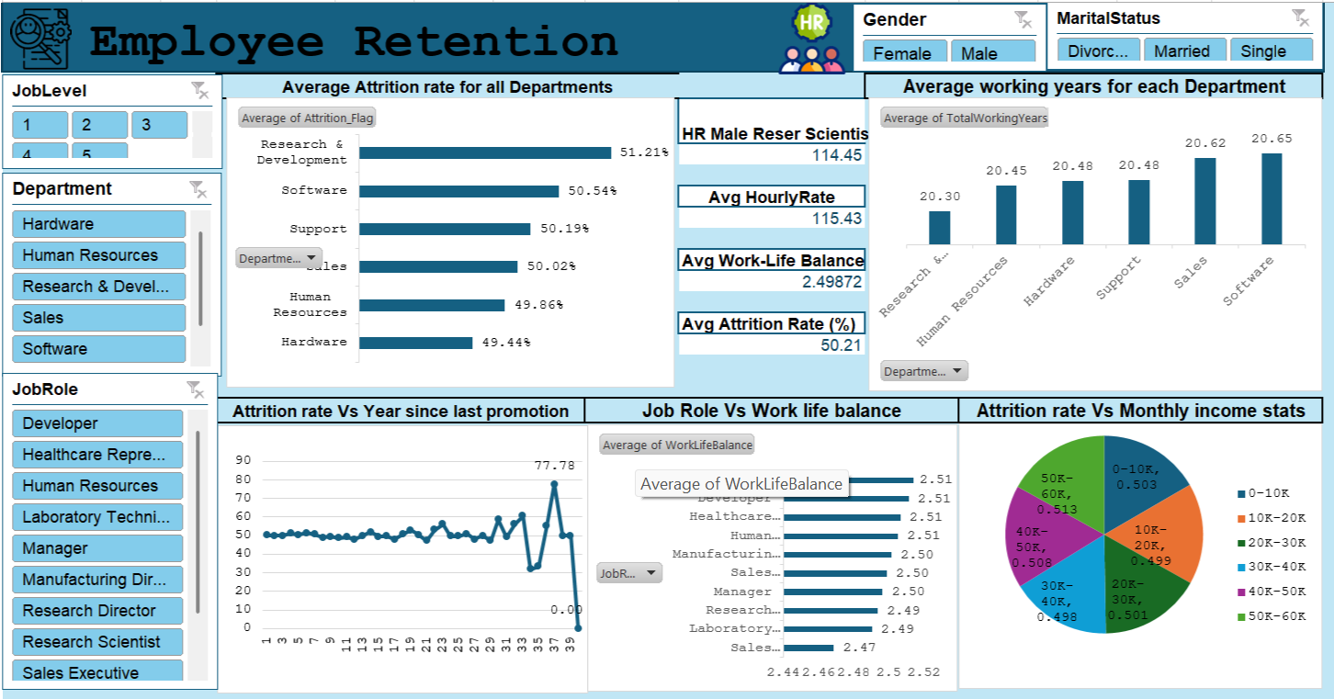



Excel for HR Analysis Dashboards
Familiar, flexible, and great for quick analysis
Supports ~1M rows; good for mid-size data
Imports via CSV, XLSX, or copy-paste
Basic interactivity: slicers, pivots, formatting
Limited automation via VBA or Power Query
Standard visuals: bar, line, pie charts
Best for static reports and quick setup

Slide 8
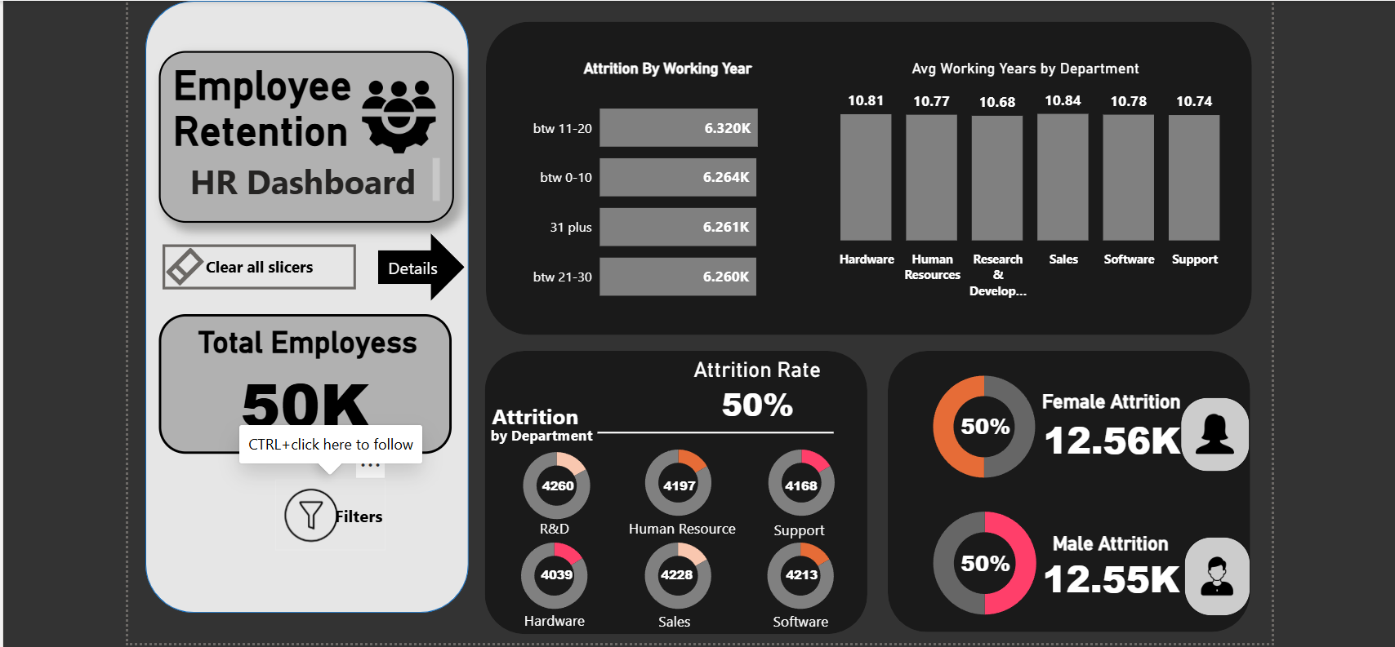
Power BI for HR Analysis Dashboards
Scalable, interactive, and cloud-ready
Connects to SQL, Excel, APIs, cloud sources
Optimized for large datasets and fast performance
Rich interactivity: drill-through, filters, bookmarks
Auto-refresh via Power BI Service
Custom visuals and DAX for deep analysis
Great for real-time tracking and investor views

Slide 9
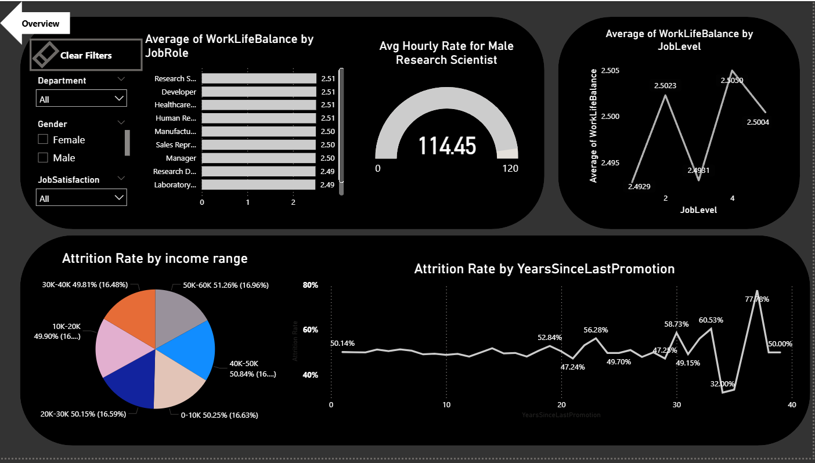
Power BI for HR Analysis Dashboards
Navigation – part 2

Slide 10
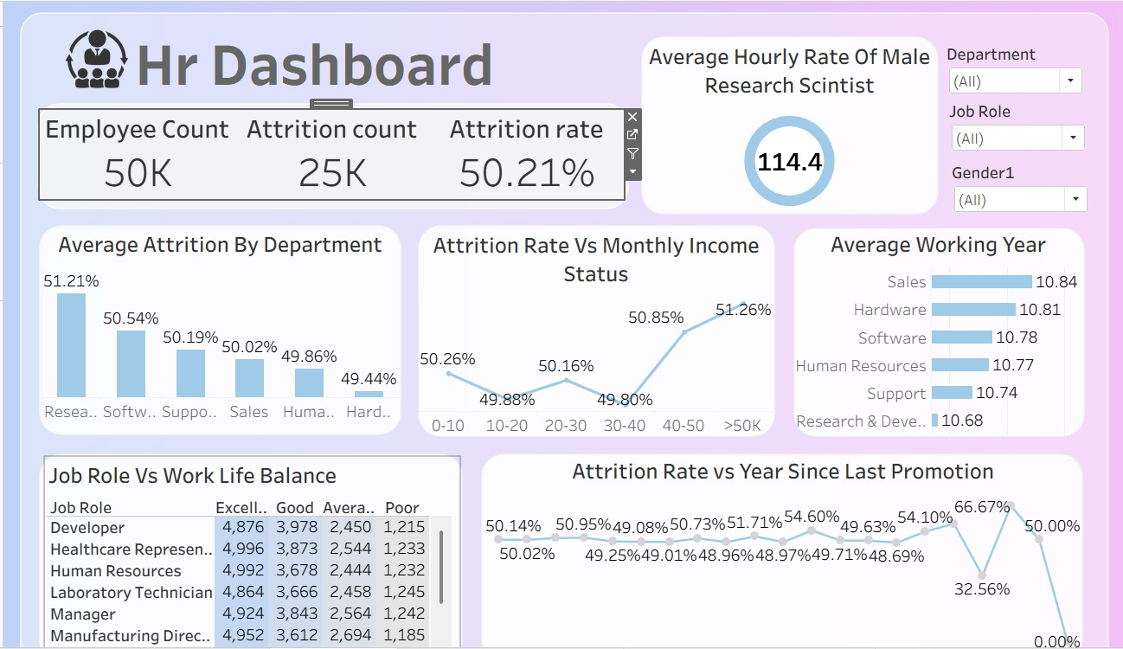
Tableau for HR Analysis Dashboards
Visually rich and built for storytelling
Connects to live and big data sources
Drag-and-drop for quick visual creation
Interactive dashboards: filters, tooltips
Auto-refresh with dynamic live updates
Artistic visuals: heat maps, tree maps, storyboards
Ideal for pitch decks and storytelling

Slide 11
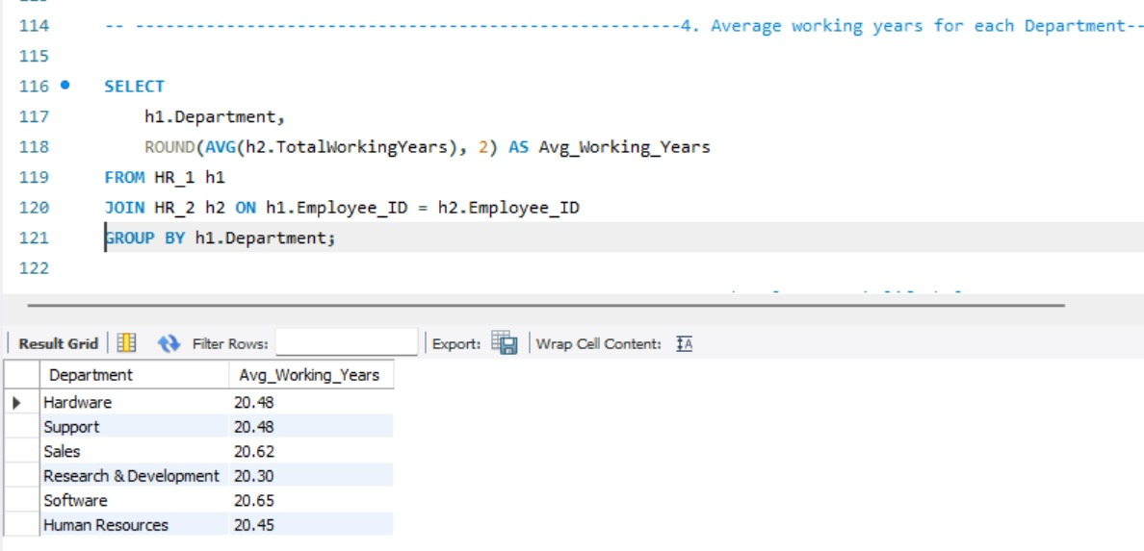
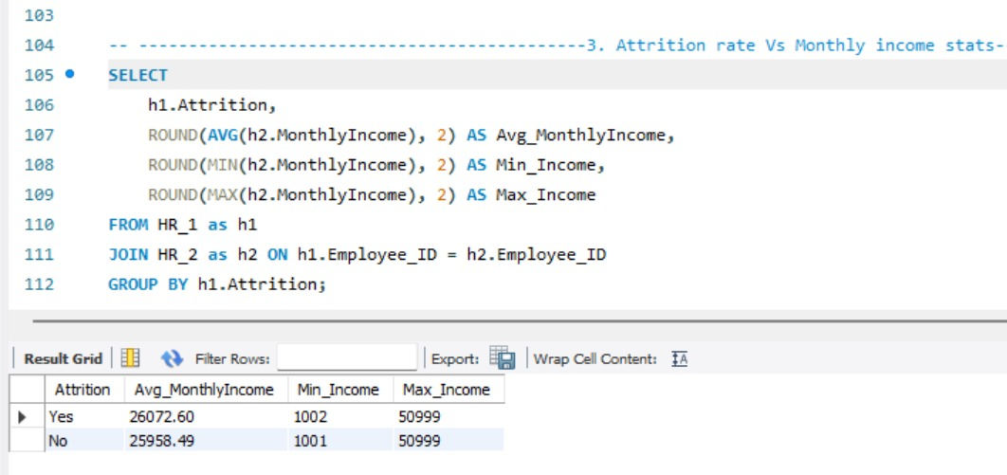
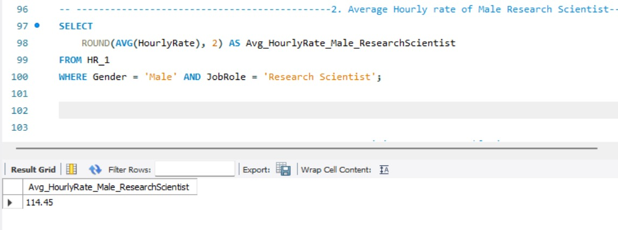
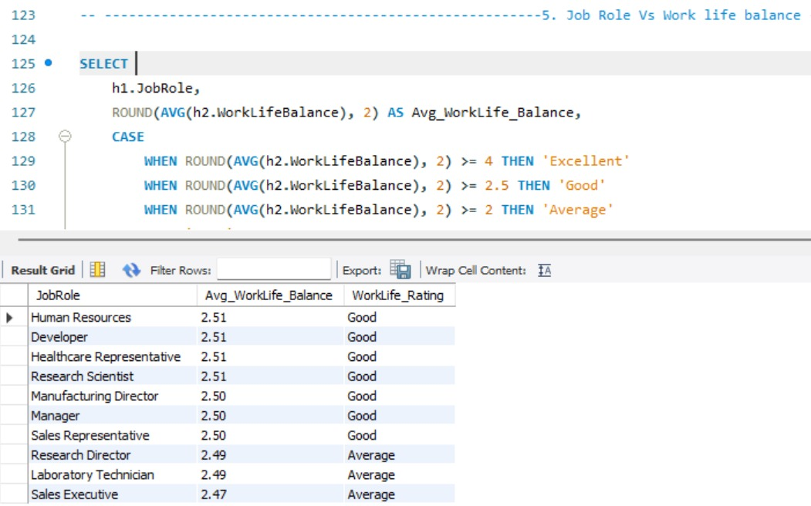
SQL Script for HR Data Analysis
This HR analysis project utilized SQL (Structured Query Language) to query and analyze employee data, providing key insights into Human Resources metrics. We performed calculations like finding the average monthly income for employees who left (Attrition = Yes) versus those who stayed (Attrition = No), and determined the average hourly rate for a specific group (Male Research Scientists). This demonstrates SQL's power in data aggregation and filtering to support HR decision-making.

Slide 12
CONCLUSION :
Attrition is highest among young, low-tenure employees and customer-facing roles.
Low satisfaction, limited growth, and below-average pay are the core drivers of exits.
High workload and poor manager relationships further increase turnover.
Most resignations occur within the first 1–3 years, showing onboarding gaps.
Strengthening growth opportunities, compensation, and manager support can improve retention.
Employees without regular performance feedback are more likely to leave.
Flexible work options show a strong link to better retention and engagement.

Slide 13
GitHub Project Repository
This HR Analytics project is publicly available on GitHub, containing all analysis files used across multiple tools. The repository is structured to allow easy navigation and reproducibility of the complete analytical workflow.
📊 Excel File — HR dataset with pivot tables, slicers, and dashboard visualizations
⚡ Power BI Report — Interactive .pbix file with DAX measures and drill-through filters
🗄 SQL Script — Queries for attrition analysis, income aggregation, and workforce trends
📈 Tableau Workbook — Story-driven dashboards with heat maps and attrition storytelling
🔗 GitHub Repository: github.com/your-username/HR-Analytics-Employee-Retention

Slide 14

Thank You !

