Slide 1
Kickstarter Crowdfunding
Data Analysis Project

Slide 2
Agenda
A Structured Walkthrough of Our Analytical Journey
Analytical Workflow Overview
Insights & Key Findings
Dashboards & Visualizations

Slide 3
Meet the Team
From Data to Design – Our Core Contributors
Ankit Jaysingh Bramhane
Chaitanya Girish Pawar
Gangotri Lingade
Kodandaram Gedela
Komal Prakash Mahana
Kunigiri Ajay Kumar
Sumit Sanjay Patil
Vinita Pal

Slide 4

Project Overview
Campaign Data, Simplified and Compared
Project Focus:
Objective
Tool Used
Excel
Power BI
Tableau
SQL
Analyzing Kickstarter crowdfunding campaigns to uncover key success factors.
Apply analytical and visualization skills across multiple platforms to derive actionable business insights.
Methodology
Outcome
Applied a uniform set of analytical questions across all tool to consistently explore campaign attributes, funding goals, categories, and outcomes.
Identified patterns and predictors of successful crowdfunding campaigns using multi-tool analysis
.

Slide 5
Analytical Workflow Overview
From Raw Data to Actionable Insights
Data Preparation
& Exploration
Cleaned the dataset by removing duplicates, handling missing values, and fixing formatting issues
Used Excel and SQL to compute summary statistics and uncover early trends in funding goals, categories, and outcomes
Crowd
Funding
Tool Evaluation & Comparison
Assessed analytical depth and visualization flexibility across all platforms
Highlighted each tool’s strengths for storytelling and decision-making
Visualization
Across Platforms
Insight Generation
Built interactive dashboards in Excel, Power BI, and Tableau
Visualized category performance, country-level success, and time-based patterns
Identified top-performing categories and regions
Pinpointed campaign traits linked to higher success rates

Slide 6




Insights & Key Findings
What Drives Crowdfunding Success on Kickstarter
Top-Performing
Categories
Optimal Funding
Goals
Ideal Campaign Duration
Geographic Success
Technology, Design, and Games showed the highest success rates
Campaigns with moderate goals (vs. high targets) had better success
Campaigns lasting around 30 days performed best
United States and United Kingdom led in both campaign count and funding volume

Slide 7

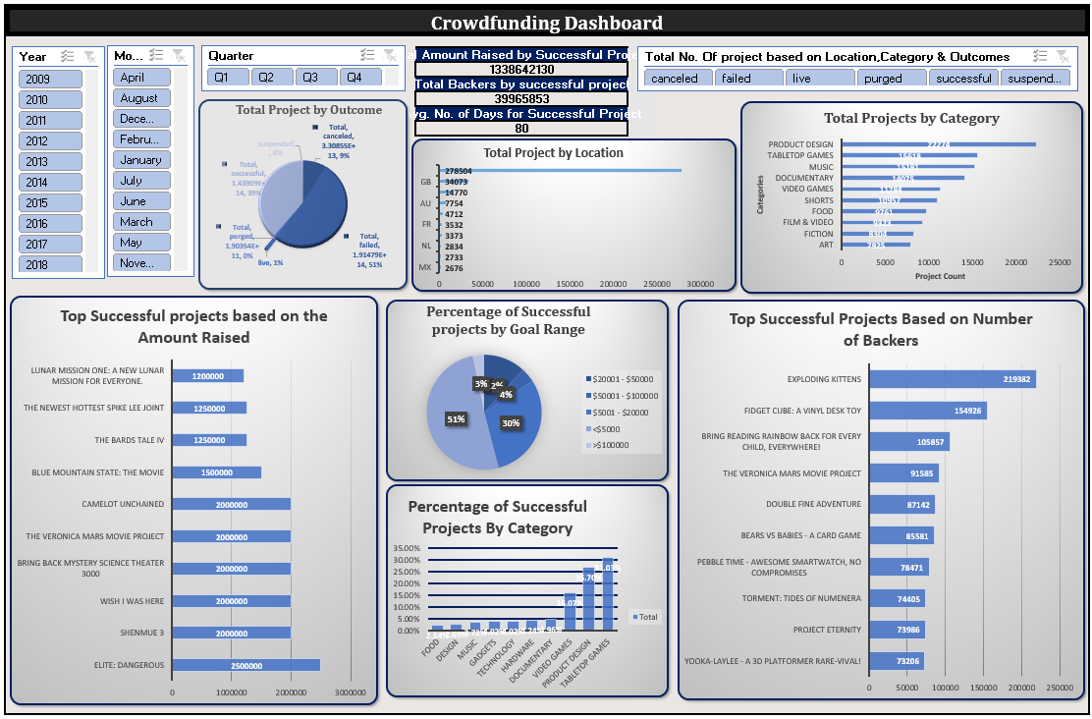

Excel for Crowdfunding Dashboards
Familiar, flexible, and great for quick analysis
Supports ~1M rows; good for mid-size data
Imports via CSV, XLSX, or copy-paste
Basic interactivity: slicers, pivots, formatting
Limited automation via VBA or Power Query
Standard visuals: bar, line, pie charts
Best for static reports and quick setup

Slide 8
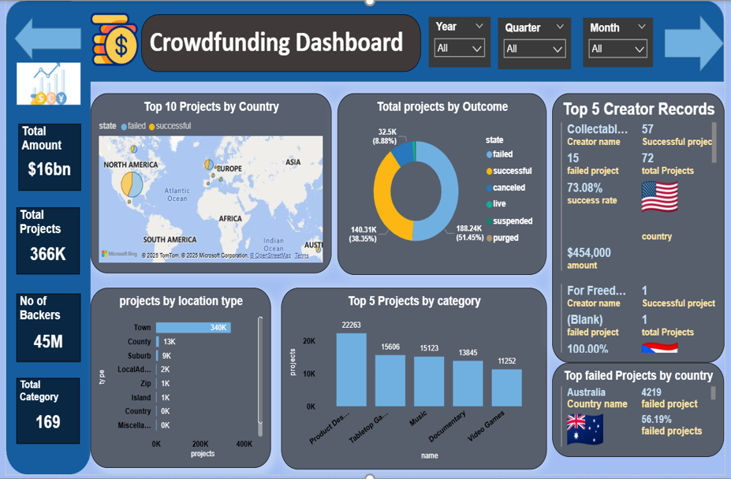
Power BI for Crowdfunding Dashboards
Scalable, interactive, and cloud-ready
Connects to SQL, Excel, APIs, cloud sources
Optimized for large datasets and fast performance
Rich interactivity: drill-through, filters, bookmarks
Auto-refresh via Power BI Service
Custom visuals and DAX for deep analysis
Great for real-time tracking and investor views

Slide 9
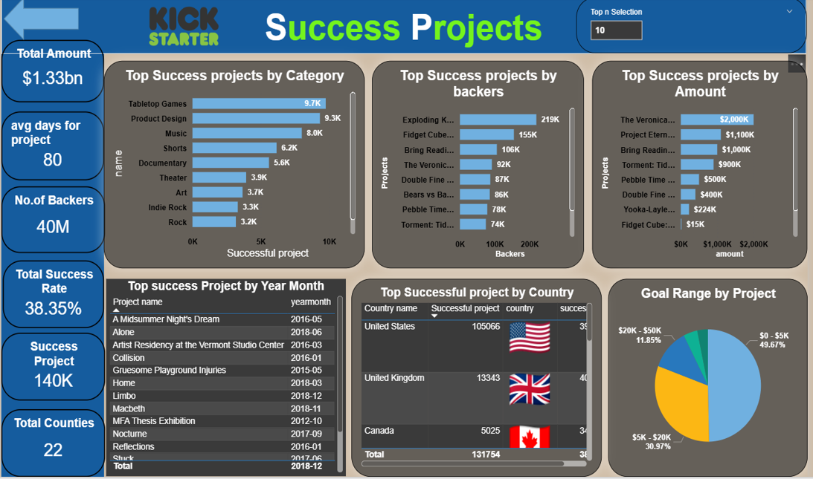
Power BI for Crowdfunding Dashboards
Navigation – part 2

Slide 10
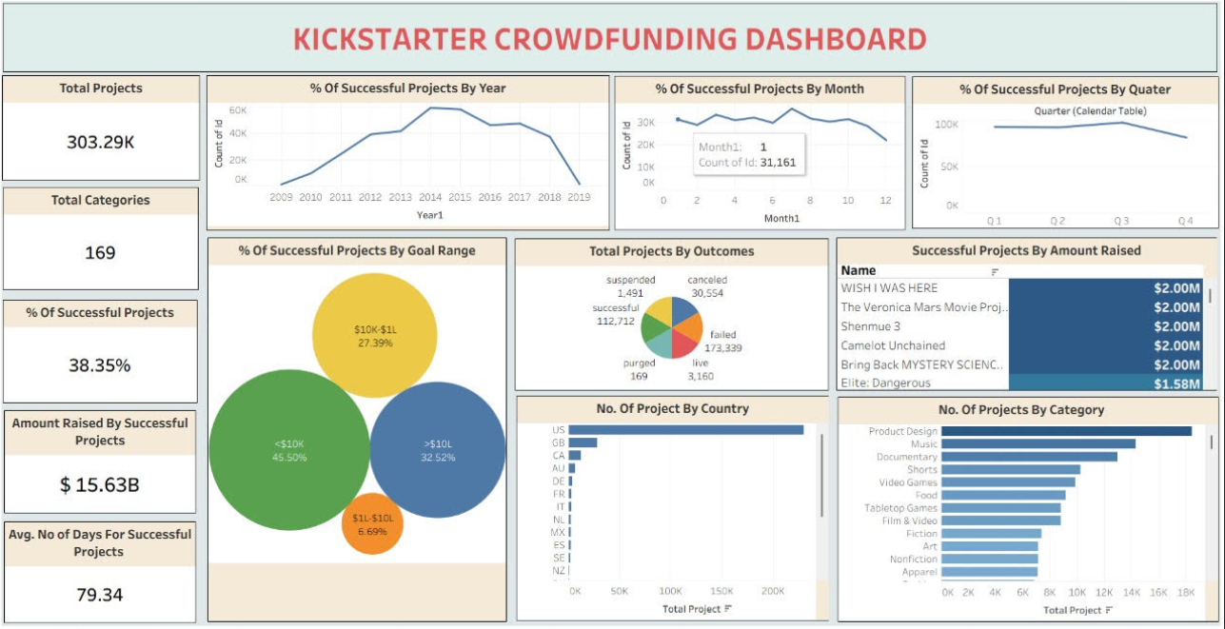
Tableau for Crowdfunding Dashboards
Visually rich and built for storytelling
Connects to live and big data sources
Drag-and-drop for quick visual creation
Interactive dashboards: filters, tooltips
Auto-refresh with dynamic live updates
Artistic visuals: heat maps, tree maps, storyboards
Ideal for pitch decks and storytelling

Slide 11
Conclusion & Key Takeaways
📊
📈
🌍
Key Metrics
Project Outcomes
Top Locations
💰 Total Raised: $1.34 Billion
👥 Total Backers: 39.97 Million
Average Duration: 80 Day
✅ Successful: 39%
🔄 Live: 1%
❌ Failed: 51%
🚫 Cancelled: 9%
🇺🇸 United States: 278,504
🇬🇧 Great Britain: 34,073
🇨🇦 Canada: Notable presence
US leads by a wide margin in both count and funding
🎯
🎨.
🏆
Goal Range Success Rates
Popular Categories
Top Projects
$0–$10K: 53%
$10K–$50K: 37%
Lower goal ranges yield higher success rates
🧩 Product Design
🎲 Tabletop Games
🎵 Music
👥 Most Backers: Exploding Kittens
💰 Highest Raised: Elite: Dangerous

Slide 12
GitHub Project Repository
All project files available on GitHub for reference and reproducibility
📗 Excel File — HR dataset with pivot tables, slicers, and interactive dashboard
⚡ Power BI Report — Interactive .pbix file with DAX measures and drill-through filters
🗄️ SQL Script — Queries for project outcomes, category breakdowns, and country analysis
📈 Tableau Workbook — Story-driven dashboards with campaign success visualizations
📊 Presentation Slides — Full project walkthrough with insights and recommendations
🔗 github.com/your-username/Kickstarter-Crowdfunding-Analysis

Slide 13
Thank You !

