Slide 1
Traffic simulation in the city of Zurich
Lecture with Computer Exercises:
Modelling and Simulating Social Systems with MATLAB
FS 2014
Lecturers Authors
Dario Biasini, Dirk Helbing, Jan Dörrie, Simone Forte,
Tobias Kuhn, Olivia Woolley Charalampos Gkonos, Athina Korfiati

Slide 2
Table of Contents
General Motivation
Introduction & Fundamental Questions
Data Processing
Description of the Model
Implementation
Simulation Results

Slide 3
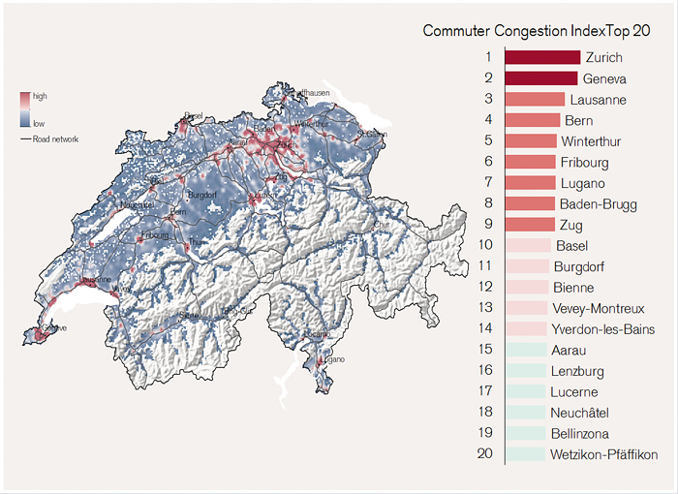
General Motivation
Credit Suisse, 2014. Morning Traffic Congestion in Switzerland – the Commuter Congestion Index. [Online] Available at: https://www.credit-suisse.com/publications/one-articles/news-and-expertise/2014/03/en/zurich-and-geneva-need-road-pricing/_jcr_content/articleContent/articleinsertcontain/clusters/articleimagezoomelem.zoom.html [Accessed 17 May 2014].

Slide 4
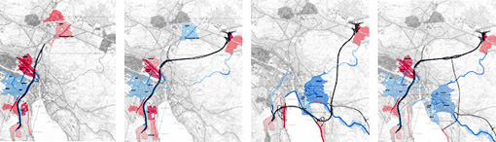
Introduction & Fundamental Questions
Highway Tunnel Zürich Project
(proposed by the ARGE Züriring consortium)
Will the construction of a tunnel eventually improve or worsen the traffic situation?
Güller Güller Architecture Urbanism, 2002. Highway Tunnel Zürich. [Online] Available at: http://www.ggau.net/html/GG03.html [Accessed 2 March 2014].

Slide 5
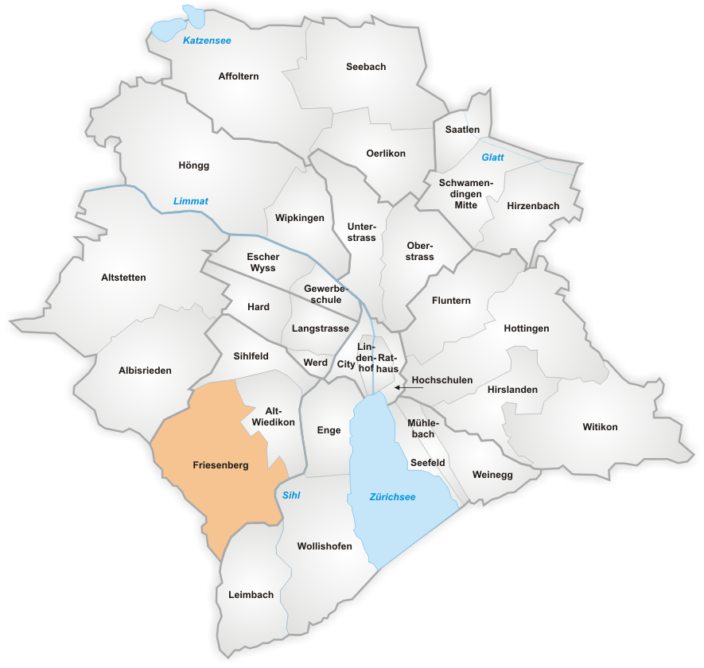
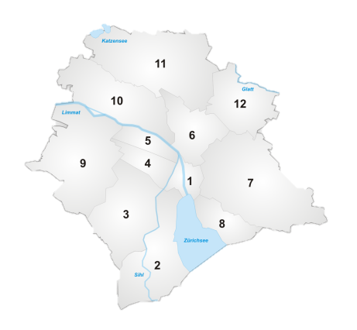
Trip Generation Points
Municipality of Zürich
12 Districts
34 Neighbourhoods
Population Data
District to Neighbourhood
Wikipedia, 2008. Subdivisions of Zürich. [Online] Available at: http://en.wikipedia.org/w/index.php?title=Subdivisions_of_Z%C3%BCrich&oldid=603437314 [Accessed 2 March 2014].

Slide 6
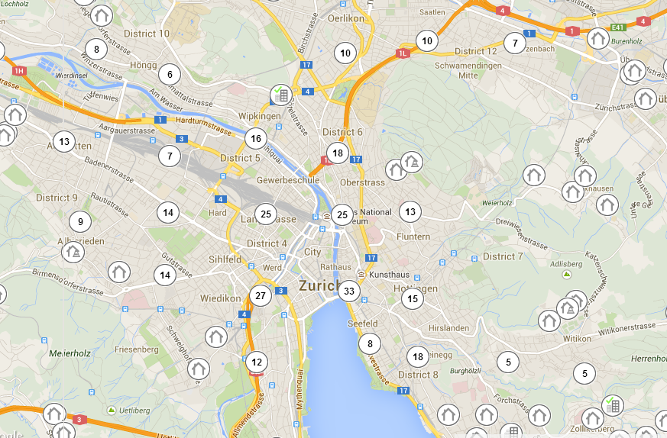
Destination Points
Companies Data
Coordinates of Clustering Points
40 Destination Points
Money House, 2014. Trade register data and business information. [Online] Available at: http://www.moneyhouse.ch/en [Accessed 2 March 2014].

Slide 7
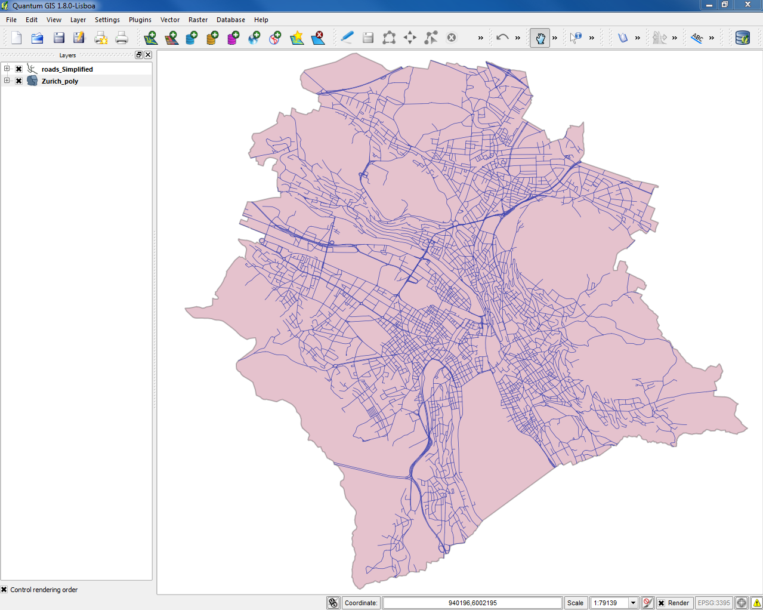


Simplified Road Network
OpenStreetMap data from “weogeo”
Processing with Quantum GIS

Slide 8

Thank you for your attention!!
Questions?

