Slide 1

Diabetes Classification Project
G.KRANTHI KUMAR REDDY

Slide 2
Introduction
Diabetes is a chronic metabolic disease characterized by elevated levels of blood glucose.
Early detection is critical to prevent complications and reduce healthcare costs.
This project uses the Pima Indians Diabetes Dataset to evaluate the ability of various machine learning models to predict diabetes.

Slide 3

Objectives
Apply multiple classification techniques to predict diabetes.
Compare the performance of Logistic Regression, LDA, QDA, NaiveBayes, KNN, Decision Trees and SVM.
Evaluate model performance using ROC curves and AUC scores.
The goal is to develop an accurate model to predict diabetes using various classification techniques and evaluate their performance for early diabetes detection.

Slide 4
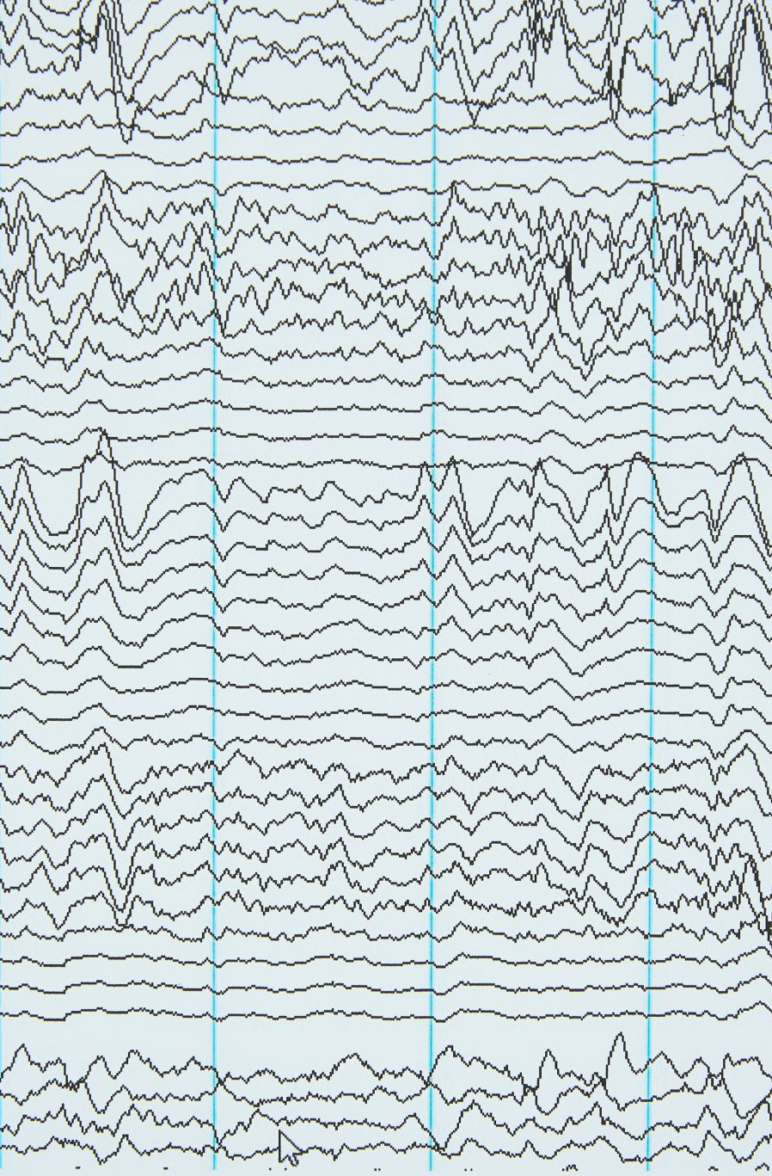
Dataset Overview
The dataset contains 8-numerical variables such as glucose level, BMI, age, insulin, blood pressure, pregnancy, SkinThickness, DiabetesPedigreeFunction and outcome as a classification.
There are 768 observations from patients with relevant health records.
Target: Binary outcome (Diabetic / Non-diabetic)

Slide 5

Data Cleaning & Preprocessing
Converted all column names to lowercase for consistency and code readability.
Zero values in critical medical features like glucose, bloodpressure, bmi, etc., were replaced with NA.
Missing values were imputed using median imputation to preserve distribution while reducing bias.
The target variable outcome was converted to a factor with labels: 0 → Non-diabetic, 1 → Diabetic

Slide 6
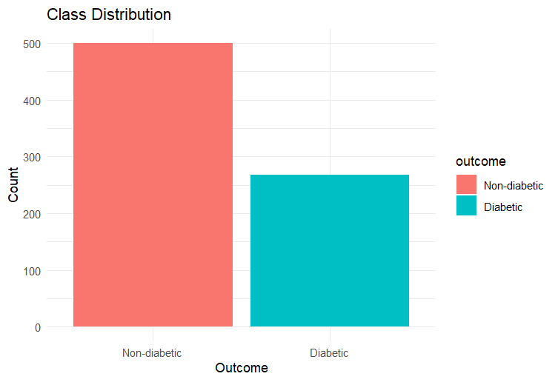
EDA – Check Class Imbalance
The dataset contains imbalanced classes.
Non-diabetic cases account for approximately 65% of the data.
Diabetic cases make up only around 35%.
This class imbalance needs to be considered during modeling to avoid biased predictions.
Techniques like stratified cross-validation or AUC-based model evaluation are used.
Notes:
Code addressing this - index <- createDataPartition(df$outcome, p = 0.7, list = FALSE)
ctrl_cv <- trainControl(
method = "cv",
number = 10,
classProbs = TRUE,
summaryFunction = custom_summary,
savePredictions = "final"
)
custom_summary <- function(data, lev = NULL, model = NULL) {
acc <- defaultSummary(data, lev, model)
roc <- twoClassSummary(data, lev, model)
c(acc, ROC = roc["ROC"])
}

Slide 7
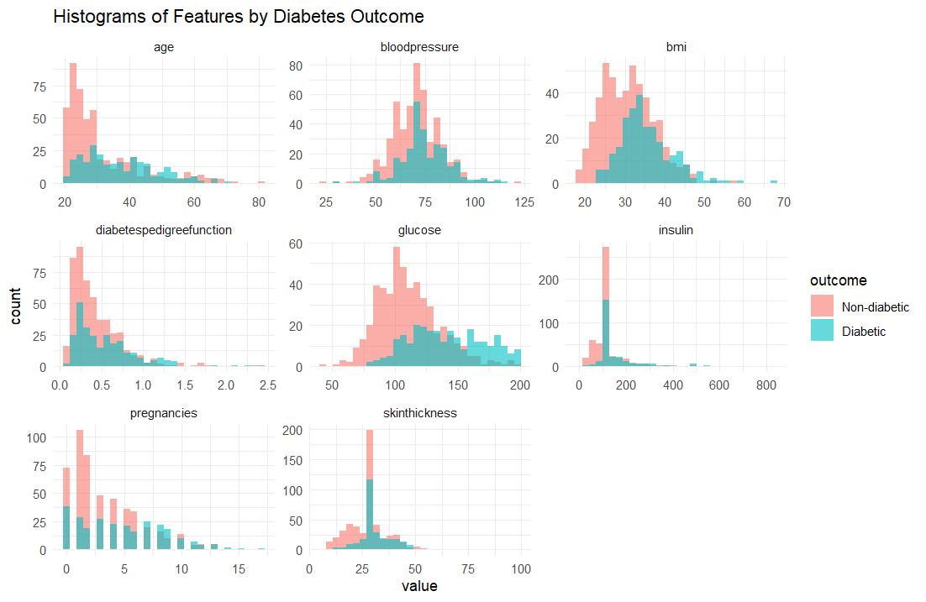
EDA – Feature Distribution Analysis
Diabetic individuals have higher glucose and higher BMI levels, showing strong class separation.
Diabetic patients are slightly older and have more pregnancies on average which means these are important demographic predictors.
Insulin and skin thickness show right-skewed distributions for both classes. Insulin values have wide variability, and outliers are present.
Glucose, BMI, and age are the strongest variables for diabetes prediction.
Notes:
Histograms were plotted to visualize feature distributions across diabetic and non-diabetic classes.

Slide 8
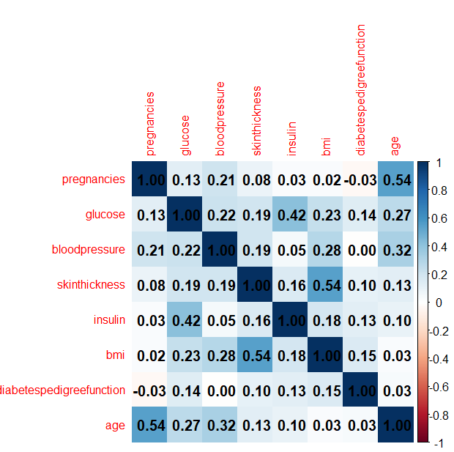
EDA – Correlation Analysis
Most features show low to moderate correlation with each other.
Glucose, BMI, and Age maintain independent predictive value.
Highest correlated variables are:
SkinThickness & BMI: 0.54
Pregnancies & Age: 0.54
Glucose & Insulin: 0.42
Notes:
Used corrplot() to identify feature correlations. It helps detect multicollinearity and understand variable relationships.

Slide 9
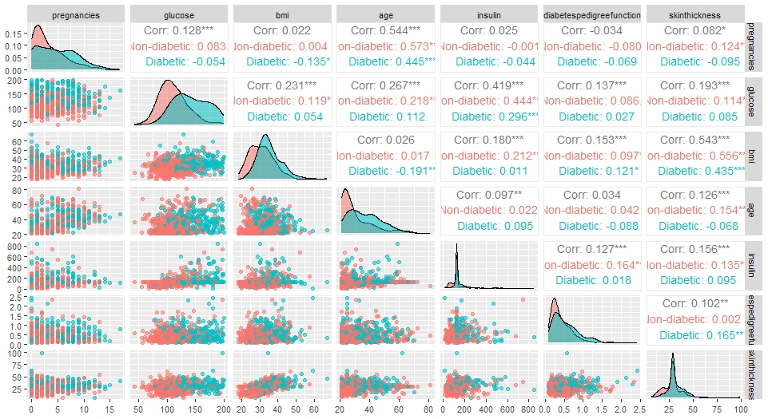
EDA – Pair Plots
Glucose shows the strongest overall correlation with insulin (0.419), especially in non-diabetics (0.444), indicating glucose-insulin interplay in healthy individuals.
Age & glucose have moderate positive correlation (0.267 overall, 0.218 in non-diabetics) — older individuals tend to have more pregnancies.
BMI vs. SkinThickness show meaningful correlation only in non-diabetics — diabetic patterns are more scattered.
Notes:
Visualized interactions among key features using ggpairs() grouped by outcome. Examine non-linear patterns, outliers, and clusters.

Slide 10
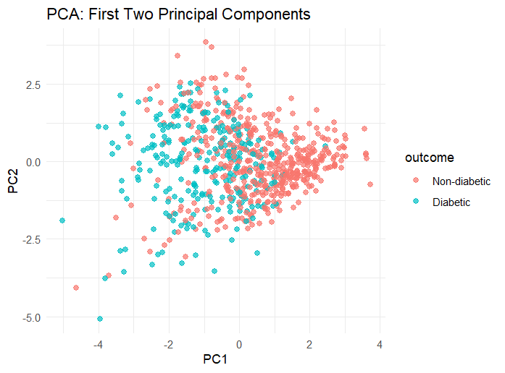
EDA - PCA
The first two principal components (PC1 & PC2) explain the most variance in the dataset.
There is some class separation, but overlap exists.
Diabetic and non-diabetic patients cluster in different regions, but are not clearly separable.
PCA suggests non-linear patterns are present and SVM is used.
Notes:
PCA was performed to reduce dimensionality and to visualize class separation potential. A 2D PCA plot showed moderate class separability based on the top 2 principal components.

Slide 11
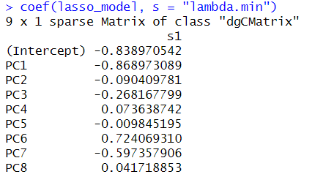
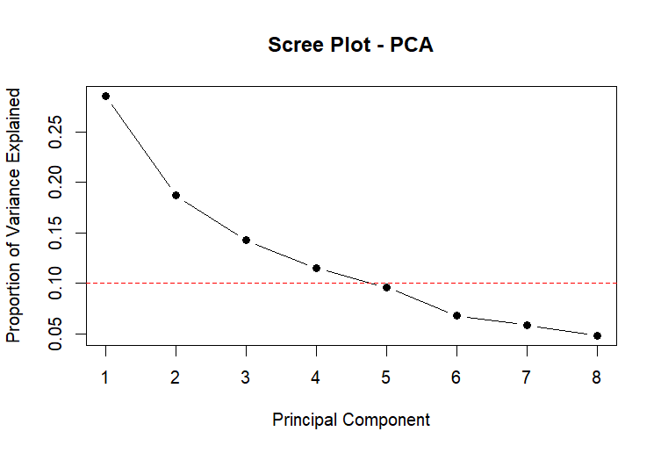
PCA + Lasso
The scree plot shows that the first two principal components (PC1 & PC2) account for the largest proportion of variance.
LASSO was applied on PCA components.
Key non-zero coefficients include:
PC1: -0.87 which is strong
PC6: +0.72 is also strong
PC3, PC7: moderate
PC5, PC8: minimal
This suggests that dimensionality reduction via PCA, followed by LASSO, can identify and retain the most predictive components while discarding noise.

Slide 12
why PCA is not ideal for model building on this dataset:
Loss of Interpretability -:In PCA, original features (like Glucose, BMI, Age) are combined into components (PC1, PC2, etc.) ,These principal components are abstract — you can’t easily say "PC1 means high glucose."
In medical datasets (like diabetes), you want models where you can explain: "Higher glucose → Higher diabetes risk."
If you use PCA, this clear interpretation is lost.
Original Features Are Already Strong -:
Glucose, BMI, and Age individually show good separation between diabetic and non-diabetic. So, transforming them with PCA is unnecessary.
PCA is more useful when:
You have very high-dimensional data (hundreds/thousands of features), Or many features are highly redundant.
In your case: Only 8 features, and they're useful individually.
PCA Assumes Linear Structure
PCA works by finding linear combinations of features.
But diabetes prediction may involve nonlinear relationships (e.g., glucose × age interaction).
Therefore, models like SVMs, Decision Trees, or even Feature Engineering (with interactions and squares) are better than applying PCA alone.

Slide 13

Feature Engineering
Added second-order terms such as squared and interaction features to allow linear models to capture non-linear relationships.
Squared features: glucose², bmi², age², insulin²
Interaction terms: glucose × bmi, glucose × age, bmi × age, glucose × insulin, bmi × insulin, age × insulin
This will capture interaction effects between key predictors.
Will provide improved AUC and accuracy for linear classifiers.
Also helped bridge the performance gap between linear and non-linear models.
Notes:
To enhance model performance by enabling models to learn non-linear relationships without changing their core structure. Included this second order terms in Logistic, LDA, QDA, NB. KNN, SVM, Tree methods handle interactions implicitly, so its not used in these models.

Slide 14

Model Training
Data split: 70% Training, 30% Testing
Used createDataPartition() (stratified sampling) to preserve class balance.
Trained 7 supervised classifiers: Logistic Regression, LDA, QDA, Naive Bayes, KNN, Decision Tree, SVM.
Each model trained on the training set and evaluated on the test set.
Applied 10-fold cross-validation using caret.

Slide 15

Evaluation Metrics
Evaluated models using confusion matrix, ROC, AUC.
Performed hyperparameter tuning (KNN, SVM, Tree) using tuneGrid.
Extracted bestTune values for final comparison .
CV accuracy and AUC over 10 folds to compare models and to avoid overfitting to the test set.

Slide 16
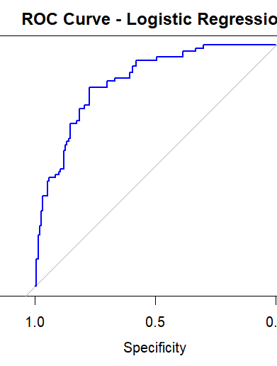
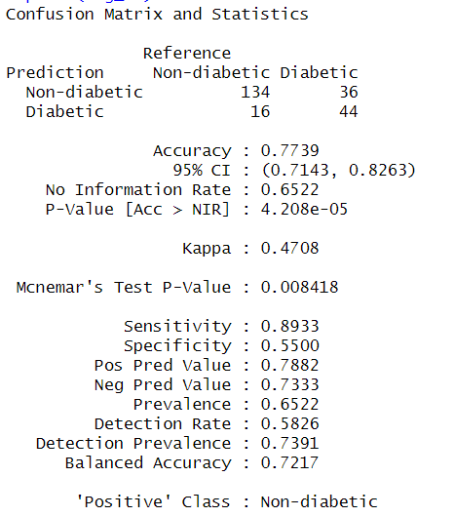
Logistic Regression
Achieved an accuracy of 77.39%, which means strong overall performance on the test set.
AUC = 0.8489 reflects excellent ability to distinguish between diabetic and non-diabetic cases.
The model is conservative and favors non-diabetic predictions but shows slightly higher Type II error.
Notes:
True Negatives (TN): 134 — Correctly predicted non-diabetic cases
True Positives (TP): 44 — Correctly predicted diabetic cases
False Positives (FP): 16 — Predicted diabetic when actually non-diabetic (Type I Error)
False Negatives (FN): 36 — Predicted non-diabetic when actually diabetic (Type II Error)

Slide 17
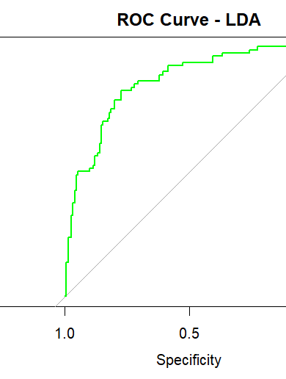
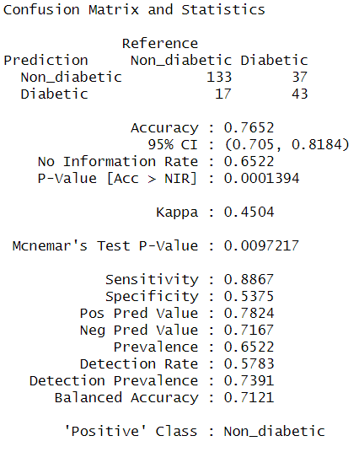
Linear Discriminant Analysis
Achieved an accuracy of 76.52%, showing strong generalization performance.
AUC = 0.8533 indicates a very strong discriminative ability between diabetic and non-diabetic classes.
LDA performs well and correctly identifies non-diabetics with moderate Type II errors
Notes:
True Negatives (TN): 133 — Correct predictions for non-diabetic cases
True Positives (TP): 43 — Correct predictions for diabetic cases
False Positives (FP): 17 — Non-diabetics predicted as diabetic (Type I Error)
False Negatives (FN): 37 — Diabetics predicted as non-diabetic (Type II Error)

Slide 18
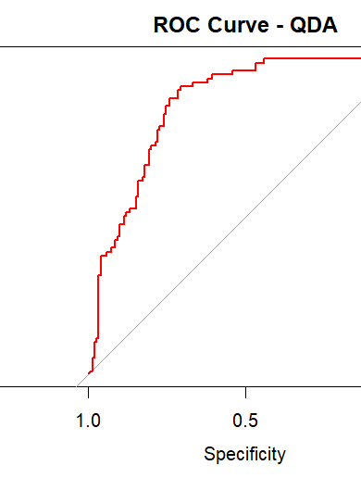
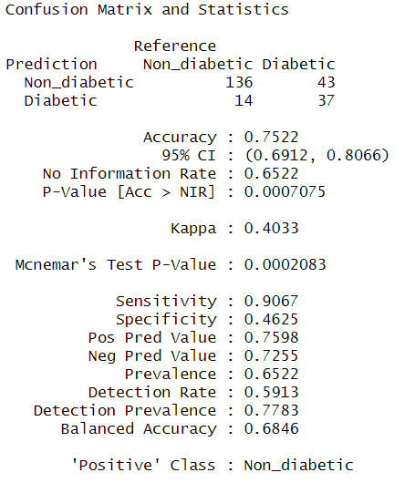
Quadratic Discriminant Analysis
Achieved an accuracy of 75.22% indicating solid classification performance.
AUC = 0.8532 showing t ability to separate diabetic vs. non-diabetic cases.
QDA performs well overall, especially in identifying non-diabetics with higher Type II error .
Notes:
True Negatives (TN): 136 — Correctly classified non-diabetics
True Positives (TP): 37 — Correctly classified diabetics
False Positives (FP): 14 — Non-diabetics predicted as diabetic (Type I Error)
False Negatives (FN): 43 — Diabetics predicted as non-diabetic (Type II Error)

Slide 19
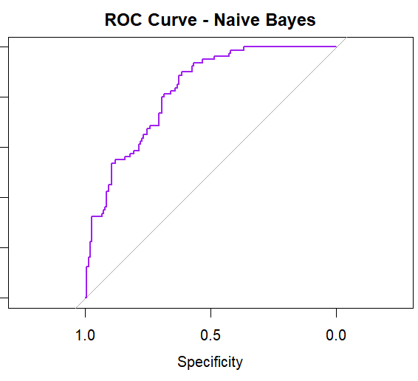
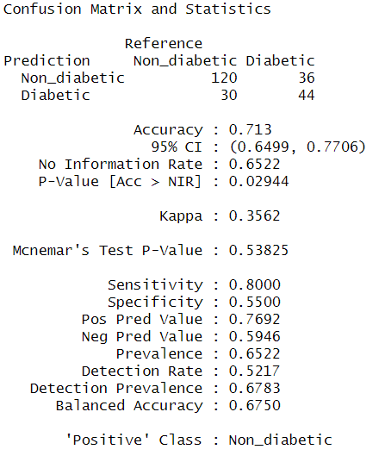
Naïve Bayes
Accuracy = 71.3%, which is a moderate overall performance.
AUC = 0.8229, indicates strong ability to discriminate between diabetic and non-diabetic classes.
Naive Bayes performs well and is very fast and easy to implement. It tends to generate more Type I errors.
Notes:
True Negatives (TN): 120 — Correctly classified non-diabetic patients
True Positives (TP): 44 — Correctly classified diabetic patients
False Positives (FP): 30 — Non-diabetics misclassified as diabetic (Type I Error)
False Negatives (FN): 36 — Diabetics missed and classified as non-diabetic (Type II Error)

Slide 20
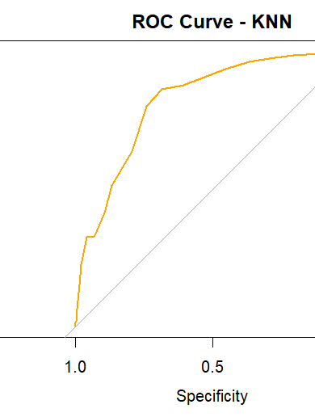
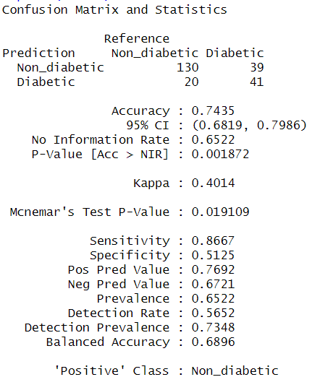
K-Nearest Neighbors
Accuracy = 74.35% indicates good overall model performance.
AUC = 0.8307, showing strong ability to distinguish diabetic from non-diabetic cases.
KNN performs well in identifying non-diabetic patients but exhibits a relatively high Type II error rate which means it misses more actual diabetics.
Notes:
True Negatives (TN): 130 — Correctly classified non-diabetic cases
True Positives (TP): 41 — Correctly classified diabetic cases
False Positives (FP): 20 — Non-diabetics incorrectly classified as diabetic (Type I Error)
False Negatives (FN): 39 — Diabetics incorrectly classified as non-diabetic (Type II Error)

Slide 21
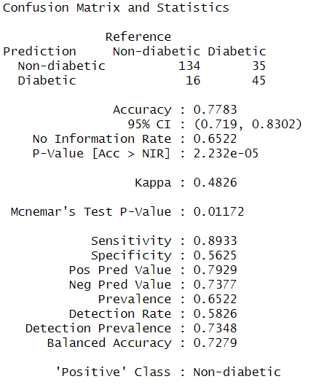
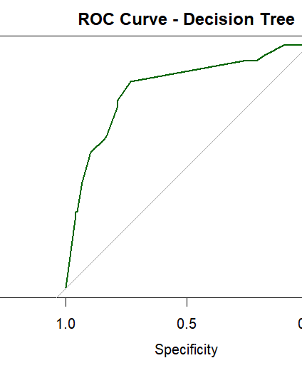
Decision Trees
Accuracy = 77.83%, indicates strong and consistent performance.
AUC = 0.8237, confirming the model's good ability to separate diabetic and non-diabetic classes.
Decision Tree demonstrates high sensitivity (low Type II error), making it effective at catching diabetics.
Notes:
True Negatives (TN): 134 — Non-diabetics correctly predicted
True Positives (TP): 45 — Diabetics correctly predicted
False Positives (FP): 16 — Predicted diabetic when actually non-diabetic (Type I Error)
False Negatives (FN): 35 — Predicted non-diabetic when actually diabetic (Type II Error)

Slide 22
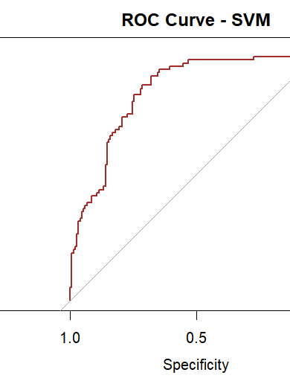
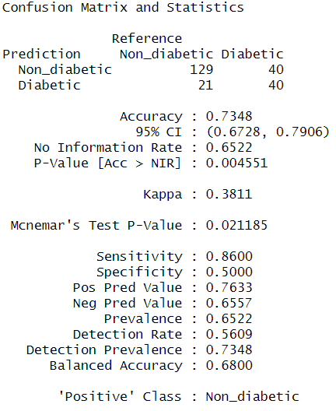
Support Vector Machine
Accuracy = 73.48%, reflecting a solid predictive performance.
AUC = 0.8268, indicating strong ability to discriminate between diabetic and non-diabetic individuals.
SVM shows high sensitivity, meaning it does well in detecting non-diabetic patients. It has moderate Type II error. Strong AUC and hyperparameter tuning make it a good non-linear classifier.
Notes:
True Negatives (TN): 129 — Correctly identified non-diabetics
True Positives (TP): 40 — Correctly identified diabetics
False Positives (FP): 21 — Predicted diabetic when actually non-diabetic (Type I Error)
False Negatives (FN): 40 — Predicted non-diabetic when actually diabetic (Type II Error)

Slide 23
Hyperparameters used in models
Model | Tunable Parameters | Grid Searched Values | Best Tuned Values
Naive Bayes | usekernel, laplace, adjust | usekernel = TRUE/FALSE, laplace = 0:2, adjust = 1 | usekernel = FALSE, laplace = 0, adjust = 1
KNN | k | k = 3 to 25 (odd) | k = 21
Decision Tree | cp (complexity param) | cp = 0.001 to 0.05 (step 0.005) | cp = 0.041
SVM (Radial Kernel) | C, sigma | C = 2^(-2:2), sigma = 2^(-5:1) | C = 0.25, sigma = 0.0625
LDA, QDA, and Logistic Regression do not have tunable hyperparameters, we used cross-validation to evaluate their performance consistently.
For all other models, tuning was done via grid search. The values are given in the table.
Notes:
Naive Bayes has options like whether it uses a kernel, and how smooth the probability estimates should be. We tested all combinations and found the best one to not to not to use a kernel
KNN (K-Nearest Neighbors) depends on how many neighbors it looks at. we tried odd numbers from 3 to 25 and found that 21 neighbors worked best as it gave the highest accuracy.
Decision Tree models need a setting called the complexity parameter (cp), which controls how simple or detailed the tree is. We tested different values and found the best one as when cp = 0.041.
SVM (Support Vector Machine) has two main settings: , which controls how much we allow mistakes, and sigma, which controls the shape of the boundary. After testing a range of values, the best combination was C = 0.25 and sigma = 0.0625.

Slide 24
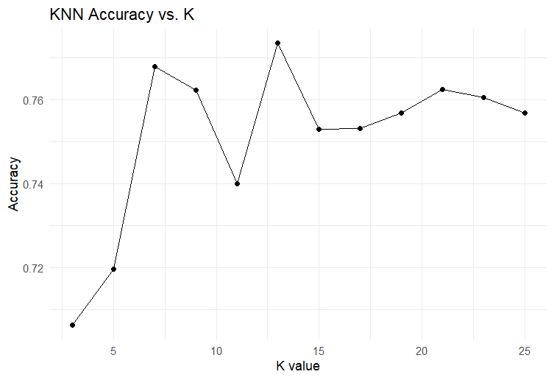
KNN Hyperparameter Tuning: Accuracy vs. K
KNN performance depends on the value of K.
We tested K values from 3 to 25 using 10-fold cross-validation.
The model achieved the highest accuracy at K = 13.
The increasing K values cause fluctuations and performance drops.
This tuning helps identify the optimal complexity for best generalization.

Slide 25
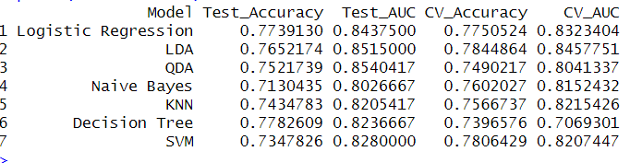
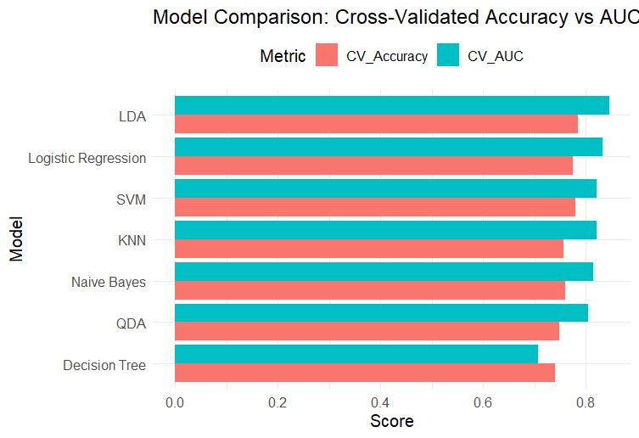
Model Comparison
The highest cross-validation accuracy was achieved by Logistic Regression (77.51%), followed closely by LDA (78.45%) and SVM (78.06%). Decision Tree has the lowest CV Accuracy (73.97%)
The best cross-validated AUC was observed in LDA (0.8458), followed closely by Logistic Regression (0.8323) and QDA (0.8041).
LDA shows both high Accuracy and high AUC, making it the most balanced and reliable model.
QDA and Naive Bayes perform well, but QDA has slightly better AUC.
KNN and SVM are strong, especially with tuning, but less interpretable

Slide 26

Results
The top recommended models are:
LDA is the most balanced model, offering high accuracy, highest AUC, and consistency across both CV and test evaluations.
SVM for highest CV accuracy (with tuning).
Logistic Regression as a reliable, explainable baseline.

Slide 27
Conclusion
Feature engineering (second-order terms) improved performance in linear models.
Cross-validation ensured robust, unbiased evaluation.
Hyperparameter tuning significantly improved non-linear models like SVM and KNN.
LDA / Logistic Regression is good when transparency is important and it’s balanced and simple.
SVM should be used if performance is the priority.

