Slide 1
CONTENTS
ABSTRACT
INTRODUCTION
LITERATURE SURVEY
OBJECTIVES
SOFTWARE SPECIFICATION
METHODOLOGY
SIMULATION MODEL OF EV
RESULTS CASE
FUTURE WORK
ADVANTAGES
CONCLUSION
REFERENCES

Slide 2
ABSTRACT
Electric vehicles provide to humanity as a sustainable mode of transport, but not polluting the environment, due to this the interest in electric vehicles is increasing day by day.
The energy consumption values of the electric vehicles can be determined. In the same way the effect of parameters on vehicles performances and energy consumption can also be monitored.
The range of electric vehicles is medium, and they can reach high speeds, in future by making use of developed electric motor and battery technology, longer distance vehicles can be manufactured.
Therefore, performance of longer distance vehicles can be optimized by selecting the motors and batteries depending on the drive cycles. In these times, the dynamic model of an electric vehicle is created with MATLAB/Simulink software tool.
Here we have created different models for Drive Cycle management, for modelling of EV.

Slide 3
ABSTRACT
The variation in graphs and display lead us to different conclusions that how different drive cycles differ in each other in the simulation.
We used different drive cycles sources to get our results , we simulated models for different set of time and got simulation results.

Slide 4
INTRODUCTION
An electric vehicle (EV) is one that operates on an electric motor, instead of an internal-combustion (IC) engine that generates power by burning a mix of fuel and gases.
Therefore, such as a vehicle is seen as a possible replacement for current-generation automobile, in order to address the issue of rising pollution, global warming, depleting natural resources, etc.
Though the concept of electric vehicles has been around for a long time, it has drawn a considerable amount of interest in the past decade amid a rising carbon footprint and other environmental impacts of fuel-based vehicles.
Due to combustion of oil, it will create environmental pollution problem.
The cost of the batteries and motors are stable, so EV prefers than the fuel based vehicles.

Slide 5
LITERATURE SURVEY
Sl.no | Title | Author | Conclusion
1 | A Review on Electric Vehicles: Technologies and Challenges | Sanguesa.J.A, Torres-Sanz.V, Garrido.P, Martinez. F.J, Marquez-Barja.J.M | Electric Vehicle Emit Zero emissions: this type of vehicles neither emit tailpipe pollutants, Carbon monoxide (CO), nor nitrogen oxide (NO). Also, the manufacture processes tend to be more respectful with the environment, although battery manufacturing adversely affects carbon footprint.
2 | Modelling and Performance Analysis of an Electric Vehicle with MATLAB/Simulink | Thomas Parker Hitesh s C. Sunanda | The first electric car in 1884, after 25 years the invention of lead-acid batteries. After that date, many electric vehicle models appeared. However, the development of internal combustion engine technology and the reduction in mass production costs have left electric vehicles behind.

Slide 6
LITERATURE SURVEY
Sl.no | Title | Author | Conclusion
3 | Modelling of Hybrid Electric Vehicle Charger and Study the Simulation Results | Abhishek Gaurav, Anurag Gaur G. B. Shrestha, B. C. Chew | It is necessary that alternating sources for oil are now being found. Due to combustion of oil, it will create environmental pollution.
4 | Modelling and Simulation of Electric Vehicle to Optimize Its Cost and Range | Shivangi Kaushik | Due to the uses of fuels in the vehicles CO gas dissipated in the large amount. The carbon monoxide gas effect the environment very badly. The CO reduction is the main challenge, and it can be achieved by the Eco-friendly vehicle or car called Electric vehicle (EV). The EVs are very economical due to their driven process achieved by an electric motor.

Slide 7
OBJECTIVES
To run a most simple & low run time vehicle model using individual component model
To check out performance Parameter: speed, soc, current ect… with various drive cycles
To play with: motor power vehicle body(rolling resisence, air drag, weight) inputs
To know matlab models & their configuration to match with actual vehicle

Slide 8
SOFTWARE SPECIFICATION
Software : MATLAB/Simulink
Version : R2021a
The above mentioned are modelled and simulated using MATLAB/Simulink.
Software Input tool are Drive Cycle, Signal Builder, Multiport Switch, Longitudinal Driver, Controlled Voltage Source, Controlled PWM Voltage, Controlled PWM Voltage, Controlled Voltage Source H-Bridge, Current Sensor, DC Motor, SOC, Vehicle Subsystem.
Software Output tool are Scope, Total Distance travelled.
These tools are use to understand and visualization of performance of the electric vehicle[EV].

Slide 9
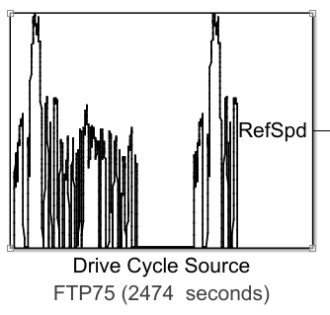
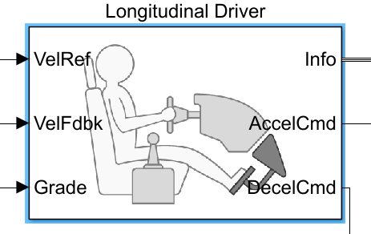
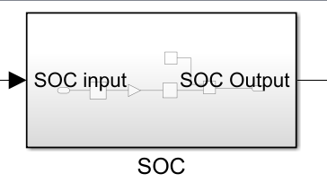
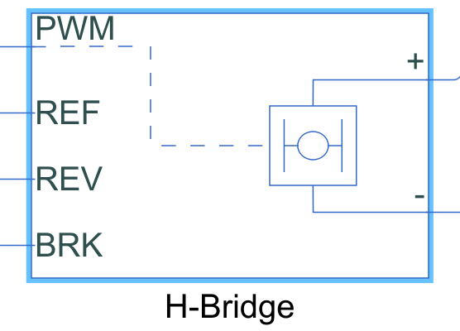
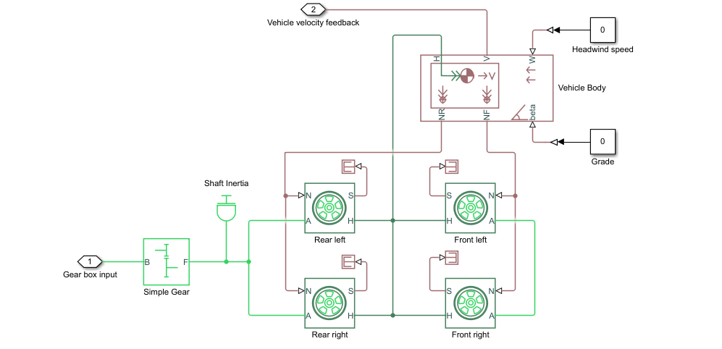
Vehicle Subsystem

Slide 10
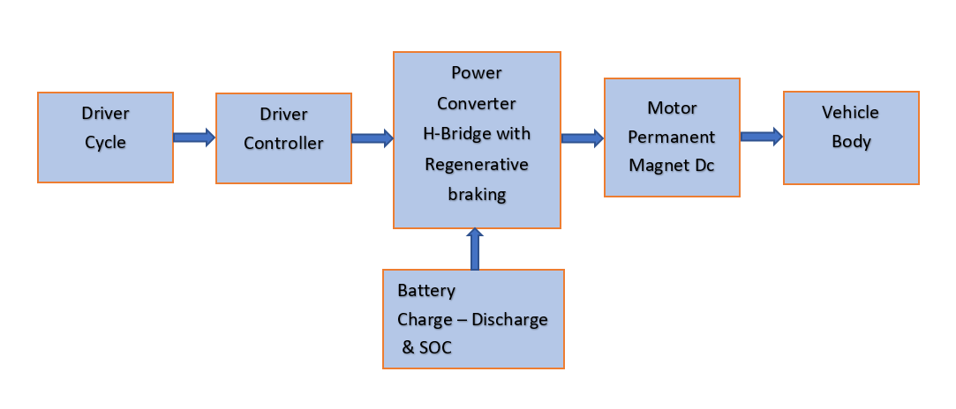
METHODOLOGY
General blocks of Electric Vehicle have been represented in the diagram given below,

Slide 11
METHODOLOGY
Drive cycle: This is the input given to the vehicle. There are different types of drive cycle based on the application we choose. In this vehicle is simulated for acceleration & deceleration for a particular type with the varying speed range.
Driver controller: To drive the drive cycle as per the given condition, a driver controller is present to run the vehicle taking the input and feedback from to move from one place to another.
Power Converter: They are used to process and control the flow of electrical energy by supplying required voltages and current in a form that is optimally suited for the user loads.
Battery: This the powerhouse which supplies the energy required to drive the vehicle.
Motor: It is the rotating device which converts the electrical energy in the form of current and voltage into the mechanical energy at the vehicle through a transmission system.
Vehicle body: This is where the output is achieved via the motor power is transferred to the wheel considering the different forces and resistance and compare with the input drive cycle.

Slide 12
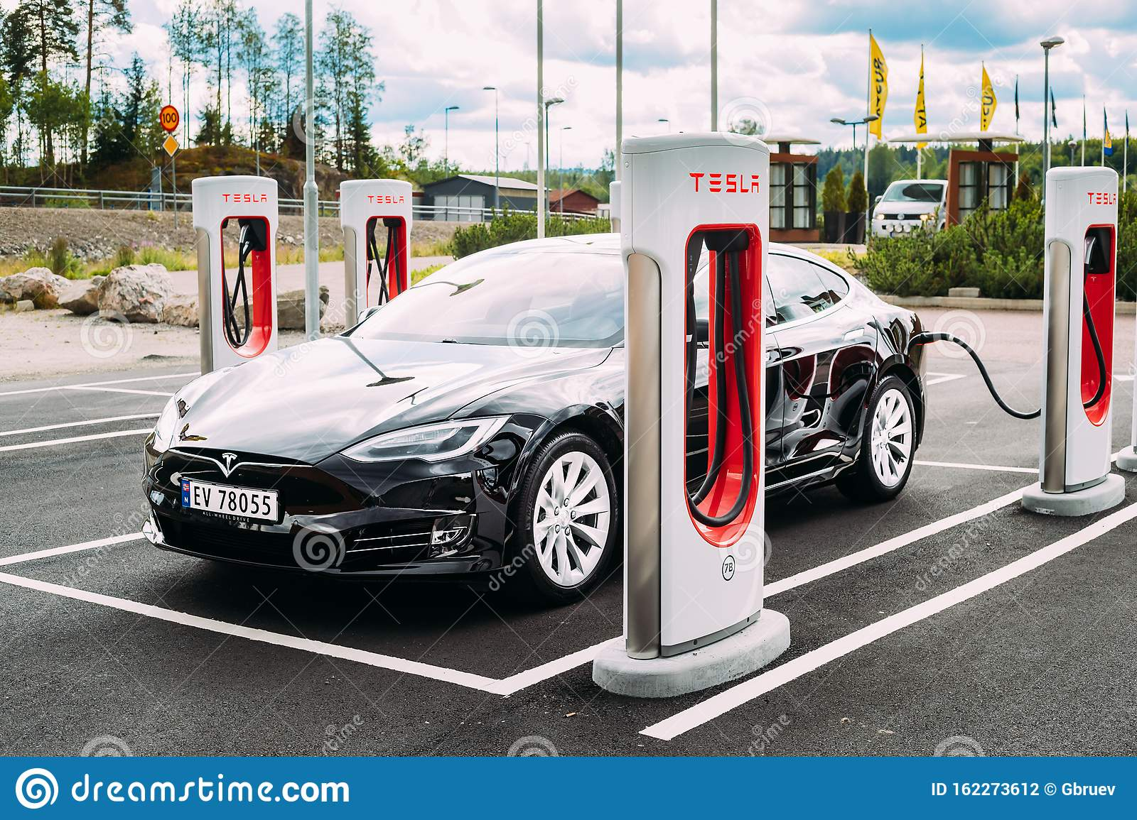
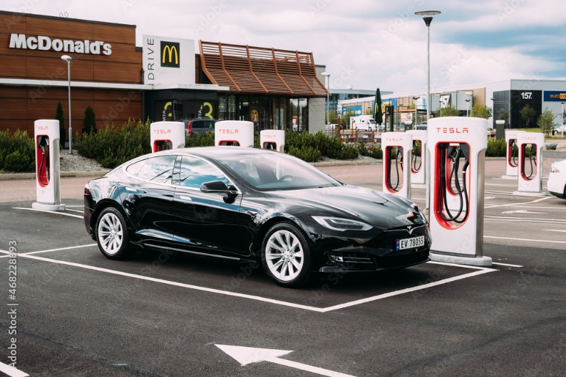
METHODOLOGY
NO IC Engine
Only electric drive
Battery pack size is (20-80 kwh)
Example: Tesla, Nissan, Kia, etc…

Slide 13
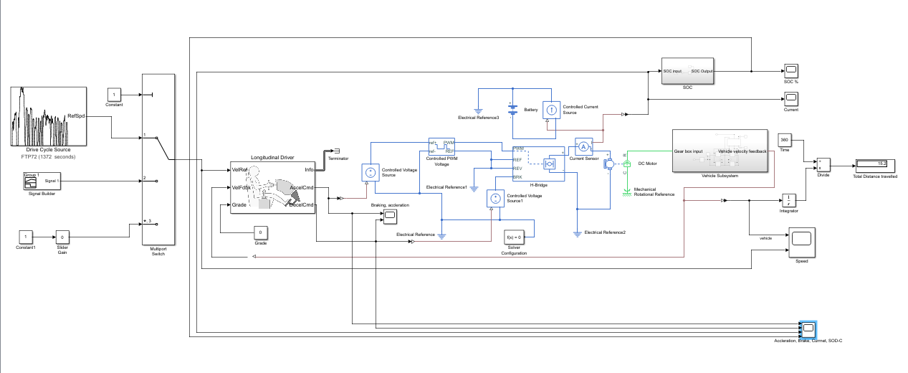
SIMULATION MODEL OF EV

Slide 14
RESULTS CASE
The simulations are run for various drive cycles and the results are in the following table.
Simulation Time - It is the time for which the simulation is run. Each drive cycle has its own time duration which needs to be updated in simulation time, each time the drive cycle is changed.
Speed Trace - It is a plot of the reference speed from the drive cycle and the feedback speed from the vehicle body.
SOC (%) - It is the state of charge of the battery which decreases when the vehicle accelerated and slightly increases when the vehicle decelerates.
Distance Travelled - It is the total distance travelled by the vehicle following a particular drive cycle and its duration.

Slide 15
 | Case 1 | Case 2 | Case 3 | Case 4
Drive Cycle, Simulation Time (sec) | FTP75, 2474 | US06,600 | Artemis Motorway 150kmph, 1068 | World Harmonized Vehicle Cycle, 900
Vehicle body weight (kg), Frontal area (m2), Rolling resistance | 800, 3, 0.015 | 800, 3, 0.015 | 800, 3, 0.015 | 800, 3, 0.015
Battery Nominal Voltage (V) | 300 | 300 | 400 | 200
DC Motor Rated load (kW), Rated DC supply voltage (V) | 60, 300 | 75, 200 | 85, 350 | 60, 150
H-Brigde Output voltage amplitude | 300 | 200 | 350 | 150
SOC at end of drive cycle (Initial SOC 100%) | 96 | 94 | 93 | 97
Top speed reached? kWh per km | Yes | No | No | Yes

Slide 16
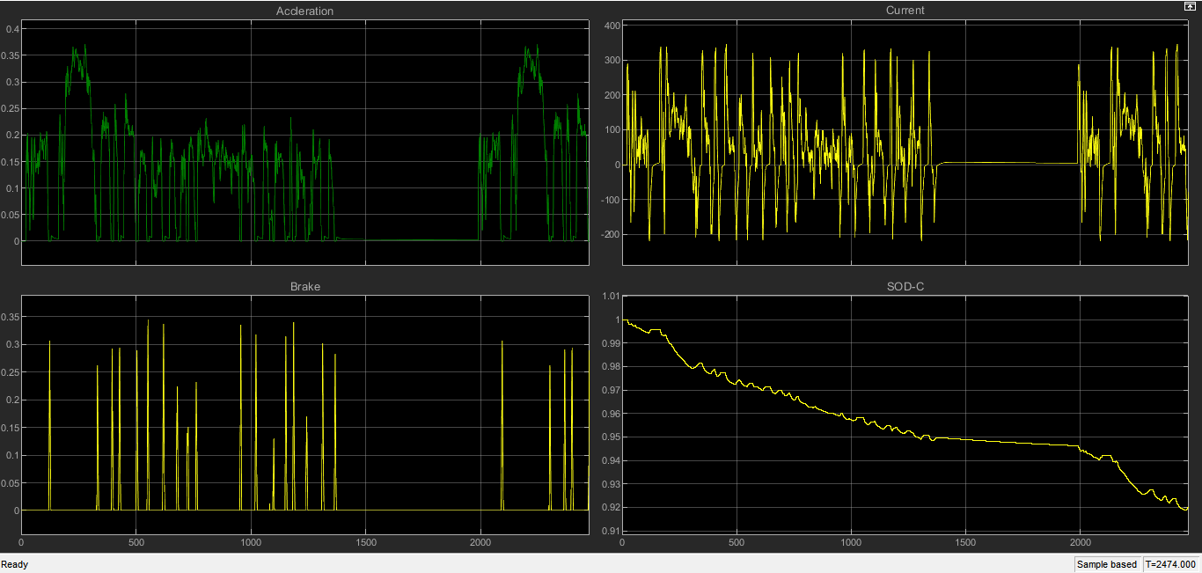
FTP75, 2474

Slide 17
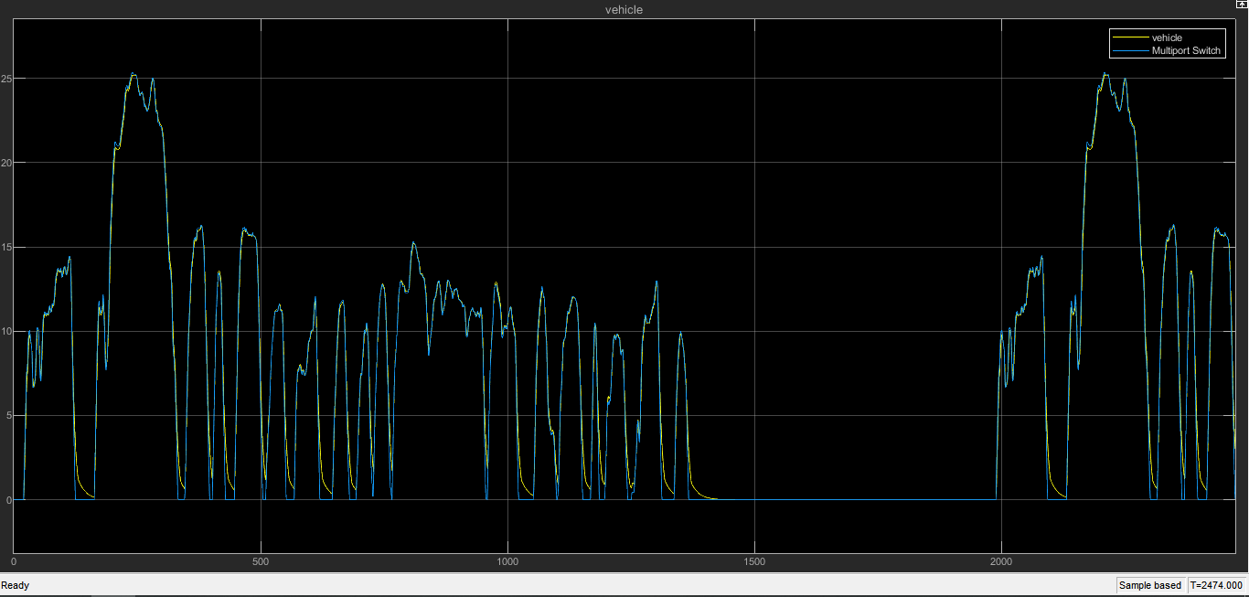
FTP75, 2474

Slide 18
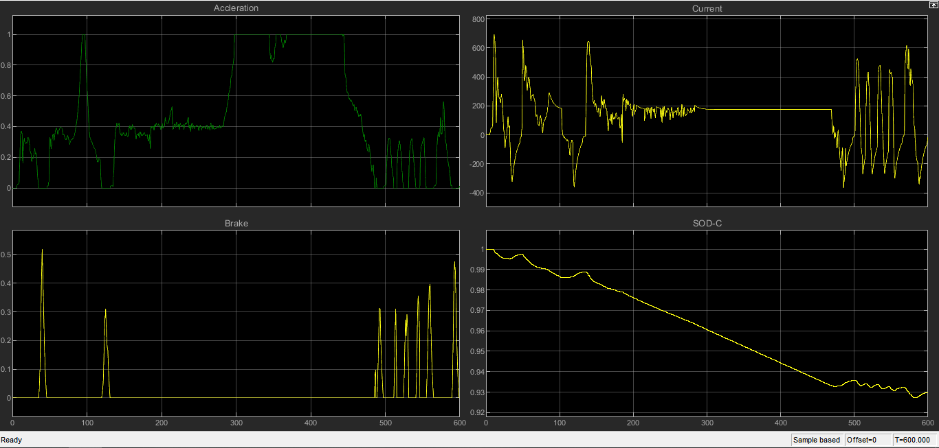
US06,600

Slide 19
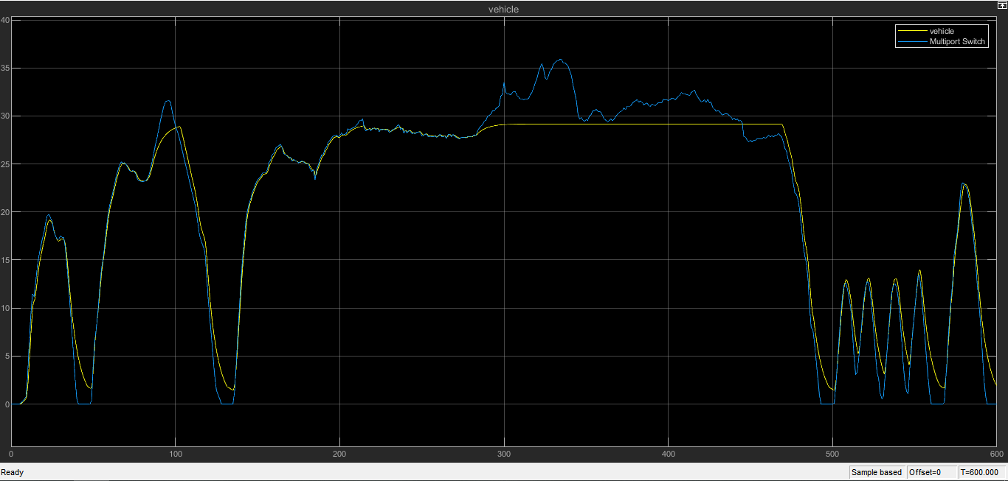
US06,600

Slide 20
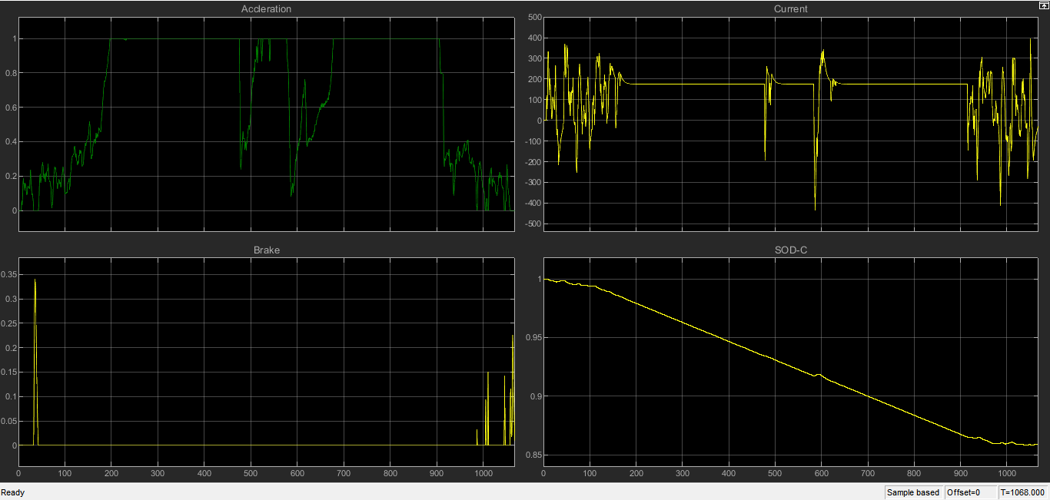
Artemis Motorway 150kmph, 1068

Slide 21
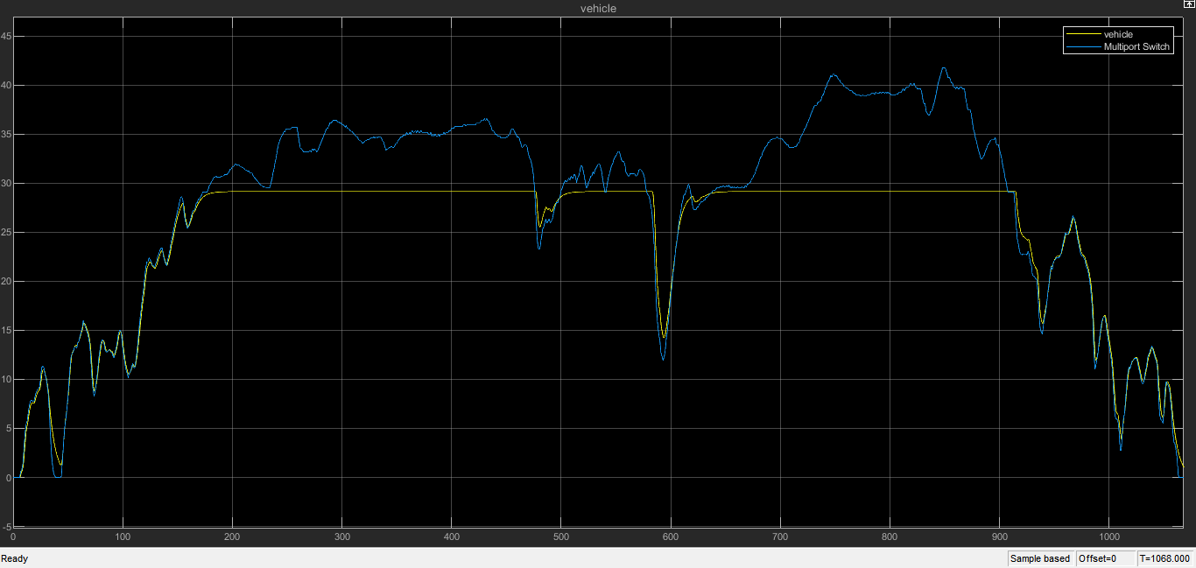
Artemis Motorway 150kmph, 1068

Slide 22
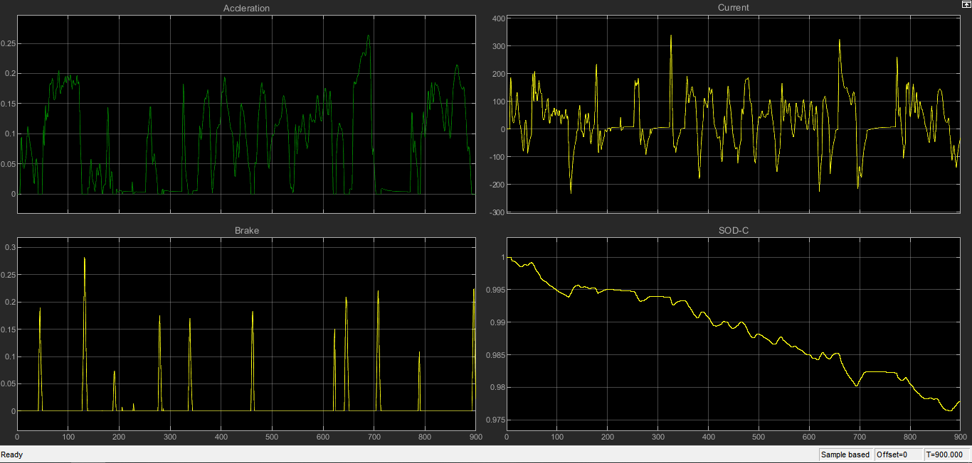
World Harmonized Vehicle Cycle (WHVC),900

Slide 23
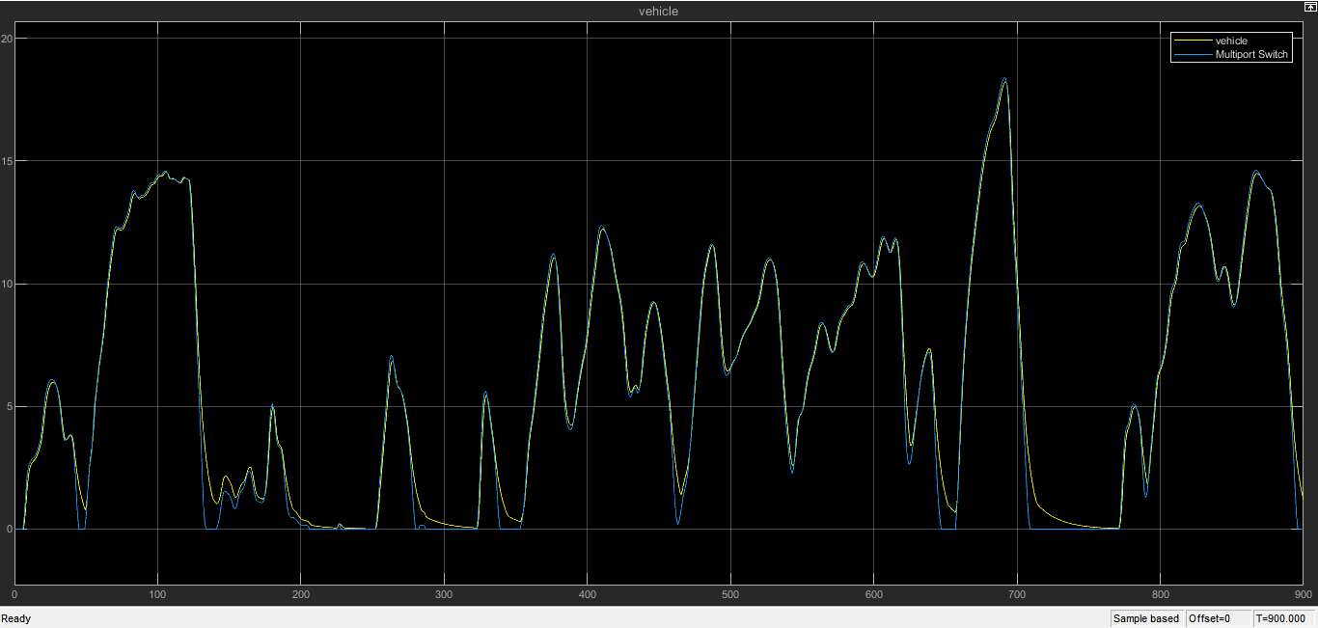
World Harmonized Vehicle Cycle (WHVC),900

Slide 24
FUTURE WORK
As electric vehicle manufacturing is becoming popular every day, its market share is also expected to rise greatly.
India is expected to grow by an amazing 50% by 2023.
It is estimated that almost 75-80% of fuel expenses are reduced by using Evs.
Currently, 82% of the oil demand in India is fulfilled by import.
The best part is that, apart from reducing environmental pollution, EVs can lower oil import by about $60 Billion by 2030
Surprisingly, the fuel price of EVs can be as low as only 1.1Rs/ km. As a result, the overall cost of about Rs 20,000 is reduced while traveling every 5000 km by an EV.

Slide 25
ADVANTAGES
EVs offer the following advantages over traditional vehicles:
Zero emissions: This type of vehicles neither emit tailpipe pollutants, Carbon Dioxide(CO2), nor nitrogen dioxide(NO2).
Simplicity: The engines are simpler and more compact, they do not need a cooling circuit, and neither is necessary for incorporating gearshift, clutch, or elements that reduce the engine noise.
Reliability: Having less, and simpler, components makes this type of vehicles have fewer breakdowns. In addition, EVs Engine do not suffer from explosions, vibrations, or fuel corrosion.
Cost: The maintenance cost of the vehicle and the cost of the electricity required is much lower in comparison to maintenance and fuel costs of traditional combustion vehicles. The energy cost per kilometer is significantly lower in EVs than in traditional.
Comfort: Traveling in EVs is more comfortable, due to the absence of vibrations or engine noise.

Slide 26
CONCLUSION
In the speed trace plots for all the drive cycles which are observed in this study, the feedback speed plot and the reference speed plot overlap each other almost completely but there are regions where both the speeds are different. It is when the vehicle is decelerating. The reference speed plot falls sharply but the feedback speed does not. This is due to the inertia of the vehicle body. As the inertia of the vehicle body is higher, it takes a longer duration for it to decelerate. That is why the overlapping is not 100%.
The battery's state of charge for each drive cycle can be visualized from the SOC plot. As long as the vehicle is accelerating the SOC is decreasing but as soon as the deceleration starts, the SOC plot goes slightly up. This is because the battery is being charged, due to regenerative braking during deceleration.

Slide 27
REFERENCES
P-Chatterjee, J-Singh, R-Singh, YAR-Avadh and S-Kanchan “Electric Vehicle Modeling in MATLAB and Simulink with SoC & SoE Estimation of a Lithium-ion Battery” https://iopscience.iop.org/article/10.1088/1757-899X/1116/1/012103/pdf .
Hitesh s, C.Sunanda, “Modeling and Performance Analysis of an Electric Vehicle with MATLAB”, International Research Journal of Engineering and Technology (IRJET), Volume: 07 Issue | 06 June 2020.
Sanguesa.J.A, Torres Sanz.V, Garrido.P, Martinez. F.J. Marquez Barja. J.M, “A Review on Electric Vehicles: Technologies and Challenges”, Smart Cities 2021, 4, 372–404. https://doi.org/10.3390/smartcities4010022 | March 2021.
Abhishek Gaurav, Anurag Gaur, “Modelling of Hybrid Electric Vehicle Charger and Study the Simulation Results”, DOI:978-1-7281-7549-2/20/$31.00 ©2020 IEEE | 9 September 2020.
G. B. Shrestha, B. C. Chew, “The Optimization of Charge-Discharge Cycle of Electric Vehicle Batteries” | Nanyang Technological University, Singapore.
Nilay Awasthi, “Designing of Electric Vehicle using MATLAB and Simulink”, Electronic copy available at: https://ssrn.com/abstract=3701771
Nilay Awasthi, “Designing of Electric Vehicle using MATLAB and Simulink”, Electronic copy available at: https://ssrn.com/abstract=3701771.

Slide 28
THANK YOU

