Slide 1
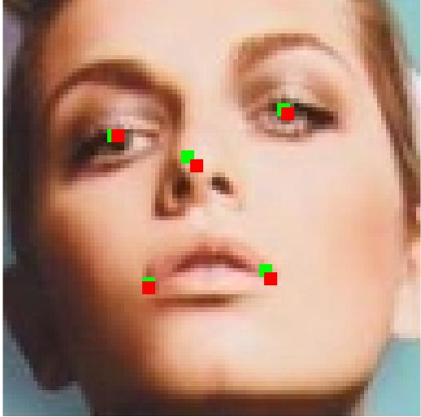
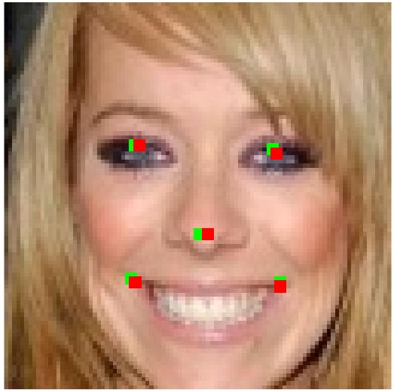
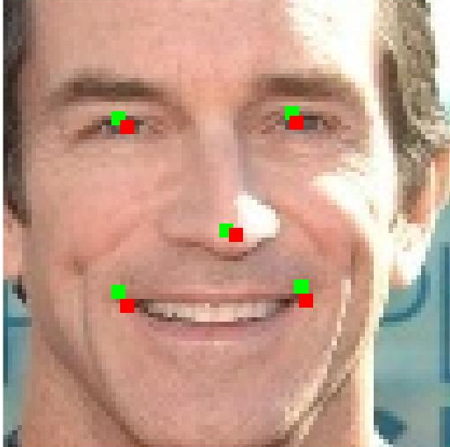

Slide 2
Ins
Controller
In
Buf
Out
Buf
PE 0
External
memory
PE 1
External
memory
……
PE n_{pe}
LOAD
CALC
SAVE

Slide 3
Ch 1
Conv 1
Adder
Tree
Ch 2
Conv 2
+
+
Pool
Ch out
……
Shifter
Ch n
Conv n
bias

Slide 4
Type
Judgement
LOAD
Ins FIFO
Decode
FSM
Input
Buffer
LOAD
Dep
Check
CALC
Ins FIFO
Decode
FSM
PE
Array
CALC
SAVE
Ins FIFO
Decode
FSM
Output
Buffer
SAVE

Slide 5
3x3 conv, 16
2x2 Pooling
3x3 conv, 16, ReLU
3x3 conv, 32
2x2 Pooling
3x3 conv, 32, ReLU
3x3 conv, 48
2x2 Pooling
3x3 conv, 64, ReLU
3x3 conv, 64, ReLU
3x3 conv, 80
2x2 Pooling
3x3 conv, 128
2x2 Pooling
FC, 10
96x96x3

Slide 6
feature maps
convolution kernels
output
1
7
3
4
7
X
+
input
(a) Convolution layer
(b) Fully Connected Layer
(c) Rectified Linear Unit
(d) Max-pooling Layer

