Slide 1
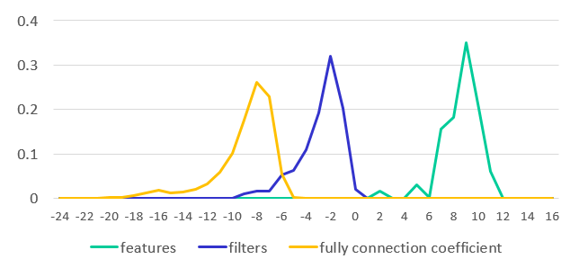
Input images
CNN model
Weight quantization phase
Weight dynamic range analysis
Weight quantization configuration
Data quantization phase
Fixed-point CNN model
Floating-point CNN model
Layer 1
Layer 1
Feature maps
Feature maps
Dynamic range analysis and finding optimal quantization strategy
…
…
Feature maps
Feature maps
Layer N
Layer N
Weight and data quantization configuration

