Slide 1
_Let’s Collab
Group Members – Varshil Patel(220343120070)
Bhagyashri Andhare(220343120011)
Shweta Kamble (220343120043)
Saurabh Laddha(220343120052)
Project Guide – Mrs. Harshita Maheshwari

Slide 2
Contents
Introduction
Objective And Scope of Project
Modification and Improvement over existing Implementation
Project Plan
Technology
Data Flow Diagram
ERD /Database Tables
Screenshot
System Requirements And Technology used
Applications
Advantages & Limitations
Conclusion
Future Scopes
References

Slide 3
Introduction
Let’s Collab is a platform where developers can help each other and also work together on freelance projects.
This application provides platform for developers for collaborating.

Slide 4
Objective and Scope of Project:
Let’s Collab provides a platform for developers where they can find other developers who are interested in collaborating in a freelance job or a personal project.
It could be really good for developers who are only familiar with one aspect of a project; they could find people who are willing to work with them on a project and make new friends at the same time.
Let’s Collab provides a project post where you can get help from other people who are ready to help you with a project and another is where you can take a freelance job and collaborate with other developers for that job.

Slide 5
Modification and improvement over the existing Implementation:
Currently available freelancing websites/applications don’t let developers collaborate on a project so a single person has to know frontend, backend, UI/UX design, etc. so currently if you don’t know or are not good at any one of them you can't fulfil clients request up to their expectation or cannot do work on the project/job at all.
After implementation of project
Now if we let a front end developer collaborate with a backend developer and a UI designer they all can finish the job/project together and they all can grow together.

Slide 6
Project Plan:
No. of User’s and Modules
Users- The person or organisation that will use the project's product or service.
No. of user’s and specify each user's work in brief.
User/Developers
Users/Developers will be the customers as well as workers. A developer can post a project/work if he needs help or he can post the project as a job and other developers can get him the services needed.

Slide 7
Admin Admin will manage the project assignment, payment system, user addition, etc. Admin will make the operations of the users fluent.
Modules - Module is a logical separation of a functionality within a project.
Modules:
1.Users/Developers management
2.Projects/Work management
3.Login/Sign up
4.Payment management

Slide 8
Technology:
Frontend- React
Backend- Node.js, Node Express
Database- MongoDB

Slide 9
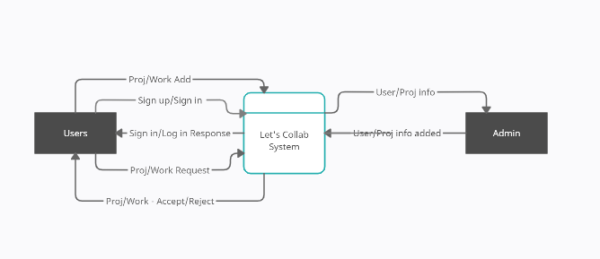
Data Flow Diagram (DFD): Level 0:

Slide 10
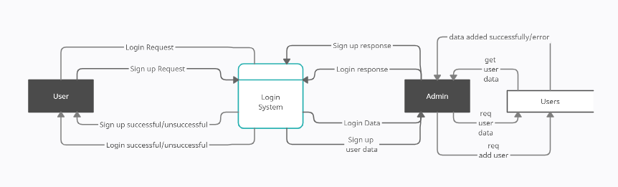
Level 1:

Slide 11
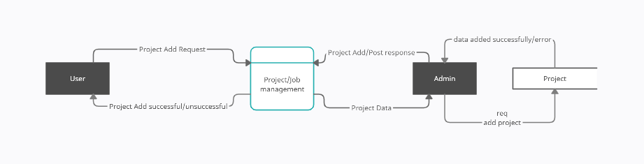
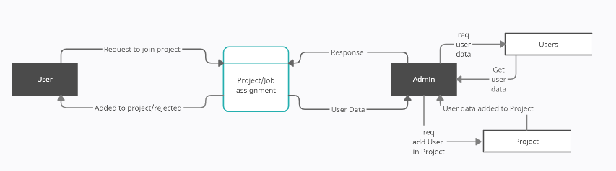

Slide 12
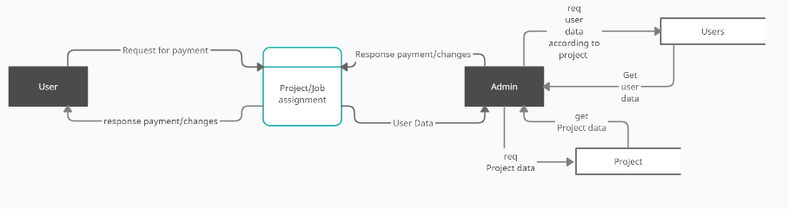

Slide 13
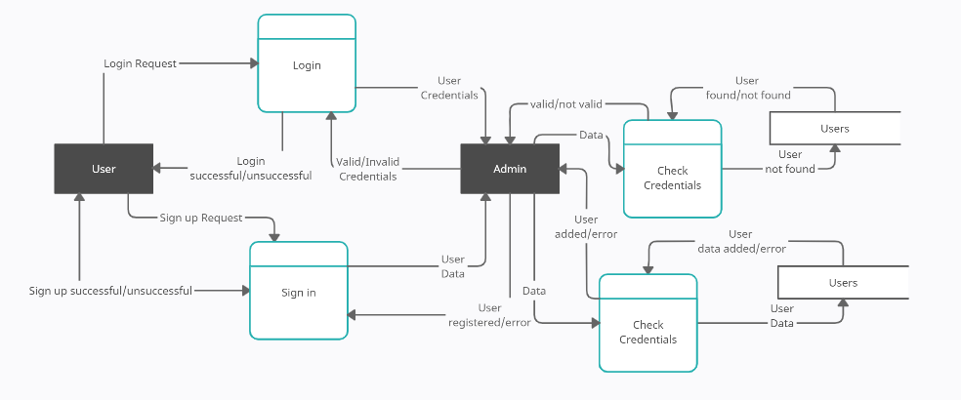
Level 2:

Slide 14
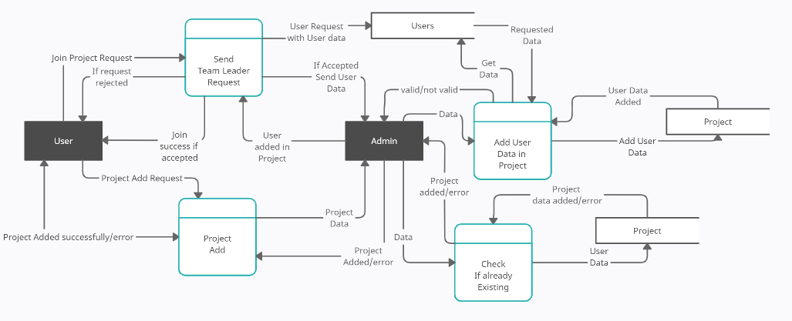

Slide 15
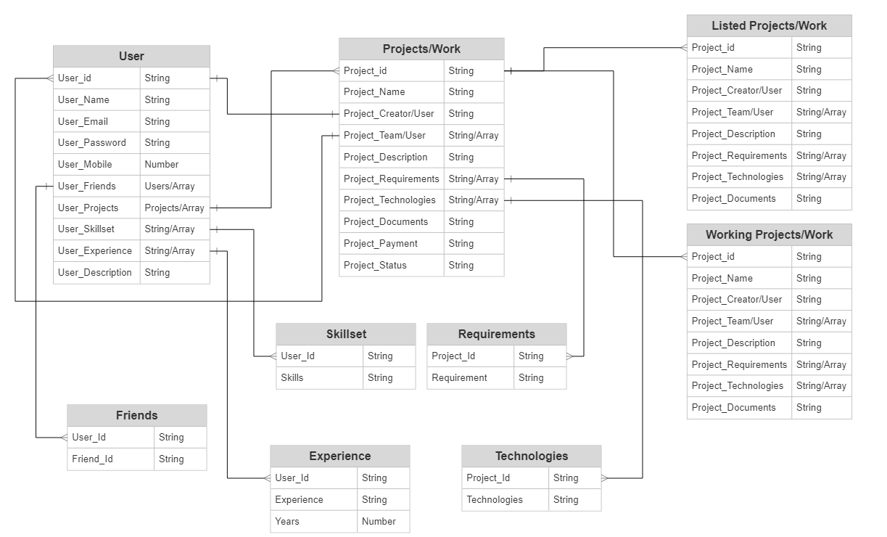
ERD / Database Tables:

Slide 16
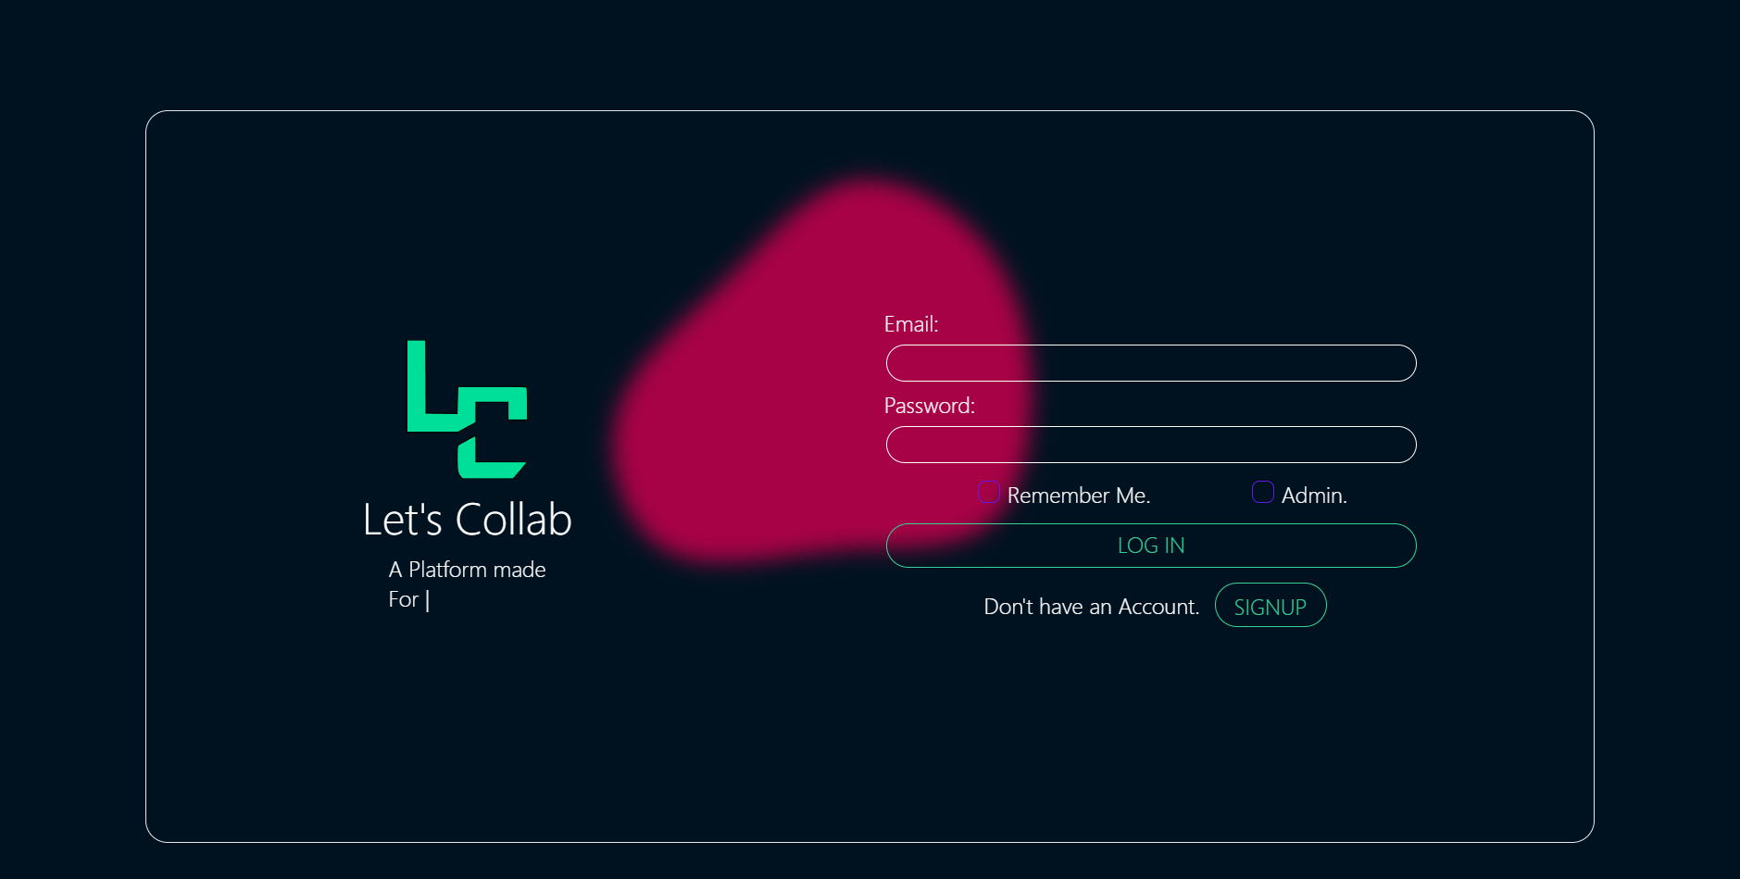
Screenshots

Slide 17
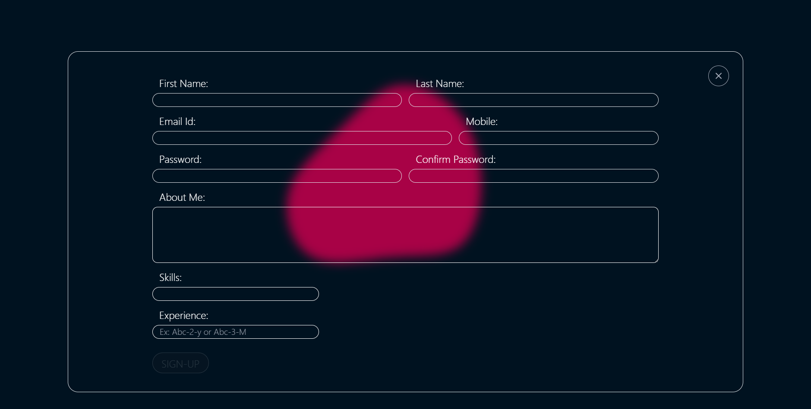

Slide 18
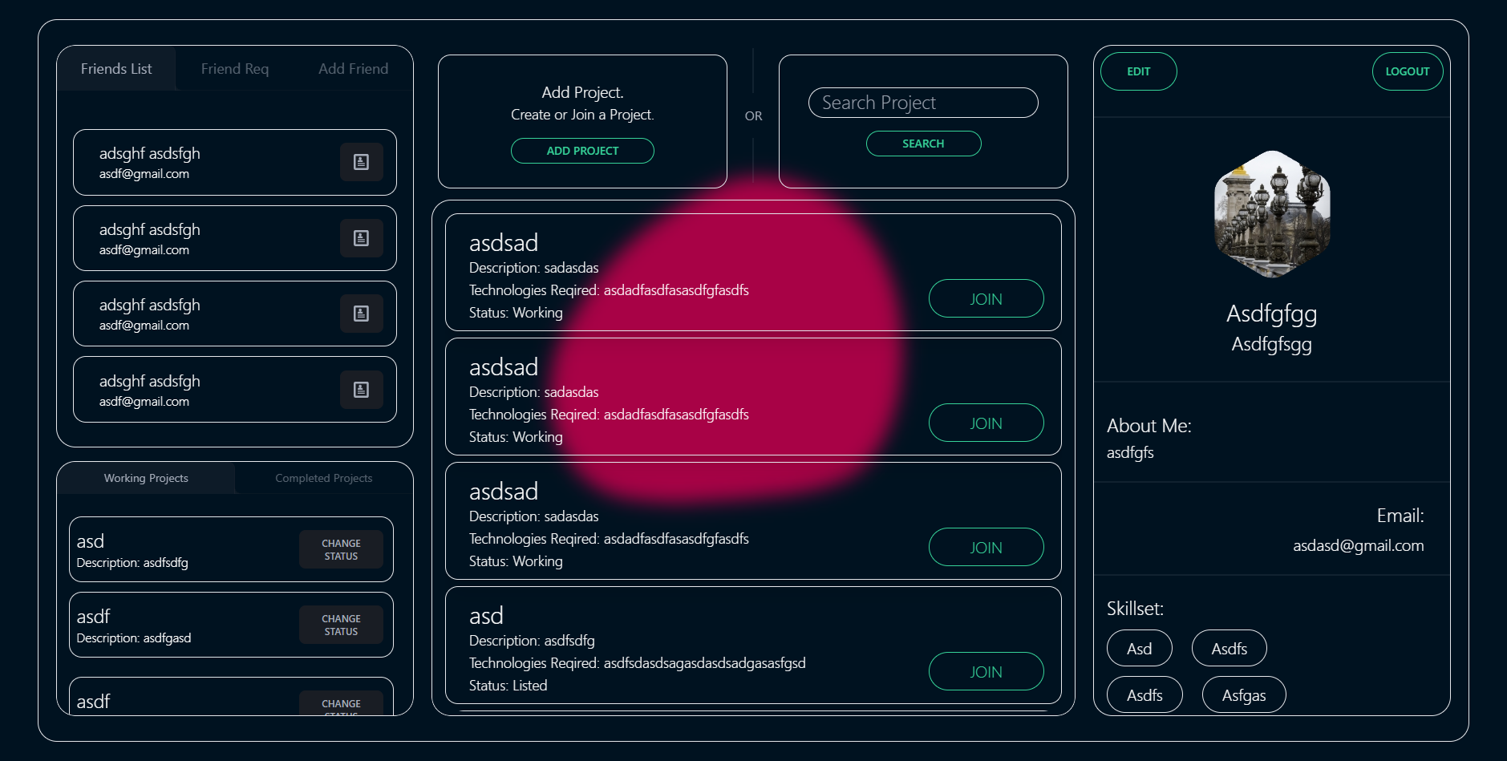

Slide 19
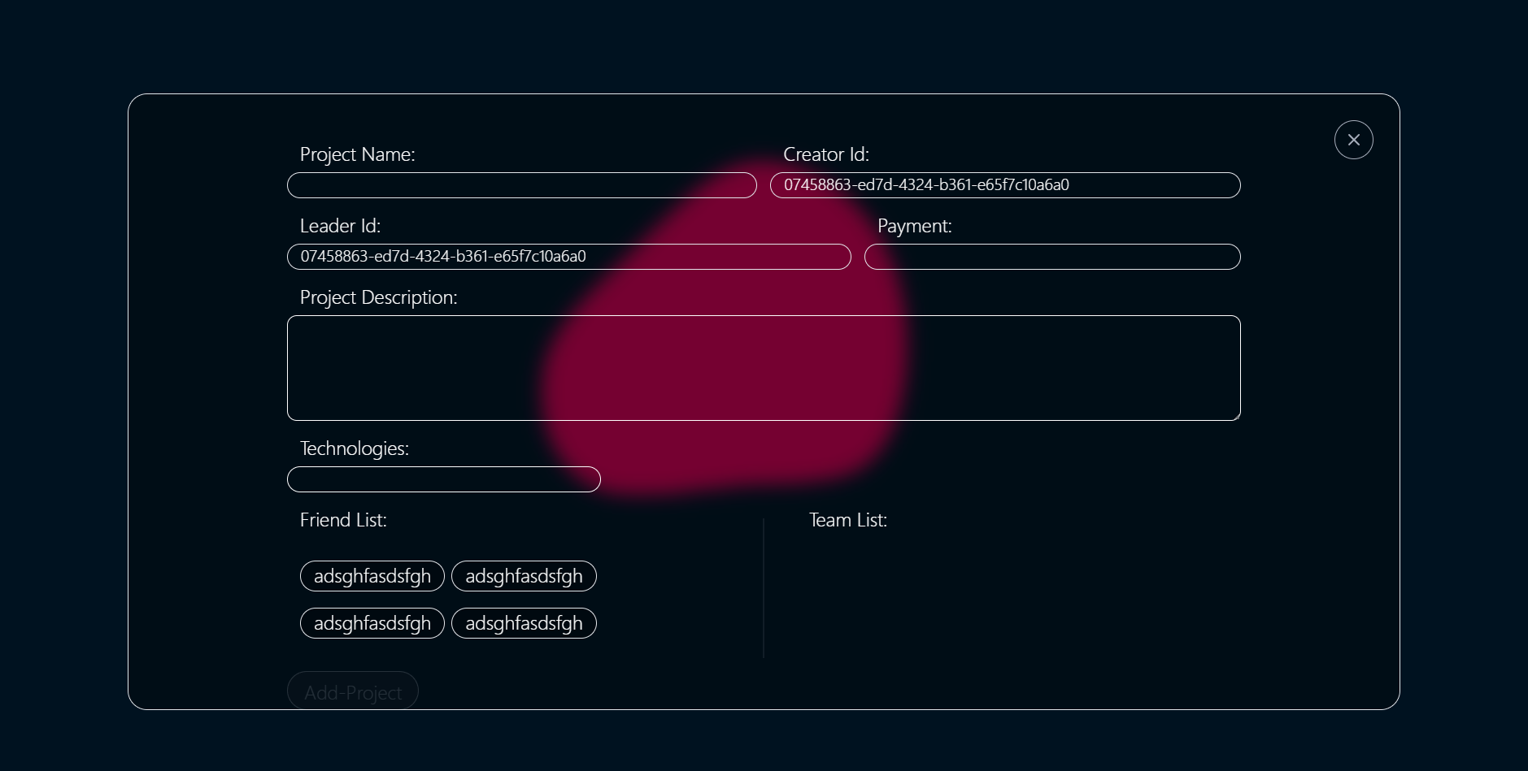

Slide 20
System Requirements
Software Requirements:
Windows (All Versions)
Visual Studio
React,Node
Mongodb
Hardware Components:
•Processor – i3
•Hard Disk – 5 GB

Slide 21
Technologies Used
HTML : Page Layout has been designed in HTML.
CSS : Used for all designing part.
JavaScript : All Validation task and animations has been developed by JS.
JSP : All front end logic has been written in JSP.
Mongodb: used for tables and rows to process and store various forms of data
React: React is a JavaScript-based UI development library. Although React is a library rather than a language, it is widely used in web development.

Slide 22
Applications
Can be used in as freelancing platform.

Slide 23
Advantages
Developers can collab with other developers for the technology they don’t know hence they can work together to perform the tasks
Saves Time, cost and energy.
Transparency in the system.

Slide 24
Limitations
Developers has to share code with each other

Slide 25
Conclusion
It’s on you to find a way to fill your time with paid work, whether it’s client direct, subcontracting, or through a jobs marketplace.
There are dozens and dozens of different types of freelance jobs, and more companies are hiring freelancers than ever before.So this platform will be the great help to them.
It has been an absolute pleasure working with eachother using such platform

Slide 26
Future Scope
In future updates we can provide hosting services and remote repositories so the developers can work on a single remote repository and don't have to share the code each time they make some changes.
We can also add a rating system so the developers who help people on their personal project and have good rating in their freelance work can get some benefits.

Slide 27
References
Mr. Saleel Bagde for Database.
Mrs. Harshita Maheshwari for HTML JS & CSS also she was our project guide.
https://www.stackoverflow.net
Github
YouTube
A special thanks to Infoway Management who arranged extra lab time for us.

Slide 28
THANK YOU

