Slide 1
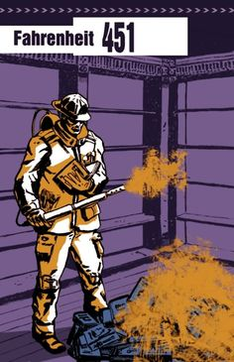
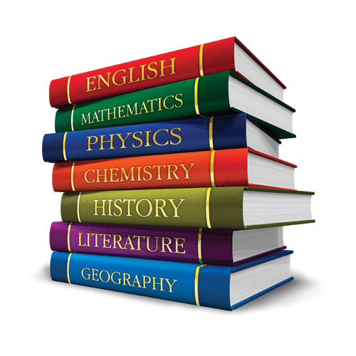
The Need to Read!
By: Audrey Carroll 6/15/16
Notes:
I am sure that most of us have had to read a book for school at some point in our lives, but I am curious… How many of you have read the book Fahrenheit 451 by Ray Bradbury? I had to read it for English class my sophomore year of highschool, and I’ve got to say; if the future ever comes to that, I am definitely one of those people that would hide books away in my attic. Most of those books would be of the fiction and fantasy genres, because those are my favorite types of books to read.

Slide 2
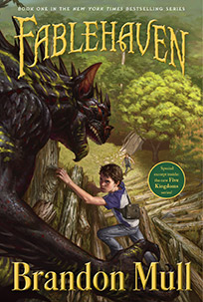
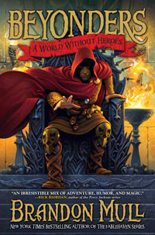
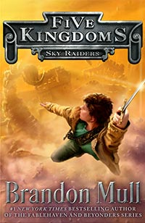
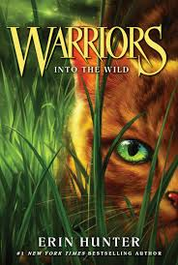
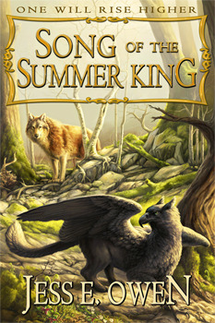
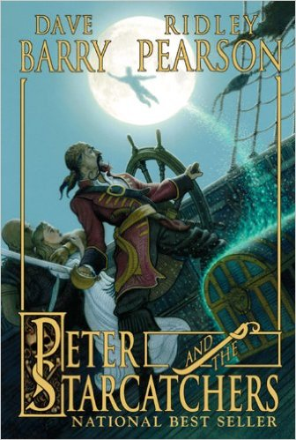
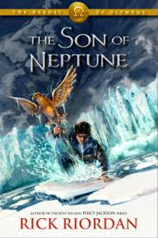
Fiction and Fantasy:
http://www.goodreads.com/book/show/15751365-song-of-the-summer-king
http://brandonmull.com/
http://warriors.wikia.com/wiki/Into_the_Wild
https://www.amazon.com/Peter-Starcatchers-Dave-Barry/dp/078684907X
https://en.wikipedia.org/wiki/The_Son_of_Neptune
Notes:
A poster by the author Brandon Mull, says “Imagination can take you places… READ!”, and this is true; you can get lost in a good book. Reading is fun, and relaxing. You don’t always need a piece of chocolate to help you forget your stress, after a busy day. According to Sheryl Ness of the Mayo Clinic blog, “Reading can be a good way to forget about your daily worries, relax, and unwind.” It doesn’t have to be fiction or fantasy, it could be sci-fi fantasy, historical fiction, biography(written through research of a person’s life), autobiography(One’s own writings of their life), sports, nonfiction, or historical nonfiction. It can be any genre that captures your interest, and takes you to a different time or place. This is only one of the benefits of reading.

Slide 3
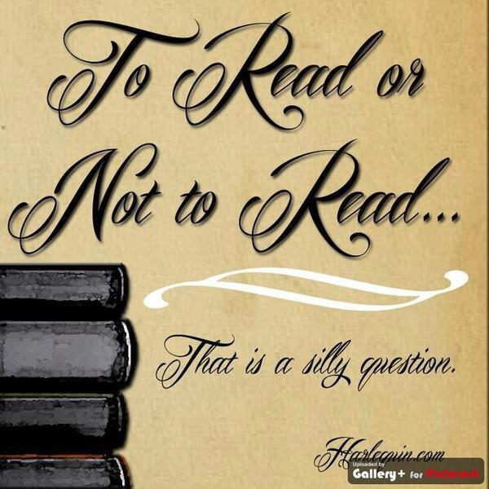
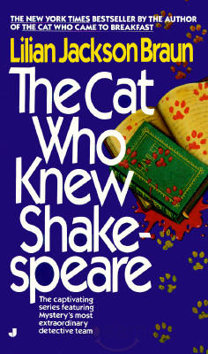
The Benefits:
www.best-books-for-kids.com lists about five different reasons, why reading is good for us.
It helps exercise the brain.
Reading is a task that can strengthen brain connections, and even create new ones.
Through reading, you can learn about different people, places, and events.
It exposes us to different ideas, beliefs, and ways of life that are unlike the ones surrounding us.
Reading can improve one’s vocabulary.
I have to pause and look up a word almost every time I read a “Cat Who…” mystery by Lilian Jackson Braun.
Reading helps develop imagination and creativity.
When we read a book without pictures, our brains must translate the descriptions of the people places and things for us.
Reading strengthens one’s ability to empathize as well.
When you read you are identifying with the character(s) in the story, and this can help you be more empathetic in real life.
NCES(National Center for Education Statistics) also found a positive relationship between level of educational attainment and the amount of literature a person reads, which reinforces the belief that reading proficiency is an important component of academic success.
Notes:
www.best-books-for-kids.com lists about five different reasons, why reading is good for us.
It helps exercise the brain.
Reading is a task that can strengthen brain connections, and even create new ones.
Through reading, you can learn about different people, places, and events.
It exposes us to different ideas, beliefs, and ways of life that are unlike the ones surrounding us.
Reading can improve one’s vocabulary.
I have to pause and look up a word almost every time I read a “Cat Who…” mystery by Lilian Jackson Braun.
Reading helps develop imagination and creativity.
When we read a book without pictures, our brains must translate the descriptions of the people places and things for us.
Reading strengthens one’s ability to empathize as well.
When you read you are identifying with the character(s) in the story, and feeling what they are feeling.
NCES also found a positive relationship between level of educational attainment and the amount of literature a person reads, which reinforces the belief that reading proficiency is an important component of academic success.
Unfortunately, not everyone reads.

Slide 4
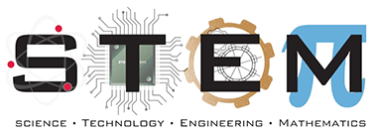

The Importance:
It is believed, at uk.pearson.com, that reading for pleasure, is more likely to determine whether we do well in school than or social or economic background.
Reading and literacy are part of our daily lives.
According to www.3plearning.com, literacy is NOT just the ability to read, but also the ability to view, write, design, speak and listen in a way that allows us to communicate effectively.
Reading skills are important for us to be successful in school and at work.
The Huffington Post says that, without the ability to read and write, there is no job at all in the STEM(Science, Technology, Engineering, and Math) education is going to be enough preparation.
Rob Furman of the Huffington, believes that STEM should be turned into STREAM.
( Science, Technology, Reading, Engineering, Arts, and Math)

Slide 5

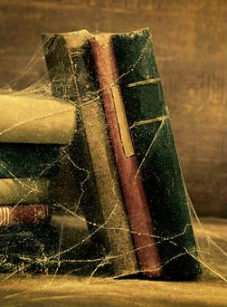
Problems:
A survey done by the NEA(National Endowment for the Arts)in 2004, found that fewer than half of American adults read literature.(though this may not include reading comics, magazines and online reading.)
www.quora.com points out that not reading limits the channels of information input in our lives.
If I don’t have a good book to read, I read about an event to go to, or read up on a news story that caught my interest.
According to www.twistimage.com, when we skim,flip, and use multiple screens to consume content; we are also rewiring our brains, and pushing them farther away from a place of deep learning and understanding.
Notes:
A survey done by the NEA(National Endowment for the Arts)in 2004, found that fewer than half of American adults read literature.(though this may not include reading comics, magazines and online reading.)
www.quora.com points out that not reading limits the channels of information input in our lives.
If I don’t have a good book to read, I read about an event to go to, or read up on a news story that caught my interest.
According to www.twistimage.com, when we skim,flip, and use multiple screens to consume content; we are also rewiring our brains, and pushing them farther away from a place of deep learning and understanding.

Slide 6

The Final Chapter:
These problems can be fixed.
It’s not that hard to become literate. You can buy books, read things online, or check them out from your local library FOR FREE!
Reading is fun. You can read anything you want, from comic books and mangas, to biographies and scientific articles.
We( or at least I )don’t want a future like the one depicted in Ray Bradbury’s Fahrenheit 451.
So next time you have had a stressful day, and Netflix doesn’t have the next season of the show you were watching. Pick up a book. Lookup articles on internet. Let reading take you to a different world that is more or less stress free.
Notes:
We( or at least I )don’t want a future like the one depicted in Ray Bradbury’s Fahrenheit 451.

