Slide 1
Data Mining: Introduction
Introduction to Data Mining
数据挖掘（双语）
马小科
计算机科学与技术学院
xkma@xidian.edu.cn

Slide 2
辅导教师
马亚雄 助理研究员
mayaxiong@xidian.edu.cn
查宇洪 硕士生
1260432818@qq.com

Slide 3
考核方式与课程安排
闭卷笔试70%+平时成绩30%
  平时10
  实验20
理论+实践：理论16次+实践4次
线下+线上：线下13+线上3次
任务 | 时间与地点
线上授课 | 9.6、9.7、9.13 8:30-10:05am 西电课堂(连续三个周末)
实践教学 | 10.30、11.13、11.20、12.4 18:00-22:00 教学实践中心(机房)

Slide 4


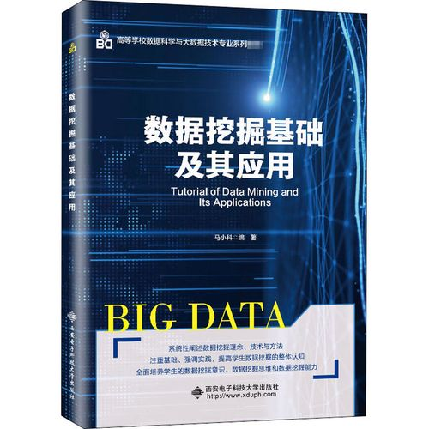
教材
  Pangning Tan. Intorduction to Data Mining. 人民邮电出版社. 2006
  Jiawei Han著. 数据挖掘: 概念与技术. 机械工业出版社, 2001.
  马小科. 数据挖掘基础及其应用. 西安电子科技大学出版社，2020

Slide 5
课程主要内容
Introduction to Data Mining 2
Data 2+2
Exploring Data 2
Classification 8
Association Analysis 8
Cluster Analysis 8
Complex Network Analysis 2

Slide 6


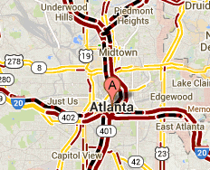
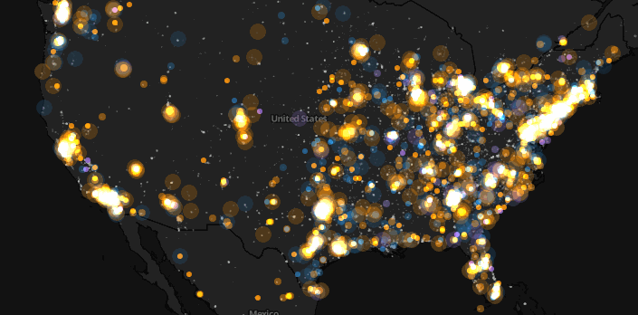
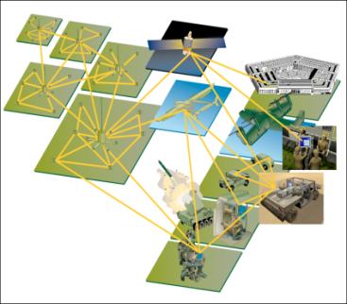
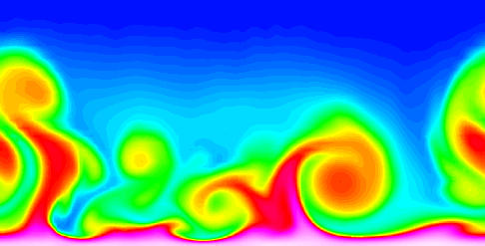
Large-scale Data is Everywhere!
There has been enormous data growth in both commercial and scientific databases due to advances in data generation and collection technologies
New mantra
  Gather whatever data you can whenever and wherever possible.
Expectations
  Gathered data will have value either for the purpose collected or for a purpose not envisioned.
E-Commerce
Cyber Security
Traffic Patterns
Social Networking: Twitter
MIT: Top 20 Technique
1. Data Mining
2. Machine Learning
3. Artificial Intelligence
Sensor Networks
Computational Simulations

Slide 7
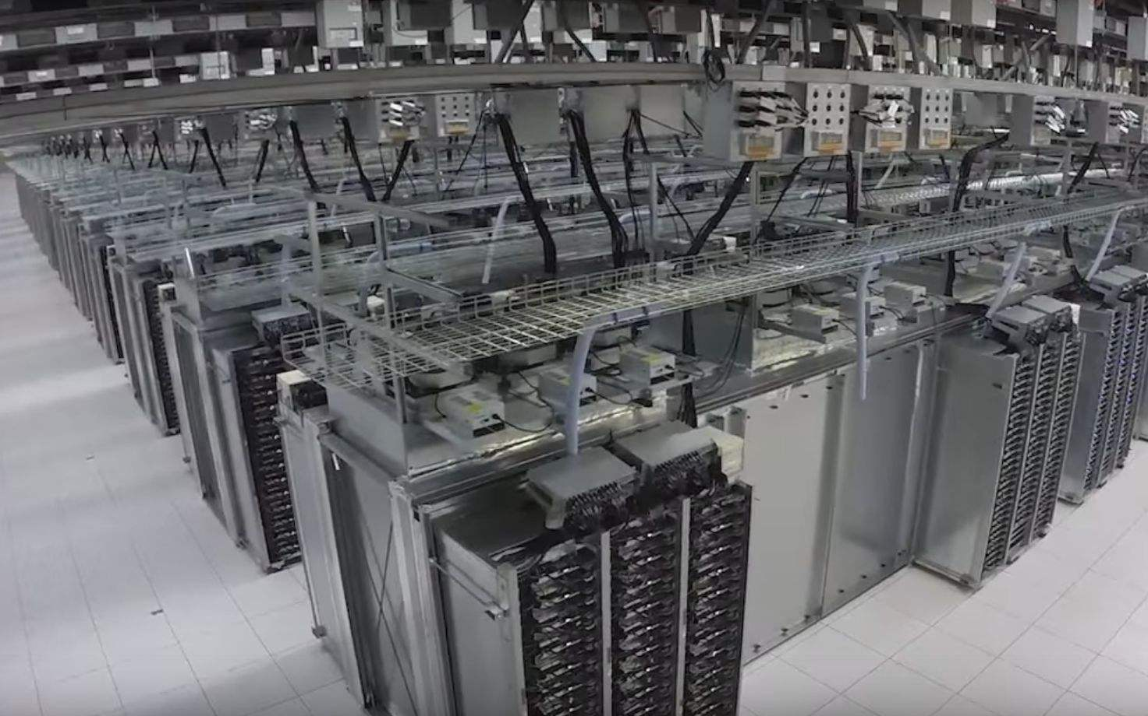
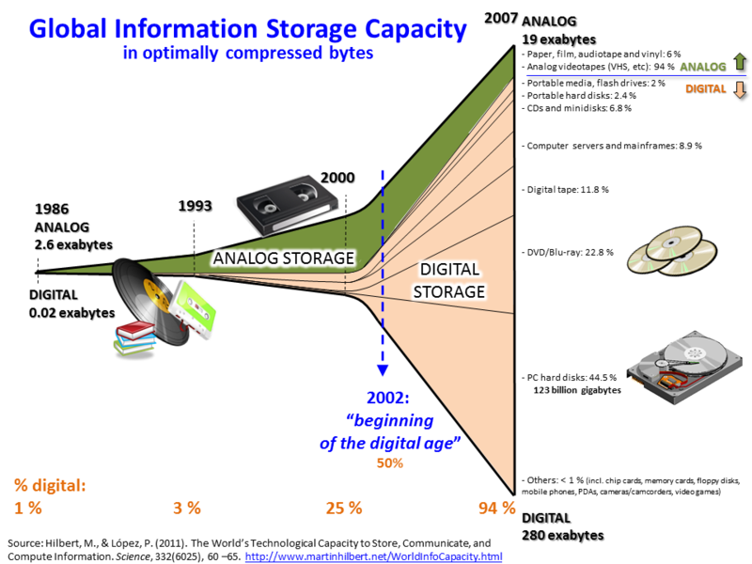
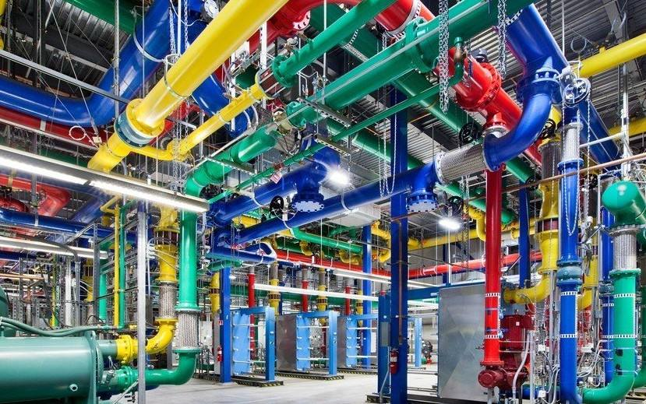
Why Data Mining
大容量存储设备
亚纳秒级存储，Sciences，2017
Google Data Center

Slide 8
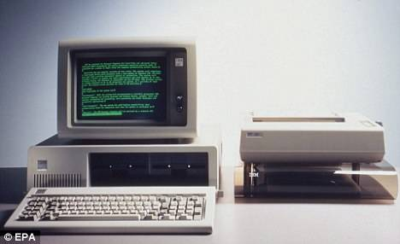
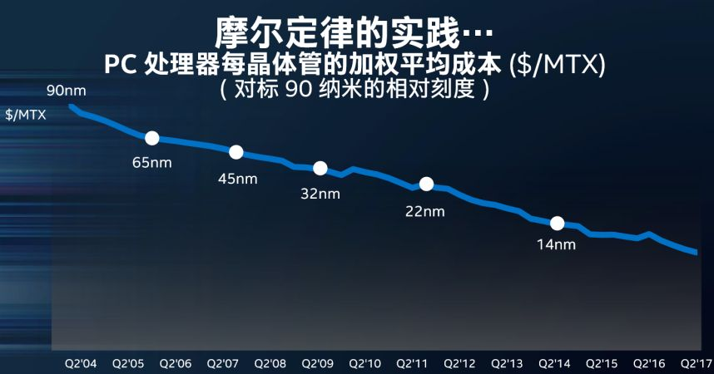
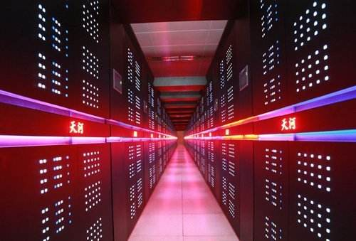
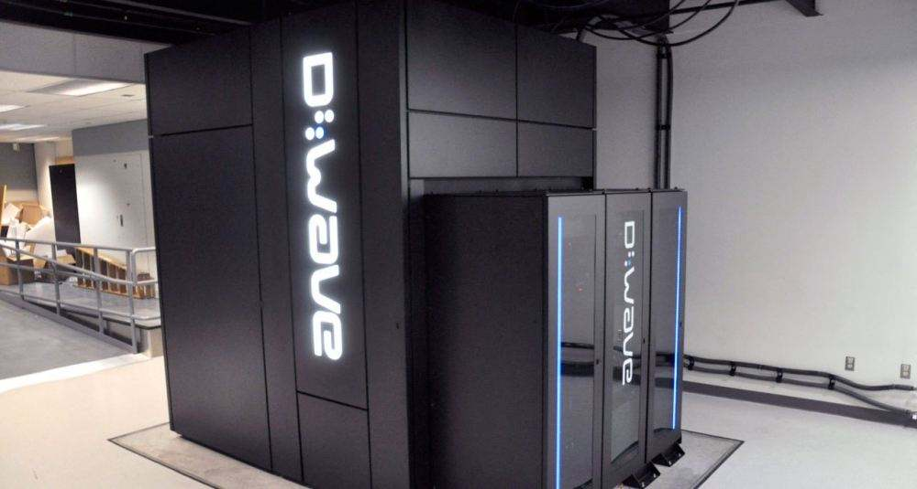
Why Data Mining
High performance
IBM PC
天河
5.49
亿亿
次/秒
量子
1亿倍

Slide 9
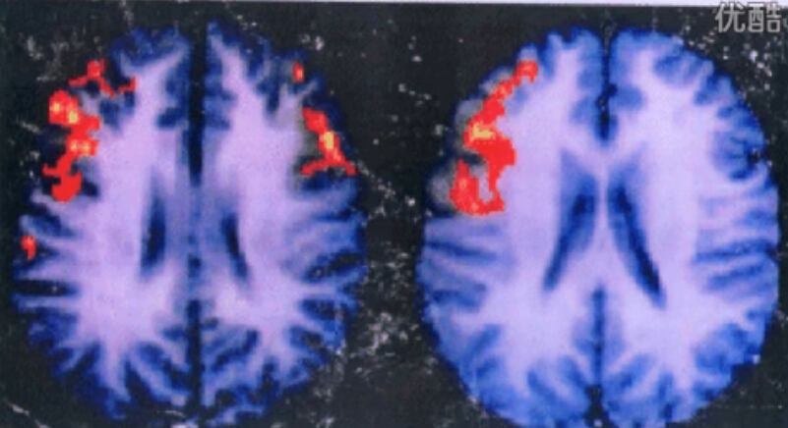
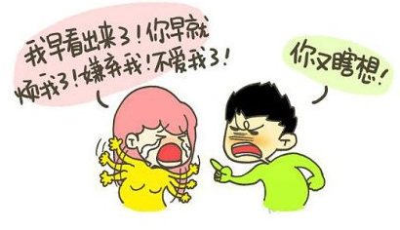
Why explain phenomena?
Difference: Emotion and expression
Never ever quarrel with your wife/girlfriend since there is no chance to win ---Hilary

Slide 10
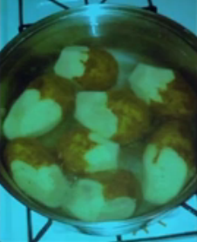
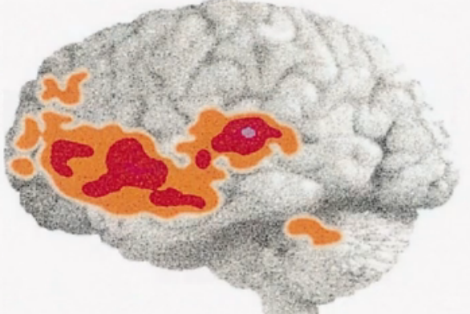
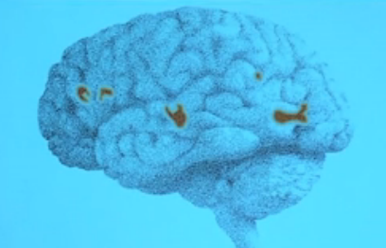
Why explain phenomena?
Seretonin (血清素) male 52% much than female
可怕的第六感 SenseLuxury

Slide 11
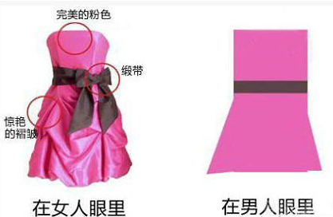
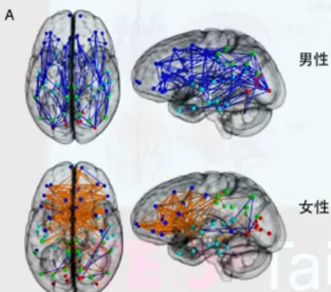
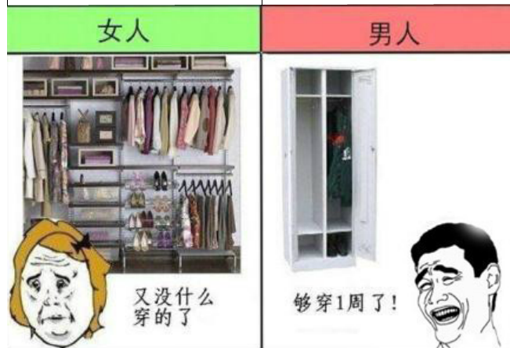
Why explain phenomena?
The Sixth sense: female > male

Slide 12




Why Data Mining? Commercial Viewpoint
Lots of data is being collected
and warehoused
  Web data
    Google has Peta Bytes of web data
    Facebook has billions of active users
  purchases at department/
  grocery stores, e-commerce
    Amazon handles millions of visits/day
  Bank/Credit Card transactions
Computers have become cheaper and more powerful
Competitive Pressure is Strong
  Provide better, customized services for an edge (e.g. in Customer Relationship Management)

Slide 13
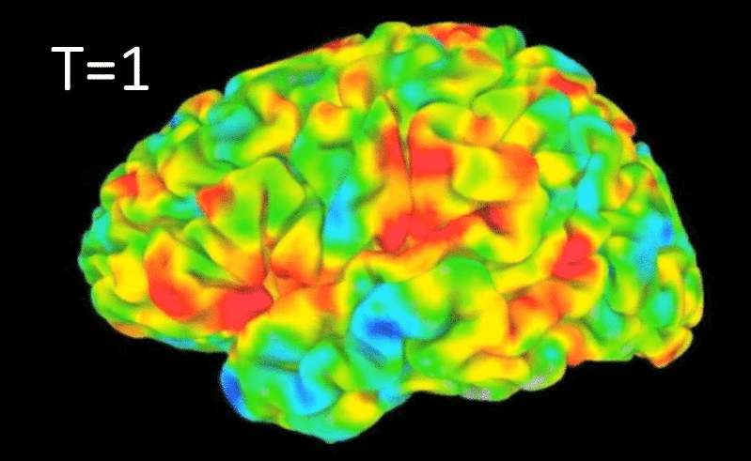
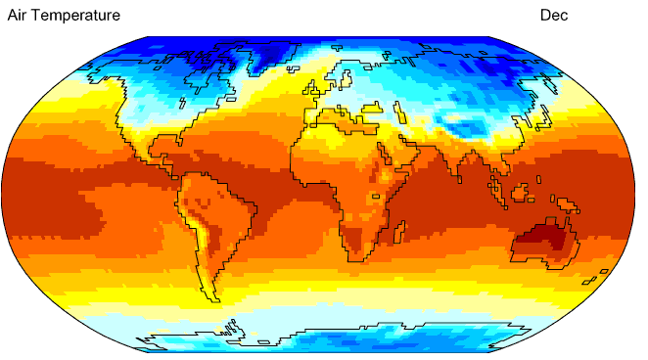
Why Data Mining? Scientific Viewpoint
Data collected and stored at
enormous speeds
  remote sensors on a satellite
    NASA EOSDIS archives over
    petabytes of earth science data / year
  telescopes scanning the skies
    Sky survey data
  High-throughput biological data
  scientific simulations
    terabytes of data generated in a few hours
Data mining helps scientists
  in automated analysis of massive datasets
  In hypothesis formation
fMRI Data from Brain
Sky Survey Data
Gene Expression Data
Surface Temperature of Earth

Slide 14
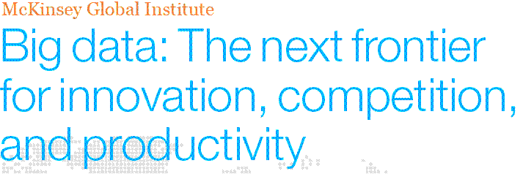
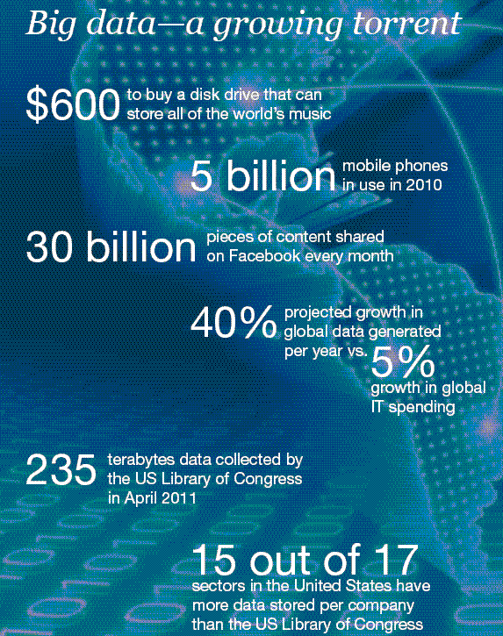
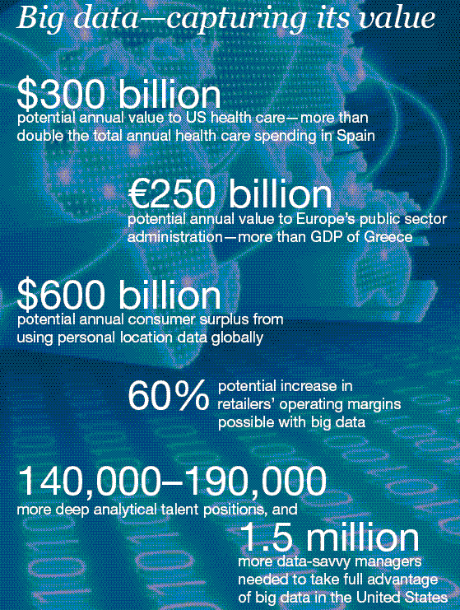
Great opportunities to improve productivity in all walks of life

Slide 15

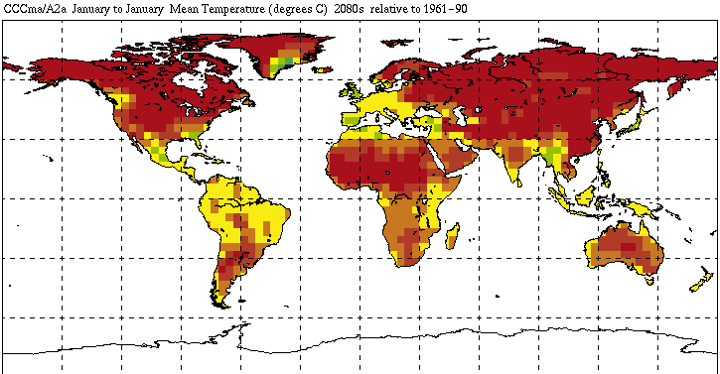
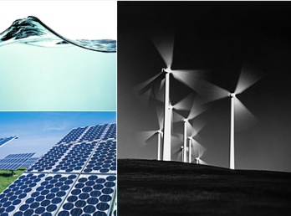
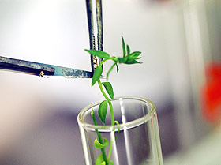
Great Opportunities to Solve Society’s Major Problems
Improving health care and reducing costs
Predicting the impact of climate change
Finding alternative/ green energy sources
Reducing hunger and poverty by
increasing agriculture production

Slide 16
What is Data Mining?
Many Definitions
  Non-trivial extraction of implicit, previously unknown and potentially useful information from data
  Exploration & analysis, by automatic or semi-automatic means, of large quantities of data in order to discover
  meaningful patterns

Slide 17
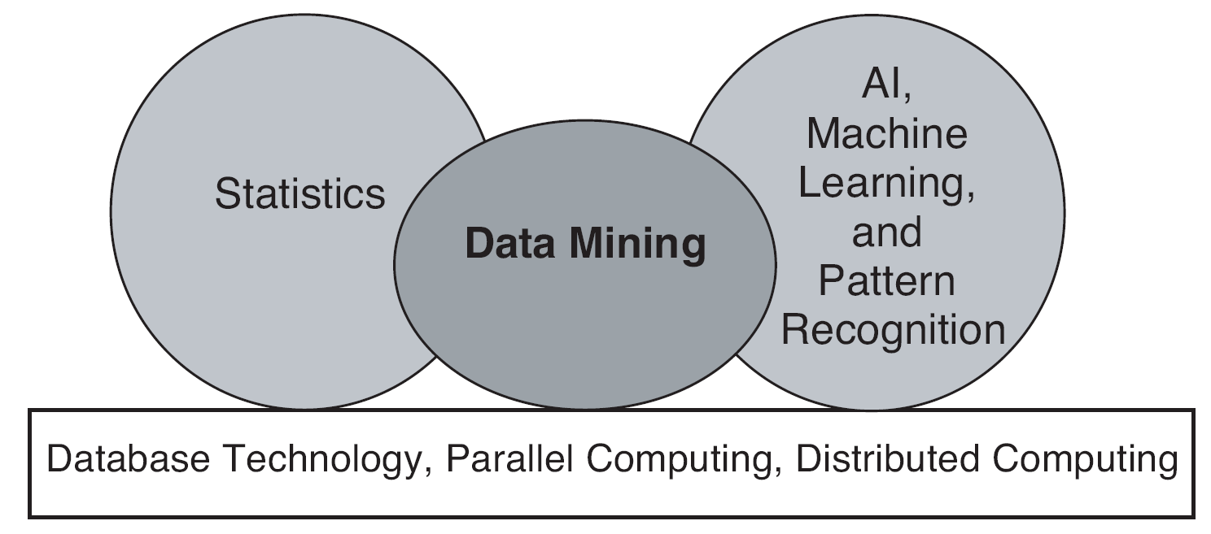
Origins of Data Mining
Draws ideas from machine learning/AI, pattern recognition, statistics, and database systems
Traditional techniques may be unsuitable due to data that is
  Large-scale
  High dimensional
  Heterogeneous
  Complex
  Distributed
A key component of the emerging field of data science and data-driven discovery

Slide 18
Data Mining Tasks
Prediction Methods
  Use some variables to predict unknown or future values of other variables.
Description Methods
  Find human-interpretable patterns that describe the data.
From [Fayyad, et.al.] Advances in Knowledge Discovery and Data Mining, 1996

Slide 19


Data Mining Tasks …
Data
Clustering
Predictive Modeling
Association
Rules
Anomaly
Detection
Milk

Slide 20
Predictive Modeling: Classification
Find a model for class attribute as a function of the values of other attributes
Model for predicting credit worthiness
Class

Slide 21
Classification Example
categorical
categorical
quantitative
class
Test
Set
Learn
Classifier
Training
Set
Model

Slide 22
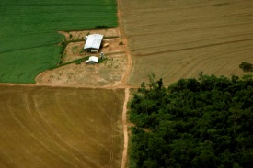
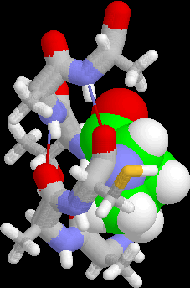
Examples of Classification Task
Classifying credit card transactions
as legitimate or fraudulent
Classifying land covers (water bodies, urban areas, forests, etc.) using satellite data
Categorizing news stories as finance,
weather, entertainment, sports, etc
Identifying intruders in the cyberspace
Predicting tumor cells as benign or malignant
Classifying secondary structures of protein
as alpha-helix, beta-sheet, or random coil

Slide 23
Classification: Application 1
Fraud Detection
  Goal: Predict fraudulent cases in credit card transactions.
  Approach:
    Use credit card transactions and the information on its account-holder as attributes.
      When does a customer buy, what does he buy, how often he pays on time, etc
    Label past transactions as fraud or fair transactions. This forms the class attribute.
    Learn a model for the class of the transactions.
    Use this model to detect fraud by observing credit card transactions on an account.

Slide 24
Classification: Application 2
Churn prediction for telephone customers
  Goal: To predict whether a customer is likely to be lost to a competitor.
  Approach:
    Use detailed record of transactions with each of the past and present customers, to find attributes.
      How often the customer calls, where he calls, what time-of-the day he calls most, his financial status, marital status, etc.
    Label the customers as loyal or disloyal.
    Find a model for loyalty.

Slide 25
Classification: Application 3
Sky Survey Cataloging
  Goal: To predict class (star or galaxy) of sky objects, especially visually faint ones, based on the telescopic survey images (from Palomar Observatory).
      3000 images with 23,040 x 23,040 pixels per image.
  Approach:
    Segment the image.
    Measure image attributes (features) - 40 of them per object.
    Model the class based on these features.
    Success Story: Could find 16 new high red-shift quasars, some of the farthest objects that are difficult to find!
From [Fayyad, et.al.] Advances in Knowledge Discovery and Data Mining, 1996

Slide 26
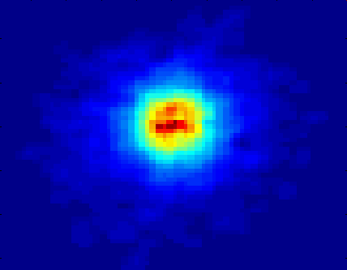
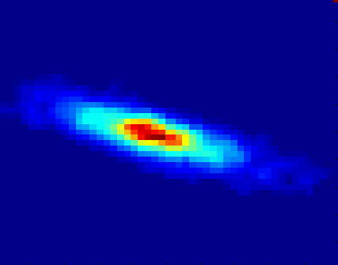
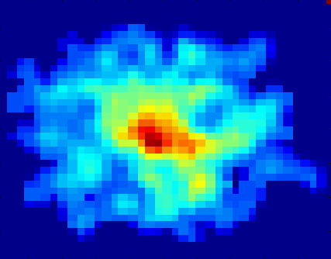
Classifying Galaxies
Courtesy: http://aps.umn.edu
Early
Class:
Stages of Formation
Attributes:
Image features,
Characteristics of light waves received, etc.
Intermediate
Late
Data Size:
72 million stars, 20 million galaxies
Object Catalog: 9 GB
Image Database: 150 GB

Slide 27
Regression
Predict a value of a given continuous valued variable based on the values of other variables, assuming a linear or nonlinear model of dependency.
Extensively studied in statistics, neural network fields.
Examples:
  Predicting sales amounts of new product based on advetising expenditure.
  Predicting wind velocities as a function of temperature, humidity, air pressure, etc.
  Time series prediction of stock market indices.

Slide 28
Clustering
Finding groups of objects such that the objects in a group will be similar (or related) to one another and different from (or unrelated to) the objects in other groups
Inter-cluster distances are maximized
Intra-cluster distances are minimized

Slide 29
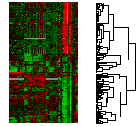
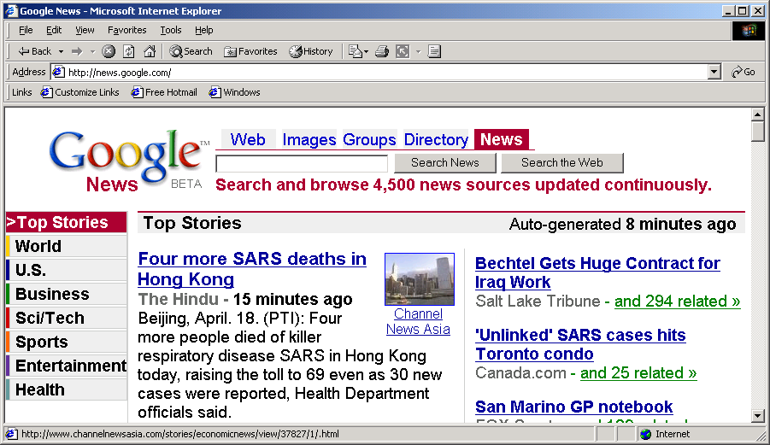
Applications of Cluster Analysis
Understanding
  Custom profiling for targeted marketing
  Group related documents for browsing
  Group genes and proteins that have similar functionality
  Group stocks with similar price fluctuations
Summarization
  Reduce the size of large data sets
Courtesy: Michael Eisen
Use of K-means to partition Sea Surface Temperature (SST) and Net Primary Production (NPP) into clusters that reflect the Northern and Southern Hemispheres.

Slide 30
Clustering: Application 1
Market Segmentation:
  Goal: subdivide a market into distinct subsets of customers where any subset may conceivably be selected as a market target to be reached with a distinct marketing mix.
  Approach:
    Collect different attributes of customers based on their geographical and lifestyle related information.
    Find clusters of similar customers.
    Measure the clustering quality by observing buying patterns of customers in same cluster vs. those from different clusters.

Slide 31
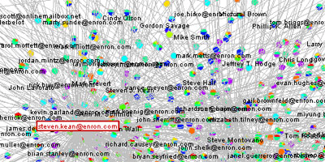
Clustering: Application 2
Document Clustering:
  Goal: To find groups of documents that are similar to each other based on the important terms appearing in them.
  Approach: To identify frequently occurring terms in each document. Form a similarity measure based on the frequencies of different terms. Use it to cluster.
Enron email dataset

Slide 32
Association Rule Discovery: Definition
Given a set of records each of which contain some number of items from a given collection
  Produce dependency rules which will predict occurrence of an item based on occurrences of other items.
Rules Discovered:
{Milk} --> {Coke}
{Diaper, Milk} --> {Beer}

Slide 33
Association Analysis: Applications
Market-basket analysis
  Rules are used for sales promotion, shelf management, and inventory management
Telecommunication alarm diagnosis
  Rules are used to find combination of alarms that occur together frequently in the same time period
Medical Informatics
  Rules are used to find combination of patient symptoms and test results associated with certain diseases

Slide 34
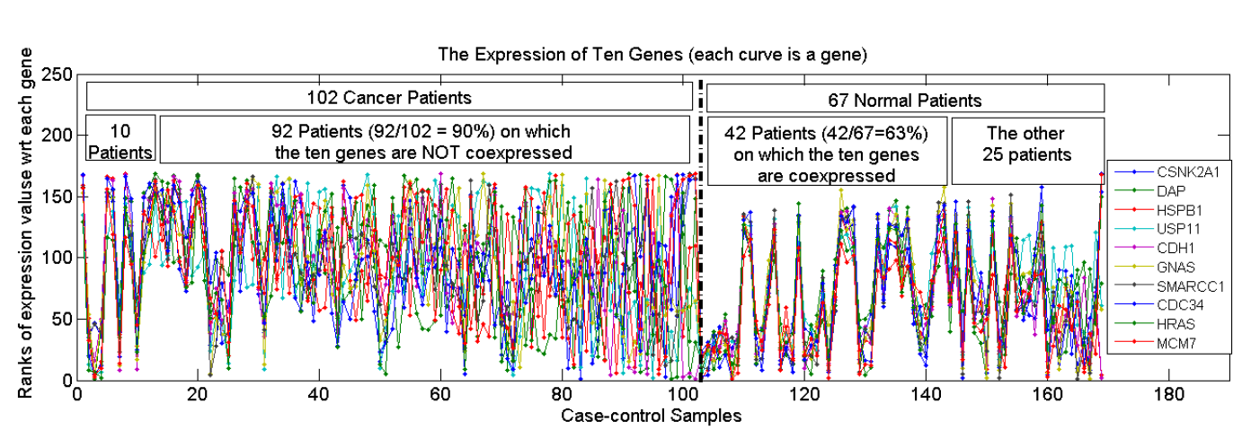
Association Analysis: Applications
An Example Subspace Differential Coexpression Pattern from lung cancer dataset
Enriched with the TNF/NFB signaling pathway
which is well-known to be related to lung cancer
P-value: 1.4*10⁻⁵ (6/10 overlap with the pathway)
  Three lung cancer datasets [Bhattacharjee et al. 2001], [Stearman et al. 2005], [Su et al. 2007]

Slide 35
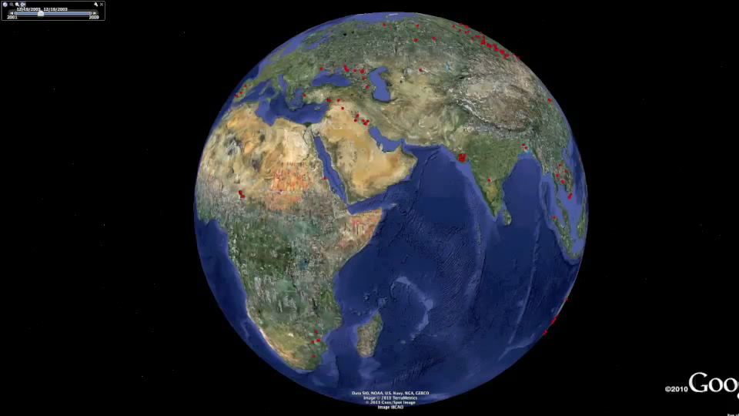
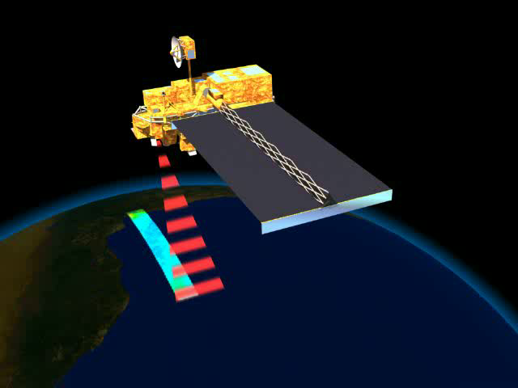
Deviation/Anomaly/Change Detection
Detect significant deviations from normal behavior
Applications:
  Credit Card Fraud Detection
  Network Intrusion
  Detection
  Identify anomalous behavior from sensor networks for monitoring and surveillance.
  Detecting changes in the global forest cover.

Slide 36
Motivating Challenges
Scalability
High Dimensionality
Heterogeneous and Complex Data
Data Ownership and Distribution
Non-traditional Analysis

