Slide 1

Data Mining
Model Overfitting
Introduction to Data Mining, 2nd Edition

Slide 2
Classification Errors
Training errors (apparent errors)
  Errors committed on the training set
Test errors
  Errors committed on the test set
Generalization errors
  Expected error of a model over random selection of records from same distribution

Slide 3
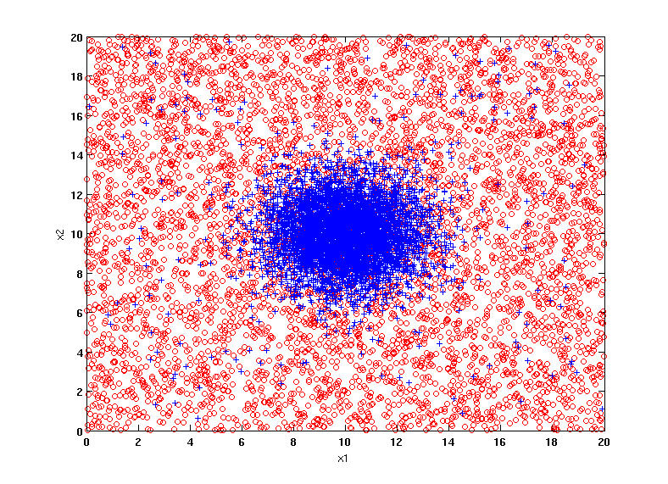
Example Data Set
Two class problem:
+ : 5200 instances
5000 instances generated from a Gaussian centered at (10,10)
200 noisy instances added
o : 5200 instances
Generated from a uniform distribution
10 % of the data used for training and 90% of the data used for testing

Slide 4
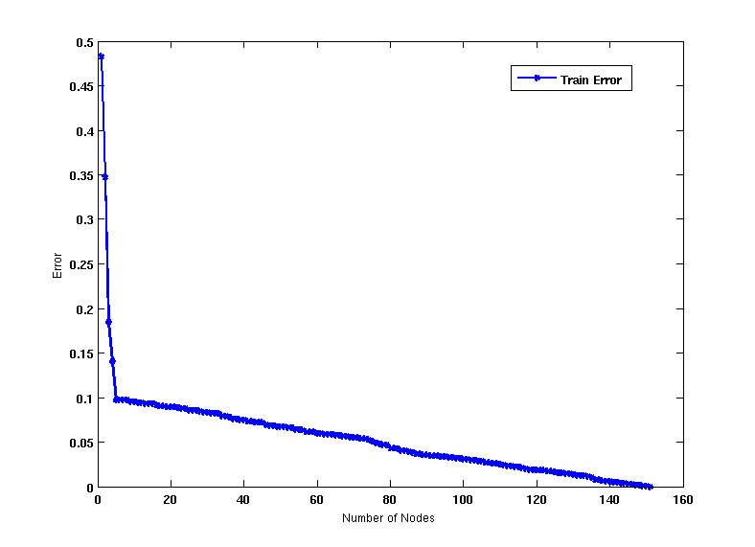
Increasing number of nodes in Decision Trees

Slide 5
Decision Tree with 4 nodes
Decision Tree
Decision boundaries on Training data

Slide 6
Decision Tree with 50 nodes
Decision Tree
Decision Tree
Decision boundaries on Training data

Slide 7
Which tree is better?
Decision Tree with 4 nodes
Which tree is better ?
Decision Tree with 50 nodes

Slide 8
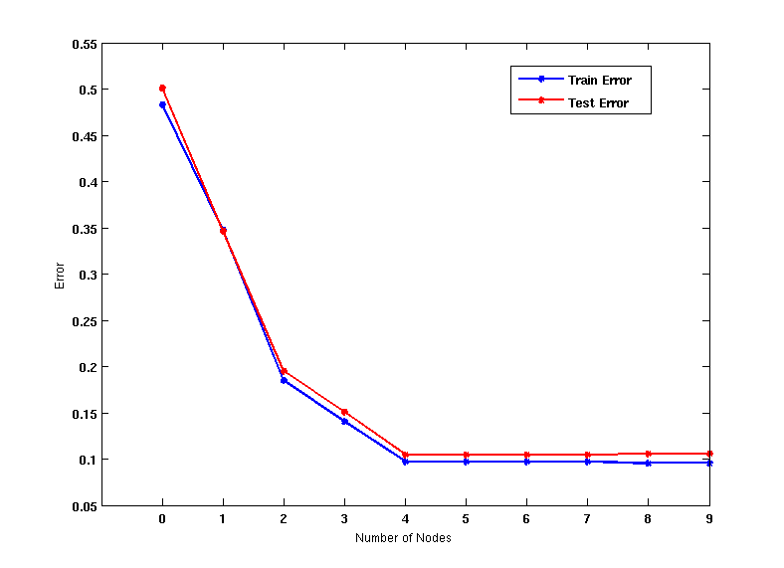
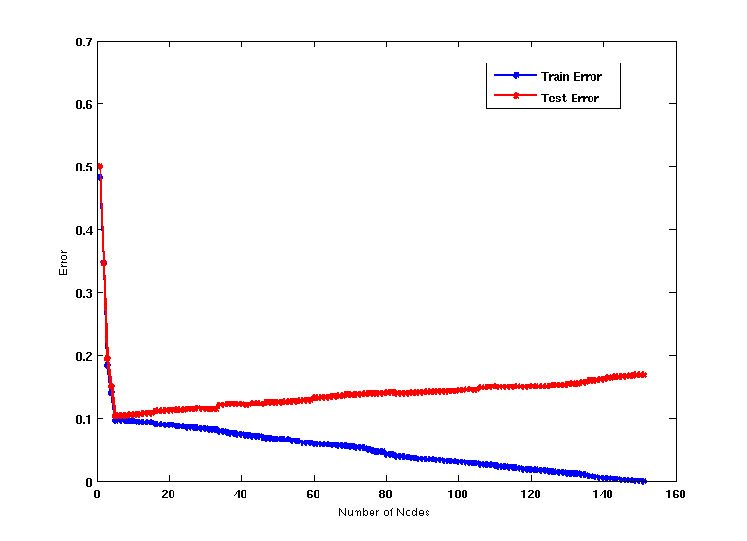
Model Overfitting
Underfitting: when model is too simple, both training and test errors are large
Overfitting: when model is too complex, training error is small but test error is large

Slide 9
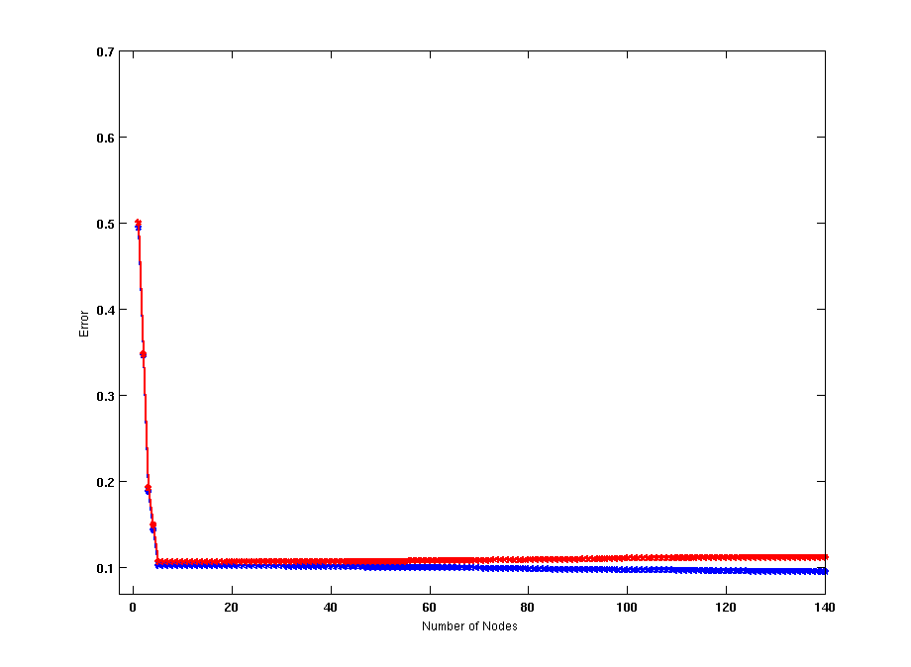
Model Overfitting
Using twice the number of data instances
If training data is under-representative, testing errors increase and training errors decrease on increasing number of nodes
Increasing the size of training data reduces the difference between training and testing errors at a given number of nodes

Slide 10
Model Overfitting
Decision Tree with 50 nodes
Decision Tree with 50 nodes
Using twice the number of data instances
If training data is under-representative, testing errors increase and training errors decrease on increasing number of nodes
Increasing the size of training data reduces the difference between training and testing errors at a given number of nodes

Slide 11
Reasons for Model Overfitting
Limited Training Size
High Model Complexity
  Multiple Comparison Procedure

Slide 12
Effect of Multiple Comparison Procedure
Consider the task of predicting whether stock market will rise/fall in the next 10 trading days
Random guessing:
  P(correct) = 0.5
Make 10 random guesses in a row:
Day 1 | Up
Day 2 | Down
Day 3 | Down
Day 4 | Up
Day 5 | Down
Day 6 | Down
Day 7 | Up
Day 8 | Up
Day 9 | Up
Day 10 | Down

Slide 13
Effect of Multiple Comparison Procedure
Approach:
  Get 50 analysts
  Each analyst makes 10 random guesses
  Choose the analyst that makes the most number of correct predictions
Probability that at least one analyst makes at least 8 correct predictions

Slide 14
Effect of Multiple Comparison Procedure
Many algorithms employ the following greedy strategy:
  Initial model: M
  Alternative model: M’ = M ∪ γ,
  where γ is a component to be added to the model (e.g., a test condition of a decision tree)
  Keep M’ if improvement, Δ(M,M’) > α
Often times, γ is chosen from a set of alternative components, Γ = {γ₁, γ₂, …, γ_{k}}
If many alternatives are available, one may inadvertently add irrelevant components to the model, resulting in model overfitting

Slide 15
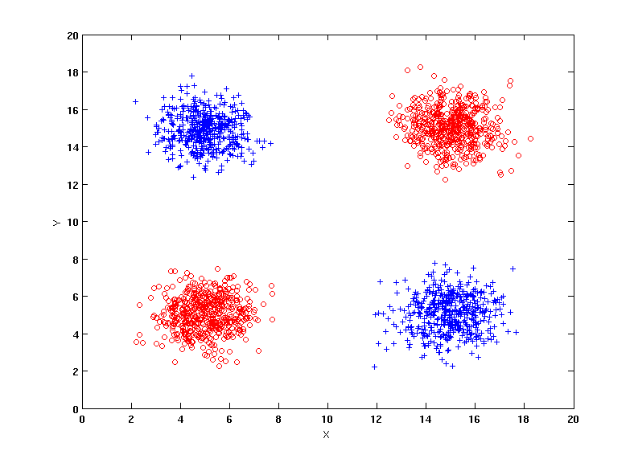
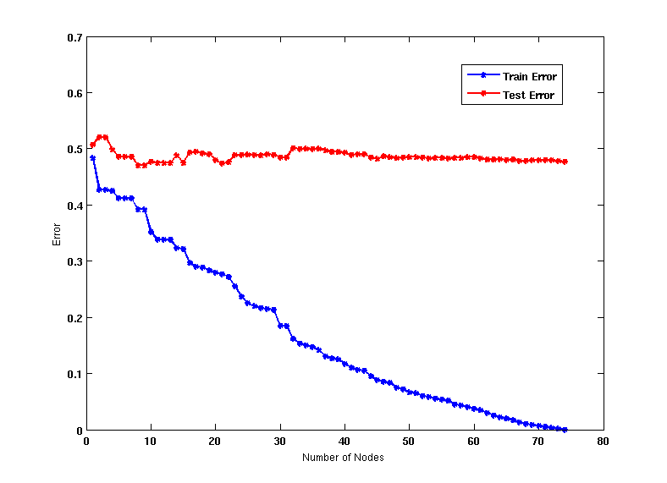
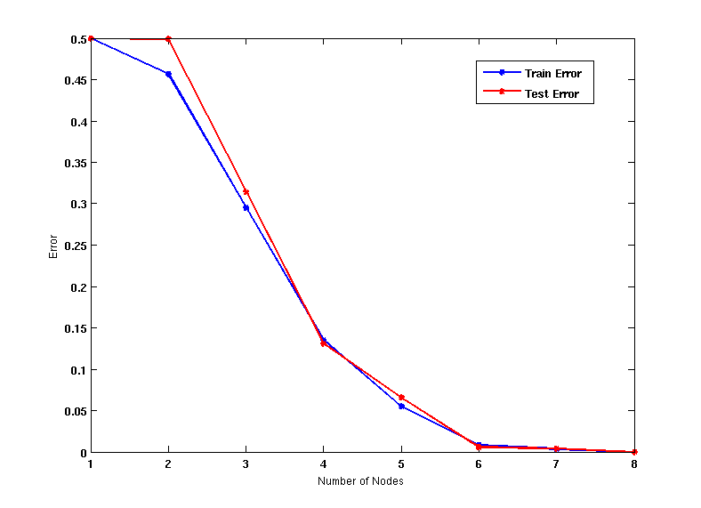
Effect of Multiple Comparison - Example
Use additional 100 noisy variables generated from a uniform distribution along with X and Y as attributes.
Use 30% of the data for training and 70% of the data for testing
Using only X and Y as attributes

Slide 16
Notes on Overfitting
Overfitting results in decision trees that are more complex than necessary
Training error does not provide a good estimate of how well the tree will perform on previously unseen records
Need ways for estimating generalization errors

Slide 17
Model Selection
Performed during model building
Purpose is to ensure that model is not overly complex (to avoid overfitting)
Need to estimate generalization error
  Using Validation Set
  Incorporating Model Complexity
  Estimating Statistical Bounds

Slide 18
Model Selection:
Using Validation Set
Divide training data into two parts:
  Training set:
    use for model building
  Validation set:
    use for estimating generalization error
    Note: validation set is not the same as test set
Drawback:
  Less data available for training

Slide 19
Model Selection:
Incorporating Model Complexity
Rationale: Occam’s Razor
  Given two models of similar generalization errors, one should prefer the simpler model over the more complex model
  A complex model has a greater chance of being fitted accidentally by errors in data
  Therefore, one should include model complexity when evaluating a model
  Gen. Error(Model) = Train. Error(Model, Train. Data) +
  x Complexity(Model)

Slide 20
Estimating the Complexity of Decision Trees
Pessimistic Error Estimate of decision tree T with k leaf nodes:
  err(T): error rate on all training records
  Ω: trade-off hyper-parameter (similar to )
    Relative cost of adding a leaf node
  k: number of leaf nodes
  N_{train}: total number of training records

Slide 21
Estimating the Complexity of Decision Trees: Example
e(T_{L}) = 4/24
e(T_{R}) = 6/24
Ω = 1
e_{gen}(T_{L}) = 4/24 + 1*7/24 = 11/24 = 0.458
e_{gen}(T_{R}) = 6/24 + 1*4/24 = 10/24 = 0.417

Slide 22
Estimating the Complexity of Decision Trees
Resubstitution Estimate:
  Using training error as an optimistic estimate of generalization error
  Referred to as optimistic error estimate
e(T_{L}) = 4/24
e(T_{R}) = 6/24

Slide 23
Minimum Description Length (MDL)
Cost(Model,Data) = Cost(Data|Model) + x Cost(Model)
  Cost is the number of bits needed for encoding.
  Search for the least costly model.
Cost(Data|Model) encodes the misclassification errors.
Cost(Model) uses node encoding (number of children) plus splitting condition encoding.

Slide 24
Estimating Statistical Bounds
Before splitting: e = 2/7, e’(7, 2/7, 0.25) = 0.503
e’(T) = 7 × 0.503 = 3.521
After splitting:
e(T_{L}) = 1/4, e’(4, 1/4, 0.25) = 0.537
e(T_{R}) = 1/3, e’(3, 1/3, 0.25) = 0.650
e’(T) = 4 × 0.537 + 3 × 0.650 = 4.098
Therefore, do not split

Slide 25
Model Selection for Decision Trees
Pre-Pruning (Early Stopping Rule)
  Stop the algorithm before it becomes a fully-grown tree
  Typical stopping conditions for a node:
    Stop if all instances belong to the same class
    Stop if all the attribute values are the same
  More restrictive conditions:
    Stop if number of instances is less than some user-specified threshold
    Stop if class distribution of instances are independent of the available features (e.g., using χ ² test)
    Stop if expanding the current node does not improve impurity
    measures (e.g., Gini or information gain).
    Stop if estimated generalization error falls below certain threshold

Slide 26
Model Selection for Decision Trees
Post-pruning
  Grow decision tree to its entirety
  Subtree replacement
    Trim the nodes of the decision tree in a bottom-up fashion
    If generalization error improves after trimming, replace sub-tree by a leaf node
    Class label of leaf node is determined from majority class of instances in the sub-tree
  Subtree raising
    Replace subtree with most frequently used branch

Slide 27
Example of Post-Pruning
Training Error (Before splitting) = 10/30
Pessimistic error = (10 + 0.5)/30 = 10.5/30
Training Error (After splitting) = 9/30
Pessimistic error (After splitting)
= (9 + 4 × 0.5)/30 = 11/30
PRUNE!
Class = Yes | 20
Class = No | 10
Error = 10/30
Class = Yes | 8
Class = No | 4
Class = Yes | 3
Class = No | 4
Class = Yes | 4
Class = No | 1
Class = Yes | 5
Class = No | 1

Slide 28
Examples of Post-pruning

Slide 29
Model Evaluation
Purpose:
  To estimate performance of classifier on previously unseen data (test set)
Holdout
  Reserve k% for training and (100-k)% for testing
  Random subsampling: repeated holdout
Cross validation
  Partition data into k disjoint subsets
  k-fold: train on k-1 partitions, test on the remaining one
  Leave-one-out: k=n

Slide 30
Cross-validation Example
3-fold cross-validation

Slide 31
Issues with Naïve Bayes Classifier
If one of the conditional probabilities is zero, then the entire expression becomes zero
Need to use other estimates of conditional probabilities than simple fractions
Probability estimation:
c: number of classes
p: prior probability of the class
m: parameter
N_{c}: number of instances in the class
N_{ic}: number of instances having attribute value A_{i} in class c

Slide 32
Example of Naïve Bayes Classifier
A: attributes
M: mammals
N: non-mammals
P(A|M)P(M) > P(A|N)P(N)
=> Mammals

Slide 33
Naïve Bayes (Summary)
Robust to isolated noise points
Handle missing values by ignoring the instance during probability estimate calculations
Robust to irrelevant attributes
Independence assumption may not hold for some attributes
  Use other techniques such as Bayesian Belief Networks (BBN)

Slide 34
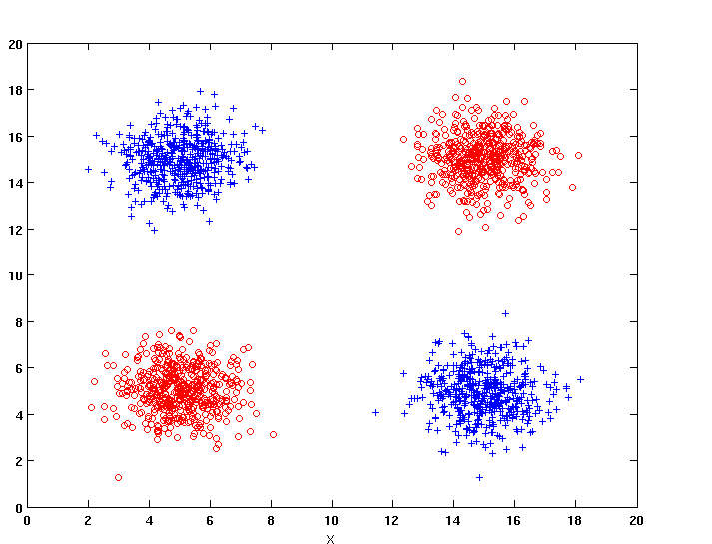
Naïve Bayes
How does Naïve Bayes perform on the following dataset?
Conditional independence of attributes is violated

Slide 35
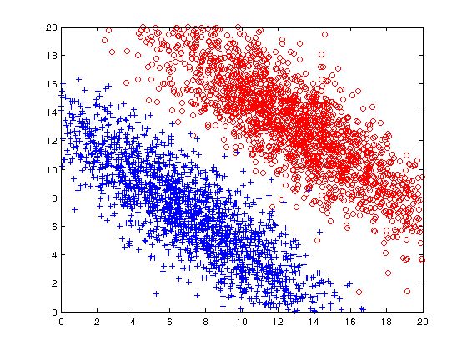
Naïve Bayes
How does Naïve Bayes perform on the following dataset?
Naïve Bayes can construct oblique decision boundaries

Slide 36
Naïve Bayes
How does Naïve Bayes perform on the following dataset?
Y = 1 | 1 | 1 | 1 | 0
Y = 2 | 0 | 1 | 0 | 0
Y = 3 | 0 | 0 | 1 | 1
Y = 4 | 0 | 0 | 1 | 1
 | X = 1 | X = 2 | X = 3 | X = 4
Y = 1 | 1 | 1 | 1 | 0
Y = 2 | 0 | 1 | 0 | 0
Y = 3 | 0 | 0 | 1 | 1
Y = 4 | 0 | 0 | 1 | 1
 | X = 1 | X = 2 | X = 3 | X = 4
Conditional independence of attributes is violated

Slide 37
Bayesian Belief Networks
Provides graphical representation of probabilistic relationships among a set of random variables
Consists of:
  A directed acyclic graph (dag)
    Node corresponds to a variable
    Arc corresponds to dependence
    relationship between a pair of variables
  A probability table associating each node to its immediate parent

Slide 38
Conditional Independence
D is parent of C
A is child of C
B is descendant of D
D is ancestor of A
A node in a Bayesian network is conditionally independent of all of its nondescendants, if its parents are known

Slide 39
Conditional Independence
Naïve Bayes assumption:

Slide 40
Probability Tables
If X does not have any parents, table contains prior probability P(X)
If X has only one parent (Y), table contains conditional probability P(X|Y)
If X has multiple parents (Y₁, Y₂,…, Y_{k}), table contains conditional probability P(X|Y₁, Y₂,…, Y_{k})

Slide 41
Example of Bayesian Belief Network

Slide 42
Example of Inferencing using BBN
Given: X = (E=No, D=Yes, CP=Yes, BP=High)
  Compute P(HD|E,D,CP,BP)?
P(HD=Yes| E=No,D=Yes) = 0.55
P(CP=Yes| HD=Yes) = 0.8
P(BP=High| HD=Yes) = 0.85
  P(HD=Yes|E=No,D=Yes,CP=Yes,BP=High)
  ∝ 0.55 × 0.8 × 0.85 = 0.374
P(HD=No| E=No,D=Yes) = 0.45
P(CP=Yes| HD=No) = 0.01
P(BP=High| HD=No) = 0.2
  P(HD=No|E=No,D=Yes,CP=Yes,BP=High)
  ∝ 0.45 × 0.01 × 0.2 = 0.0009
Classify X as Yes

Slide 43
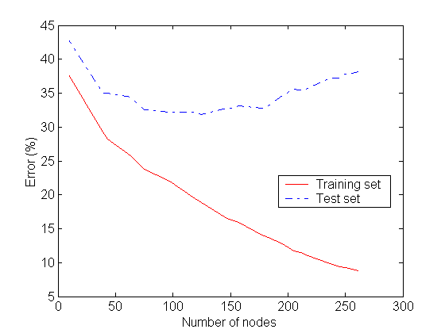
1、Underfitting and Overfitting
Overfitting
Underfitting: when model is too simple, both training and test errors are large

Slide 44
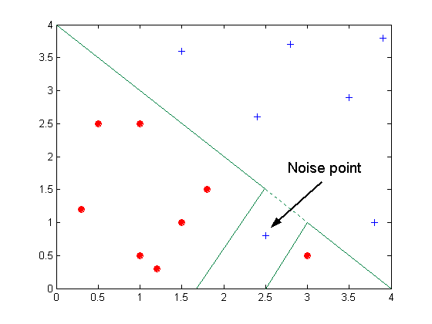
Overfitting due to Noise
Decision boundary is distorted by noise point

Slide 45
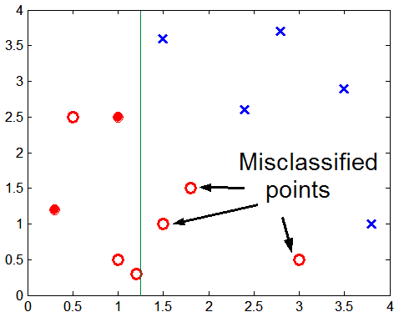
Overfitting due to Insufficient Examples
Lack of data points in the lower half of the diagram makes it difficult to predict correctly the class labels of that region
- Insufficient number of training records in the region causes the decision tree to predict the test examples using other training records that are irrelevant to the classification task

Slide 46
Notes on Overfitting
事实：Overfitting results in decision trees that are more complex than necessary
结果：Training error no longer provides a good estimate of how well the tree will perform on previously unseen records
结论：Need new ways for estimating errors

Slide 47
Estimating Generalization Errors
Re-substitution errors: error on training (Σ e(t) )
Generalization errors: error on testing (Σ e’(t))
Methods for estimating generalization errors:
  Optimistic approach: e’(t) = e(t)
  Pessimistic approach:
    For each leaf node: e’(t) = (e(t)+0.5)
    Total errors: e’(T) = e(T) + N × 0.5 (N: number of leaf nodes)
    For a tree with 30 leaf nodes and 10 errors on training
    (out of 1000 instances):
    Training error = 10/1000 = 1%
    Generalization error = (10 + 30×0.5)/1000 = 2.5%

Slide 48
Occam’s Razor（奥卡姆剃刀）
原则：Given two models of similar generalization errors, one should prefer the simpler model over the more complex model
原因：For complex models, there is a greater chance that it was fitted accidentally by errors in data
结论：Therefore, one should include model complexity when evaluating a model

Slide 49
Minimum Description Length (MDL)
最小描述长度
Cost(Model,Data) = Cost(Data|Model) + Cost(Model)
  Cost is the number of bits needed for encoding.
  Search for the least costly model.
Cost(Data|Model) encodes the misclassification errors.
Cost(Model) uses node encoding (number of children) plus splitting condition encoding.

Slide 50
How to Address Overfitting
Pre-Pruning (Early Stopping Rule)先剪枝（提前终止规则）
  Stop the algorithm before it becomes a fully-grown tree
  Typical stopping conditions for a node:
    Stop if all instances belong to the same class
    Stop if all the attribute values are the same
  More restrictive conditions:
    Stop if number of instances is less than some user-specified threshold
    Stop if class distribution of instances are independent of the available features (e.g., using χ ² test)
    Stop if expanding the current node does not improve impurity
    measures (e.g., Gini or information gain)

Slide 51
How to Address Overfitting…
Post-pruning（后剪枝）
  Grow decision tree to its entirety
  Trim the nodes of the decision tree in a bottom-up fashion
  If generalization error improves after trimming, replace sub-tree by a leaf node.
  Class label of leaf node is determined from majority class of instances in the sub-tree
  Can use MDL for post-pruning

Slide 52
Example of Post-Pruning
Training Error (Before splitting) = 10/30
Pessimistic error = (10 + 0.5)/30 = 10.5/30
Training Error (After splitting) = 9/30
Pessimistic error (After splitting)
= (9 + 4 × 0.5)/30 = 11/30
PRUNE!
Class = Yes | 20
Class = No | 10
Error = 10/30
Class = Yes | 8
Class = No | 4
Class = Yes | 3
Class = No | 4
Class = Yes | 4
Class = No | 1
Class = Yes | 5
Class = No | 1

Slide 53
Examples of Post-pruning
  Optimistic error?
  Pessimistic error?
Case 1:
Don’t prune for both cases
C0: 11
C1: 3
C0: 2
C1: 4
Don’t prune case 1, prune case 2
Case 2:
C0: 14
C1: 3
C0: 2
C1: 2

Slide 54
Handling Missing Attribute Values
Missing values affect decision tree construction in three different ways:
  Affects how impurity measures are computed
  树节点中包括缺失特征值的记录，影响其不纯性计算
  Affects how to distribute instance with missing value to child nodes
  父节点中包括缺失特征值的记录，影响该记录如何分配到孩子节点
  Affects how a test instance with missing value is classified
  测试记录中包括缺失特征值的记录，影响测试记录的分类

Slide 55
Computing Impurity Measure
Before Splitting:
Entropy(Parent)
= -0.3 log(0.3)-(0.7)log(0.7) = 0.8813
Split on Refund:
Entropy(Refund=Yes) = 0
Entropy(Refund=No)
= -(2/6)log(2/6) – (4/6)log(4/6) = 0.9183
Entropy(Children)
= 0.3 (0) + 0.6 (0.9183) = 0.551
Gain = 0.9 × (0.8813 – 0.551) = 0.3303
Missing value

Slide 56
Distribute Instances
Refund
Yes
No
Probability that Refund=Yes is 3/9
Probability that Refund=No is 6/9
Assign record to the left child with weight = 3/9 and to the right child with weight = 6/9
Refund
Yes
No

Slide 57
Classify Instances
New record:
 | Married | Single | Divorced | Total
Class=No | 3 | 1 | 0 | 4
Class=Yes | 6/9 | 1 | 1 | 2.67
Total | 3.67 | 2 | 1 | 6.67
Refund
Yes
No
NO
MarSt
Single,
Divorced
Married
Probability that Marital Status
= Married is 3.67/6.67
Probability that Marital Status ={Single,Divorced} is 3/6.67
TaxInc
NO
< 80K
> 80K
NO
YES

Slide 58
Other Issues
Data Fragmentation
Search Strategy
Expressiveness
Tree Replication

Slide 59
Data Fragmentation
Number of instances gets smaller as you traverse down the tree
Number of instances at the leaf nodes could be too small to make any statistically significant decision

Slide 60
Search Strategy
Finding an optimal decision tree is NP-hard
The algorithm presented so far uses a greedy, top-down, recursive partitioning strategy to induce a reasonable solution
Other strategies?
  Bottom-up
  Bi-directional

Slide 61
Expressiveness
Decision tree provides expressive representation for learning discrete-valued function
  But they do not generalize well to certain types of Boolean functions
    Example: parity function:
      Class = 1 if there is an even number of Boolean attributes with truth value = True
      Class = 0 if there is an odd number of Boolean attributes with truth value = True
    For accurate modeling, must have a complete tree
Not expressive enough for modeling continuous variables
  Particularly when test condition involves only a single attribute at-a-time

Slide 62
Decision Boundary
Border line between two neighboring regions of different classes is known as decision boundary
Decision boundary is parallel to axes because test condition involves a single attribute at-a-time

Slide 63
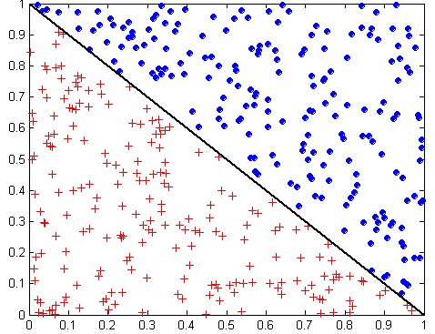
Oblique Decision Trees 斜决策树
x + y < 1
Class = +
Class =
Test condition may involve multiple attributes
More expressive representation
Finding optimal test condition is computationally expensive

Slide 64
Tree Replication 树的复制
Same subtree appears in multiple branches

Slide 65
二、分类模型的评估 Model Evaluation
Metrics for Performance Evaluation
  How to evaluate the performance of a model?
Methods for Performance Evaluation
  How to obtain reliable estimates?
Methods for Model Comparison
  How to compare the relative performance among competing models?

Slide 66
Model Evaluation
Metrics for Performance Evaluation
  How to evaluate the performance of a model?
Methods for Performance Evaluation
  How to obtain reliable estimates?
Methods for Model Comparison
  How to compare the relative performance among competing models?

Slide 67
Metrics for Performance Evaluation
Focus on the predictive capability of a model
  Rather than how fast it takes to classify or build models, scalability, etc.
Confusion Matrix混淆矩阵:
 | PREDICTED CLASS
ACTUAL CLASS |  | Class=Yes | Class=No
 | Class=Yes | a | b
 | Class=No | c | d
a: TP (true positive)
b: FN (false negative)
c: FP (false positive)
d: TN (true negative)

Slide 68
Metrics for Performance Evaluation…
Most widely-used metric:
 | PREDICTED CLASS
ACTUAL CLASS |  | Class=Yes | Class=No
 | Class=Yes | a (TP) | b (FN)
 | Class=No | c (FP) | d (TN)

Slide 69
Limitation of Accuracy
Consider a 2-class problem
  Number of Class 0 examples = 9990
  Number of Class 1 examples = 10
If model predicts everything to be class 0, accuracy is 9990/10000 = 99.9 %
  Accuracy is misleading because model does not detect any class 1 example

Slide 70
Cost Matrix
 | PREDICTED CLASS
ACTUAL CLASS | C(i|j) | Class=Yes | Class=No
 | Class=Yes | C(Yes|Yes) | C(No|Yes)
 | Class=No | C(Yes|No) | C(No|No)
C(i|j): Cost of misclassifying class j example as class i

Slide 71
Computing Cost of Classification
Cost Matrix | PREDICTED CLASS
ACTUAL CLASS | C(i|j) | + | -
 | + | -1 | 100
 | - | 1 | 0
Model M₁ | PREDICTED CLASS
ACTUAL CLASS |  | + | -
 | + | 150 | 40
 | - | 60 | 250
Model M₂ | PREDICTED CLASS
ACTUAL CLASS |  | + | -
 | + | 250 | 45
 | - | 5 | 200
Accuracy = 80%
Cost = 3910
Accuracy = 90%
Cost = 4255

Slide 72
Cost vs Accuracy
Count | PREDICTED CLASS
ACTUAL CLASS |  | Class=Yes | Class=No
 | Class=Yes | a | b
 | Class=No | c | d
Accuracy is proportional to cost if
1. C(Yes|No)=C(No|Yes) = q
2. C(Yes|Yes)=C(No|No) = p
N = a + b + c + d
Accuracy = (a + d)/N
Cost = p (a + d) + q (b + c)
= p (a + d) + q (N – a – d)
= q N – (q – p)(a + d)
= N [q – (q-p) × Accuracy]
Cost | PREDICTED CLASS
ACTUAL CLASS |  | Class=Yes | Class=No
 | Class=Yes | p | q
 | Class=No | q | p

Slide 73
Cost-Sensitive Measures
查准率
r和p的调和平均值2/(1/r+1/p)
查全率
Precision is biased towards C(Yes|Yes) & C(Yes|No)
Recall is biased towards C(Yes|Yes) & C(No|Yes)
F-measure is biased towards all except C(No|No)

Slide 74
Model Evaluation
Metrics for Performance Evaluation
  How to evaluate the performance of a model?
Methods for Performance Evaluation
  How to obtain reliable estimates?
Methods for Model Comparison
  How to compare the relative performance among competing models?

Slide 75
Methods for Performance Evaluation
How to obtain a reliable estimate of performance?
Performance of a model may depend on other factors besides the learning algorithm:
  Class distribution
  Cost of misclassification
  Size of training and test sets

Slide 76
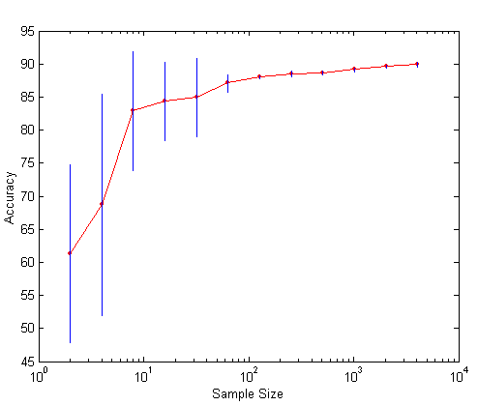
Learning Curve
Learning curve shows how accuracy changes with varying sample size
Requires a sampling schedule for creating learning curve:
  Arithmetic sampling
  (Langley, et al)
  Geometric sampling
  (Provost et al)
Effect of small sample size:
  Bias in the estimate
  Variance of estimate

Slide 77
Methods of Estimation
Holdout
  Reserve 2/3 for training and 1/3 for testing
Random subsampling
  Repeated holdout
Cross validation
  Partition data into k disjoint subsets
  k-fold: train on k-1 partitions, test on the remaining one
  Leave-one-out: k=n
Stratified sampling
  oversampling vs undersampling
Bootstrap
  Sampling with replacement

Slide 78
Model Evaluation
Metrics for Performance Evaluation
  How to evaluate the performance of a model?
Methods for Performance Evaluation
  How to obtain reliable estimates?
Methods for Model Comparison
  How to compare the relative performance among competing models?

Slide 79
ROC (Receiver Operating Characteristic)
Developed in 1950s for signal detection theory to analyze noisy signals
  Characterize the trade-off between positive hits and false alarms
ROC curve plots TP (on the y-axis) against FP (on the x-axis)
Performance of each classifier represented as a point on the ROC curve
  changing the threshold of algorithm, sample distribution or cost matrix changes the location of the point

Slide 80
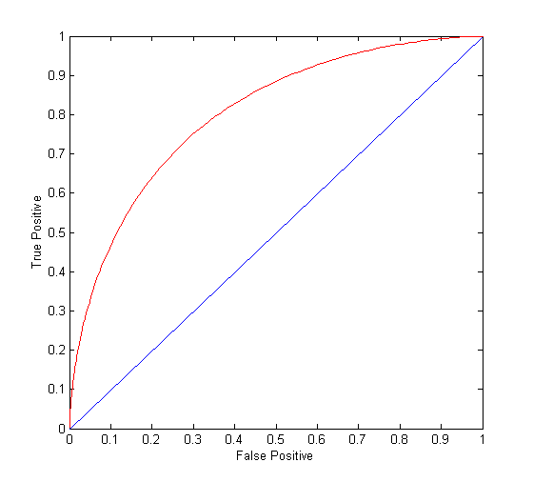
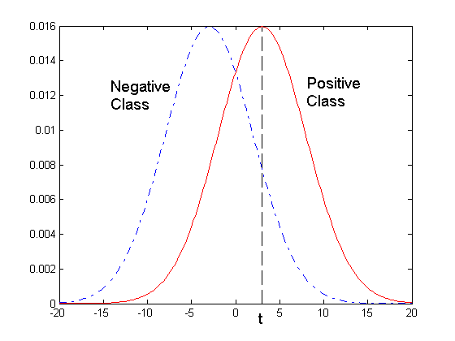
ROC Curve
- 1-dimensional data set containing 2 classes (positive and negative)
- any points located at x > t is classified as positive
At threshold t:
TP=0.5, FN=0.5, FP=0.12, TN=0.88

Slide 81
ROC Curve
(TP,FP):
(0,0): declare everything
to be negative class
(1,1): declare everything
to be positive class
(1,0): ideal
Diagonal line:
  Random guessing
  Below diagonal line:
    prediction is opposite of the true class

Slide 82
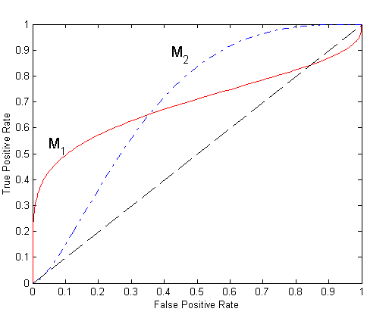
Using ROC for Model Comparison
No model consistently outperform the other
  M₁ is better for small FPR
  M₂ is better for large FPR
Area Under the ROC curve
  Ideal:
    Area = 1
  Random guess:
    Area = 0.5

Slide 83
How to Construct an ROC curve
Use classifier that produces posterior probability for each test instance P(+|A)
Sort the instances according to P(+|A) in decreasing order
Apply threshold at each unique value of P(+|A)
Count the number of TP, FP,
TN, FN at each threshold
TP rate, TPR = TP/(TP+FN)
FP rate, FPR = FP/(FP + TN)
Instance | P(+|A) | True Class
1 | 0.95 | +
2 | 0.93 | +
3 | 0.87 | -
4 | 0.85 | -
5 | 0.85 | -
6 | 0.85 | +
7 | 0.76 | -
8 | 0.53 | +
9 | 0.43 | -
10 | 0.25 | +

Slide 84
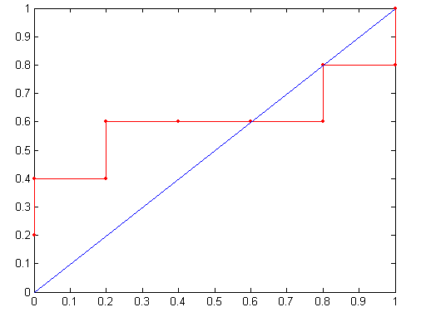
How to construct an ROC curve
Threshold >=
ROC Curve:

Slide 85
Test of Significance
Given two models:
  Model M1: accuracy = 85%, tested on 30 instances
  Model M2: accuracy = 75%, tested on 5000 instances
Can we say M1 is better than M2?
  How much confidence can we place on accuracy of M1 and M2?
  Can the difference in performance measure be explained as a result of random fluctuations in the test set?

Slide 86
Confidence Interval for Accuracy
Prediction can be regarded as a Bernoulli trial
  A Bernoulli trial has 2 possible outcomes
  Possible outcomes for prediction: correct or wrong
  Collection of Bernoulli trials has a Binomial distribution:
    x ∼ Bin(N, p) x: number of correct predictions
    e.g: Toss a fair coin 50 times, how many heads would turn up?
    Expected number of heads = N×p = 50 × 0.5 = 25
Given x (# of correct predictions) or equivalently, acc=x/N, and N (# of test instances),
Can we predict p (true accuracy of model)?

Slide 87
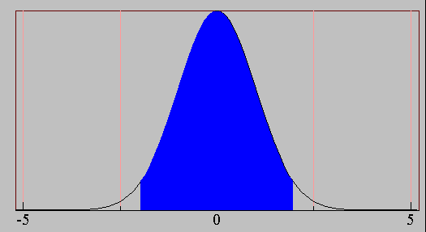
Confidence Interval for Accuracy
Area = 1 - α
For large test sets (N > 30),
  acc has a normal distribution
  with mean p and variance
  p(1-p)/N
Confidence Interval for p:
Z_{α/2}
Z_{1- α /2}

Slide 88
Confidence Interval for Accuracy
Consider a model that produces an accuracy of 80% when evaluated on 100 test instances:
  N=100, acc = 0.8
  Let 1-α = 0.95 (95% confidence)
  From probability table, Z_{α/2}=1.96
1-α | Z
0.99 | 2.58
0.98 | 2.33
0.95 | 1.96
0.90 | 1.65
N | 50 | 100 | 500 | 1000 | 5000
p(lower) | 0.670 | 0.711 | 0.763 | 0.774 | 0.789
p(upper) | 0.888 | 0.866 | 0.833 | 0.824 | 0.811

Slide 89
Comparing Performance of 2 Models
Given two models, say M1 and M2, which is better?
  M1 is tested on D1 (size=n1), found error rate = e₁
  M2 is tested on D2 (size=n2), found error rate = e₂
  Assume D1 and D2 are independent
  If n1 and n2 are sufficiently large, then
  Approximate:

Slide 90
Comparing Performance of 2 Models
To test if performance difference is statistically significant: d = e1 – e2
  d ~ N(d_{t},σ_{t}) where d_{t} is the true difference
  Since D1 and D2 are independent, their variance adds up:
  At (1-α) confidence level,

Slide 91
An Illustrative Example
Given: M1: n1 = 30, e1 = 0.15
M2: n2 = 5000, e2 = 0.25
d = |e2 – e1| = 0.1 (2-sided test)
At 95% confidence level, Z_{α/2}=1.96
=> Interval contains 0 => difference may not be
statistically significant

Slide 92
Comparing Performance of 2 Algorithms
Each learning algorithm may produce k models:
  L1 may produce M11 , M12, …, M1k
  L2 may produce M21 , M22, …, M2k
If models are generated on the same test sets D1,D2, …, Dk (e.g., via cross-validation)
  For each set: compute d_{j} = e_{1j} – e_{2j}
  d_{j} has mean d_{t} and variance σ_{t}
  Estimate:

