Slide 1
数据挖掘
事务数据中的关联规则挖掘

Slide 2
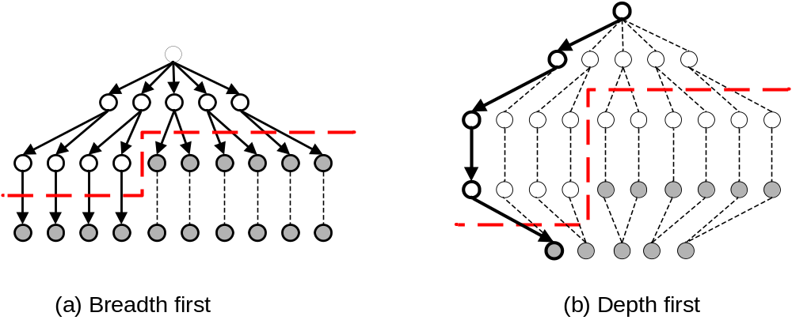
Alternative Methods for Frequent Itemset Generation
Traversal of Itemset Lattice
  Breadth-first vs Depth-first

Slide 3
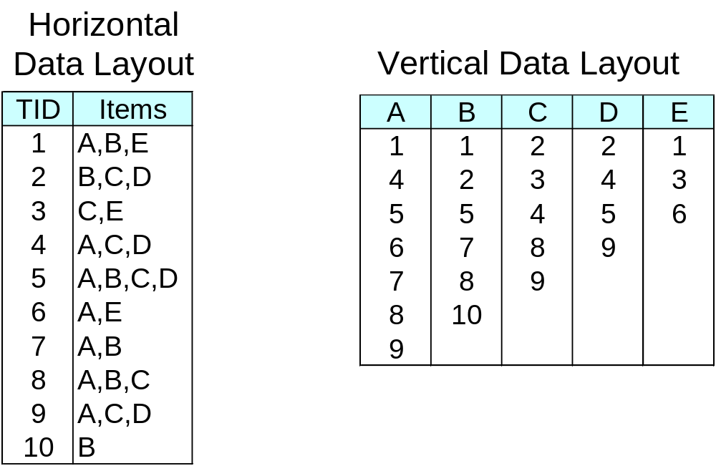
Alternative Methods for Frequent Itemset Generation
Representation of Database
  horizontal vs vertical data layout

Slide 4
基于事务数据的紧凑表示（较少存储空间，直接读入内存），通过树来存储事务数据，基于数的结构挖掘频繁项集
FP-tree算法

Slide 5
FP-growth Algorithm
Use a compressed representation of the database using an FP-tree
Once an FP-tree has been constructed, it uses a recursive divide-and-conquer approach to mine the frequent itemsets

Slide 6
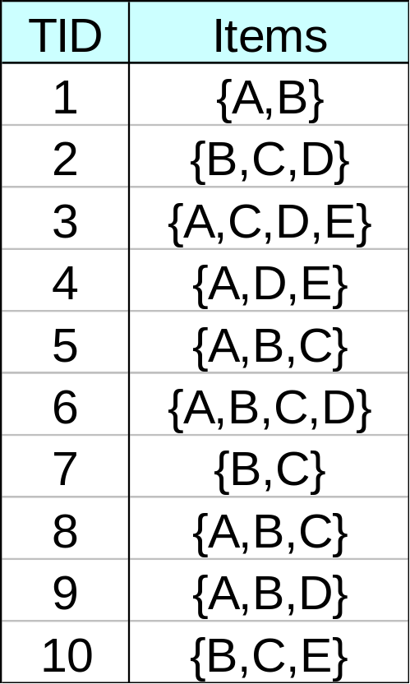
FP-tree construction
null
After reading TID=1:
A:1
B:1
After reading TID=2:
null
A:1
B:1
B:1
C:1
D:1

Slide 7
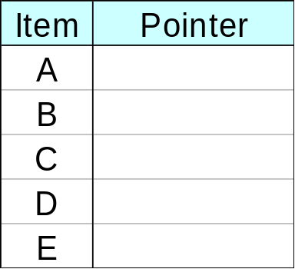
FP-Tree Construction
Transaction Database
null
A:7
B:3
B:5
C:3
C:1
D:1
Header table
D:1
C:3
E:1
D:1
E:1
D:1
E:1
D:1
Pointers are used to assist frequent itemset generation

Slide 8
FP-growth
null
Conditional Pattern base for D:
P = {(A:1,B:1,C:1),
(A:1,B:1),
(A:1,C:1),
(A:1),
(B:1,C:1)}
Recursively apply FP-growth on P
Frequent Itemsets found (with sup > 1):
AD, BD, CD, ACD, BCD
A:7
B:1
B:5
C:1
C:1
D:1
C:3
D:1
D:1
D:1
D:1

Slide 9
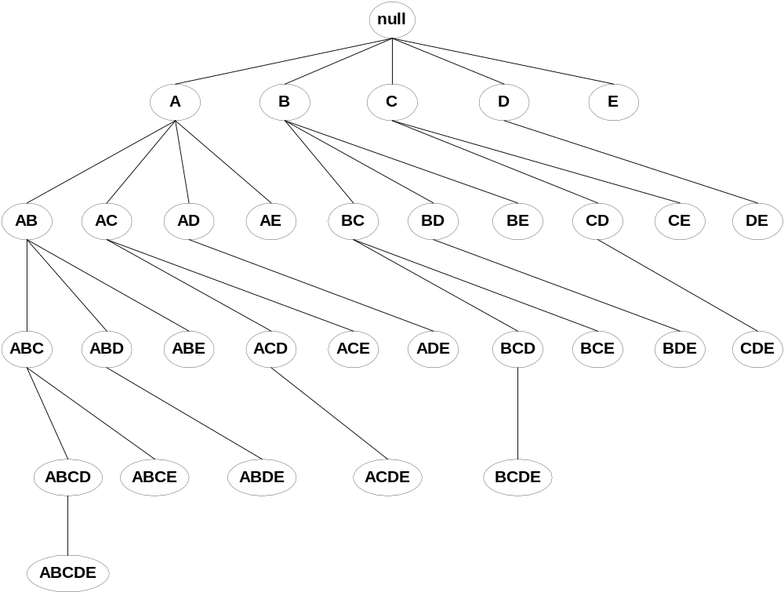
Tree Projection
Set enumeration tree:
Possible Extension: E(A) = {B,C,D,E}
Possible Extension: E(ABC) = {D,E}

Slide 10
Tree Projection
Items are listed in lexicographic order
Each node P stores the following information:
  Itemset for node P
  List of possible lexicographic extensions of P: E(P)
  Pointer to projected database of its ancestor node
  Bitvector containing information about which transactions in the projected database contain the itemset

Slide 11
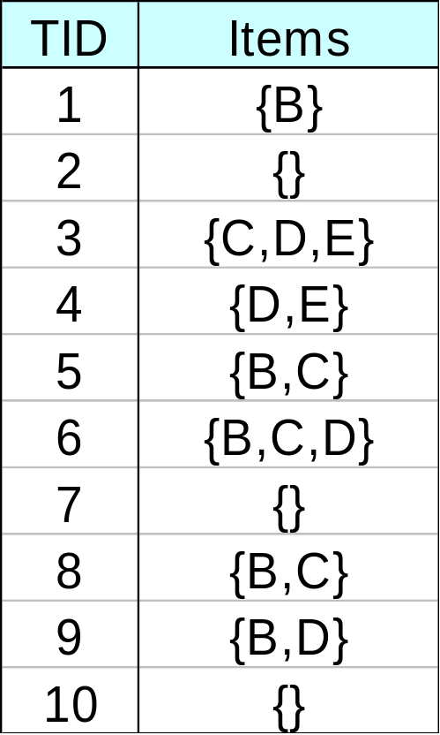
Projected Database
Projected Database for node A:
Original Database:
For each transaction T, projected transaction at node A is T ∩ E(A)

Slide 12
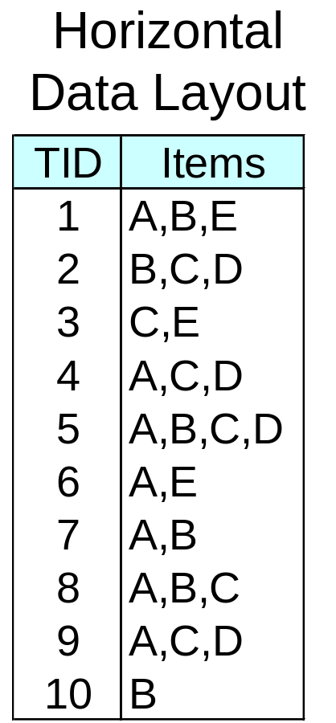
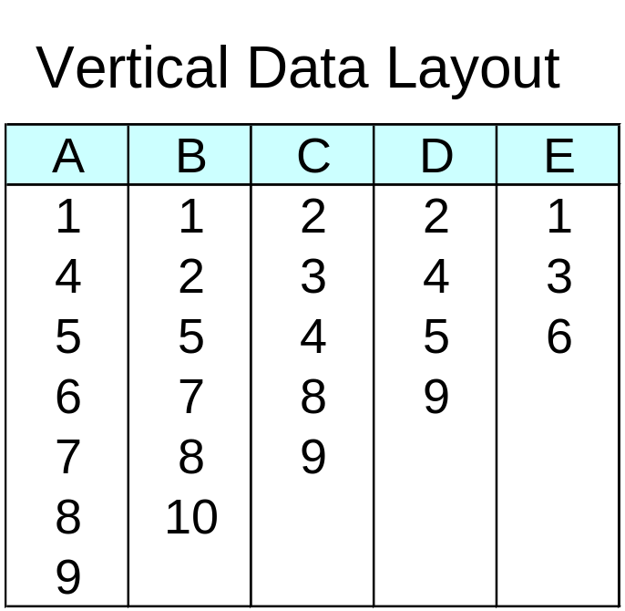
ECLAT
For each item, store a list of transaction ids (tids)
TID-list

Slide 13
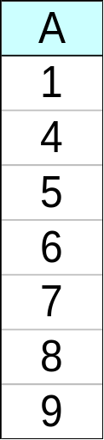
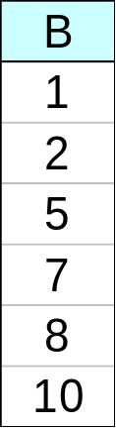
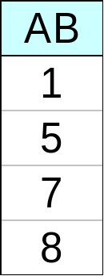
ECLAT
Determine support of any k-itemset by intersecting tid-lists of two of its (k-1) subsets.
3 traversal approaches:
  top-down, bottom-up and hybrid
Advantage: very fast support counting
Disadvantage: intermediate tid-lists may become too large for memory
∧
→

Slide 14
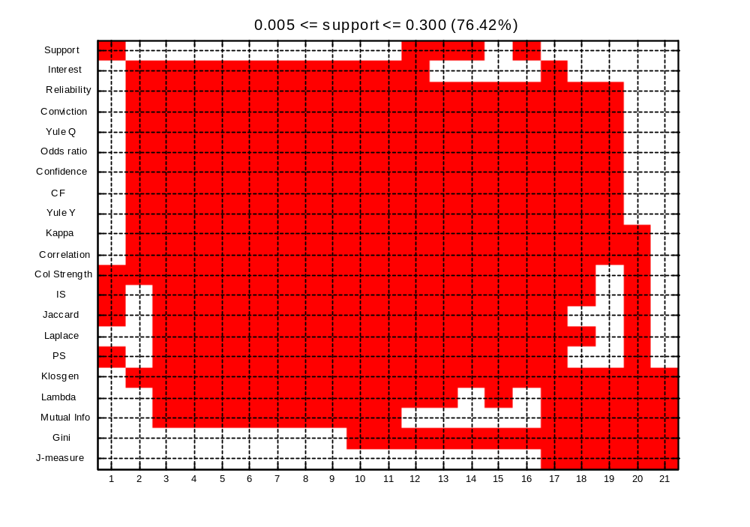
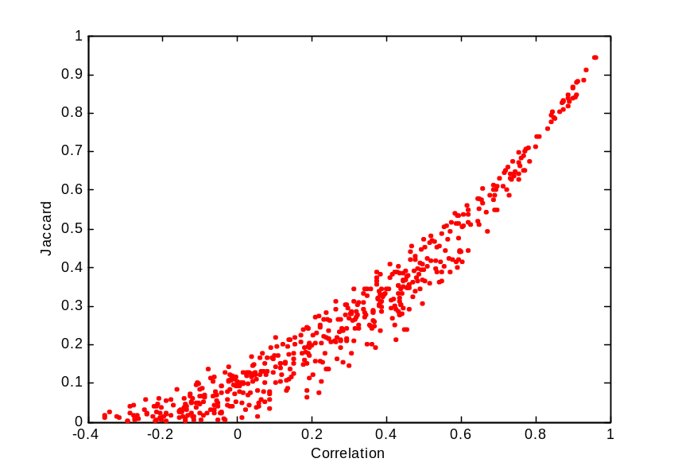
Effect of Support-based Pruning
0.5% ≤ support ≤ 30%
Scatter Plot between Correlation & Jaccard Measure
76.42% pairs have correlation > 0.85

Slide 15
Subjective Interestingness Measure
Objective measure:
  Rank patterns based on statistics computed from data
  e.g., 21 measures of association (support, confidence, Laplace, Gini, mutual information, Jaccard, etc).
Subjective measure:
  Rank patterns according to user’s interpretation
    A pattern is subjectively interesting if it contradicts the
    expectation of a user (Silberschatz & Tuzhilin)
    A pattern is subjectively interesting if it is actionable
    (Silberschatz & Tuzhilin)

Slide 16
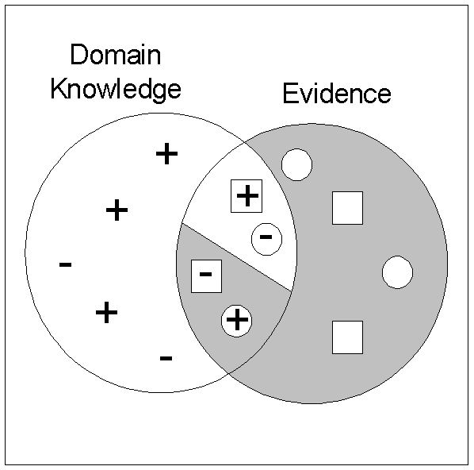
Interestingness via Unexpectedness
Need to model expectation of users (domain knowledge)
Need to combine expectation of users with evidence from data (i.e., extracted patterns)
+
Pattern expected to be frequent
-
Pattern expected to be infrequent
Pattern found to be frequent
Pattern found to be infrequent
+
-
Expected Patterns
-
+
Unexpected Patterns

Slide 17
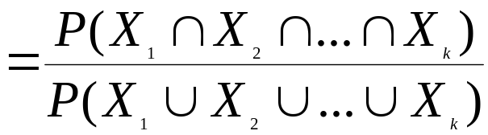
Interestingness via Unexpectedness
Web Data (Cooley et al 2001)
  Domain knowledge in the form of site structure
  Given an itemset F = {X₁, X₂, …, X_{k}} (X_{i} : Web pages)
    L: number of links connecting the pages
    lfactor = L / (k × k-1)
    cfactor = 1 (if graph is connected), 0 (disconnected graph)
  Structure evidence = cfactor × lfactor
  Usage evidence
  Use Dempster-Shafer theory to combine domain knowledge and evidence from data

