Slide 1

Cluster Analysis: Concepts and Algorithms
Lecture Notes for Chapter 7
Introduction to Data Mining

Slide 2
What is Cluster Analysis?
Given a set of objects, place them in groups such that the objects in a group are similar (or related) to one another and different from (or unrelated to) the objects in other groups
Inter-cluster distances are maximized
Intra-cluster distances are minimized

Slide 3
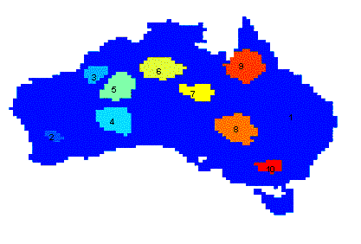
Applications of Cluster Analysis
Understanding
  Group related documents for browsing, group genes and proteins that have similar functionality, or group stocks with similar price fluctuations
Summarization
  Reduce the size of large data sets
Clustering precipitation in Australia

Slide 4
Notion of a Cluster can be Ambiguous
How many clusters?
Six Clusters
Two Clusters
Four Clusters

Slide 5
Types of Clusterings
A clustering is a set of clusters
Important distinction between hierarchical and partitional sets of clusters
  Partitional Clustering
    A division of data objects into non-overlapping subsets (clusters)
  Hierarchical clustering
    A set of nested clusters organized as a hierarchical tree

Slide 6
Partitional Clustering
Original Points
A Partitional Clustering

Slide 7
Hierarchical Clustering
Traditional Hierarchical Clustering
Traditional Dendrogram
Non-traditional Hierarchical Clustering
Non-traditional Dendrogram

Slide 8
Other Distinctions Between Sets of Clusters
Exclusive versus non-exclusive
  In non-exclusive clusterings, points may belong to multiple clusters.
    Can belong to multiple classes or could be ‘border’ points
  Fuzzy clustering (one type of non-exclusive)
    In fuzzy clustering, a point belongs to every cluster with some weight between 0 and 1
    Weights must sum to 1
    Probabilistic clustering has similar characteristics
Partial versus complete
  In some cases, we only want to cluster some of the data

Slide 9
Types of Clusters
Well-separated clusters
Prototype-based clusters
Contiguity-based clusters
Density-based clusters
Described by an Objective Function

Slide 10
Types of Clusters: Well-Separated
Well-Separated Clusters:
  A cluster is a set of points such that any point in a cluster is closer (or more similar) to every other point in the cluster than to any point not in the cluster.
3 well-separated clusters

Slide 11
Types of Clusters: Prototype-Based
Prototype-based
  A cluster is a set of objects such that an object in a cluster is closer (more similar) to the prototype or “center” of a cluster, than to the center of any other cluster
  The center of a cluster is often a centroid, the average of all the points in the cluster, or a medoid, the most “representative” point of a cluster
4 center-based clusters

Slide 12
Types of Clusters: Contiguity-Based
Contiguous Cluster (Nearest neighbor or Transitive)
  A cluster is a set of points such that a point in a cluster is closer (or more similar) to one or more other points in the cluster than to any point not in the cluster.
8 contiguous clusters

Slide 13
Types of Clusters: Density-Based
Density-based
  A cluster is a dense region of points, which is separated by low-density regions, from other regions of high density.
  Used when the clusters are irregular or intertwined, and when noise and outliers are present.
6 density-based clusters

Slide 14
Types of Clusters: Objective Function
Clusters Defined by an Objective Function
  Finds clusters that minimize or maximize an objective function.
  Enumerate all possible ways of dividing the points into clusters and evaluate the `goodness' of each potential set of clusters by using the given objective function. (NP Hard)
  Can have global or local objectives.
    Hierarchical clustering algorithms typically have local objectives
    Partitional algorithms typically have global objectives
  A variation of the global objective function approach is to fit the data to a parameterized model.
    Parameters for the model are determined from the data.
    Mixture models assume that the data is a ‘mixture' of a number of statistical distributions.

Slide 15
Characteristics of the Input Data Are Important
Type of proximity or density measure
  Central to clustering
  Depends on data and application
Data characteristics that affect proximity and/or density are
  Dimensionality
    Sparseness
  Attribute type
  Special relationships in the data
    For example, autocorrelation
  Distribution of the data
Noise and Outliers
  Often interfere with the operation of the clustering algorithm
Clusters of differing sizes, densities, and shapes

Slide 16
Clustering Algorithms
K-means and its variants
Hierarchical clustering
Density-based clustering

Slide 17
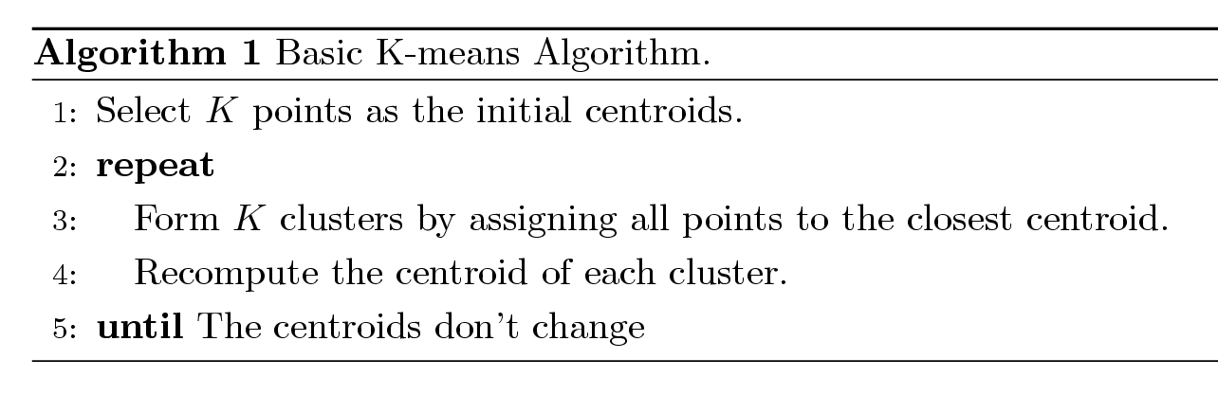
K-means Clustering
Partitional clustering approach
Number of clusters, K, must be specified
Each cluster is associated with a centroid (center point)
Each point is assigned to the cluster with the closest centroid
The basic algorithm is very simple

Slide 18
Example of K-means Clustering

Slide 19
Example of K-means Clustering

Slide 20
K-means Clustering – Details
Simple iterative algorithm.
  Choose initial centroids;
  repeat {assign each point to a nearest centroid; re-compute cluster centroids}
  until centroids stop changing.
Initial centroids are often chosen randomly.
  Clusters produced can vary from one run to another
The centroid is (typically) the mean of the points in the cluster, but other definitions are possible (see Table 7.2).
K-means will converge for common proximity measures with appropriately defined centroid (see Table 7.2)
Most of the convergence happens in the first few iterations.
  Often the stopping condition is changed to ‘Until relatively few points change clusters’
Complexity is O( n * K * I * d )
  n = number of points, K = number of clusters,
  I = number of iterations, d = number of attributes

Slide 21
K-means Objective Function
A common objective function (used with Euclidean distance measure) is Sum of Squared Error (SSE)
  For each point, the error is the distance to the nearest cluster center
  To get SSE, we square these errors and sum them.
  x is a data point in cluster C_{i} and m_{i} is the centroid (mean) for cluster C_{i}
  SSE improves in each iteration of K-means until it reaches a local or global minima.

Slide 22
Two different K-means Clusterings
Original Points
Optimal Clustering
Sub-optimal Clustering

Slide 23
Importance of Choosing Initial Centroids …

Slide 24
Importance of Choosing Initial Centroids …

Slide 25
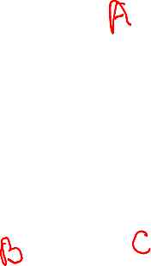
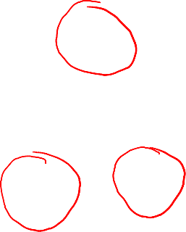
Importance of Choosing Intial Centroids
Depending on the choice of initial centroids, B and C may get merged or remain separate

Slide 26
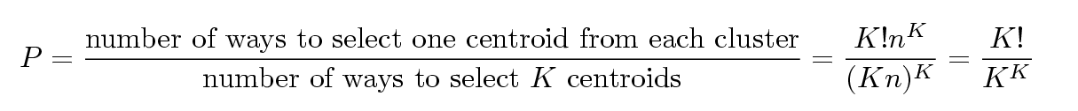
Problems with Selecting Initial Points
If there are K ‘real’ clusters then the chance of selecting one centroid from each cluster is small.
  Chance is relatively small when K is large
  If clusters are the same size, n, then
  For example, if K = 10, then probability = 10!/10¹⁰ = 0.00036
  Sometimes the initial centroids will readjust themselves in ‘right’ way, and sometimes they don’t
  Consider an example of five pairs of clusters

Slide 27
10 Clusters Example
Starting with two initial centroids in one cluster of each pair of clusters

Slide 28
10 Clusters Example
Starting with two initial centroids in one cluster of each pair of clusters

Slide 29
10 Clusters Example
Starting with some pairs of clusters having three initial centroids, while other have only one.

Slide 30
10 Clusters Example
Starting with some pairs of clusters having three initial centroids, while other have only one.

Slide 31
Solutions to Initial Centroids Problem
Multiple runs
  Helps, but probability is not on your side
Use some strategy to select the k initial centroids and then select among these initial centroids
  Select most widely separated
    K-means++ is a robust way of doing this selection
  Use hierarchical clustering to determine initial centroids
Bisecting K-means
  Not as susceptible to initialization issues

Slide 32
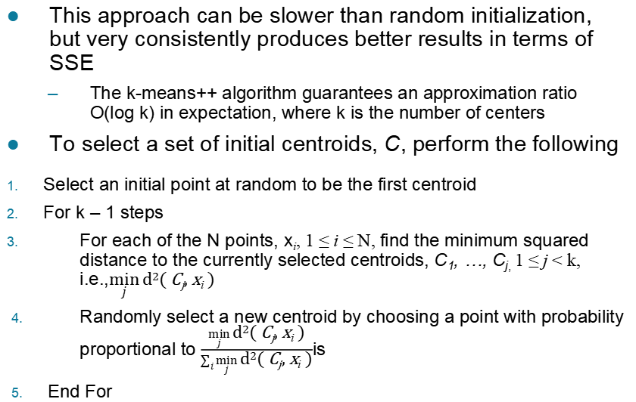
K-means++
This approach can be slower than random initialization, but very consistently produces better results in terms of SSE
  The k-means++ algorithm guarantees an approximation ratio
  O(log k) in expectation, where k is the number of centers
To select a set of initial centroids, C, perform the following
Select an initial point at random to be the first centroid
For k – 1 steps
For each of the N points, x_{i}, 1 ≤ i ≤ N, find the minimum squared
distance to the currently selected centroids, C₁, …, C_{j,} 1 ≤ j < k,
i.e.,$\min_{j}{\text{d}\text{2}\text{( }\text{C}\text{j}\text{, }\text{x}\text{i}\text{ )}}$
Randomly select a new centroid by choosing a point with probability
proportional to $\frac{\min_{j}{\text{d}\text{2}\text{( }\text{C}\text{j}\text{, }\text{x}\text{i}\text{ )}}}{\sum_{i}{\min_{j}{\text{d}\text{2}\text{( }\text{C}\text{j}\text{, }\text{x}\text{i}\text{ )}}}}$is
End For

Slide 33
Bisecting K-means
Bisecting K-means algorithm
  Variant of K-means that can produce a partitional or a hierarchical clustering
CLUTO: http://glaros.dtc.umn.edu/gkhome/cluto/cluto/overview

Slide 34
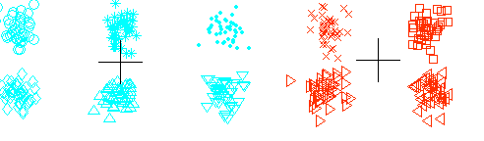
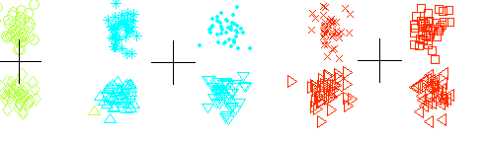
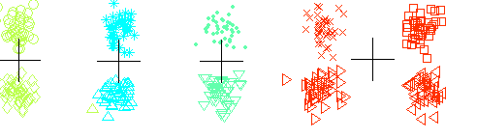
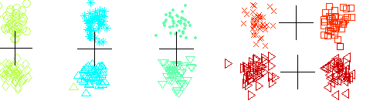
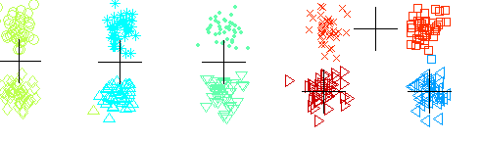
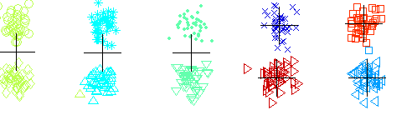
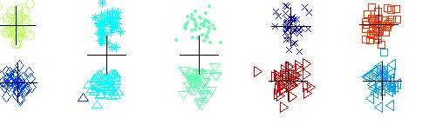
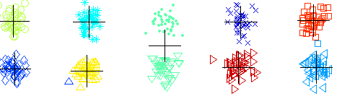
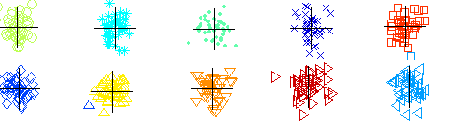
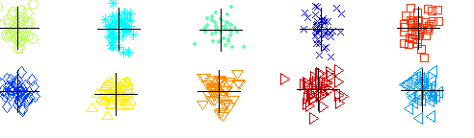
Bisecting K-means Example

Slide 35
Limitations of K-means
K-means has problems when clusters are of differing
  Sizes
  Densities
  Non-globular shapes
K-means has problems when the data contains outliers.
  One possible solution is to remove outliers before clustering

Slide 36
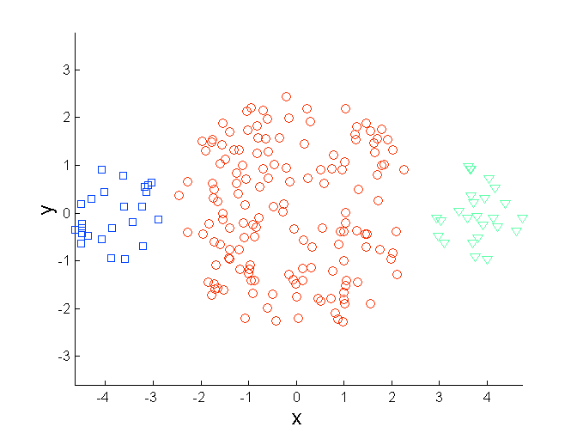
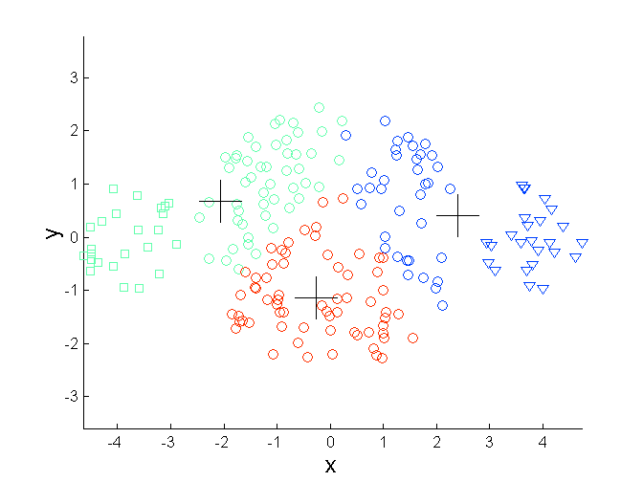
Limitations of K-means: Differing Sizes
Original Points
K-means (3 Clusters)

Slide 37
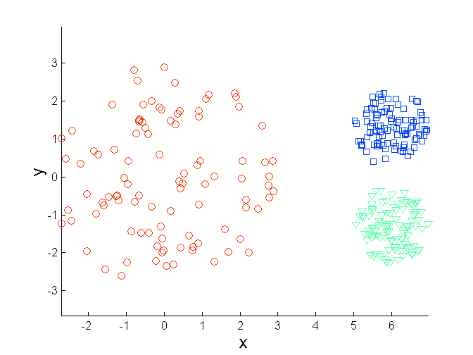
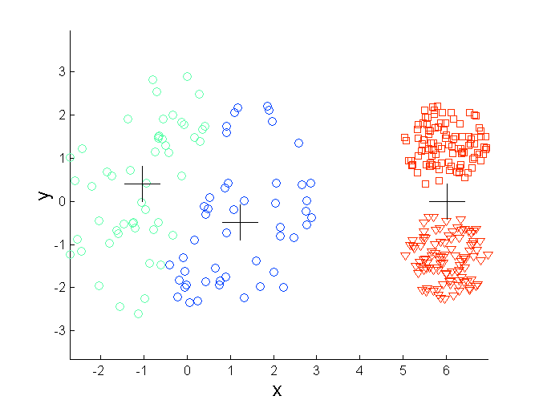
Limitations of K-means: Differing Density
Original Points
K-means (3 Clusters)

Slide 38
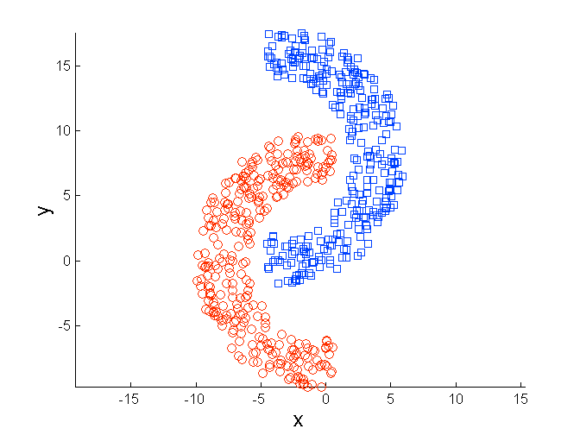
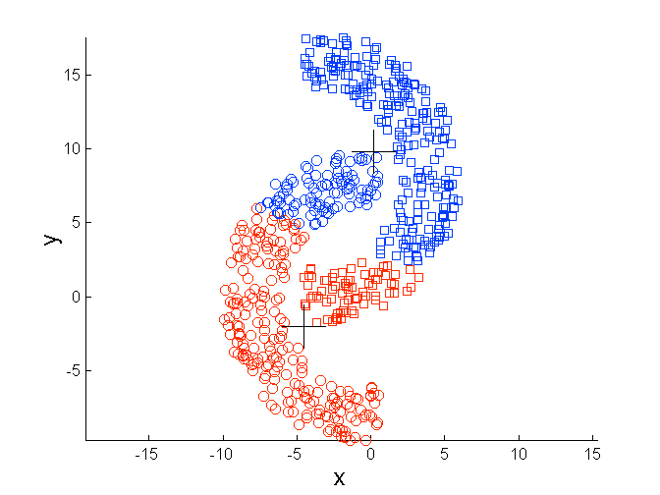
Limitations of K-means: Non-globular Shapes
Original Points
K-means (2 Clusters)

Slide 39
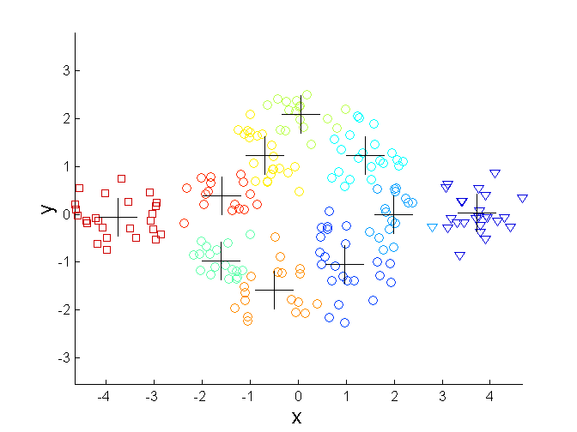
Overcoming K-means Limitations
Original Points K-means Clusters
One solution is to find a large number of clusters such that each of them represents a part of a natural cluster. But these small clusters need to be put together in a post-processing step.

Slide 40
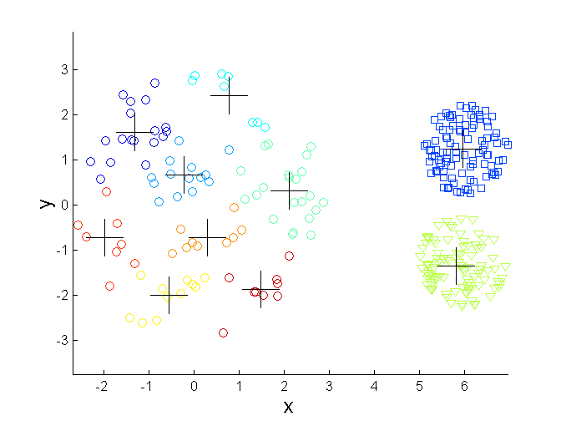
Overcoming K-means Limitations
Original Points K-means Clusters
One solution is to find a large number of clusters such that each of them represents a part of a natural cluster. But these small clusters need to be put together in a post-processing step.

Slide 41
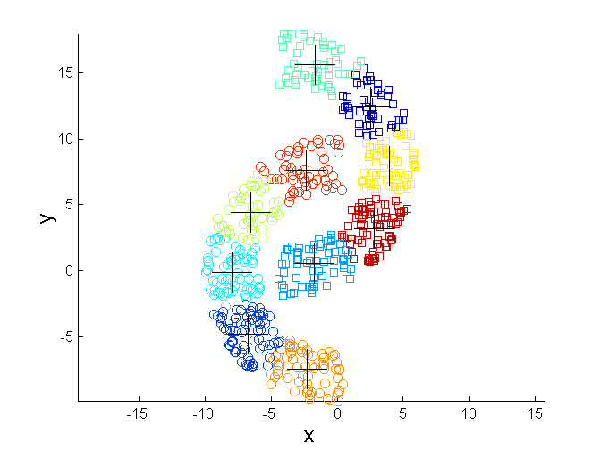
Overcoming K-means Limitations
Original Points K-means Clusters
One solution is to find a large number of clusters such that each of them represents a part of a natural cluster. But these small clusters need to be put together in a post-processing step.

Slide 42
Hierarchical Clustering
Produces a set of nested clusters organized as a hierarchical tree
Can be visualized as a dendrogram
  A tree like diagram that records the sequences of merges or splits

Slide 43
Strengths of Hierarchical Clustering
Do not have to assume any particular number of clusters
  Any desired number of clusters can be obtained by ‘cutting’ the dendrogram at the proper level
They may correspond to meaningful taxonomies
  Example in biological sciences (e.g., animal kingdom, phylogeny reconstruction, …)

Slide 44
Hierarchical Clustering
Two main types of hierarchical clustering
  Agglomerative:
    Start with the points as individual clusters
    At each step, merge the closest pair of clusters until only one cluster (or k clusters) left
  Divisive:
    Start with one, all-inclusive cluster
    At each step, split a cluster until each cluster contains an individual point (or there are k clusters)
Traditional hierarchical algorithms use a similarity or distance matrix
  Merge or split one cluster at a time

Slide 45
Agglomerative Clustering Algorithm
Key Idea: Successively merge closest clusters
Basic algorithm
  Compute the proximity matrix
  Let each data point be a cluster
  Repeat
  Merge the two closest clusters
  Update the proximity matrix
  Until only a single cluster remains
Key operation is the computation of the proximity of two clusters
  Different approaches to defining the distance between clusters distinguish the different algorithms

Slide 46
Steps 1 and 2
Start with clusters of individual points and a proximity matrix
p1
p2
p3
p4
p5
. . .
p1
p2
p3
p4
p5
.
.
.
Proximity Matrix

Slide 47
Intermediate Situation
After some merging steps, we have some clusters
C1
C2
C3
C4
C5
C1
C2
C3
C3
C4
C4
C5
Proximity Matrix
C1
C2
C5

Slide 48
Step 4
We want to merge the two closest clusters (C2 and C5) and update the proximity matrix.
C1
C2
C3
C4
C5
C1
C2
C3
C3
C4
C4
C5
Proximity Matrix
C1
C2
C5

Slide 49
Step 5
The question is “How do we update the proximity matrix?”
C2 U C5
C1
C3
C4
C1
?
C2 U C5
? ? ? ?
C3
C3
?
C4
C4
?
Proximity Matrix
C1
C2 U C5

Slide 50
How to Define Inter-Cluster Distance
p1
p2
p3
p4
p5
. . .
p1
Similarity?
p2
p3
p4
p5
MIN
MAX
Group Average
Distance Between Centroids
Other methods driven by an objective function
  Ward’s Method uses squared error
.
.
.
Proximity Matrix

Slide 51
How to Define Inter-Cluster Similarity
p1
p2
p3
p4
p5
. . .
p1
p2
p3
p4
p5
MIN
MAX
Group Average
Distance Between Centroids
Other methods driven by an objective function
  Ward’s Method uses squared error
.
.
.
Proximity Matrix

Slide 52
How to Define Inter-Cluster Similarity
p1
p2
p3
p4
p5
. . .
p1
p2
p3
p4
p5
MIN
MAX
Group Average
Distance Between Centroids
Other methods driven by an objective function
  Ward’s Method uses squared error
.
.
.
Proximity Matrix

Slide 53
How to Define Inter-Cluster Similarity
p1
p2
p3
p4
p5
. . .
p1
p2
p3
p4
p5
MIN
MAX
Group Average
Distance Between Centroids
Other methods driven by an objective function
  Ward’s Method uses squared error
.
.
.
Proximity Matrix

Slide 54
How to Define Inter-Cluster Similarity
p1
p2
p3
p4
p5
. . .
p1
×
×
p2
p3
p4
p5
MIN
MAX
Group Average
Distance Between Centroids
Other methods driven by an objective function
  Ward’s Method uses squared error
.
.
.
Proximity Matrix

Slide 55
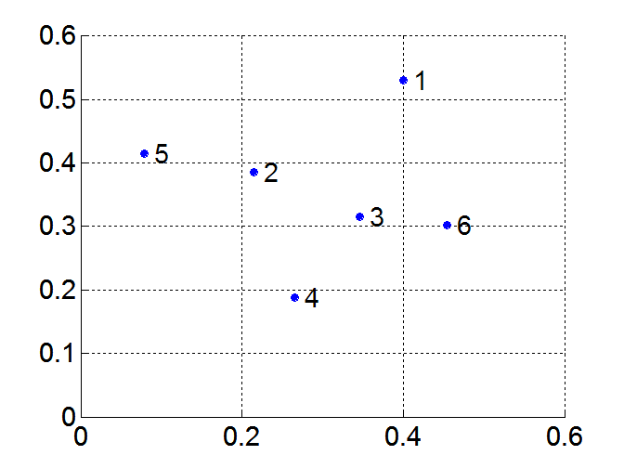
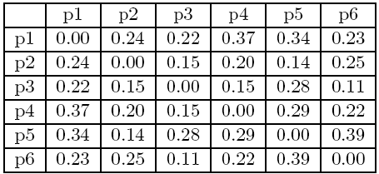
MIN or Single Link
Proximity of two clusters is based on the two closest points in the different clusters
  Determined by one pair of points, i.e., by one link in the proximity graph
Example:
Distance Matrix:

Slide 56
Hierarchical Clustering: MIN
5
1
3
5
2
1
2
3
6
4
4
Nested Clusters
Dendrogram

Slide 57
Strength of MIN
Original Points
Six Clusters
Can handle non-elliptical shapes

Slide 58
Limitations of MIN
Two Clusters
Original Points
Sensitive to noise
Three Clusters

Slide 59
MAX or Complete Linkage
Proximity of two clusters is based on the two most distant points in the different clusters
  Determined by all pairs of points in the two clusters
Distance Matrix:

Slide 60
Hierarchical Clustering: MAX
4
1
2
5
5
2
3
6
3
1
4
Nested Clusters
Dendrogram

Slide 61
Strength of MAX
Original Points
Two Clusters
Less susceptible to noise

Slide 62
Limitations of MAX
Original Points
Two Clusters
Tends to break large clusters
Biased towards globular clusters

Slide 63
Group Average
Proximity of two clusters is the average of pairwise proximity between points in the two clusters.
Distance Matrix:

Slide 64
Hierarchical Clustering: Group Average
5
4
1
2
5
2
3
6
1
4
3
Nested Clusters
Dendrogram

Slide 65
Hierarchical Clustering: Group Average
Compromise between Single and Complete Link
Strengths
  Less susceptible to noise
Limitations
  Biased towards globular clusters

Slide 66
Cluster Similarity: Ward’s Method
Similarity of two clusters is based on the increase in squared error when two clusters are merged
  Similar to group average if distance between points is distance squared
Less susceptible to noise
Biased towards globular clusters
Hierarchical analogue of K-means
  Can be used to initialize K-means

Slide 67
Hierarchical Clustering: Comparison
5
1
4
1
3
2
5
5
5
2
1
MIN
2
MAX
2
3
6
3
3
6
1
4
4
4
5
5
1
4
1
2
2
5
2
Ward’s Method
5
2
3
6
Group Average
3
3
6
4
1
1
4
4
3

Slide 68
Hierarchical Clustering: Time and Space requirements
O(N²) space since it uses the proximity matrix.
  N is the number of points.
O(N³) time in many cases
  There are N steps and at each step the size, N², proximity matrix must be updated and searched
  Complexity can be reduced to O(N² log(N) ) time with some cleverness

Slide 69
Hierarchical Clustering: Problems and Limitations
Once a decision is made to combine two clusters, it cannot be undone
No global objective function is directly minimized
Different schemes have problems with one or more of the following:
  Sensitivity to noise
  Difficulty handling clusters of different sizes and non-globular shapes
  Breaking large clusters

Slide 70
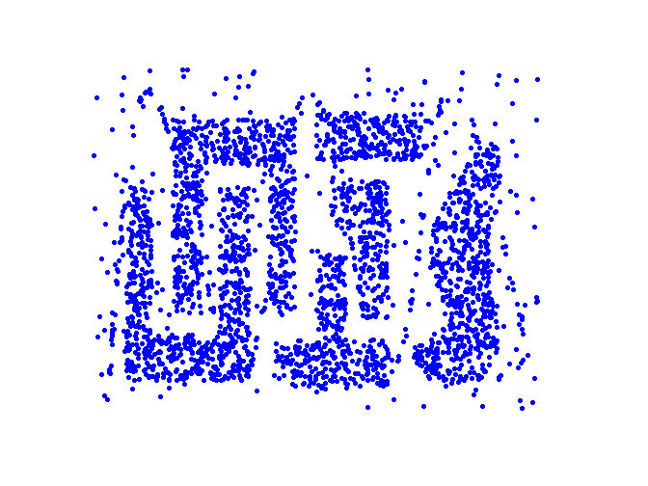
Density Based Clustering
Clusters are regions of high density that are separated from one another by regions on low density.

Slide 71
DBSCAN
DBSCAN is a density-based algorithm.
  Density = number of points within a specified radius (Eps)
  A point is a core point if it has at least a specified number of points (MinPts) within Eps
    These are points that are at the interior of a cluster
    Counts the point itself
  A border point is not a core point, but is in the neighborhood of a core point
  A noise point is any point that is not a core point or a border point

Slide 72
DBSCAN: Core, Border, and Noise Points
MinPts = 7

Slide 73
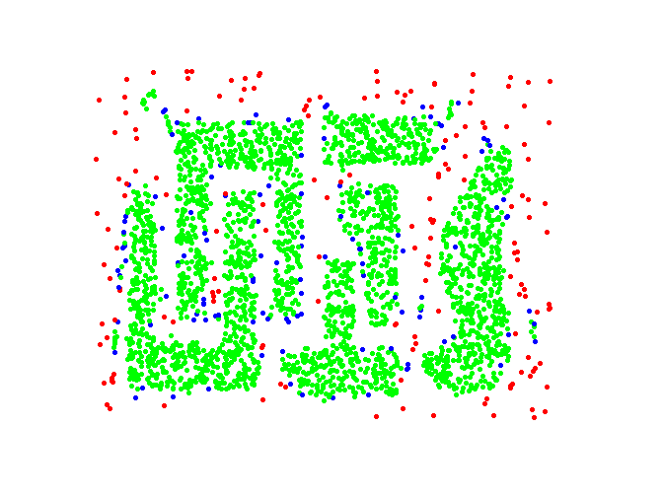
DBSCAN: Core, Border and Noise Points
Original Points
Point types: core, border and noise
Eps = 10, MinPts = 4

Slide 74
DBSCAN Algorithm
Form clusters using core points, and assign border points to one of its neighboring clusters
1: Label all points as core, border, or noise points.
2: Eliminate noise points.
3: Put an edge between all core points within a distance Eps of each other.
4: Make each group of connected core points into a separate cluster.
5: Assign each border point to one of the clusters of its associated core points

Slide 75
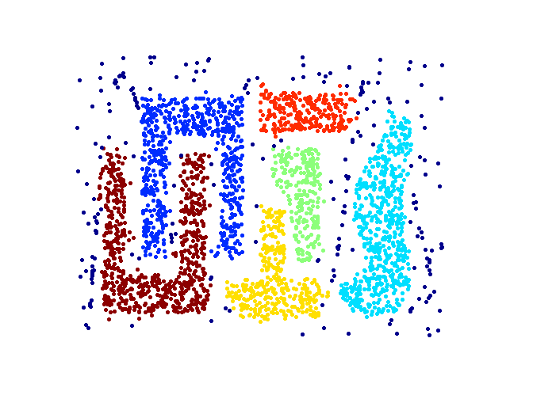
When DBSCAN Works Well
Original Points
Clusters (dark blue points indicate noise)
Can handle clusters of different shapes and sizes
Resistant to noise

Slide 76
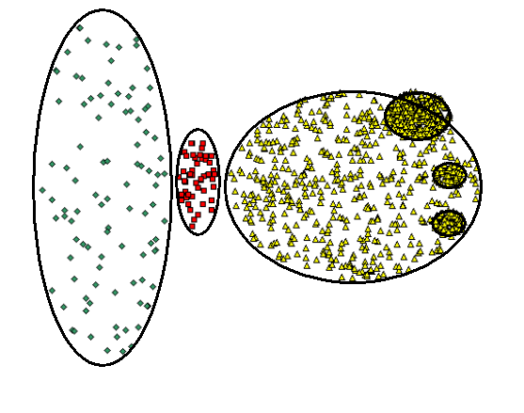
When DBSCAN Does NOT Work Well
Original Points

Slide 77
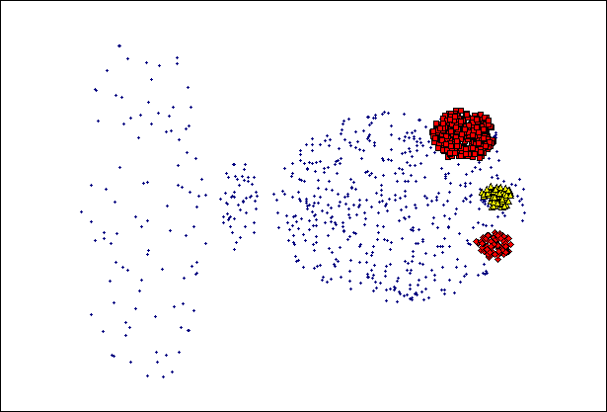
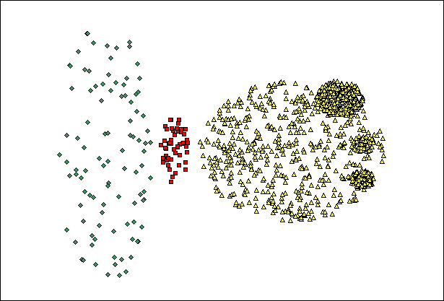
When DBSCAN Does NOT Work Well
(MinPts=4, Eps=9.92).
Original Points
Varying densities
High-dimensional data
(MinPts=4, Eps=9.75)

Slide 78
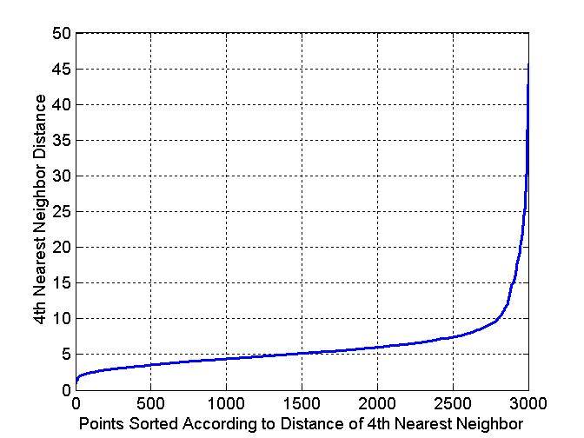
DBSCAN: Determining EPS and MinPts
Idea is that for points in a cluster, their k^{th} nearest neighbors are at close distance
Noise points have the k^{th} nearest neighbor at farther distance
So, plot sorted distance of every point to its k^{th} nearest neighbor

Slide 79
Cluster Validity
For supervised classification we have a variety of measures to evaluate how good our model is
  Accuracy, precision, recall
For cluster analysis, the analogous question is how to evaluate the “goodness” of the resulting clusters?
But “clusters are in the eye of the beholder”!
  In practice the clusters we find are defined by the clustering algorithm
Then why do we want to evaluate them?
  To avoid finding patterns in noise
  To compare clustering algorithms
  To compare two sets of clusters
  To compare two clusters

Slide 80
Clusters found in Random Data
Random Points
DBSCAN
K-means
Complete Link

Slide 81
Measures of Cluster Validity
Numerical measures that are applied to judge various aspects of cluster validity, are classified into the following two types.
  Supervised: Used to measure the extent to which cluster labels match externally supplied class labels.
    Entropy
    Often called external indices because they use information external to the data
  Unsupervised: Used to measure the goodness of a clustering structure without respect to external information.
    Sum of Squared Error (SSE)
    Often called internal indices because they only use information in the data
You can use supervised or unsupervised measures to compare clusters or clusterings

Slide 82


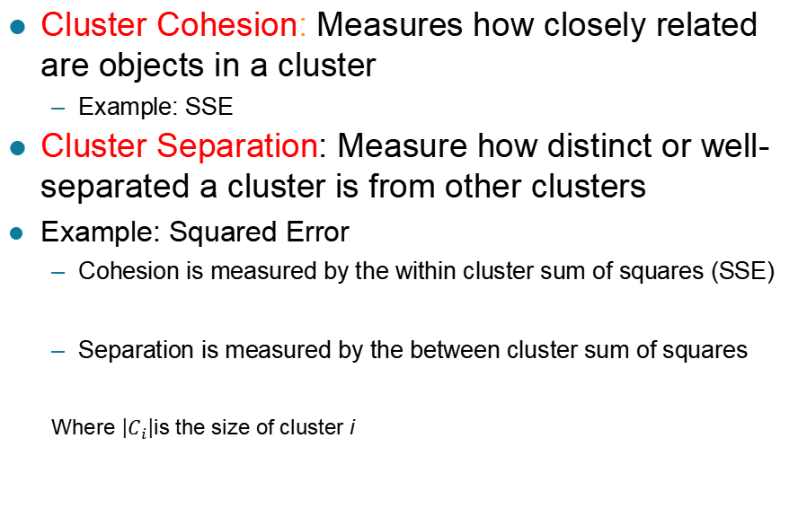
Unsupervised Measures: Cohesion and Separation
Cluster Cohesion: Measures how closely related are objects in a cluster
  Example: SSE
Cluster Separation: Measure how distinct or well-separated a cluster is from other clusters
Example: Squared Error
  Cohesion is measured by the within cluster sum of squares (SSE)
  Separation is measured by the between cluster sum of squares
  Where $\left|C_{i}\right|$is the size of cluster i
$$SSE=\sum_{i}{\sum_{x∈C_{i}}{{\left(x−m_{i}\right)}^{2}}}$$
$$SSB=\sum_{i}{\left|C_{i}\right|{\left(m−m_{i}\right)}^{2}}$$

Slide 83



Unsupervised Measures: Cohesion and Separation
Example: SSE
  SSB + SSE = constant
m
×
×
×
1
m₁
2
3
4
m₂
5
K=1 cluster:
$$SSE={\left(1−3\right)}^{2}+{\left(2−3\right)}^{2}+{\left(4−3\right)}^{2}+{\left(5−3\right)}^{2}=10$$
$$SSB=4×{\left(3−3\right)}^{2}=0$$
$$Total=10+0=10$$
K=2 clusters:
$$SSE={\left(1−1.5\right)}^{2}+{\left(2−1.5\right)}^{2}+{\left(4−4.5\right)}^{2}+{\left(5−4.5\right)}^{2}=1$$
$$SSB=2 ×{\left(3−1.5\right)}^{2}+2×{\left(4.5−3\right)}^{2}=9$$
$$Total=1+9=10$$

Slide 84
Unsupervised Measures: Cohesion and Separation
A proximity graph-based approach can also be used for cohesion and separation.
  Cluster cohesion is the sum of the weight of all links within a cluster.
  Cluster separation is the sum of the weights between nodes in the cluster and nodes outside the cluster.
cohesion
separation

Slide 85
Unsupervised Measures: Silhouette Coefficient
Silhouette coefficient combines ideas of both cohesion and separation, but for individual points, as well as clusters and clusterings
For an individual point, i
  Calculate a = average distance of i to the points in its cluster
  Calculate b = min (average distance of i to points in another cluster)
  The silhouette coefficient for a point is then given by
  s = (b – a) / max(a,b)
  Value can vary between -1 and 1
  Typically ranges between 0 and 1.
  The closer to 1 the better.
Can calculate the average silhouette coefficient for a cluster or a clustering

Slide 86
Measuring Cluster Validity Via Correlation
Two matrices
  Proximity Matrix
  Ideal Similarity Matrix
    One row and one column for each data point
    An entry is 1 if the associated pair of points belong to the same cluster
    An entry is 0 if the associated pair of points belongs to different clusters
Compute the correlation between the two matrices
  Since the matrices are symmetric, only the correlation between
  n(n-1) / 2 entries needs to be calculated.
High magnitude of correlation indicates that points that belong to the same cluster are close to each other.
  Correlation may be positive or negative depending on whether the similarity matrix is a similarity or dissimilarity matrix
Not a good measure for some density or contiguity based clusters.

Slide 87
Measuring Cluster Validity Via Correlation
Correlation of ideal similarity and proximity matrices for the K-means clusterings of the following well-clustered data set.
Corr = 0.9235

Slide 88
Measuring Cluster Validity Via Correlation
Correlation of ideal similarity and proximity matrices for the K-means clusterings of the following random data set.
K-means
Corr = 0.5810

Slide 89
Judging a Clustering Visually by its Similarity Matrix
Order the similarity matrix with respect to cluster labels and inspect visually.

Slide 90
Judging a Clustering Visually by its Similarity Matrix
Clusters in random data are not so crisp
DBSCAN

Slide 91
Judging a Clustering Visually by its Similarity Matrix
DBSCAN

Slide 92
Determining the Correct Number of Clusters
SSE is good for comparing two clusterings or two clusters
SSE can also be used to estimate the number of clusters

Slide 93
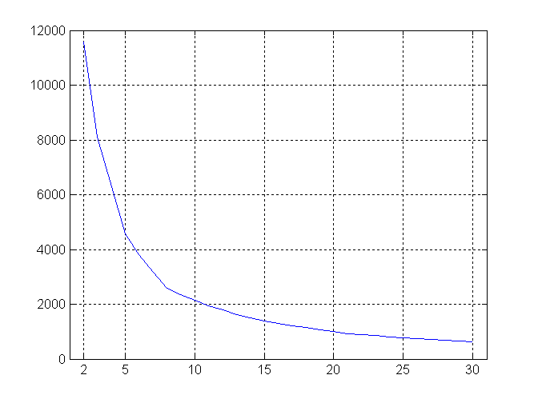
Determining the Correct Number of Clusters
SSE curve for a more complicated data set
SSE of clusters found using K-means

Slide 94
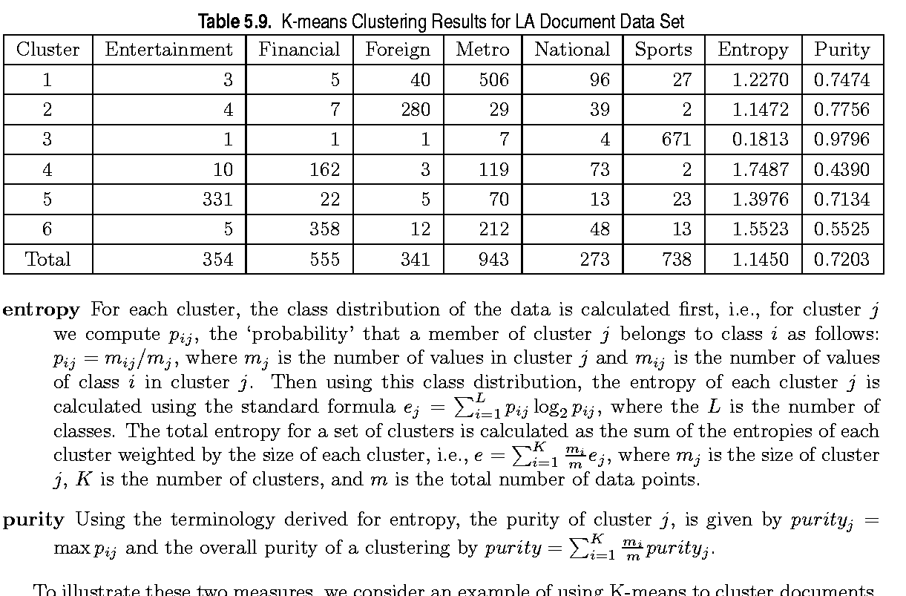
Supervised Measures of Cluster Validity: Entropy and Purity

Slide 95
Assessing the Significance of Cluster Validity Measures
Need a framework to interpret any measure.
  For example, if our measure of evaluation has the value, 10, is that good, fair, or poor?
Statistics provide a framework for cluster validity
  The more “atypical” a clustering result is, the more likely it represents valid structure in the data
  Compare the value of an index obtained from the given data with those resulting from random data.
    If the value of the index is unlikely, then the cluster results are valid

Slide 96
Statistical Framework for SSE
Example
  Compare SSE of three cohesive clusters against three clusters in random data
SSE = 0.005
  Histogram shows SSE of three clusters in 500 sets of random data points of size 100 distributed over the range 0.2 – 0.8 for x and y values

Slide 97
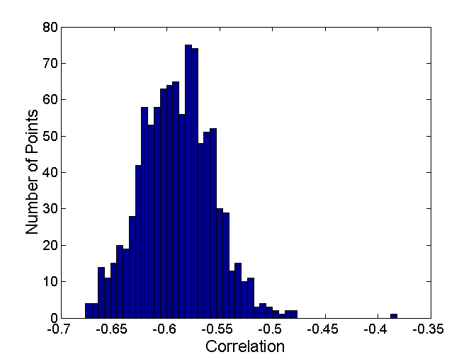
Statistical Framework for Correlation
Correlation of ideal similarity and proximity matrices for the K-means clusterings of the following two data sets.
Histogram of correlation for 500 random data sets of size 100 with x and y values of points between 0.2 and 0.8.
Corr = -0.9235
Corr = -0.5810
Correlation is negative because it is calculated between a distance matrix and the ideal similarity matrix. Higher magnitude is better.

Slide 98
Final Comment on Cluster Validity
“The validation of clustering structures is the most difficult and frustrating part of cluster analysis.
Without a strong effort in this direction, cluster analysis will remain a black art accessible only to those true believers who have experience and great courage.”
  Algorithms for Clustering Data, Jain and Dubes
H. Xiong and Z. Li. Clustering Validation Measures. In C. C. Aggarwal and C. K. Reddy, editors, Data Clustering: Algorithms and Applications, pages 571–605. Chapman & Hall/CRC, 2013.

